Slide 1



European Developments
year
PBWG 14
Bangkok, October 2025

Slide 2
Overview
Big picture
“some” performance results from Europe
Topics of interest
On-going “research”

Slide 3
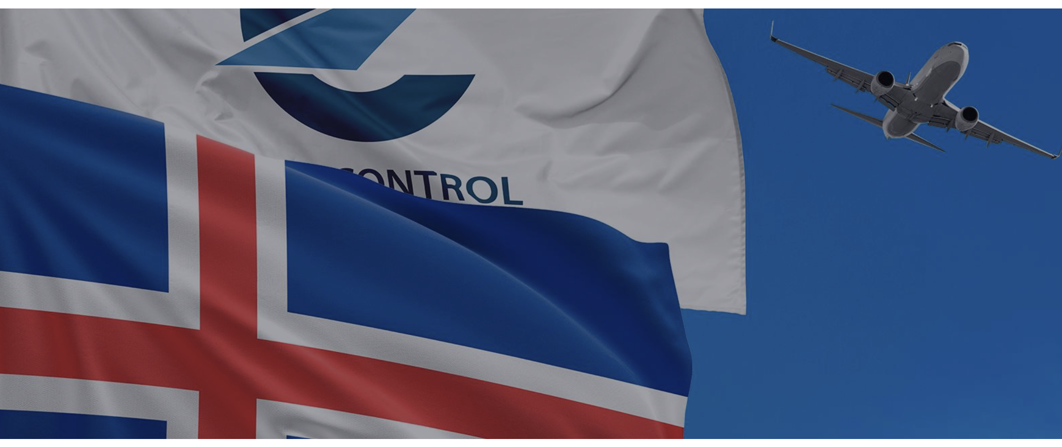
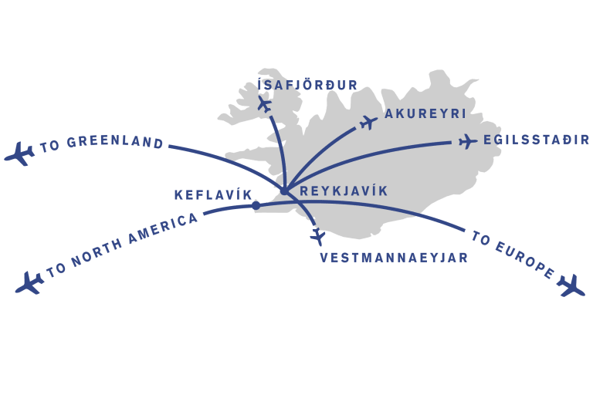
Welcome Iceland!
Newest EUROCONTROL Member State joined 1. Jan 2025
42nd Member State (observer since 1998)
World-known: Eyjafjallajökull eruption of 2010
Airspace approx. + 5.5 million km²
Average 200.000 movements p.a. ~ 540 flights per day
High share of overflights (transatlantic traffic
Largest airport Keflavik (avg. daily flights: 179), Reykjavik (avg. daily flights: 36)

