Slide 1
SECTOR ANALYSIS WORKFLOW
From APDF crossings to ASMA / DSMA reference times
A traceable, analyst-led method with data-driven recommendations
1
2
3
4
5
Crossings
Flow shape
First cuts
Pooling test
Reference set
40 / 100 NM bearing
and transit time
Circular smoothing
and local valleys
Valley-safe 5 degree
sector proposal
Runway / class P20
reference impact
Approved sectors feed
ASMA / DSMA lookup
Principle: sector geometry is proposed from observed traffic; reference-time consequences determine whether adjacent flows can be pooled.
PBWG XSMA development | 2024 European reference work
1

Slide 2
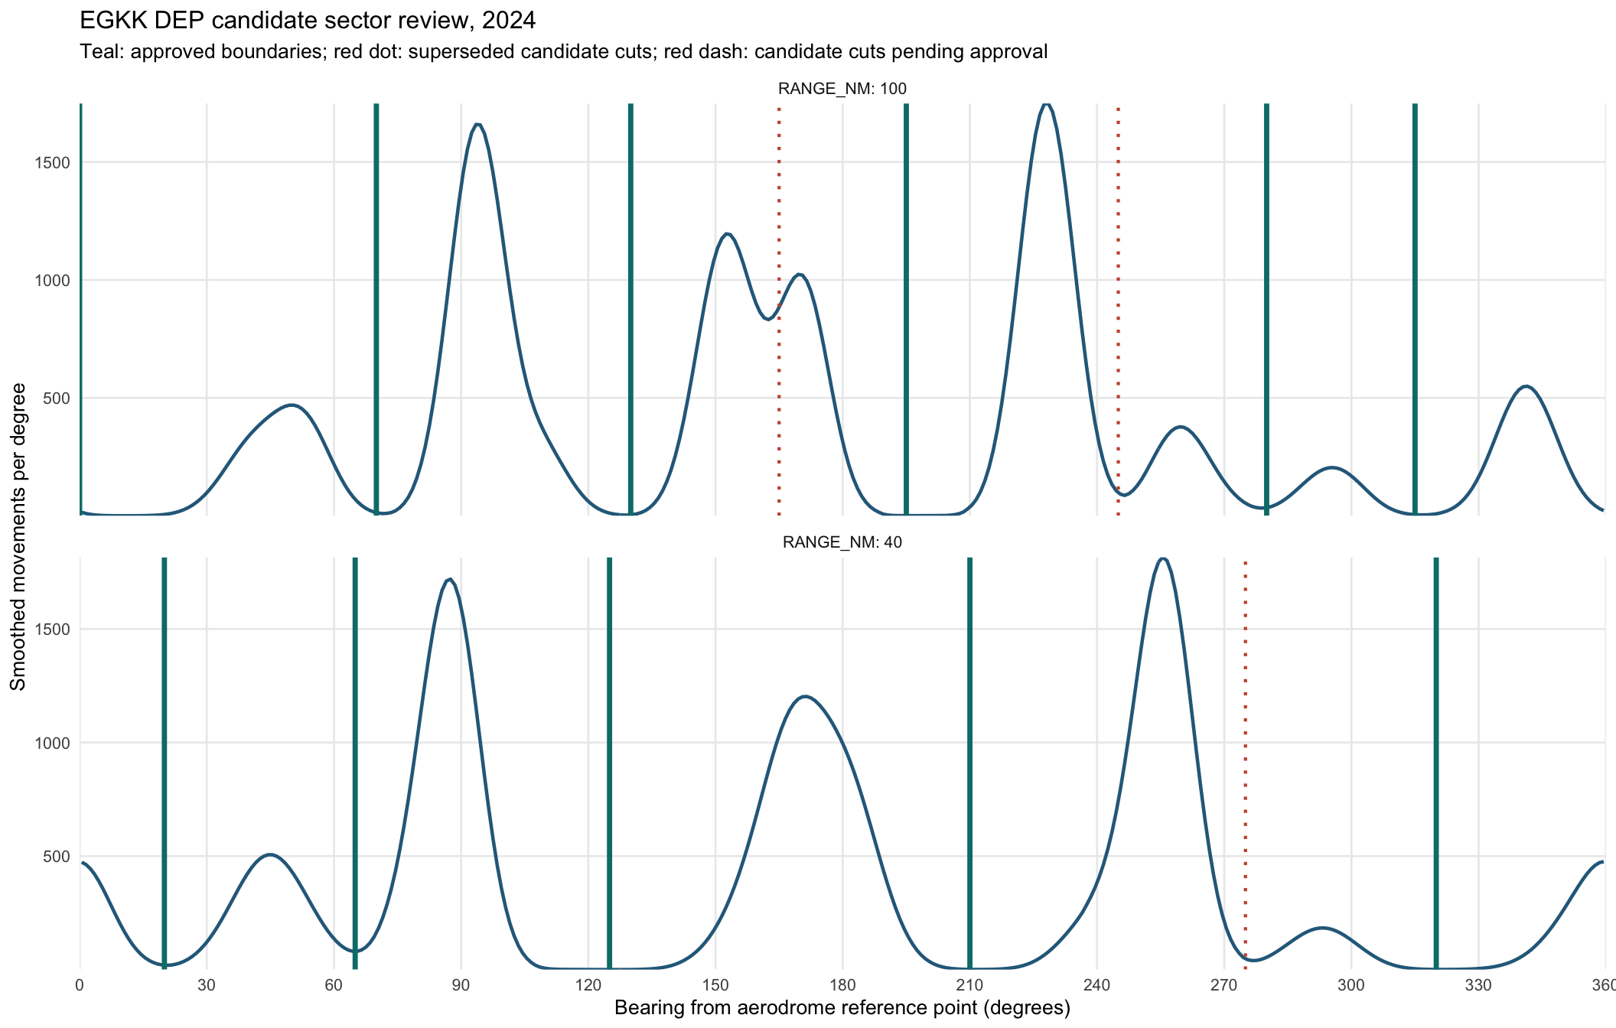
DECISION EVIDENCE
Pooling impact turns visual judgement into a defensible decision
A cut is not retained only because it looks like a valley.
-
Start with visible valleys and human-readable rounding.
-
Compare matching runway / aircraft-class reference samples.
-
Pool the candidate sectors and quantify the P20 reference shift.
-
Protect a cut when typical timing differs by more than 80 seconds or a material cell is affected.
-
Guide: propose merge, propose retain, or analyst review.
245 degree: MERGE
5 sec P20 shift
280 degree: RETAIN
26L / MT shifts 139 sec
EGKK DEP, 100 NM: local averages can look harmless while a substantive runway/class cell remains materially affected.
PBWG XSMA development | 2024 European reference work
2

Slide 3
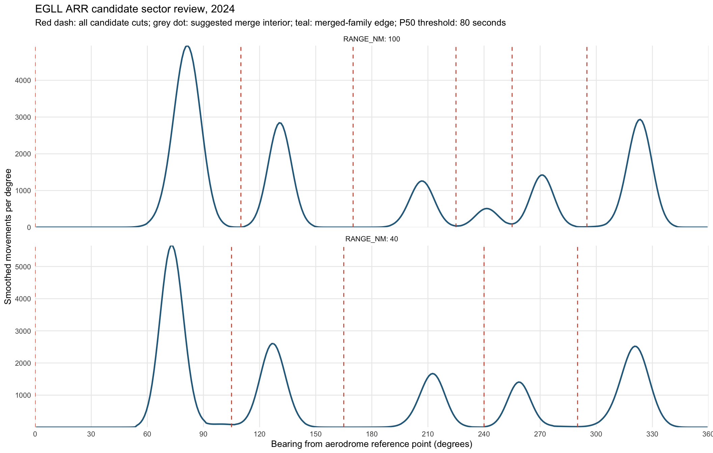
APPROVED ARRIVAL EXAMPLE
ASMA showcase: Heathrow arrival sectors
EGLL | 2024 | ARR | 40 NM and 100 NM
Approved cuts: 40 NM 000 / 105 / 170 / 235 / 285 | 100 NM 000 / 110 / 170 / 235 / 295
Approved boundaries retain the operationally distinct approach families while keeping a readable, maintainable sector definition.
PBWG XSMA development | 2024 European reference work
3

Slide 4
APPROVED DEPARTURE EXAMPLE
DSMA showcase: Gatwick departure sectors
EGKK | 2024 | DEP | 40 NM and 100 NM
Teal lines are selected boundaries; red dotted lines preserve the removed-cut audit trail. The 280 degree cut remains because pooling materially changes a real 26L / MT reference cell.
PBWG XSMA development | 2024 European reference work
4

