Slide 1
Data Ingestion
Trajectory Augmentation
Supporting Data Mapping
Indicator Calculation
Results & Visualisations

Slide 2
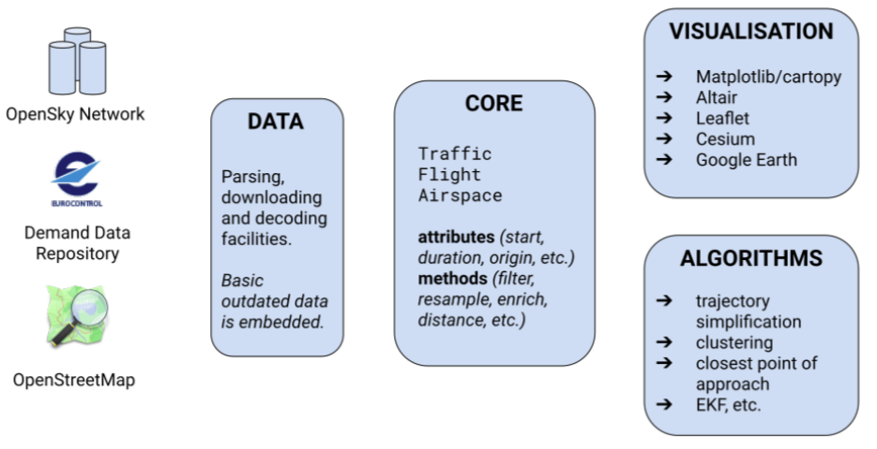

Slide 3
Data Ingestion
download
pre-processing
augmentation
Algorithm
indicator specific processing
movement/ event data mart
Results and Visualisations
analytic data summaries
aeronautical info
OurAirport.com
OpenAIP.net …
fleet
Airframes.org
trajectory data
Opensky Network
geographical data
OpenStreetMap
performance data
ansperformance.eu
Data Validation
mapping
comparison
PRU
Network Manager
PRISME

