Slide 1
source data
analytic data
reproducible results
community-collected surveillance data
Opensky Network
performance related data
ourairports
analytic data
Text
Flanders Maritime Institute
community-collected COVID data
Visualisation
John Hopkins
reproducible paper

Slide 2
service level
100%
normal variability
disruption threshold
rate of recovery
level of disruption
new reality, permanently perturbed state
duration
t₁
t₂
t_{2*}
time

Slide 3
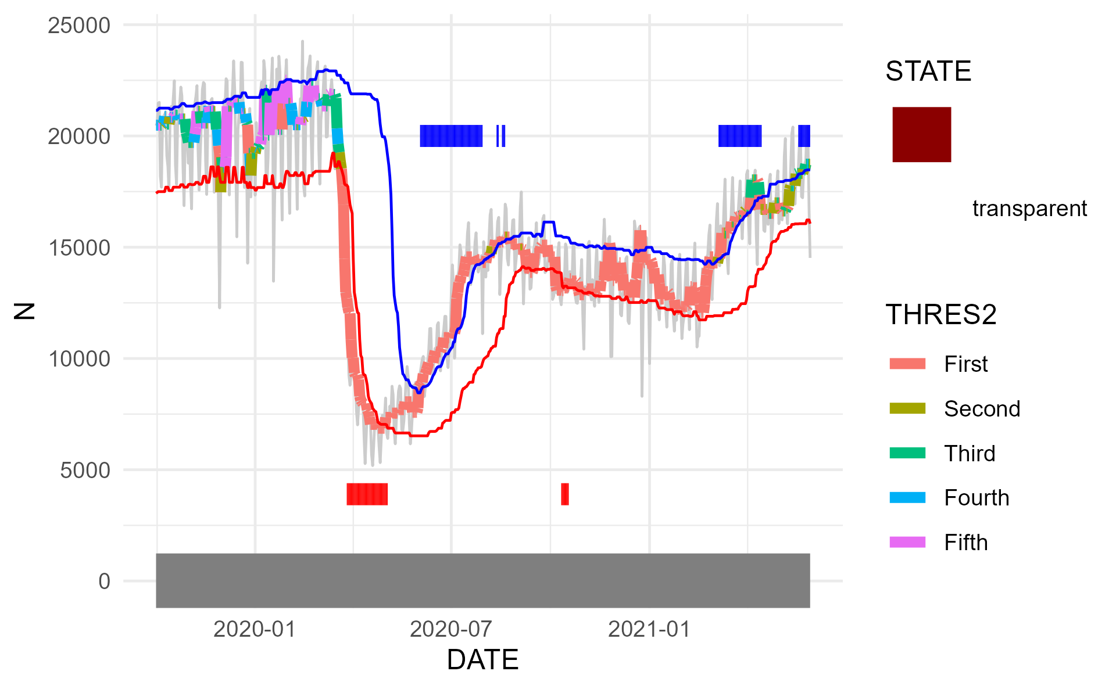
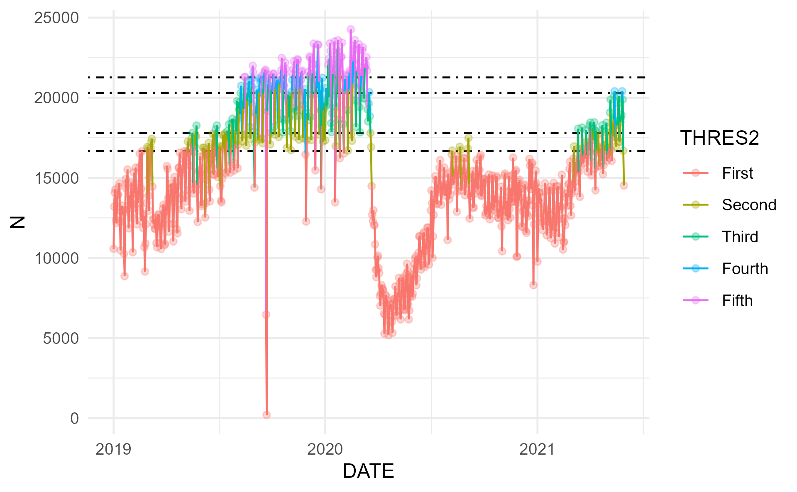
Try to remove grey band

Slide 4
recovery
episode
disruptive
episode

Slide 5
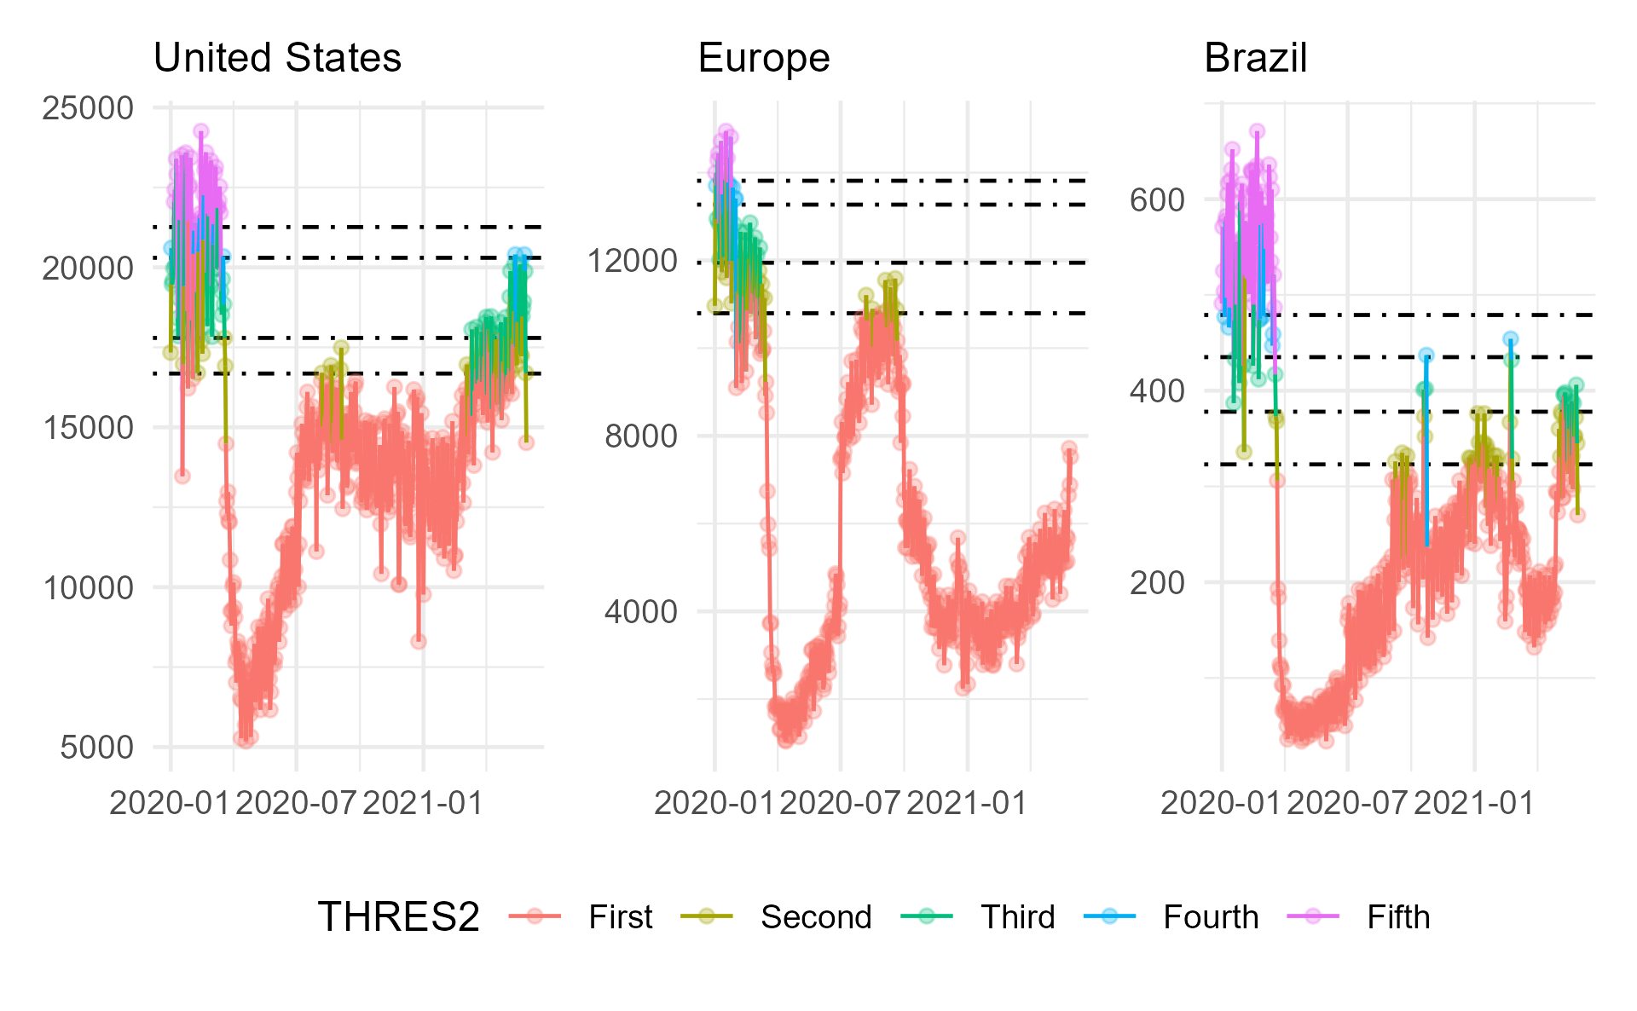

Slide 6
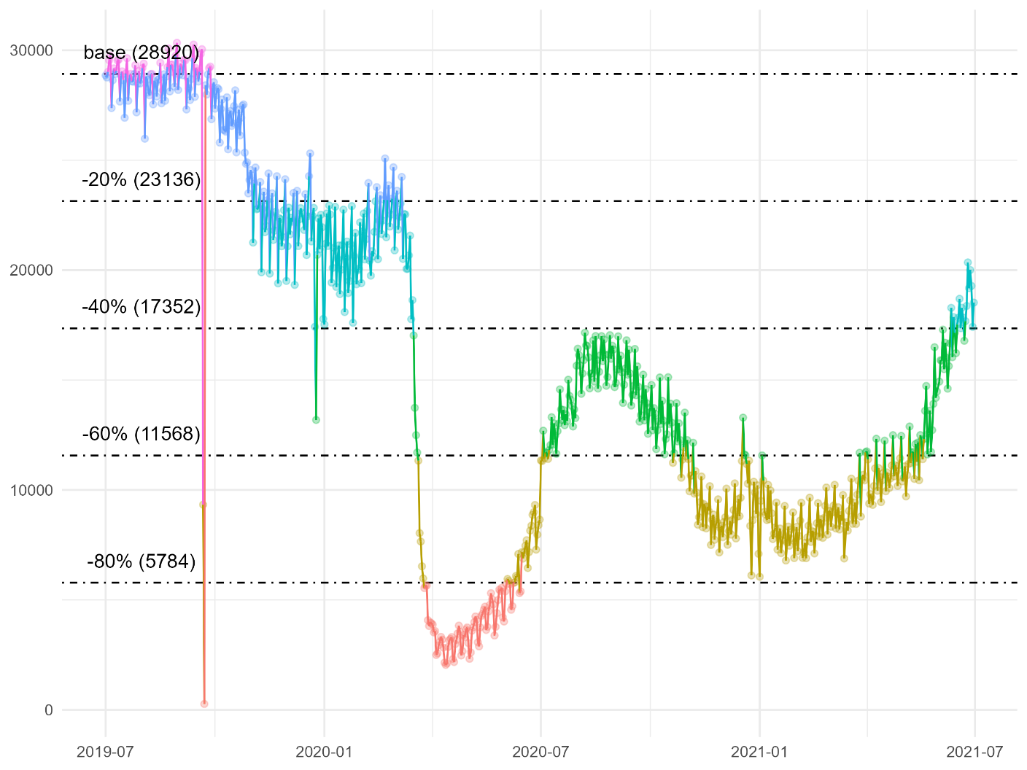
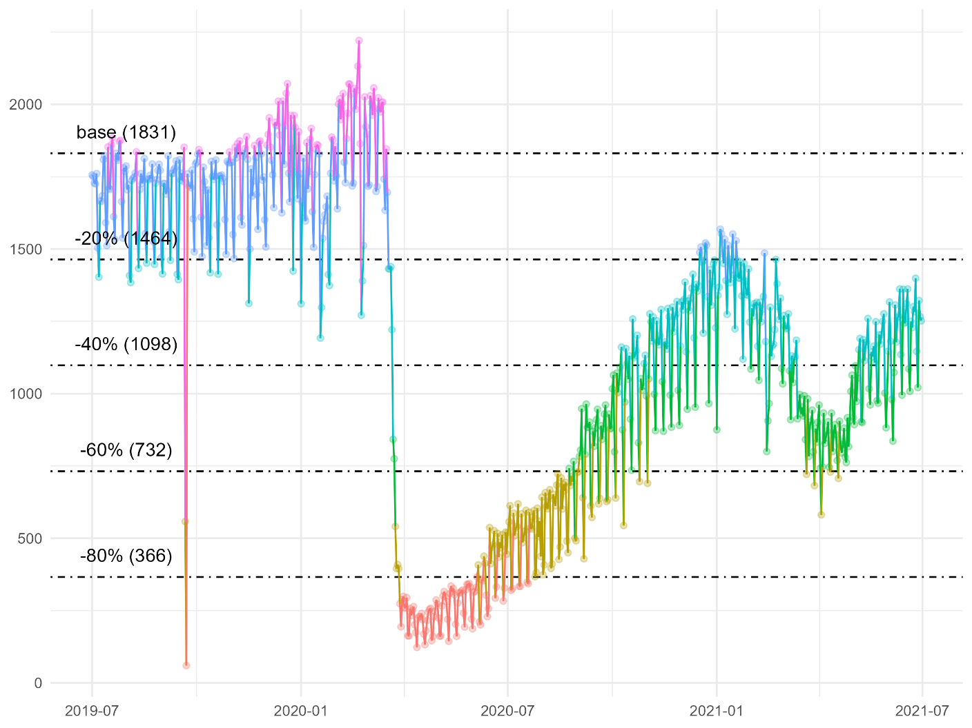
Europe
Brazil

