Slide 2

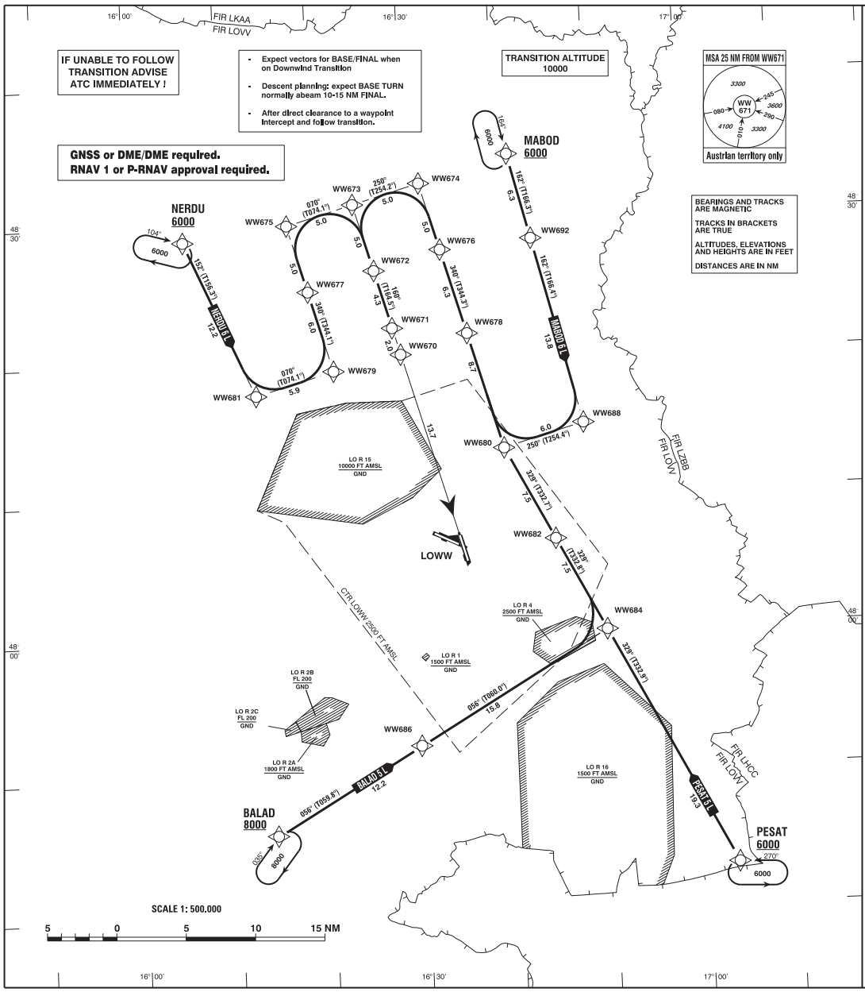
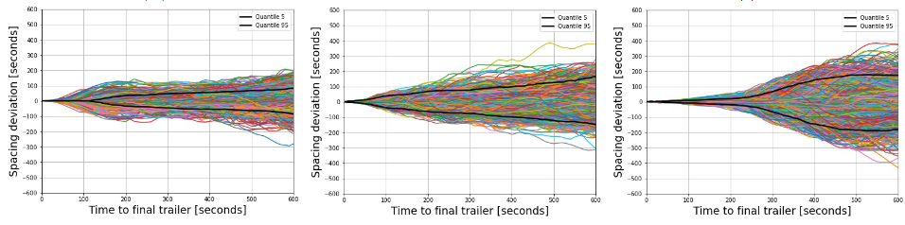
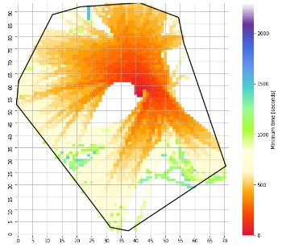
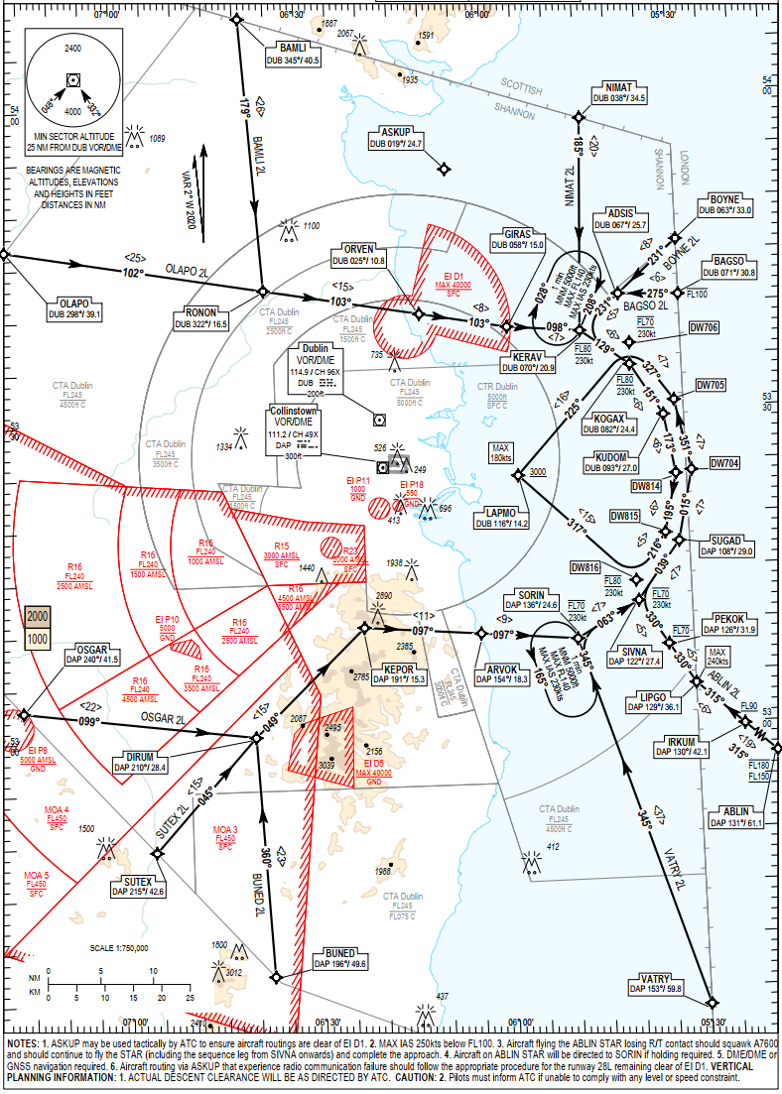
output
performance
Air Navigation System
Safety,
Efficiency
Air Navigation Services,
Arrival- and Departure process …
Current Operations
Tech. Enabler Concept Change
“Hypotheses”
Focus Area
Goal/Ambition
Perf. Objectives
Use-Case Assessment
Evidence and Interpretation of Results

Slide 3


AMAN
ext. AMAN / XMAN
“en-route absorption”
tailored release
Holdings (runway pressure)
(classical) Vectoring
Point Merge
(PBN) Tromboning

Slide 4

ALDT
ATO|fix
vs “reference time”

Slide 5

“fix”
Actual separation can be computed based on time-to-fly ∆t_{fi} / distance-to-go ∆d_{fi} of a (sequenced) flights f_{i} and f_{j}
Spacing deviation can be understood as the (realised) spacing at the fix (e.g. landing runway) and a – possible – additional spacing (e.g. safety buffer, estimation error) assuming a constant separation. Reflects “control error”.
Projecting the ATOs of a lead aircraft by the realised landing spacing, i.e. t_{ATOi} → t_{ATOi} + ∆t_{sepij} (ditto for distances) and comparing this to the position of the trailing aircraft at that moment yields the associated spacing deviation
∆t_{f1} or ∆d_{f1}
∆tsep_{f2-f1} or ∆dsep_{f2-f1}
$$t$$
$$t$$
$$t$$
∆t_{f2} or ∆d_{f2}
$sd\left(t\right)=ref_time(trailer\left(t\right))−ref_time(leader(t − ∆t$_{rwy}))

