Slide 1
UASFRA-MS-PROJDIGI: Group 4: Initial Plan
Get plain text out of Reports (ESG-, Financial Reports)
Extract and preprocess text ourselves?
Get plain text from elsewhere? Interface to these sources?
Extract the following out of plain text:
a. Entities: ORG, PERSON, LOCATION, etc.
b. Sentences where entities were found
Sentence Similarity:
Mask the entities in those sentences and vectorize the sentences with a LLM (BERT, etc)
Do similarity calculations of these vectorized sentences
Ideally, get different clusters where sentences are similar
Derive relationship tags (i.e. “ -[:EMITTED]-> ” ) from the sentences in each cluster
Attach sentence_vector to Relationship: i.e. “ -[:EMITTED {vector: sent_vector}]-> ”
Feed neo4j database with: ENTITY-1 -[:RELATION TAG {vector: sent_vector}] -> ENTITY-2
Query: Find -[:RELATION TAG {vector: sent_vector}] -> similar to Question sentence vector

Slide 2
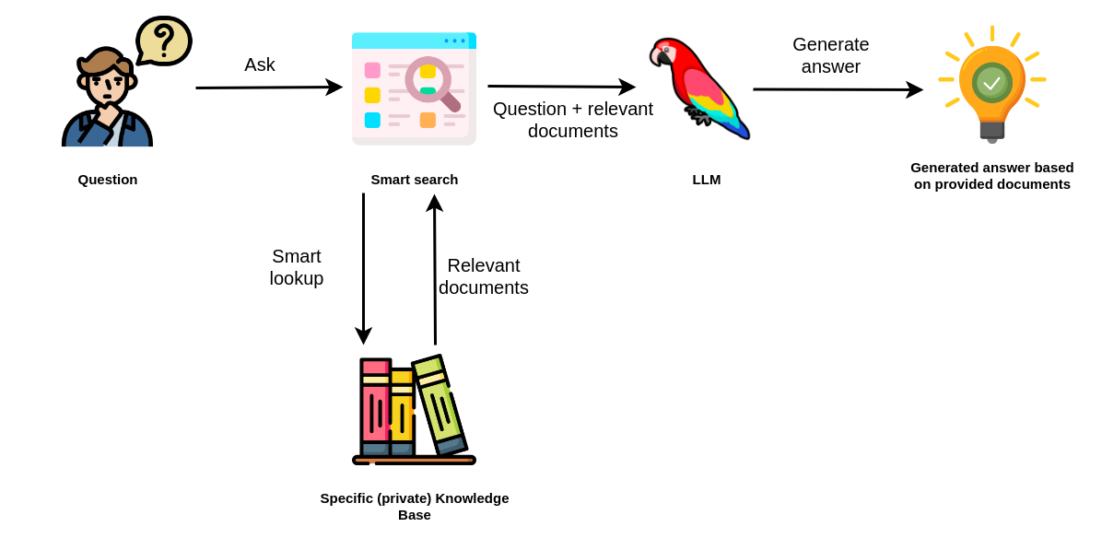



UASFRA-MS-PROJDIGI: Group 4: The plan ahead
Query similar to: Retrieval-Augmented Question-Answering LLMs:

Slide 3
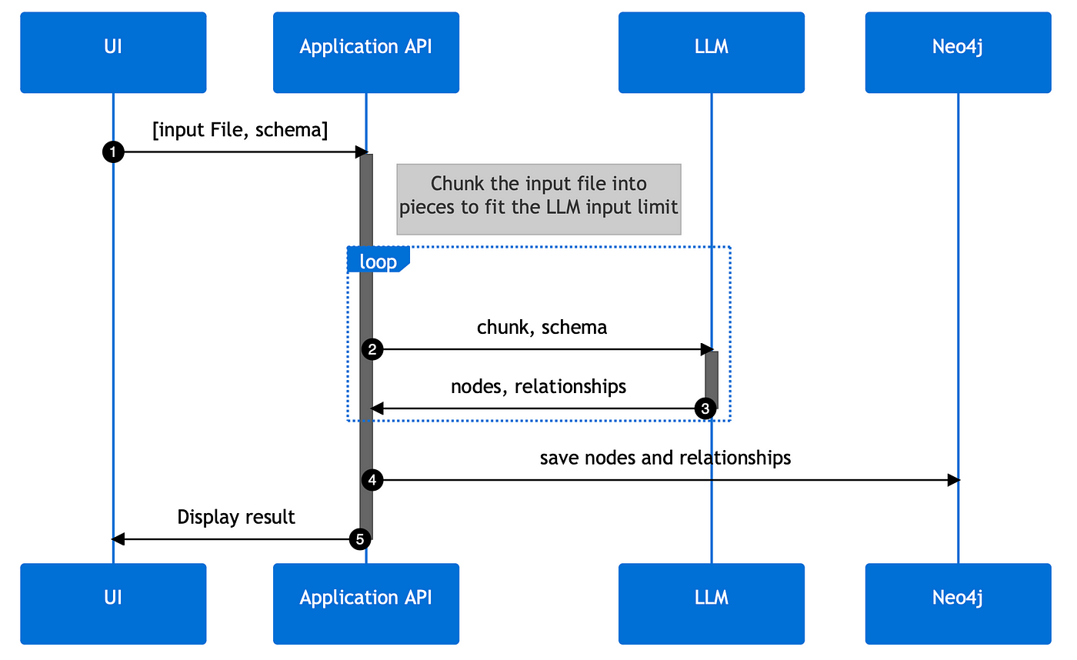
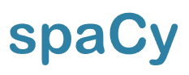
UASFRA-MS-PROJDIGI: Group 4: The plan ahead

Slide 4

Presentation
PROJECT PROPOSAL
by
Working Package 4
Project Digitalization - Winter Semester 2023/2024
Notes:
If more than one person is presenting a PPT, then alphabetically mention the initials (last name) of all the members in the footer separated by “,”.

Slide 5

Initial Plan
PDF: text text text text text text text
extract
Sentences with relevant information:
Text text text text text text text
Named Entity Recognition
Coreference Resolution
Relationship Extraction
Triplets:
Subject:
Predicate:
Object:
Cypher
Query Language
Knowledge Graph
(:Company XY)
-[:EMITTED]->
(:CO2)

Slide 6
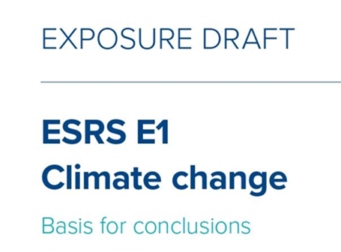
European Sustainability Reporting Standard (ESRS)

Slide 7
ESRS (Draft): Required Data to be reported
Extract:
Quantitative
Text/Number
Text

Slide 8
Initial Idea: Mapping sentences to ESRS Data Points
Text from PDFs:
"Within the 2025 target, we commit to reducing absolute Scope 1 and 2 GHG emissions by 90% from a baseline of 2017."

Slide 9
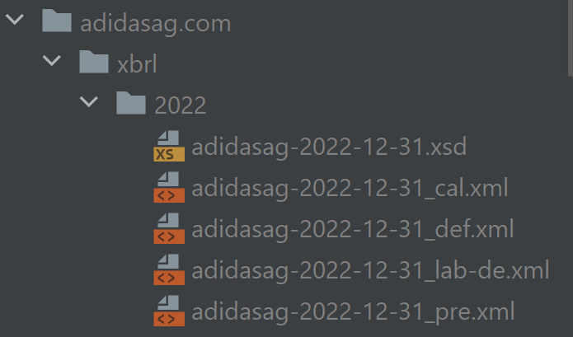
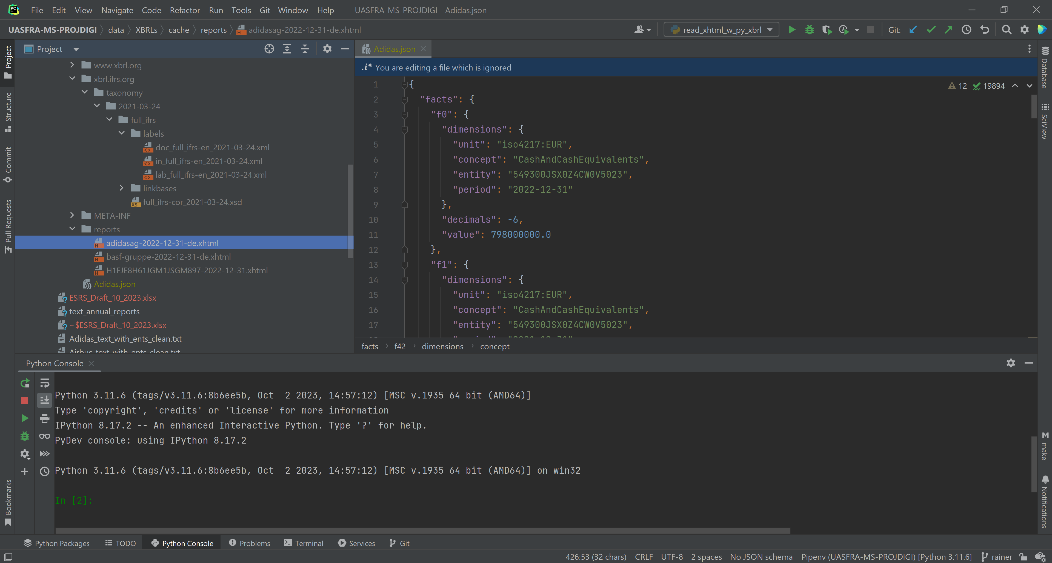
ESRS: XBRL-Format Delivery Requirement
ESEF Taxonomy Schema
Instance Document
extract and calculate:
JSON
XBRL: eXtensible Business Reporting Language
XBRL-Package:
ESEF Taxonomy Schema (.xsd)
Taxonomy Linkbases (.xml)

Slide 10
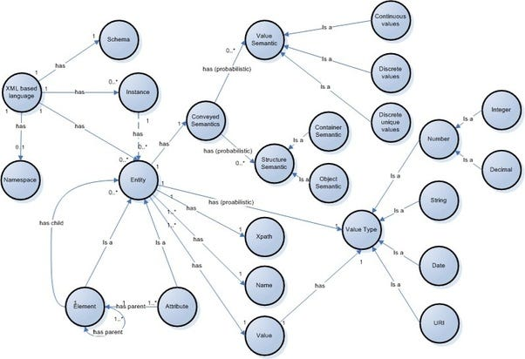
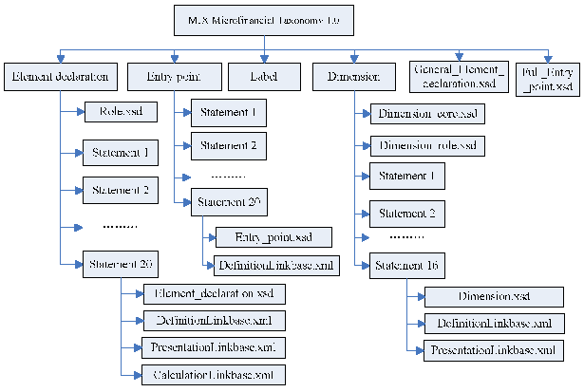
Difference between Taxonomy and Ontology
Taxonomy Schema
Ontology / Knowledge Graph
derive
Hierarchy
Concrete
Semantic Meaning
Relationships

Slide 11
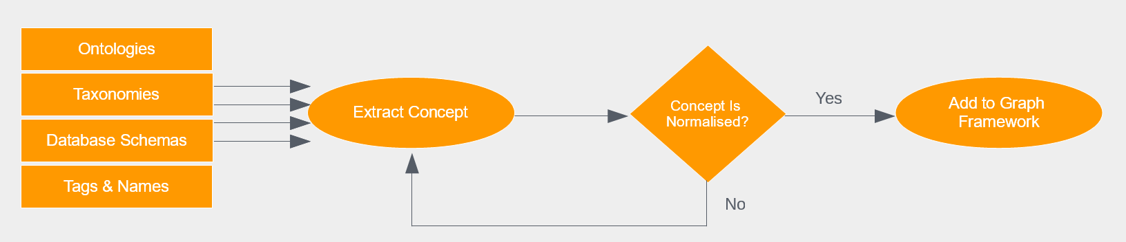
How to build a Knowledge Graph
Source: https://factnexus.com/blog/how-to-build-a-knowledge-graph
Already there:
ESEF XBRL Taxonomy: Financial Reports
ESRS (Draft)
Coming:
based on
ESRS XBRL Taxonomie: ESG-Reporting

Slide 12
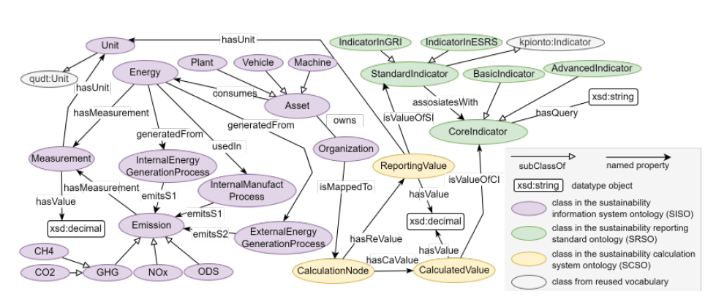
Plan ahead
Create Ontology based on coming taxonomy:
Source:
Zhou, Yuchen, and Alexander Perzylo. "OntoSustain: Towards an Ontology for Corporate Sustainability Reporting." International Semantic Web Conference (ISWC). 2023.
Cypher
Knowledge Graph

Slide 13
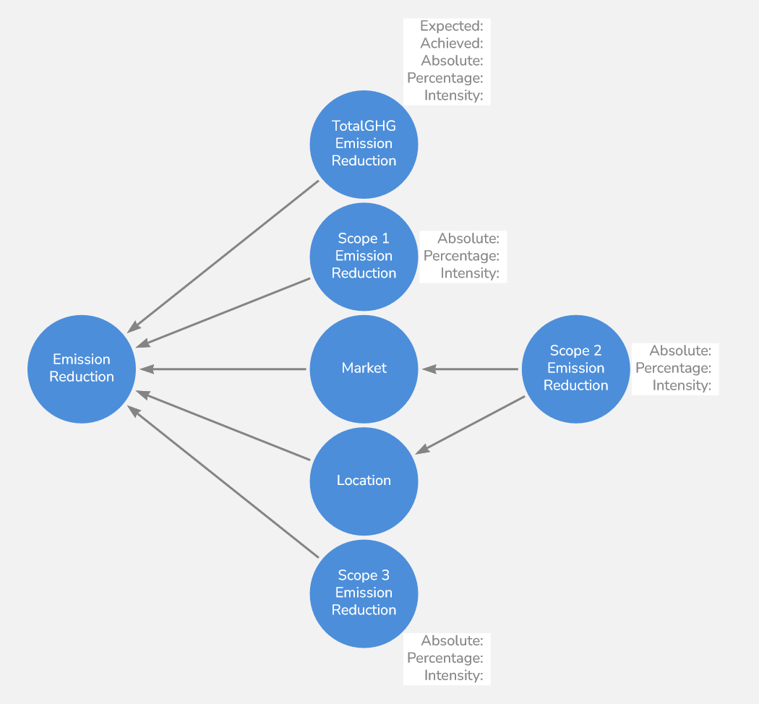
Plan ahead
Create Ontology based on coming taxonomy:
CREATE ({Absolute: "", Percentage: "", Intensity: ""})-[:_RELATED]->(`Emission Reduction`)<-[:_RELATED]-({Absolute: "", Percentage: "", Intensity: ""}),
({Expected: "", Achieved: "", Absolute: "", Percentage: "", Intensity: ""})-[:_RELATED]->(`Emission Reduction`)<-[:_RELATED]-()<-[:_RELATED]-(`Scope 2 Emission Reduction` {Absolute: "", Percentage: "", Intensity: ""}),
(`Scope 2 Emission Reduction`)-[:_RELATED]->()-[:_RELATED]->(`Emission Reduction`)
Knowledge Graph
Arrows.app example for Emission Reduction

Slide 14
Questions?
?

