Slide 1
UASFRA-MS-PROJDIGI: Group 4: The plan ahead
Get plain text out of Reports (ESG-, Financial Reports)
Extract and preprocess text ourselves?
Get plain text from elsewhere? Interface to these sources?
Extract the following out of plain text:
a. Entities: ORG, PERSON, LOCATION, etc.
b. Sentences where entities were found
Sentence Similarity:
Mask the entities in those sentences and vectorize the sentences with a LLM (BERT, etc)
Do similarity calculations of these vectorized sentences
Ideally, get different clusters where sentences are similar
Derive relationship tags (i.e. “ -[:EMITTED]-> ” ) from the sentences in each cluster
Attach sentence_vector to Relationship: i.e. “ -[:EMITTED {vector: sent_vector}]-> ”
Feed neo4j database with: ENTITY-1 -[:RELATION TAG {vector: sent_vector}] -> ENTITY-2
Query: Find -[:RELATION TAG {vector: sent_vector}] -> similar to Question sentence vector

Slide 2
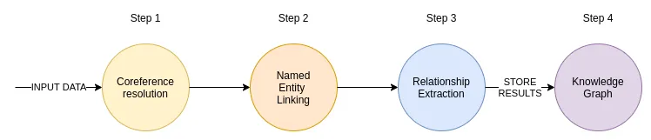

spaCy

Slide 3
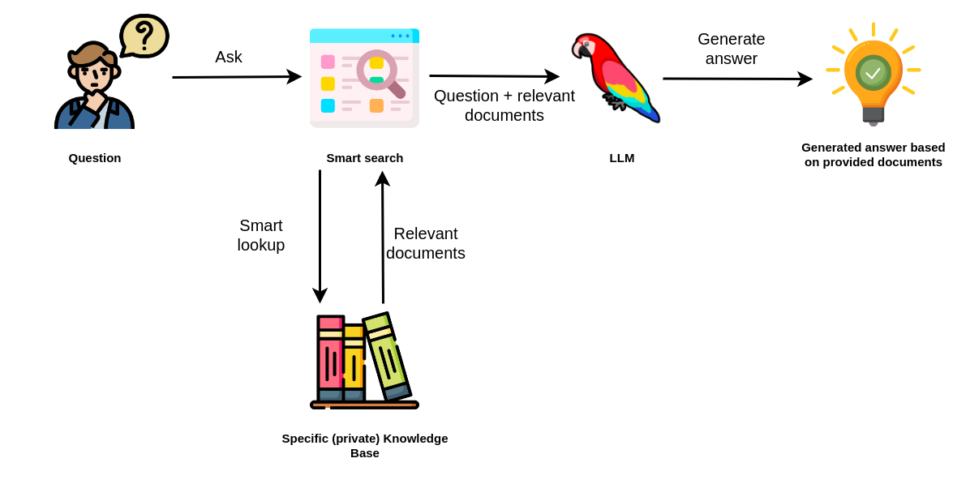



UASFRA-MS-PROJDIGI: Group 4: The plan ahead
Query similar to: Retrieval-Augmented Question-Answering LLMs:

Slide 4
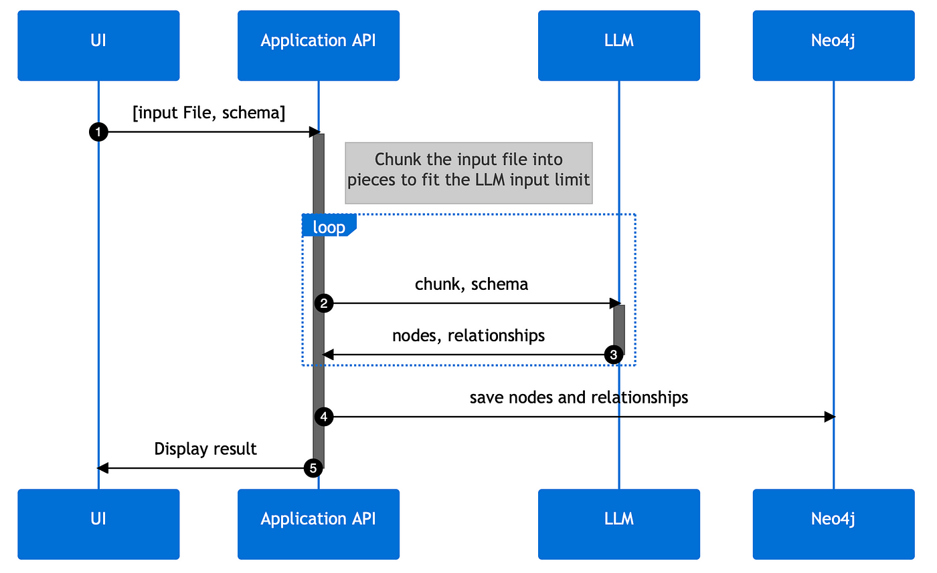
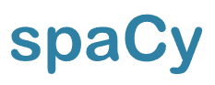
UASFRA-MS-PROJDIGI: Group 4: The plan ahead

Slide 5
ESRS (Draft) Required Data to be reorted
Extract:
Quantitative
Text/Number
Text

Slide 6
Mapping sentences to ESRS Data Points
"Within the 2025 target, we commit to reducing absolute Scope 1 and 2 GHG emissions by 90% from a baseline of 2017."

Slide 7
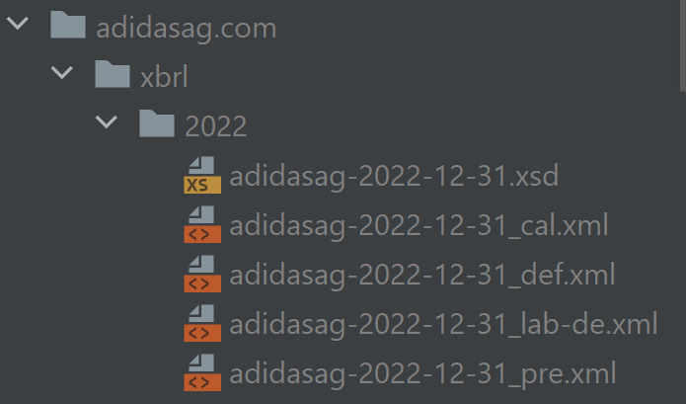
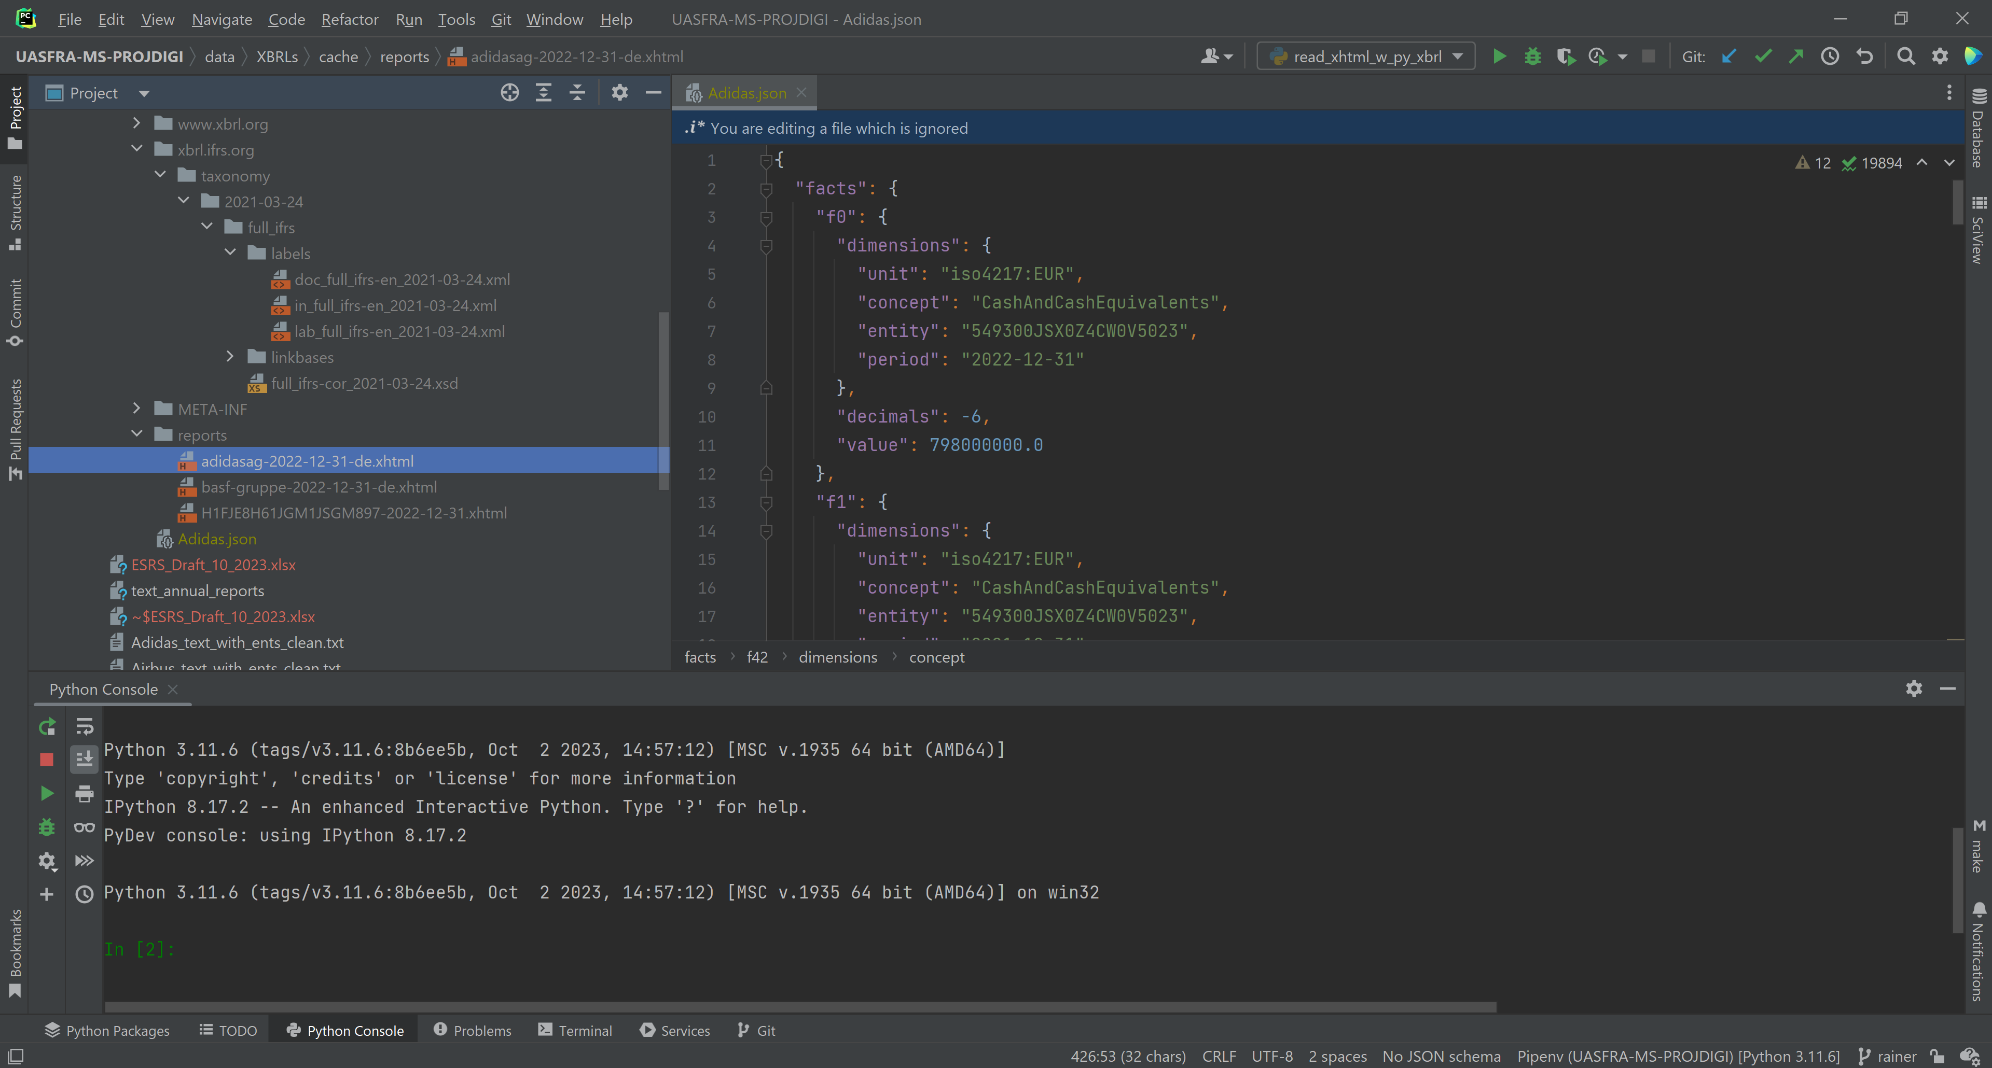
ESRS: XBRL-Format Delivery Requirement
ESRS Taxonomy
JSON

Slide 8
ESRS: XBRL-Format Delivery
Extract:
Quantitative
Text/Number
Text

