Slide 1
Protege Tutorial
Based on ProtegeOWLTutorial at protege website

Slide 2
What is protege?
Protege is a free, open-source platform to construct domain models and knowledge-based applications with ontologies.
Ontologies range from taxonomies, classifications, database schemas to fully axiomatized theories.
Ontologies are now central to many applications such as scientific knowledge portals, information management and integration systems, electronic commerce and web services

Slide 3
Install Protege
Go to http://protege.stanford.edu/doc/owl/getting-started.html to download protege (version 3.x)
Protege OWL editor is built with the full installation of protege platform. During the install process, choose the “Basic+OWL” option.
For more details: http://protege.stanford.edu/doc/owl/getting-started.html

Slide 4
Protege
There are two main ways of modelling ontologies:
  Frame-based
  OWL
Each has its own user interface
  Protege Frames editor: enables users to build and populate ontologies that are frame-based, in accordance with OKBC (Open Knowledge Base Connectivity Protocol).
    Classes
    Slots for properties and relationships
    Instances for class
  Protege OWL editor: enables users to build ontology for the Semantic Web, in particular to OWL
    Classes
    Properties
    Instances
    reasoning

Slide 5
Building an OWL Ontology
E2: Create a new OWL project
  Start protege
  File – New Project – OWL/RDF files – Ontology URI (http://www.pizza.com/ontologies/pizza.owl) – OWL DL – Properties View
  A new empty Protege-OWL project has been created.
  Save it in your local file as pizza.owl

Slide 6
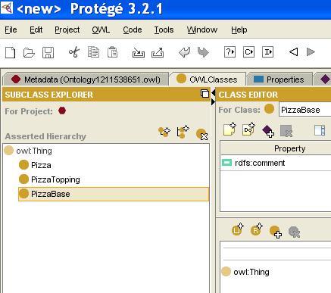
Named Classes
Go to OWL Classes tab
The empty class tree contains one class called owl:Thing, which is superclass of everything.
E3: Create subclasses Pizza, PizzaTopping and PizzaBase. They are subclasses of owl:Thing.
Naming convention
  no special naming convention
  consistency

Slide 7
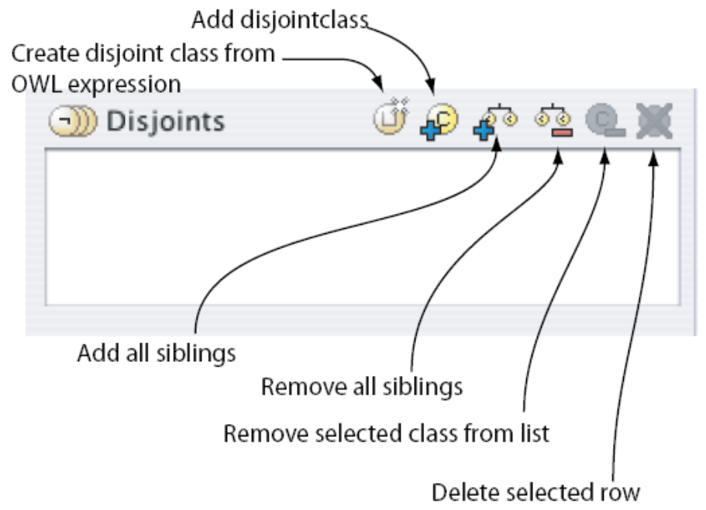
Disjoint classes
E4: How to say that Pizza, PizzaTopping and PizzaBase classes are disjoint.
Select the class Pizza
Press “add siblings” button on the disjoint classes widget
Add PizzaBase and PizzaTopping
Select the class PizzaTopping,
Add Pizza and PizzaBase to the disjoint class

Slide 8
E5: Create group of classes
Create ThinAndCrisyBase and DeepPanBase as the subclasses of PizzaBase, and each of them are disjointed.
Select PizzaBase, right click the mouse, select “create subclasses”
Follow the wizard to create these two disjoint classes.
It will save lots of time when there is need to create lots of disjoint classes.

Slide 9
E6: Create some subclasses of PizzaTopping
Select PizzaTopping,
  Create subclaesses as MeatTopping, VegetableTopping, CheeseTopping and SeafoodTopping. Make sure that these classes are disjoint to each other.
Select the class MeatTopping,
  Add disjoint subclasses: SpicyBeefTopping, PepperoniTopping, SalamiTopping and HamTopping
Select VegetableTopping:
  Add disjoint subclasses: TomatoTopping, OliveTopping, MushroomTopping, PepperTopping, OnionTopping, CaperTopping

Slide 10
E6: Creating disjoint subclasses
Select PepperTopping
  Add disjoint subclasses: RedPepperTopping, GreenPepperTopping, JalapenoPepperTopping
Select CheeseTopping
  Add disjoint subclasses: MozzarellaTopping, ParmezanTopping
Select SeafoodTopping
  Add disjoint subclasses: TunaTopping, AnchovyTopping and PrawnTopping

Slide 11
OWL Properties
OWL Properties represent relationships between two objects.
There are two main properties:
  Object properties: link object to object
  datatype properties: link object to XML Schema datatype or rdf:literal
OWL has another property – Annotation properties, to be used to add annotation information to classes, individuals, and properties

Slide 12
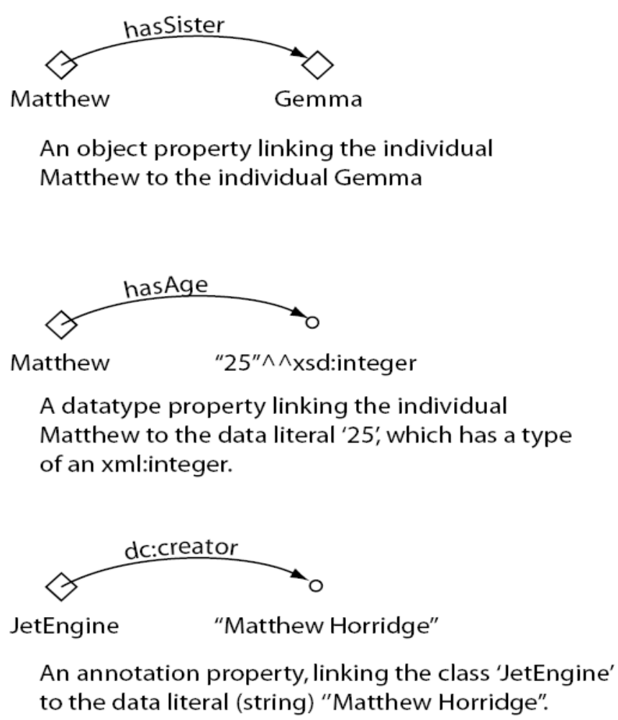

Slide 13
E7: Create an object property
Switch to the “Properties” tab,
Use “Create Object Property” button to create a new object property.
Rename it to hasIngredient

Slide 14
E8: Creating sub-properties
Select hasIngredient property
  Add hasTopping and hasBase as the subproperties

Slide 15
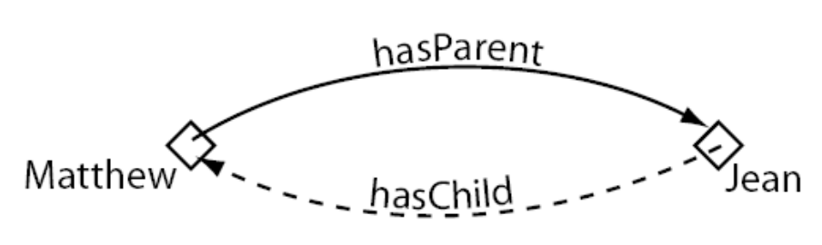
Inverse Properties
Each object property may have a corresponding inverse property.
If some property links individual a to individual b, then its inverse property will link individual b to individual a.

Slide 16
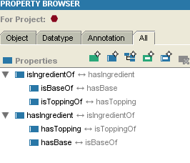
E9: Create inverse properties
Create a new object property called isIngredientOf
  Press “Set inverse property” button,
  Select “hasIngredient”
  Then the inverse relation has been set up.
Select hasBase
  Create the isBaseOf as the inverse property of hasBase
  isBaseOf is the subproperty of isIngredientOf, why?
Select hasTopping
  create isToppingOf as the inverse property.
  isToppingOf is the subproperty
  of isIngredientOf, why?

Slide 17
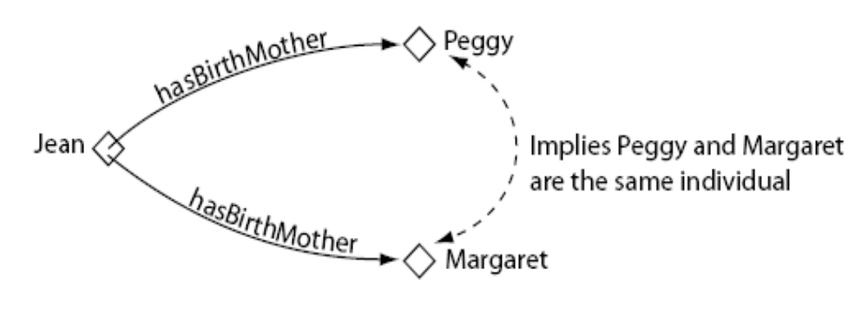
Functional Properties
If a property is functional, for a given individual, there can only be at most one individual to be related via this property.
  For a given domain, range must be unique
Functional properties are also known as single valued properties.

Slide 18
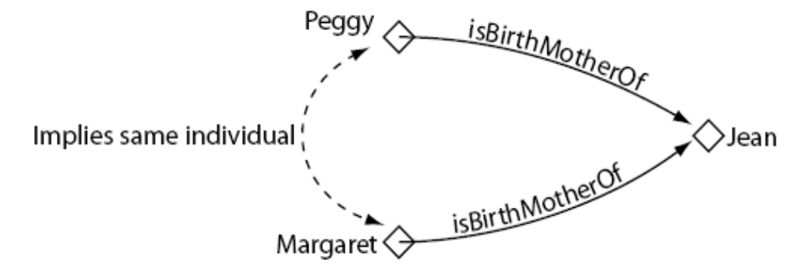
Inverse Functional Properties
If a property is inverse functional, then its inverse property is functional.
  For a given range, domain must be unique.

Slide 19
Functional vs. inverse functional properties
FunctionalProperty vs InverseFunctionalProperty
 | domain | range | example
Functional Property | For a given domain | Range is unique | hasFather: A hasFather B, A hasFather C →B=C
InverseFunctionalProperty | Domain is unique | For a given range | hasID: A hasID B, C hasID B →A=C

Slide 20
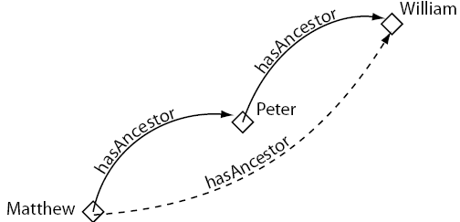
Transitive Properties
If a property is transitive, and the property related individual a to individual b, and also individual b to individual c, then we can infer that individual a is related to individual c via property P.

Slide 21

Symmetric Properties
If a property P is symmetric, and the property relates individual a to individual b, then individual b is also related to individual a via property P.

Slide 22
E10: Make the hasIngredient property transitive
Select the hasIngredient property
Tick the transitive tick box
Select the isIngredientOf property, make sure that the transitive tick box is ticked.

Slide 23
E11: Make the hasBase property functional
Select the hasBase property
Tick the “functional” tick box
OWL-DL does not allow datatype properties to be transitive, symmetric or have inverse properties.

Slide 24
Property domains and ranges
Properties link individuals from the domain to individuals from the range.
OWL uses domain and range as axioms in reasoning.

Slide 25
E12: Specify the range of hasTopping
Select hasTopping
  Press range button
  Select PizzaTopping
  Press OK button
  PizzaTopping should be displayed in the range list.
When multiple classes are added to the range, they represent the union of all classes.

Slide 26
E13: Specify Pizza as the domain of the hasTopping property
Select hasTopping property
  Press add domain button
  Select Pizza
  Press OK
  Pizza is displayed in the domain list.
When multiple classes are added as domain, they represent as the union of these classes.

Slide 27
E14: Specify the domain and range for the isToppingOf property
Select the isToppingOf property
Set the domain of the isToppingOf property to PizzaTopping
Set the range of the isToppingOf property to Pizza.

Slide 28
E15: Specify the domain and range for the hasBase property and its inverse property isBaseOf
Select the hasBase property
  Specify the domain as Pizza
  Specify the range as PizzaBase
Select the isBaseOf property
  Specify the domain as PizzaBase
  Specify the range as Pizza

Slide 29


Property restrictions
In OWL, properties are used to create restrictions.
Restrictions are used to restrict the individuals that belong to a class
Three restrictions:
  Quantifier restrictions
    Existential quantifier ( )
    Universal quantifier ( )
  Cardinality restrictions
  hasValue restrictions

Slide 30
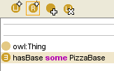
E16: Add a restriction to Pizza
Add a restriction to Pizza that specifies a Pizza must have a PizzaBase
  Select Pizza
  Select Necessary header to create a necessary condition
  Select create a restriction wizard
    Select hasBase as restricted property
    Select someValueFrom as restriction
    Put PizzaBase into the filler

Slide 31
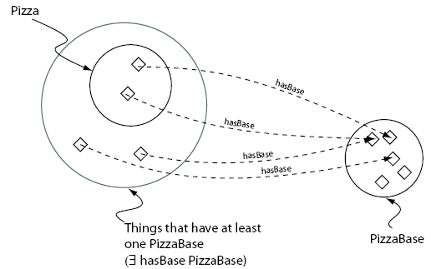
Add a restriction to Pizza

Slide 32
E18: Creating different kinds of Pizzas
Create a subclass of Pizza called NamedPizza, and a subclass of NamedPizza called MargheritaPizza.
Add comment to MargheritaPizza: A pizza that only has Mozarella and Tomato toppings

Slide 33
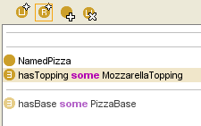
E19: Adding restrictions to MargheritaPizza
To specify that MargheritaPizza has at least one MozzarellaTopping.
  Select MargheritaPizza
  Go to “Asserted Conditions”, create new restriction.
  Select someValueFrom
  Select hasTopping as the property to be restricted.
  Enter MozzarellaTopping as the filler
  Press OK button

Slide 34
E20: Adding restrictions to MargheritaPizza
To specify that MargheritaPizza has at least one TomatoTopping.
  Select MargheritaPizza
  Go to “Asserted Conditions”, create new restriction.
  Select someValueFrom
  Select hasTopping as the property to be restricted.
  Enter TomatoTopping as the filler
  Press OK button

Slide 35
E21: Create AmericanPizza
Create AmericanPizza with toppings of pepperoni, mozzarella and tomato.
Through cloning and modifying the description of MargheritaPizza.
  Select MargheritaPizza
  Select create clone
  Add additional restriction to AmericanaPizza
    Adding PepperoniTopping
  Press OK.

Slide 36
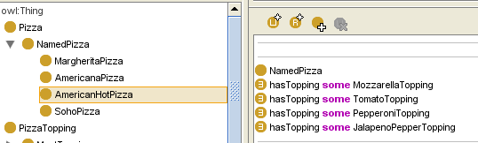
E22: Create an AmericanHotPizza and a SohoPizza
An AmericanHotPizza is almost the same as an AmericanaPizza, but has JalapenoPepperTopping on it.
A SohoPizza is almost the same as a MargheritaPizza, but has additional OliveTopping and ParmezanTopping

Slide 37
E23: Make subclasses of NamedPizza disjoint from each other
Select MargheritaPizza
Press “add all siblings” button on the “Disjoints widget” to make the pizzas disjoint from each other.

Slide 38
Using a reasoner
Ontology described in OWL-DL can be processed by a reasoner.
  Go to owl—preference, to make sure that OWL-DL is selected.
The main services offered by a reasoner is to test whether or not one class is a subclass of another class.
By performing such tests on all of the classes, it is possible for a reasoner to compute the inferred ontology class hierarchy.
Another reasoning service is consistency checking – to check whether or not it is possible for the class to have any instances.
A class is deemed to be inconsistent if it cannot possibly have any instances.

Slide 39
Using Racer
In order to reason over the ontology in Protege-OWL, a DIG compliant reasoner should be installed and started.
In this tutorial, we use Racer,
  Download at: http://www.racer-systems.com/products/download/index.phtml
  Double click RacerPro to start Racer.

Slide 40
Invoking the reasoner
Having started Racer, the ontology can be sent to the reasoner to automatically compute the classification hierarchy, and also check the logical consistency of the ontology.
In Protege, the manually constructed class hierarchy is called the asserted hierarchy. The automatically computed by the reasoner is called the inferred hierarchy.
Go to OWL – classify taxonomy – to invoke the reasoner
  If a class has been reclassified, then the class name will appear in a blue color in the inferred hierarchy.
Go to OWL – Check consistency – to invoke the reasoner
  If a class has been found to be inconsistent, it’s icon will be circled in red color.
Computing the inferred class hierarchy is also known as classifying the ontology.

Slide 41
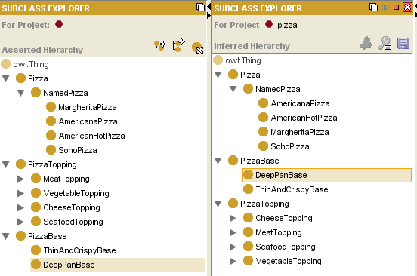
Invoke the reasoner

Slide 42
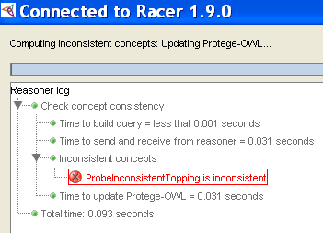
E24: Inconsistent classes
In order to demonstrate the use of the reasoner to detect inconsistencies in the ontology, we will create a class ProbeInconsistentTopping,
  Which is the subclass of CheeseTopping
  Select ProbeInconsistentTopping, go to asserted condition to add named classes, select VegetableTopping and then press OK.
  Go to OWL – check consistency

Slide 43
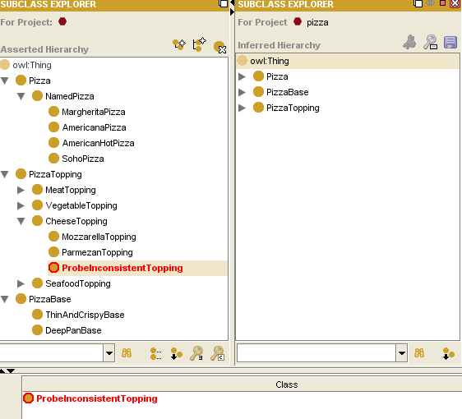
E25: Classify the ontology again
To see ProbeInconsistentTopping is inconsistent.

Slide 44
E26: Remove the disjoint statement
Between CheeseTopping and VegetableTopping to see what happens
  Select CheeseTopping
  Go to Disjoint part
  Select VegetableTopping, right click and “Delete the selected row”.
  Classify taxonomy
  The inconsistency no longer exists.

Slide 45
E27: Fix the ontology
By making CheeseTopping and VegetableTopping disjoint from each other.

Slide 46
Resources
Protege Ontology Libraries
  http://protegewiki.stanford.edu/index.php/Protege_Ontology_Library
Protege tutorial
  http://www.co-ode.org/resources/tutorials/
Protege Website
  http://protege.stanford.edu/doc/users.html
  http://protege.stanford.edu/

