Slide 1
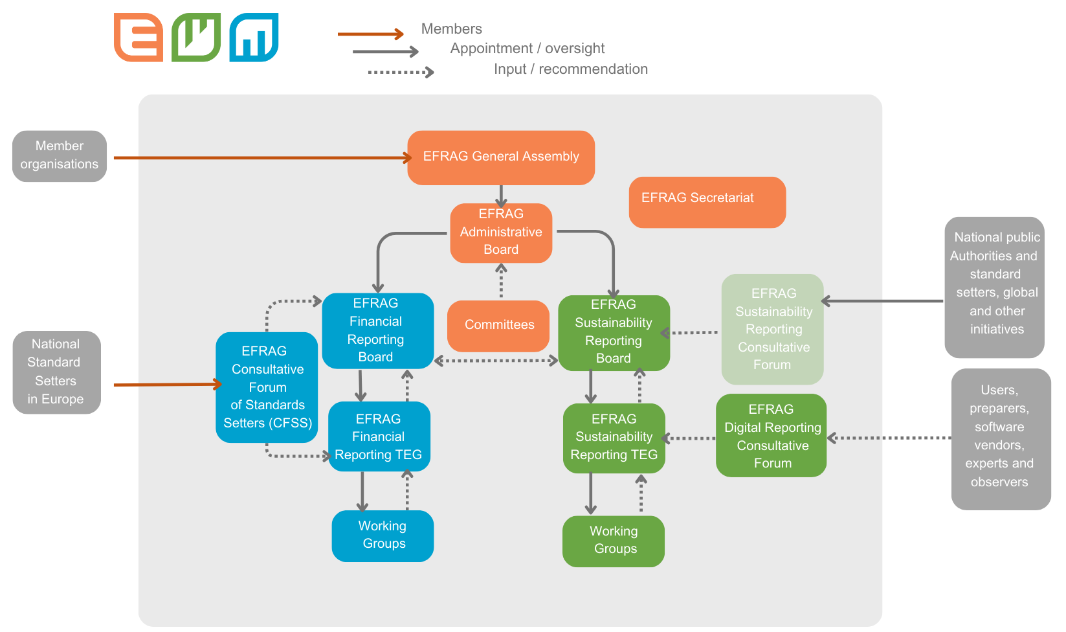
EFRAG: Organizational Structure
Source: https://efrag.org/About/Facts:

Slide 2
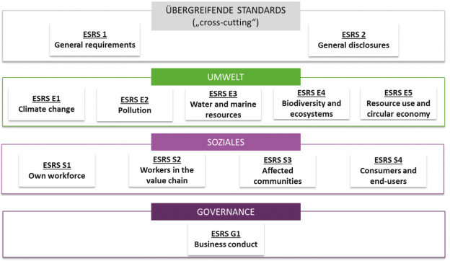
ESRS 1/2
Source: https://www.umweltbundesamt.de/umweltberichterstattung-berichtsstandards#einheitliche-eu-standards-fur-die-umwelt-und-nachhaltigkeitsberichterstattung

Slide 3
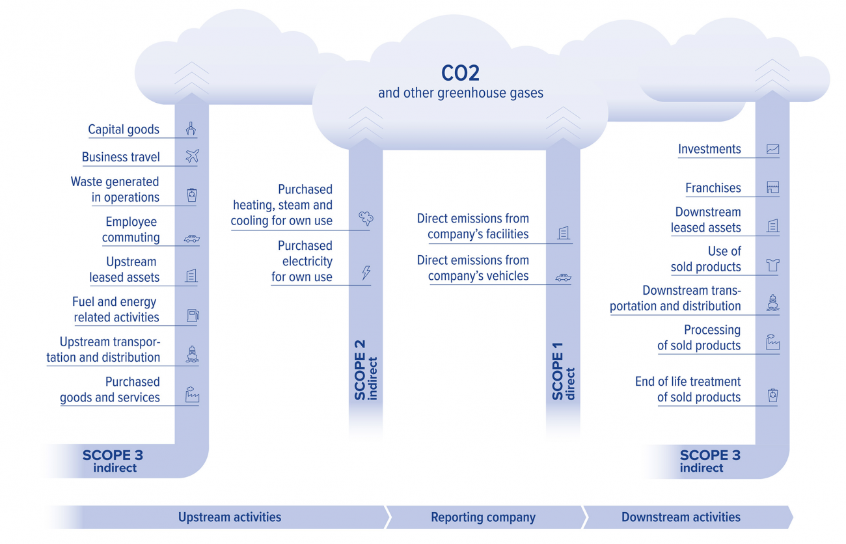
Dependencies of Scope 1, 2, 3
Source: https://www.climatepartner.com/en/scope-1-2-3-complete-guide

Slide 4
Step1: Domain and Scope of Ontology
Question 1: What is the domain the Ontology will cover?
Sustainability Reporting
Question 2: For what are we going to use the Ontology?
Store information about companies required to report according to ESRS. Retrieve information easily and quickly to answer questions related to Environmental, Social and Governance (ESG) issues that could affect the profitability of the company in the future.
Question 3: For what kind of questions the information in the Ontology should provide answers?
How much of certain GHG emissions does a certain company have? Did this emission metric decrease from last year and if yes, by how much? How much GHG were emitted by all companies combined that are in the database in a certain year? Has a certain company allocated sufficient resources to climate change in the past or is it likely that the company has to increase spending (falling profits?) to catch up with ESG requirements? How much did a company receive/pay for carbon credits to alter emission statistics?
Question 4: Who will use and maintain the Ontology?
Project participants of this semester. Project participants in the next semesters.

