Slide 1
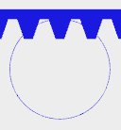

Slide 2
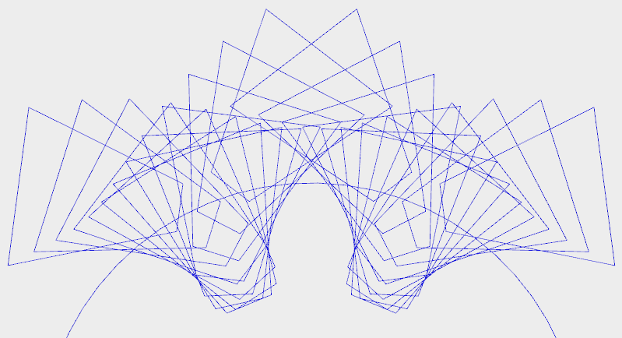
Outer circle (pitch radius + addendum)
Undercut

Slide 3






-
=
➔

Slide 4
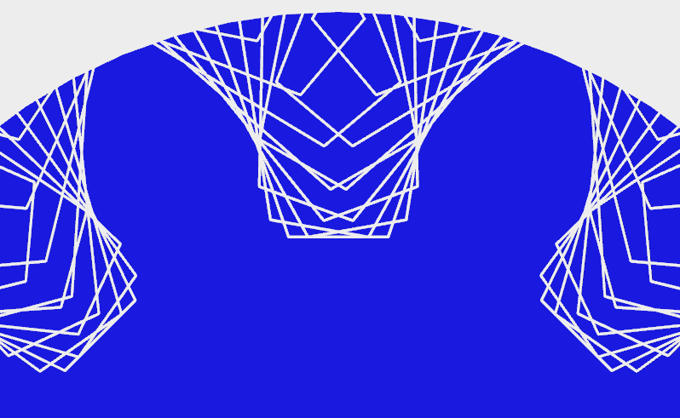
Remove concave corners that are located between two convex corners. After removal of these corners (marked by red dots) the valleys are smoothed over (new red edges).

