Slide 1
Ch.3 Terminology
From Database Design for Mere Mortals®, Third Edition, by Michael J. Hernandez (ISBN: 9780321884497). Copyright 2013 by Michael J. Hernandez. All rights reserved.

Slide 2
Ch.3 Terminology:
A. Value-Related Terms
B. Structure-Related Terms
C. Relationship-Related Terms
D. Integrity-Related Terms
From Database Design for Mere Mortals®, Third Edition, by Michael J. Hernandez (ISBN: 9780321884497). Copyright 2013 by Michael J. Hernandez. All rights reserved.

Slide 3
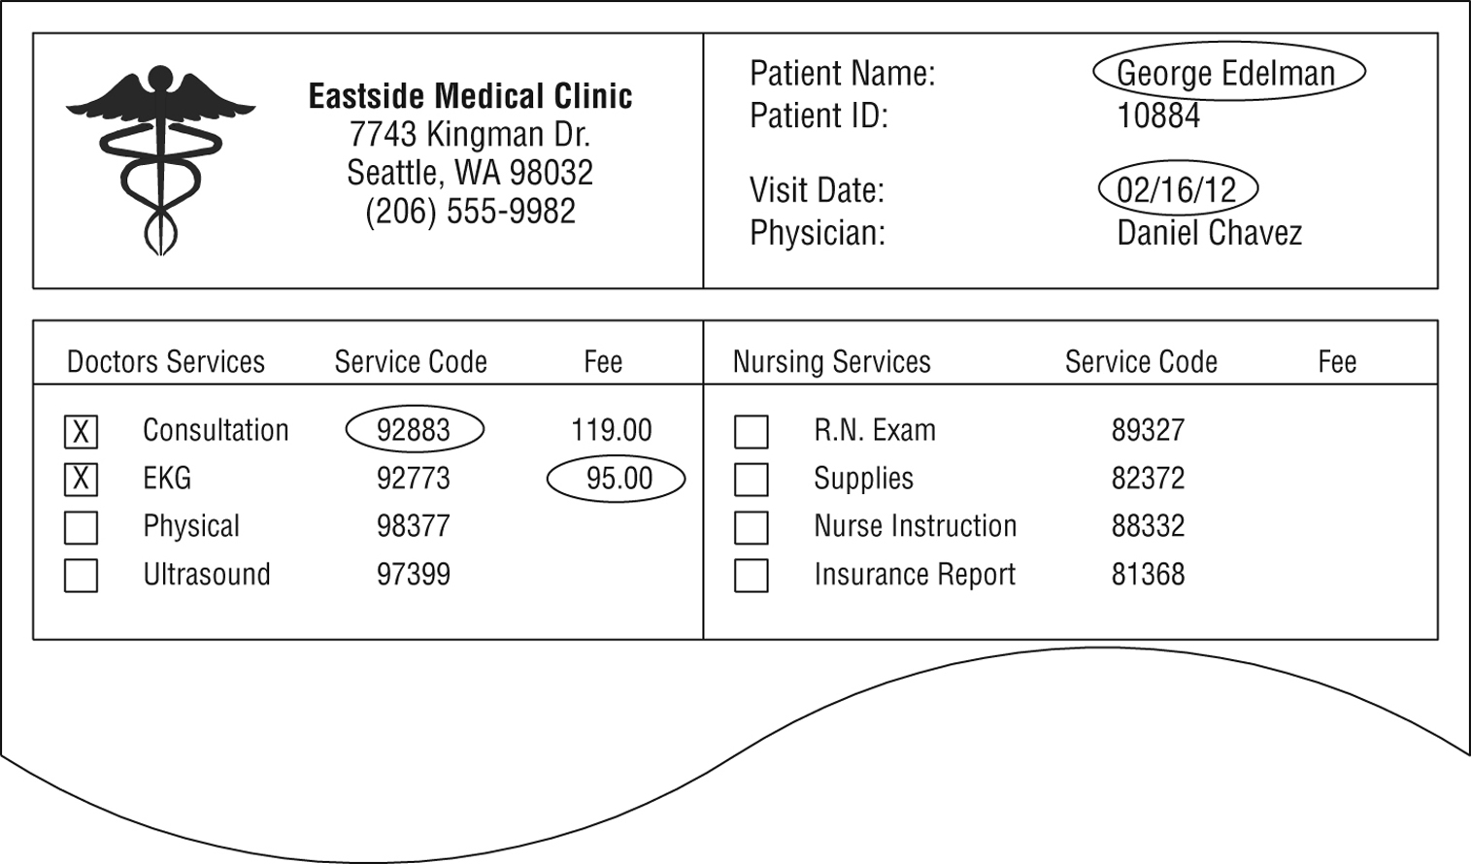
A. Value-Related Terms
Data vs Information (processed data)
  Data is what you store; information is what you retrieve.
Null – missing or unknown values
George Edleman 92883 05/16/96 95.00
Figure 3.1 An example of basic data
Figure 3.2 An example of data transformed into information
From Database Design for Mere Mortals®, Third Edition, by Michael J. Hernandez (ISBN: 9780321884497). Copyright 2013 by Michael J. Hernandez. All rights reserved.
Notes:
From Database Design for Mere Mortals®, Third Edition, by Michael J. Hernandez (ISBN: 9780321884497). Copyright 2013 by Michael J. Hernandez. All rights reserved.

Slide 4
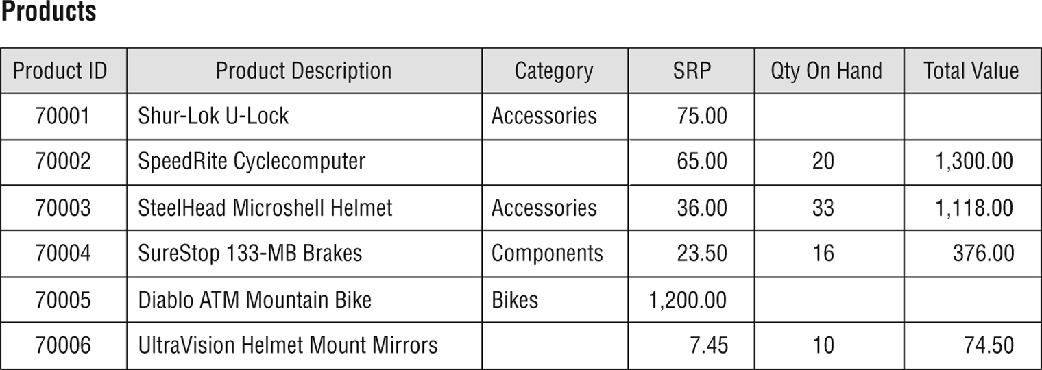
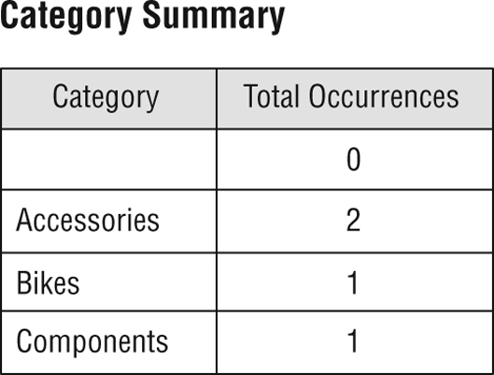
Anomalies created by null
Figure 3.4 The nulls in this table will have an effect on mathematical operations
involving the table’s fields.
[TOTAL VALUE] = [SRP] × [QTY ON HAND].
Figure 3.5 Nulls affect the results of an aggregate function.
From Database Design for Mere Mortals®, Third Edition, by Michael J. Hernandez (ISBN: 9780321884497). Copyright 2013 by Michael J. Hernandez. All rights reserved.
Notes:
From Database Design for Mere Mortals®, Third Edition, by Michael J. Hernandez (ISBN: 9780321884497). Copyright 2013 by Michael J. Hernandez. All rights reserved.

Slide 5
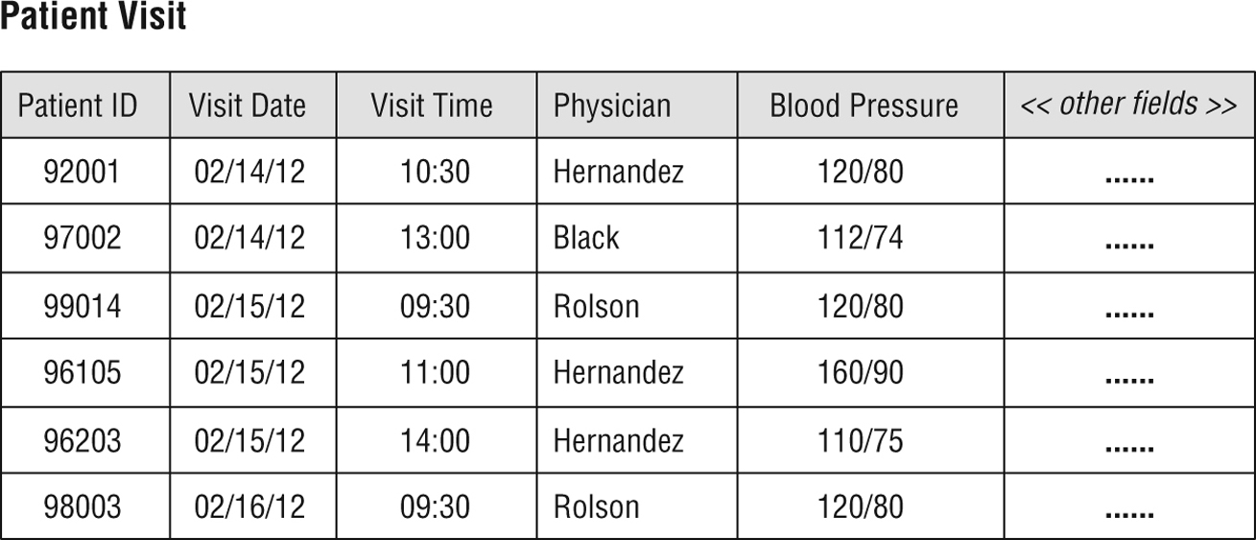
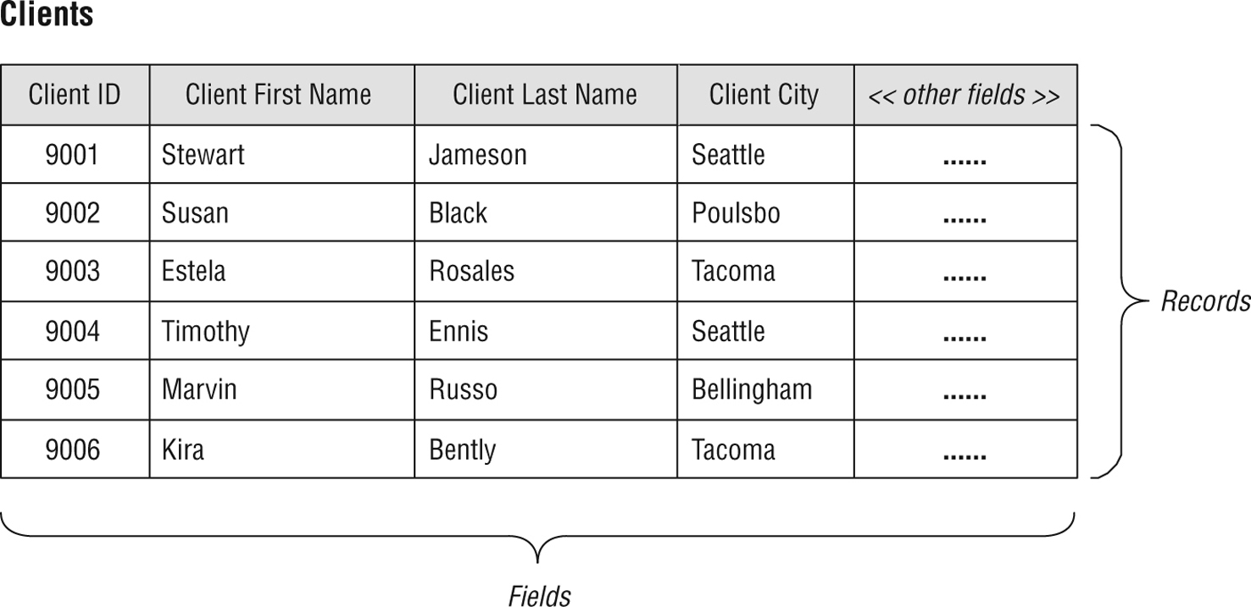
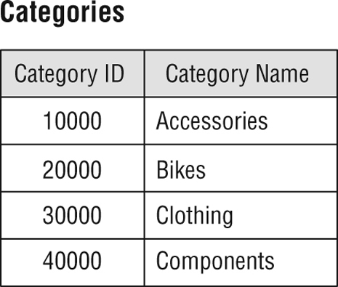
B. Structure-Related Terms
Table
  Must include at least the primary key
Figure 3.7 A table representing an event
Figure 3.8 An example of a validation table
[it is rarely modified]
Figure 3.6 A typical table structure
From Database Design for Mere Mortals®, Third Edition, by Michael J. Hernandez (ISBN: 9780321884497). Copyright 2013 by Michael J. Hernandez. All rights reserved.
Notes:
From Database Design for Mere Mortals®, Third Edition, by Michael J. Hernandez (ISBN: 9780321884497). Copyright 2013 by Michael J. Hernandez. All rights reserved.

Slide 6
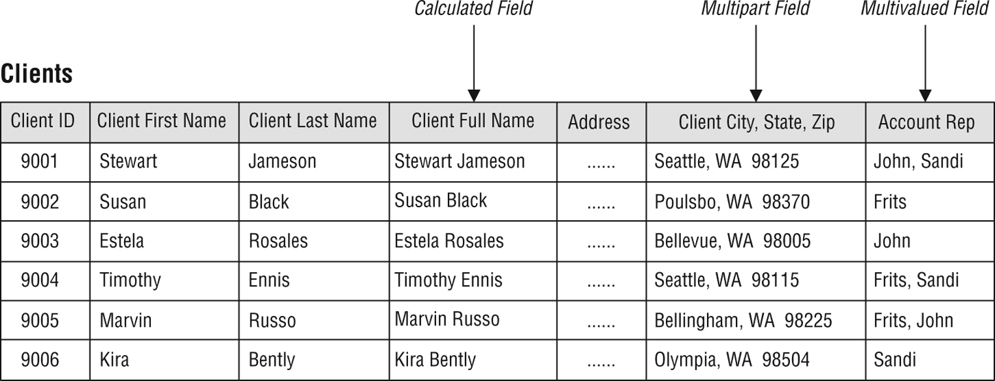
Field (attribute)
Figure 3.9 A table containing regular, calculated, multipart, and multivalued fields
[last three types exist in poorly designed databases]
3. Record (tuple) = a row, ex. Susan Black record above
From Database Design for Mere Mortals®, Third Edition, by Michael J. Hernandez (ISBN: 9780321884497). Copyright 2013 by Michael J. Hernandez. All rights reserved.
Notes:
From Database Design for Mere Mortals®, Third Edition, by Michael J. Hernandez (ISBN: 9780321884497). Copyright 2013 by Michael J. Hernandez. All rights reserved.

Slide 7
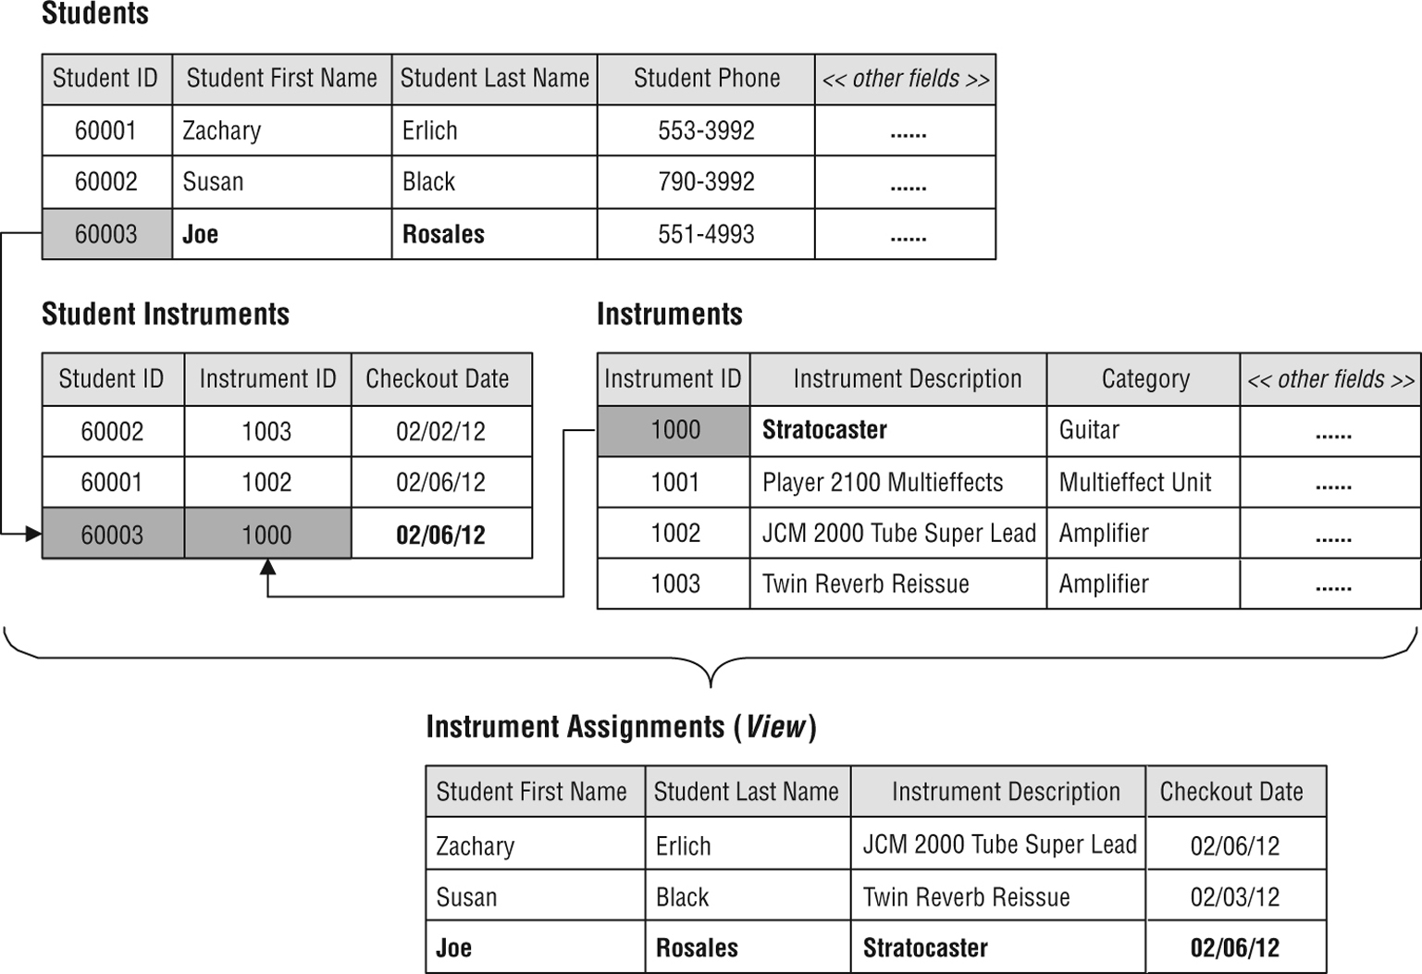
4. View = virtual table built of rows from one or more base tables
Figure 3.10 An example of a typical view
From Database Design for Mere Mortals®, Third Edition, by Michael J. Hernandez (ISBN: 9780321884497). Copyright 2013 by Michael J. Hernandez. All rights reserved.
Notes:
From Database Design for Mere Mortals®, Third Edition, by Michael J. Hernandez (ISBN: 9780321884497). Copyright 2013 by Michael J. Hernandez. All rights reserved.

Slide 8
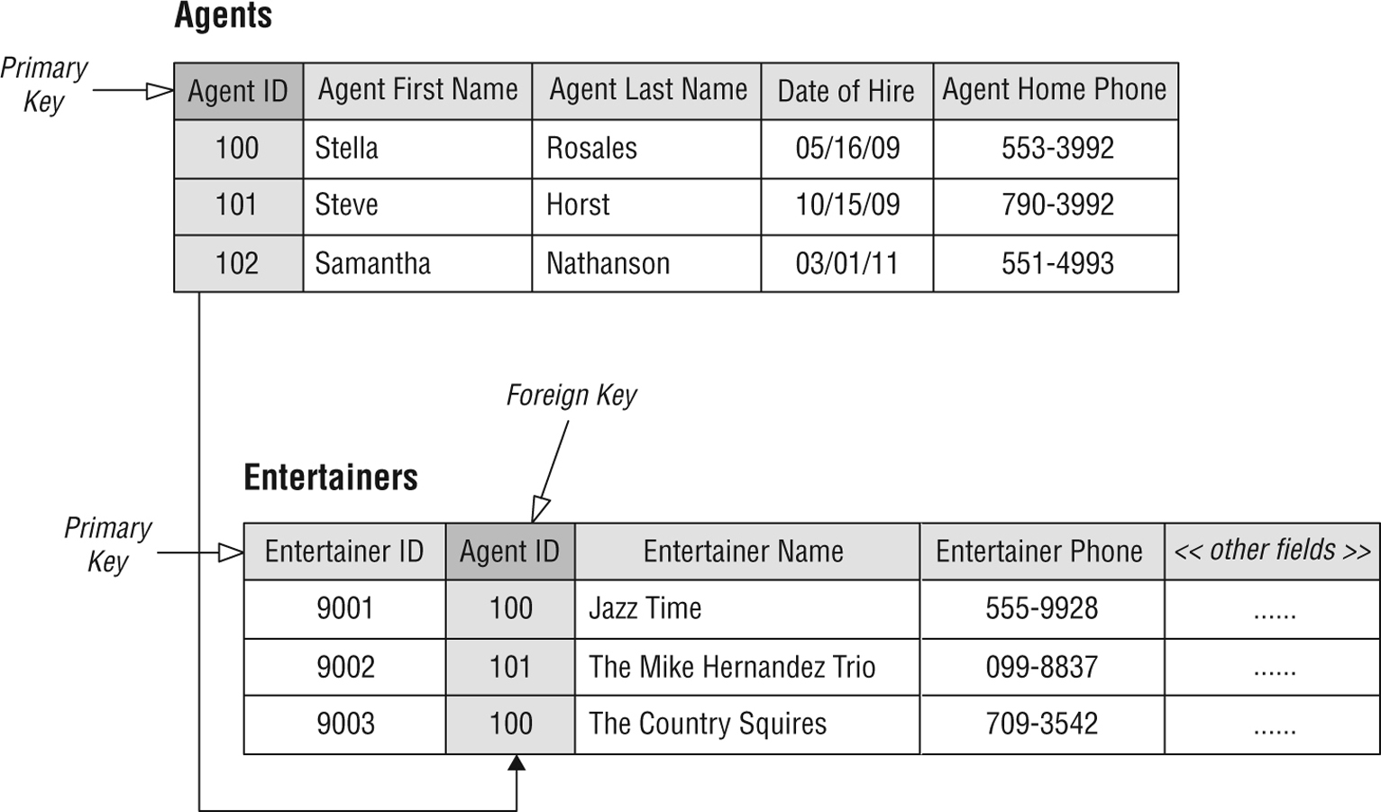
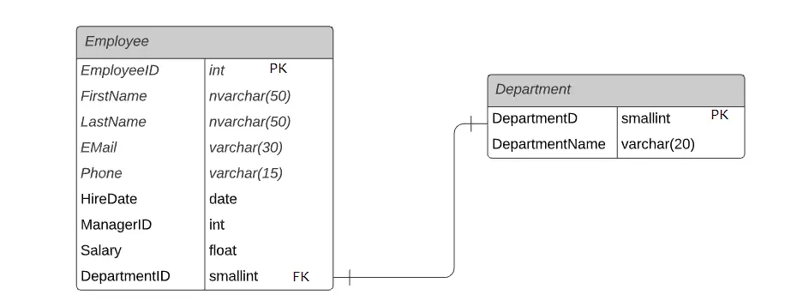
5. Keys
Primary key:
a field or a group of fields that uniquely identifies each record within a table
  Every table should have one
Foreign key:
a field that establishes relationships between two tables and it is the primary key in the other table
[Foreign key can also help with enforcing constrains]
Figure 3.11 An example of primary and foreign key fields
Ex. You cannot add in table Employee the employee Anna form Physics dept., if Physics is not created in table Departments
From Database Design for Mere Mortals®, Third Edition, by Michael J. Hernandez (ISBN: 9780321884497). Copyright 2013 by Michael J. Hernandez. All rights reserved.
Notes:
From Database Design for Mere Mortals®, Third Edition, by Michael J. Hernandez (ISBN: 9780321884497). Copyright 2013 by Michael J. Hernandez. All rights reserved.

Slide 9
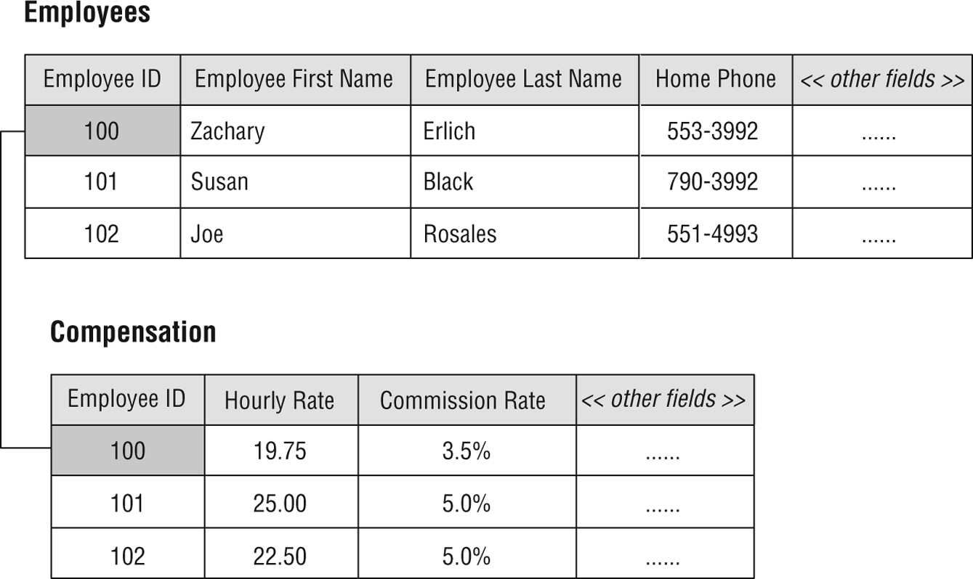
C. Relationship-Related Terms
1. Relationships
One-to-One Relationships
Figure 3.13 An example of a one-to-one relationship
From Database Design for Mere Mortals®, Third Edition, by Michael J. Hernandez (ISBN: 9780321884497). Copyright 2013 by Michael J. Hernandez. All rights reserved.
Notes:
From Database Design for Mere Mortals®, Third Edition, by Michael J. Hernandez (ISBN: 9780321884497). Copyright 2013 by Michael J. Hernandez. All rights reserved.

Slide 10
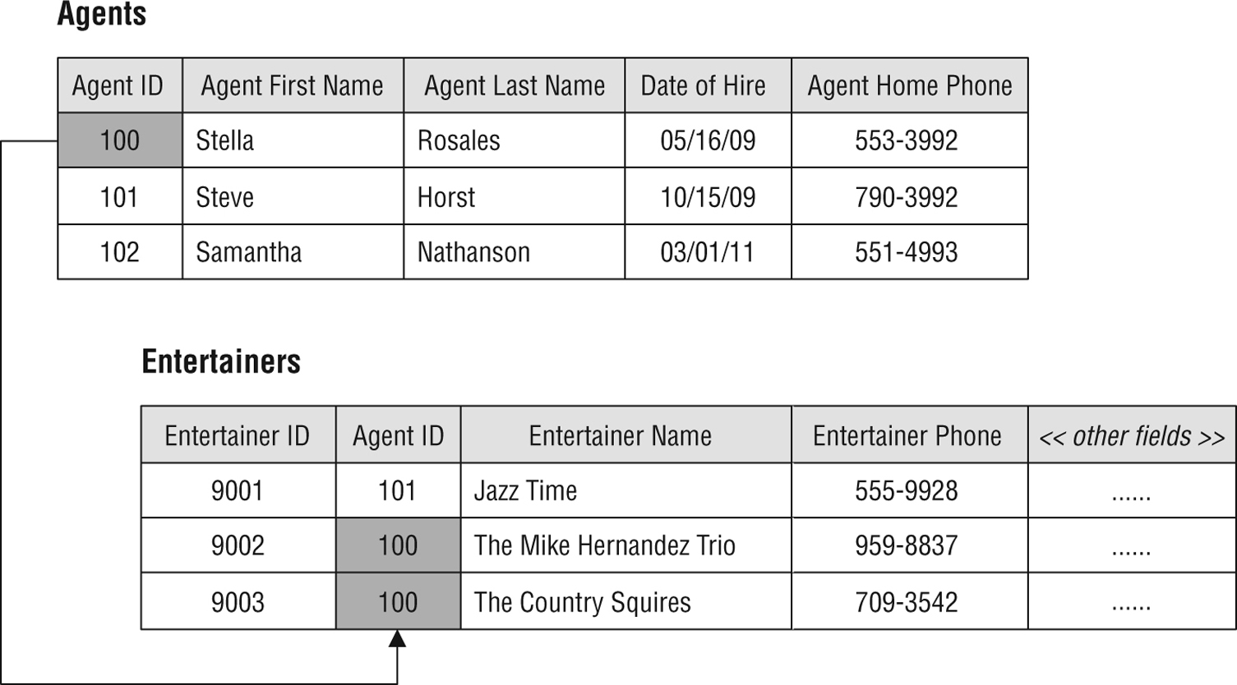
One-to-Many Relationships
Figure 3.14 An example of a one-to-many relationship
From Database Design for Mere Mortals®, Third Edition, by Michael J. Hernandez (ISBN: 9780321884497). Copyright 2013 by Michael J. Hernandez. All rights reserved.
Notes:
From Database Design for Mere Mortals®, Third Edition, by Michael J. Hernandez (ISBN: 9780321884497). Copyright 2013 by Michael J. Hernandez. All rights reserved.

Slide 11
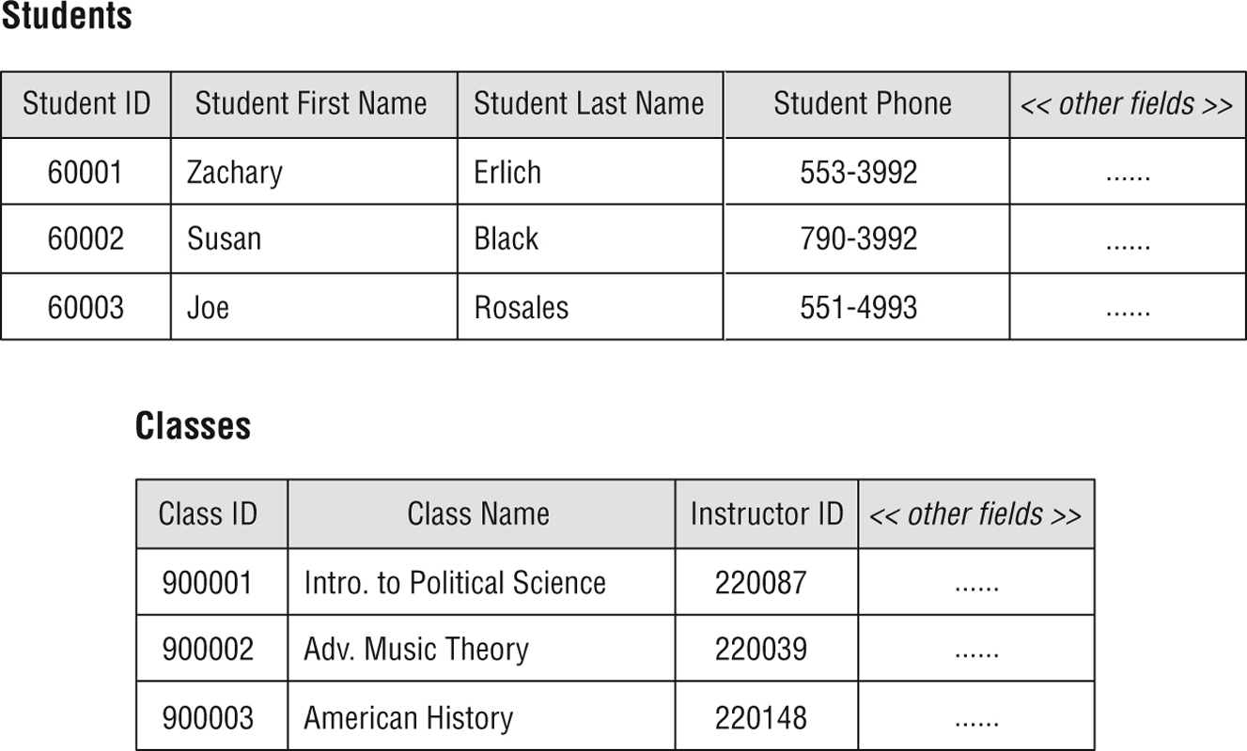
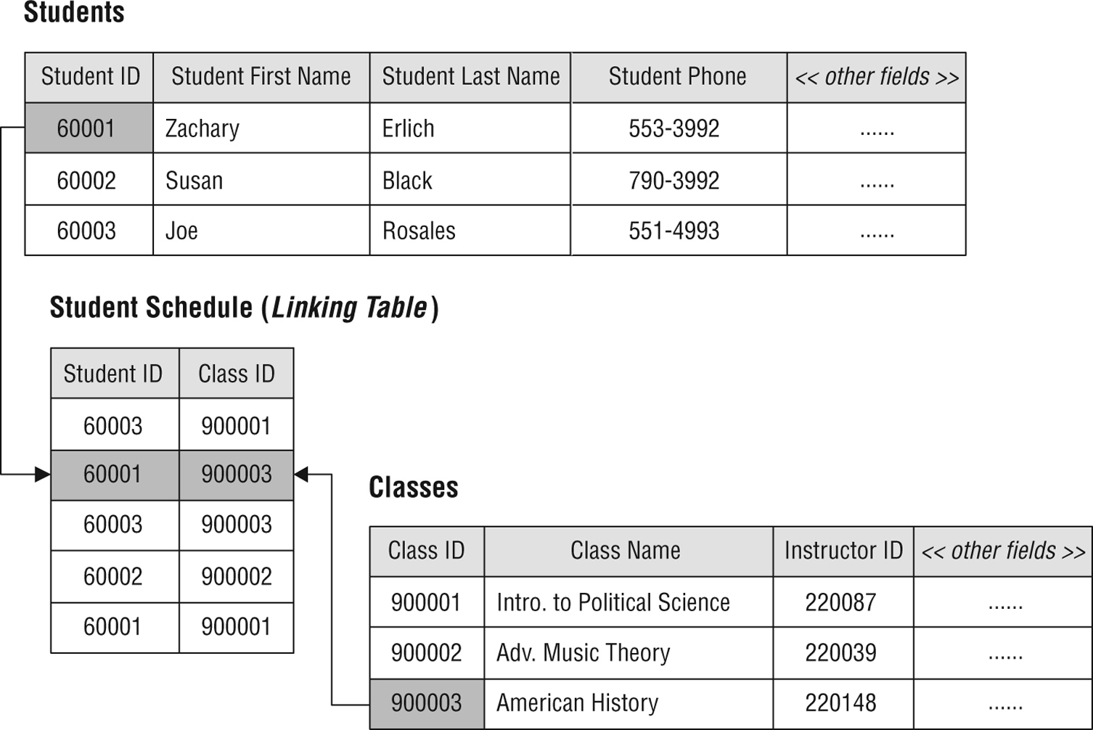
Many-to-Many Relationships
Figure 3.15 An example of an unresolved many-to-many relationship
Unresolved = how do you easily associate a student with all their classes, or a class with all its students?
Answer: This information can only be recorded in the linking (middle) table, NOT in any of the two tables
Figure 3.16 Resolving the many-to-many relationship with a linking table
From Database Design for Mere Mortals®, Third Edition, by Michael J. Hernandez (ISBN: 9780321884497). Copyright 2013 by Michael J. Hernandez. All rights reserved.
Notes:
From Database Design for Mere Mortals®, Third Edition, by Michael J. Hernandez (ISBN: 9780321884497). Copyright 2013 by Michael J. Hernandez. All rights reserved.

Slide 12
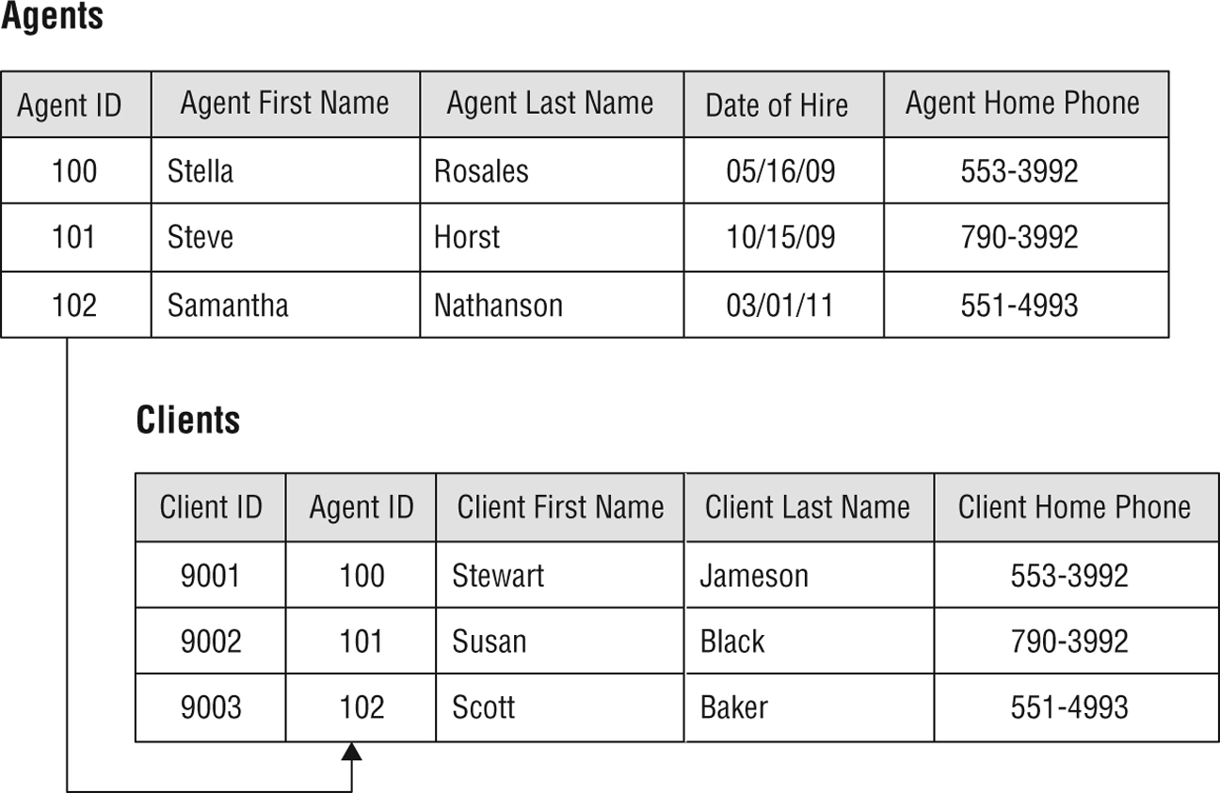
2. Mandatory/Optional Participation
-Ex. Make Agent table as mandatory participation in the database because agent 100 must exist in Agent table before using it in the Client table
[this can be enforced with a fk_constraint, we will see later]
3. Degree of Participation
-Ex. CLIENTS 1,8 = one agent must manage at least one client but no more than 8
-Ex. AGENTS 1,1 = a client must be assigned to only one agent
Figure 3.17 The AGENTS and CLIENTS tables
From Database Design for Mere Mortals®, Third Edition, by Michael J. Hernandez (ISBN: 9780321884497). Copyright 2013 by Michael J. Hernandez. All rights reserved.
Notes:
From Database Design for Mere Mortals®, Third Edition, by Michael J. Hernandez (ISBN: 9780321884497). Copyright 2013 by Michael J. Hernandez. All rights reserved.

Slide 13
D. Integrity-Related Terms
Field specifications
Data integrity – ex. no duplicate records, consistent entries like Dr. vs Doctor
Figure 3.13 An example of a one-to-one relationship
From Database Design for Mere Mortals®, Third Edition, by Michael J. Hernandez (ISBN: 9780321884497). Copyright 2013 by Michael J. Hernandez. All rights reserved.
Notes:
From Database Design for Mere Mortals®, Third Edition, by Michael J. Hernandez (ISBN: 9780321884497). Copyright 2013 by Michael J. Hernandez. All rights reserved.

