Slide 1
Ch.8 Keys
[Step 3: Create data structure ]
Importance of keys
  Identify uniquely each row (record)
  Enforce integrity
  Create table relationship
Types of keys: candidate; primary; foreign; non-key
Road map thus far for database design:
Step 1: Define mission and objectives (Ch. 5)
Step 2: Analyze current database (Ch. 6)
Step 3: Create data structure (Ch. 7 Tables; 8 Keys; 9 Fields)
From Database Design for Mere Mortals®, Third Edition, by Michael J. Hernandez (ISBN: 9780321884497). Copyright 2013 by Michael J. Hernandez. All rights reserved.
Notes:
From Database Design for Mere Mortals®, Third Edition, by Michael J. Hernandez (ISBN: 9780321884497). Copyright 2013 by Michael J. Hernandez. All rights reserved.

Slide 2
1) Elements of a candidate key
Not a multipart field
Must contain unique values
Cannot contain nulls
Cannot breach the organization’s security or privacy rules
Is not optional
Has minimum number of fields to define uniqueness
Must uniquely and exclusively identify each record
Must exclusively identify each field within a given record (i.e. any other field in a table depends on primary key only, not on other fields as well)
Can be modified only in rare or extreme cases
From Database Design for Mere Mortals®, Third Edition, by Michael J. Hernandez (ISBN: 9780321884497). Copyright 2013 by Michael J. Hernandez. All rights reserved.
Notes:
From Database Design for Mere Mortals®, Third Edition, by Michael J. Hernandez (ISBN: 9780321884497). Copyright 2013 by Michael J. Hernandez. All rights reserved.

Slide 3
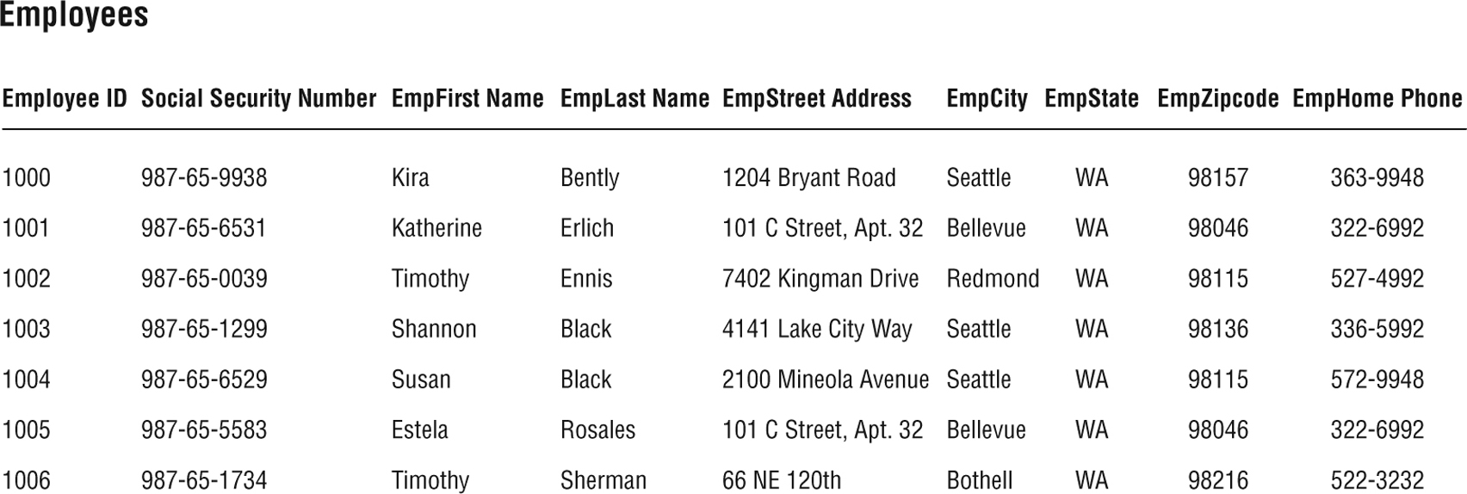
Find Candidate Keys
Figure 8.1 Are there any candidate keys in this table?
From Database Design for Mere Mortals®, Third Edition, by Michael J. Hernandez (ISBN: 9780321884497). Copyright 2013 by Michael J. Hernandez. All rights reserved.
Notes:
From Database Design for Mere Mortals®, Third Edition, by Michael J. Hernandez (ISBN: 9780321884497). Copyright 2013 by Michael J. Hernandez. All rights reserved.

Slide 4
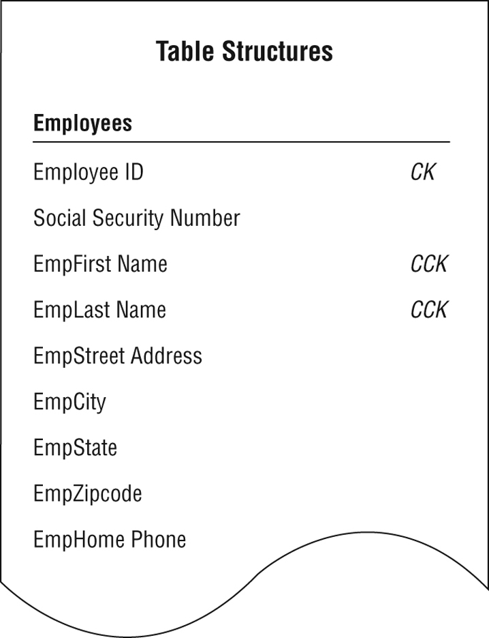
Find Candidate Keys
Figure 8.1 Are there any candidate keys in this table?
Figure 8.2 Marking candidate keys in the EMPLOYEES table structure
From Database Design for Mere Mortals®, Third Edition, by Michael J. Hernandez (ISBN: 9780321884497). Copyright 2013 by Michael J. Hernandez. All rights reserved.
Notes:
From Database Design for Mere Mortals®, Third Edition, by Michael J. Hernandez (ISBN: 9780321884497). Copyright 2013 by Michael J. Hernandez. All rights reserved.

Slide 5
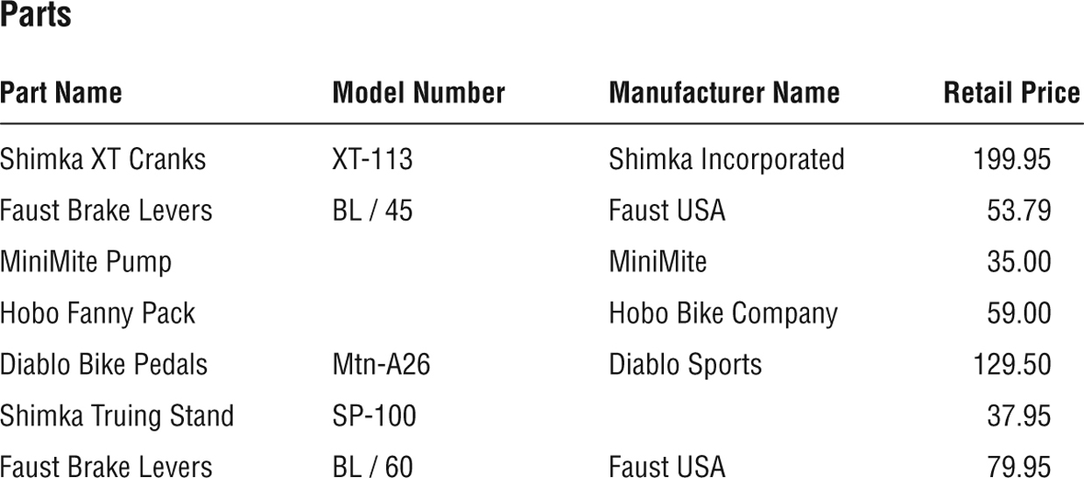
Are there candidate keys here?
Figure 8.3 Can you identify any candidate keys in the PARTS table?
From Database Design for Mere Mortals®, Third Edition, by Michael J. Hernandez (ISBN: 9780321884497). Copyright 2013 by Michael J. Hernandez. All rights reserved.
Notes:
From Database Design for Mere Mortals®, Third Edition, by Michael J. Hernandez (ISBN: 9780321884497). Copyright 2013 by Michael J. Hernandez. All rights reserved.

Slide 6
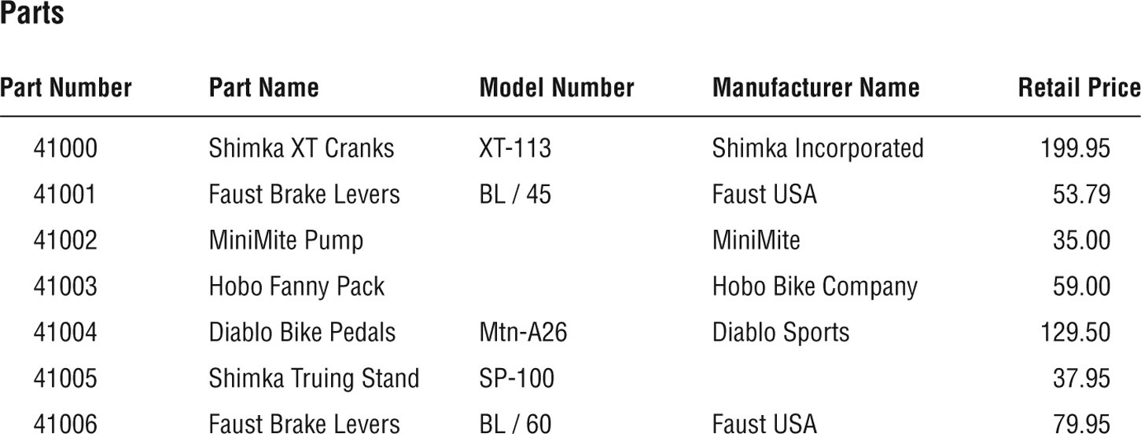
No candidate keys? ➔ Create artificial candidate keys
Figure 8.4 The PARTS table with the artificial candidate key PART NUMBER
Note: even if we have candidate keys (like, FirstName + LastName), we might create artificial candidate keys (like StudentID) because it is shorter and helps with relationships between tables
From Database Design for Mere Mortals®, Third Edition, by Michael J. Hernandez (ISBN: 9780321884497). Copyright 2013 by Michael J. Hernandez. All rights reserved.
Notes:
From Database Design for Mere Mortals®, Third Edition, by Michael J. Hernandez (ISBN: 9780321884497). Copyright 2013 by Michael J. Hernandez. All rights reserved.

Slide 7
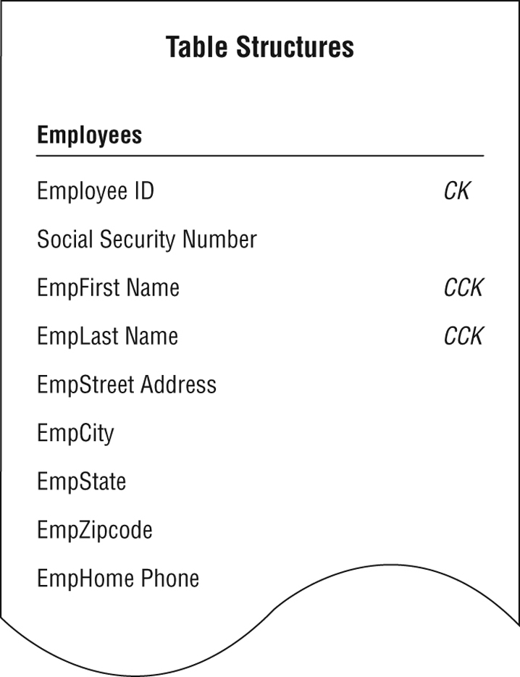
2) Select primary key from candidate keys
Exclusively identifies the table throughout the database structure and helps establish relationships with other tables
Uniquely identifies a given record within a table and exclusively represents that record throughout the entire database
Each table must have only one primary key
Each primary key is unique in the entire database structure except:
  1-to-1 relationship
  Table B is subset of table A
Figure 8.5 Which candidate key should become the primary key of the EMPLOYEES table? [CCK = composite candidate key]
Has the fewest number of fields
Contains parts of table name
From Database Design for Mere Mortals®, Third Edition, by Michael J. Hernandez (ISBN: 9780321884497). Copyright 2013 by Michael J. Hernandez. All rights reserved.
Notes:
From Database Design for Mere Mortals®, Third Edition, by Michael J. Hernandez (ISBN: 9780321884497). Copyright 2013 by Michael J. Hernandez. All rights reserved.

Slide 8
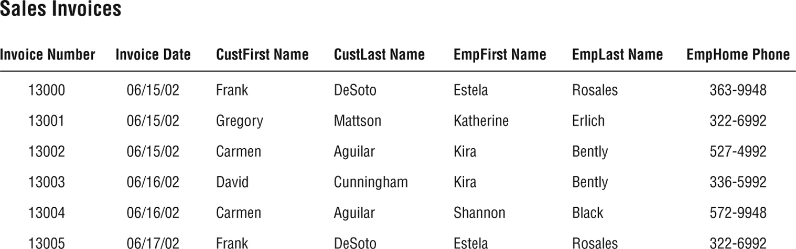





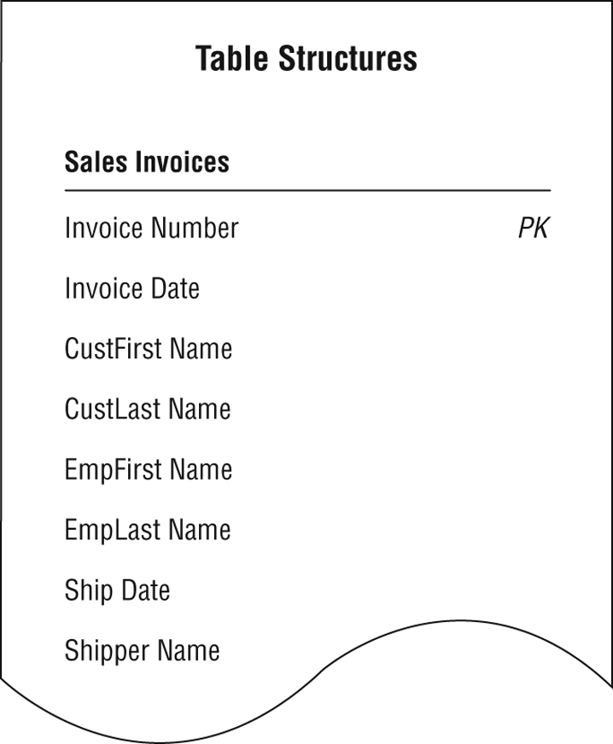
3) Test a Primary Key
Figure 8.6 Does the primary key exclusively identify the value of each field in this table?
Question: Is Invoice Number uniquely Identifying Invoice Date? CustFirst Name? etc…
Answer: Yes, yes, yes, yes, yes, no.
Ex.: Invoice Number indirectly identifies EmpHome Phone via EmpLast Name ➔ remove field EmpHome Phone from this table.
[There is only one Estela Rosales, who changed their phone, but we updated it in only one place ➔ update inconstancy (violation of the 2nd NF) ]
EmpHome Phone should entirely depend on PK, NOT on other fields; here EmpHome Phone depends on EmpFirst Name and EmpLast Name
Figure 8.7 The revised SALES INVOICES table with its new primary key
From Database Design for Mere Mortals®, Third Edition, by Michael J. Hernandez (ISBN: 9780321884497). Copyright 2013 by Michael J. Hernandez. All rights reserved.
Notes:
From Database Design for Mere Mortals®, Third Edition, by Michael J. Hernandez (ISBN: 9780321884497). Copyright 2013 by Michael J. Hernandez. All rights reserved.

Slide 9
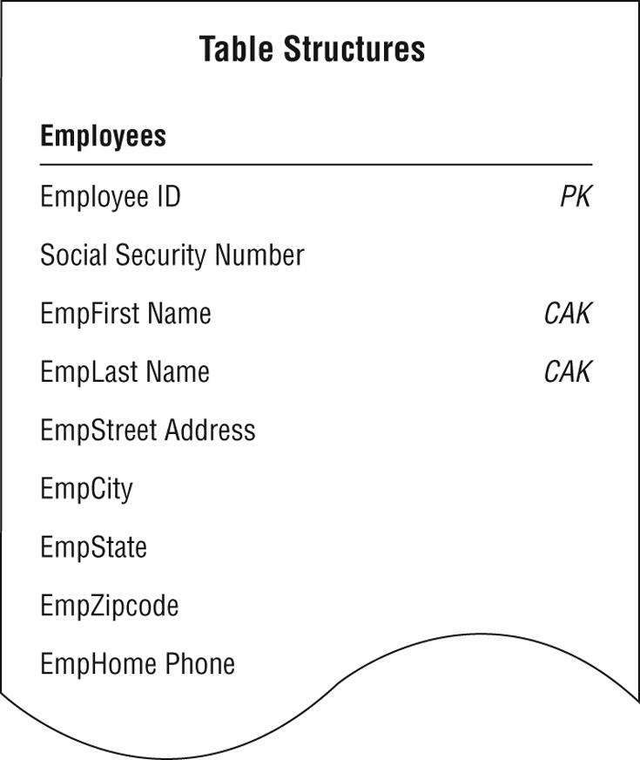
Alternate key (AK) and non-key
Alternate keys = the rest of candidate keys after choosing a primary key
Non-key = any other field that is not a primary key or (composite) alternate key
Figure 8.8 The EMPLOYEES table with designated primary and alternate keys
From Database Design for Mere Mortals®, Third Edition, by Michael J. Hernandez (ISBN: 9780321884497). Copyright 2013 by Michael J. Hernandez. All rights reserved.
Notes:
From Database Design for Mere Mortals®, Third Edition, by Michael J. Hernandez (ISBN: 9780321884497). Copyright 2013 by Michael J. Hernandez. All rights reserved.

Slide 10
MySQL to designate keys → via a constraint
CREATE TABLE person
(person_id SMALLINT UNSIGNED,
fname VARCHAR(20),
lname VARCHAR(20),
eye_color ENUM('BR','BL','GR’),
birth_date DATE,
street VARCHAR(30),
city VARCHAR(20),
state VARCHAR(20),
country VARCHAR(20),
postal_code VARCHAR(20),
CONSTRAINT pk_person PRIMARY KEY (person_id)
);
CREATE TABLE favorite_food
(person_id SMALLINT UNSIGNED,
food VARCHAR(20),
CONSTRAINT pk_favorite_food PRIMARY KEY (person_id, food),
CONSTRAINT fk_fav_food_person_id FOREIGN KEY (person_id) REFERENCES person (person_id)
);

