Slide 1
Ch.9 Field Specifications
[Step 3: Create data structure ]
Is a very important step, saves you later 3x in problem fixing time
You may ask users and management representatives to help with specifications
Specifications help with
  Field integrity (data in each field is consistent and valid)
  Understanding data
  Implementation
From Database Design for Mere Mortals®, Third Edition, by Michael J. Hernandez (ISBN: 9780321884497). Copyright 2013 by Michael J. Hernandez. All rights reserved.
Notes:
From Database Design for Mere Mortals®, Third Edition, by Michael J. Hernandez (ISBN: 9780321884497). Copyright 2013 by Michael J. Hernandez. All rights reserved.

Slide 2
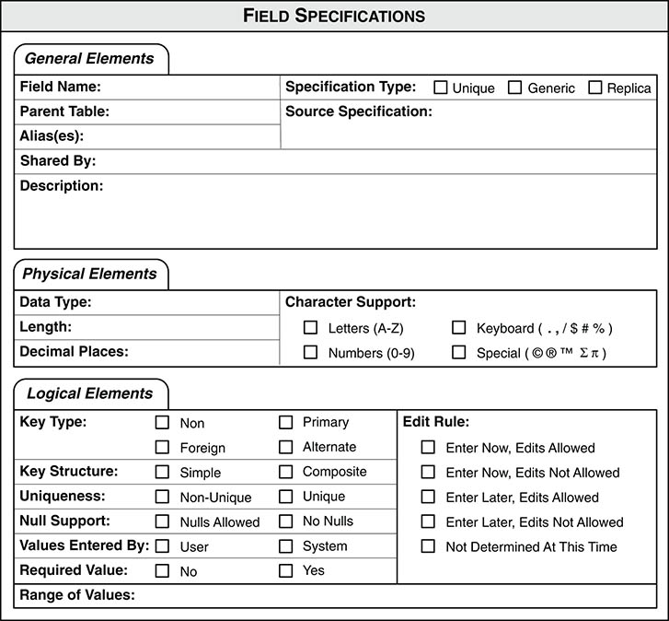
Three categories of field specifications
General Elements: Field Name, Parent Table, Specification Type, Source Specification, Shared By, Alias(es), Description
Physical Elements: Data Type, Length, Decimal Places, Character Support
Logical Elements: Key Type, Key Structure, Uniqueness, Null Support, Values Entered By, Required Value, Range of Values, Edit Rule, Operations Allowed
Figure 9.1 Field Specifications sheet
From Database Design for Mere Mortals®, Third Edition, by Michael J. Hernandez (ISBN: 9780321884497). Copyright 2013 by Michael J. Hernandez. All rights reserved.
Notes:
From Database Design for Mere Mortals®, Third Edition, by Michael J. Hernandez (ISBN: 9780321884497). Copyright 2013 by Michael J. Hernandez. All rights reserved.

Slide 3
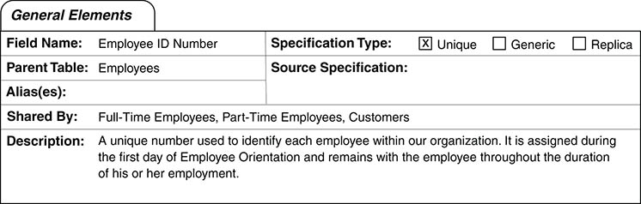
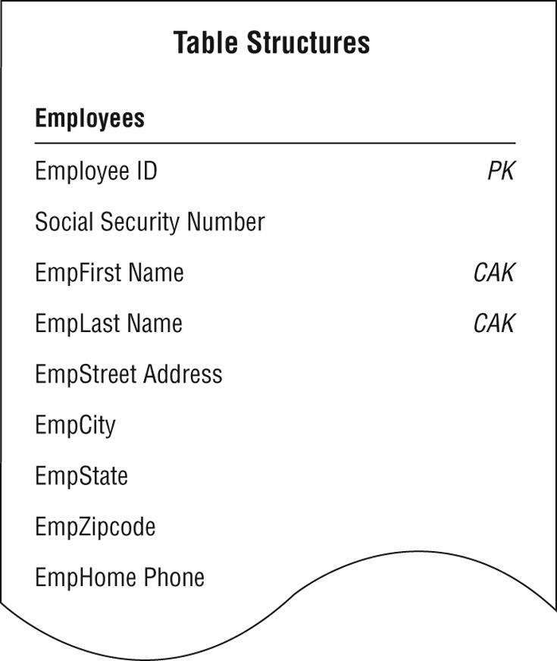
1) General Elements
Figure 9.4 The General Elements category for an EMPLOYEE ID NUMBER field
Description: clear and succinct; no acronyms; no examples; no implementation information; no rephrasing of the field name; etc.
CustLast Name—the last name of a customer.
CustLast Name—the surname of a customer, whether original or by marriage, used in all formal communications and correspondence with that customer.
From Database Design for Mere Mortals®, Third Edition, by Michael J. Hernandez (ISBN: 9780321884497). Copyright 2013 by Michael J. Hernandez. All rights reserved.
Notes:
From Database Design for Mere Mortals®, Third Edition, by Michael J. Hernandez (ISBN: 9780321884497). Copyright 2013 by Michael J. Hernandez. All rights reserved.

Slide 4
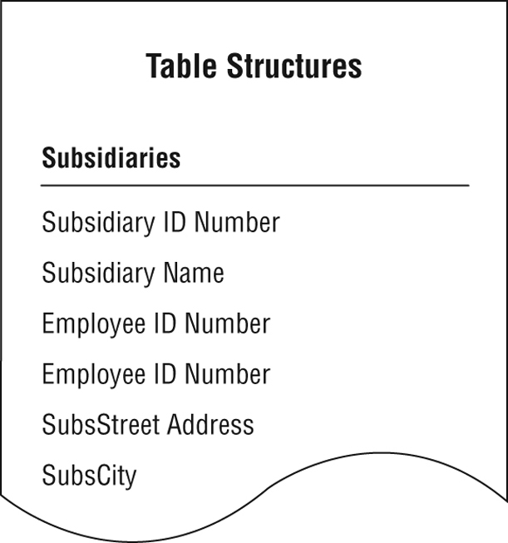
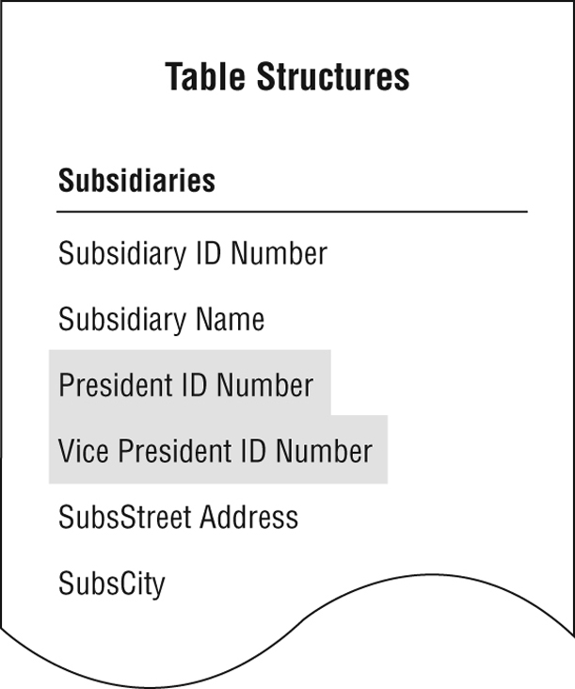
What is an alias?
Figure 9.2 A table requiring two occurrences of the same field
Figure 9.3 Using aliases in place of the EMPLOYEE ID NUMBER fields
Note: avoid aliases if possible!
From Database Design for Mere Mortals®, Third Edition, by Michael J. Hernandez (ISBN: 9780321884497). Copyright 2013 by Michael J. Hernandez. All rights reserved.
Notes:
From Database Design for Mere Mortals®, Third Edition, by Michael J. Hernandez (ISBN: 9780321884497). Copyright 2013 by Michael J. Hernandez. All rights reserved.

Slide 5
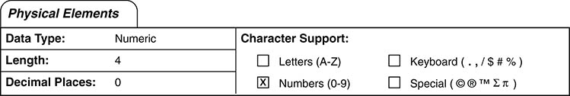
2) Physical Elements
Figure 9.5 The Physical Elements category for an EMPLOYEE ID NUMBER field
From Database Design for Mere Mortals®, Third Edition, by Michael J. Hernandez (ISBN: 9780321884497). Copyright 2013 by Michael J. Hernandez. All rights reserved.
Notes:
From Database Design for Mere Mortals®, Third Edition, by Michael J. Hernandez (ISBN: 9780321884497). Copyright 2013 by Michael J. Hernandez. All rights reserved.

Slide 6
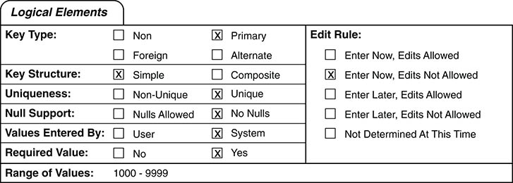
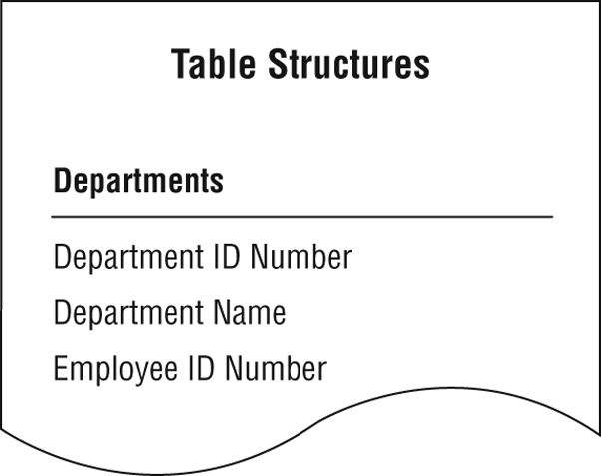
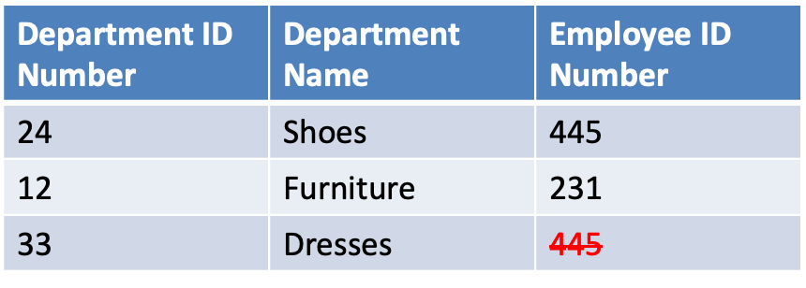
3) Logical Elements
Figure 9.7 The Logical Elements category for an EMPLOYEE ID NUMBER field in table EMPLOYEES
Note 1: PKs are marked as unique (logical); any other field is not unique, in general – see an exception example where an employee can lead only one department.
Figure 9.6 Should the values of EMPLOYEE ID NUMBER be unique?
If Employee ID Number is allowed to work in (or manage) only one department, then it is unique.
Note 2: NULL (==a blank in a record) means missing or unknown value, do NOT use it for ‘None’, ‘Not Applicable’, ‘No Response’ etc. ➔ include these as acceptable range of values
Use NULL, not a blank; use NULL rarely.
From Database Design for Mere Mortals®, Third Edition, by Michael J. Hernandez (ISBN: 9780321884497). Copyright 2013 by Michael J. Hernandez. All rights reserved.
Notes:
From Database Design for Mere Mortals®, Third Edition, by Michael J. Hernandez (ISBN: 9780321884497). Copyright 2013 by Michael J. Hernandez. All rights reserved.

Slide 7
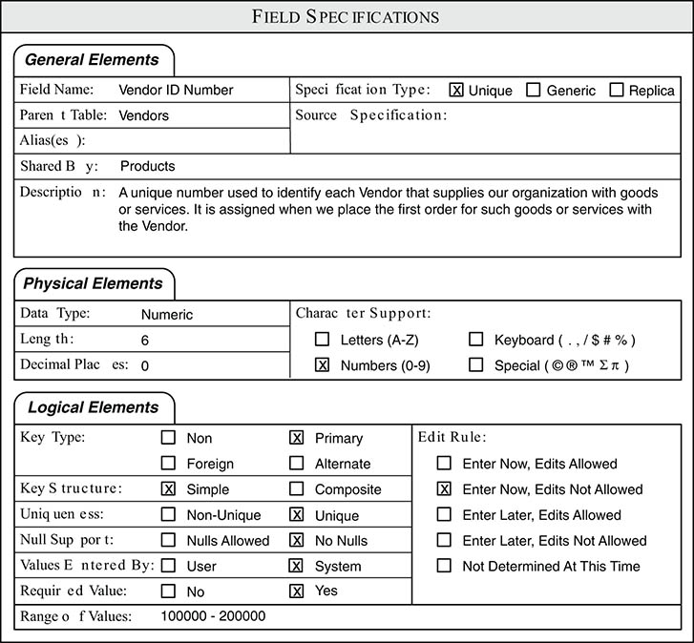
General Elements: unique vs generic vs replica
Mark as unique (in General Elements) PKs and fields that appear only once in the entire database.
Mark as generic a field that is a template for other fields.
Mark replica for
FK and or
for field that is an instance of a generic field.
Required value "Yes”: you cannot leave it blank, you must write something there, even NULL will do it.
"No Nulls”: you are not allowed to write NULL there.
Figure 9.8 Unique field specification for the VENDOR ID NUMBER field
Notes:
From Database Design for Mere Mortals®, Third Edition, by Michael J. Hernandez (ISBN: 9780321884497). Copyright 2013 by Michael J. Hernandez. All rights reserved.

Slide 8
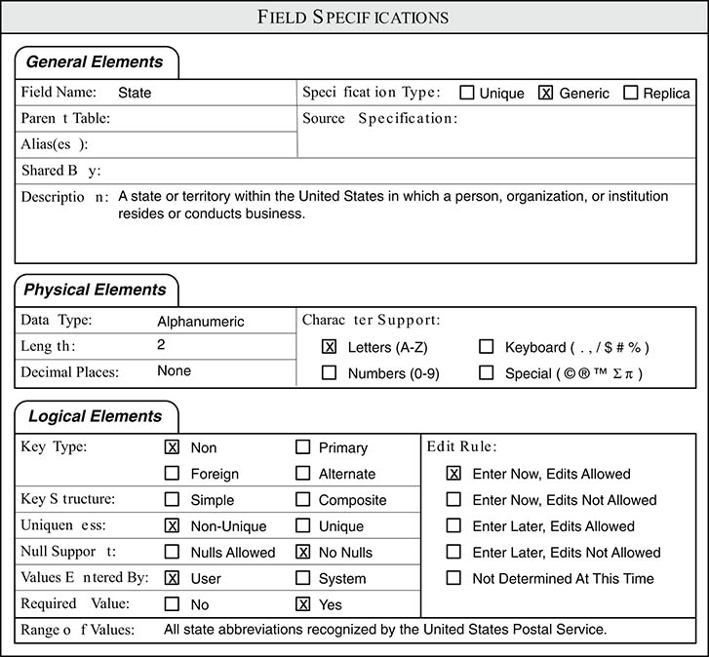
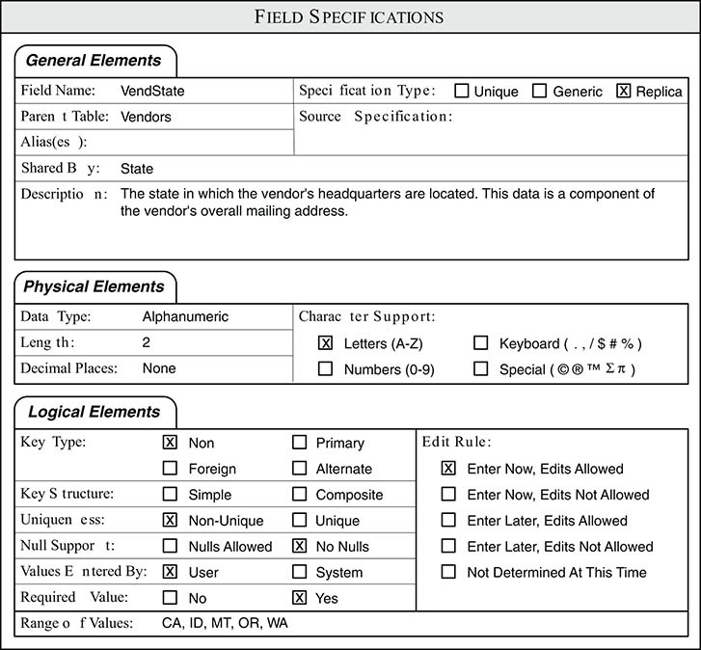



General Elements: generic vs replica
Figure 9.10 Customized Replica field specifications for the VENDSTATE field
Figure 9.9 Generic field specification for a generic STATE field
More specific
Broad
When done with field specifications for all fields (yes, a lot of work, 36 fields in Mike’s Bikes!), run them by representatives of users and management! Next, we create table relations…
Notes:
From Database Design for Mere Mortals®, Third Edition, by Michael J. Hernandez (ISBN: 9780321884497). Copyright 2013 by Michael J. Hernandez. All rights reserved.

Slide 9
MySQL to designate and generate PK
CREATE TABLE animals (
id MEDIUMINT NOT NULL AUTO_INCREMENT,
name CHAR(30) NOT NULL,
PRIMARY KEY (id)
);
INSERT INTO animals (name) VALUES
('dog'),('cat'),('penguin’),('whale'),('ostrich’);
SELECT * FROM animals;

Slide 10
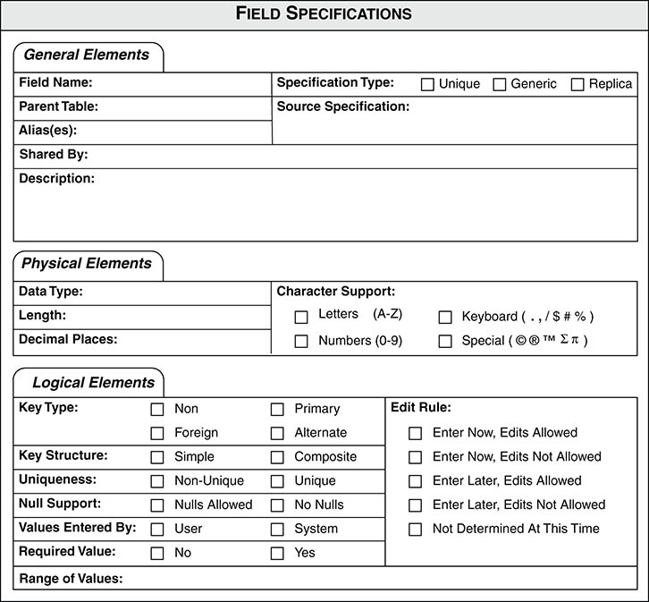
A Sample Field Specifications Form

