Slide 1
INTRO TO DATA SCIENCE · FINAL CAPSTONE
NYC Street Tree
Health Predictor
Predicting tree health from visible features to rank trees by inspection priority
Member 1 · Data & EDA Member 2 · Modeling & Evaluation Member 3 · App, Repo & Presentation
Notes:
Hook: NYC has far more street trees than inspectors. Our app estimates a tree's health from visible features and ranks trees by inspection priority.

Slide 2
The problem we're solving
New York's street trees cool blocks, clean the air, and raise quality of life — but the city has far more trees than inspectors to check them.
We turn the 2015 Street Tree Census into a simple triage signal: a health score that ranks trees by how much attention they may need.
1
2
3
Cooler, healthier blocks
Healthy trees lower heat and clean the air.
Smarter prioritization
Send limited inspection time where it matters most.
Public awareness
Help residents see what drives street-tree health.
Notes:
Impact: triage and awareness. Support prioritization, not replace an arborist.

Slide 3
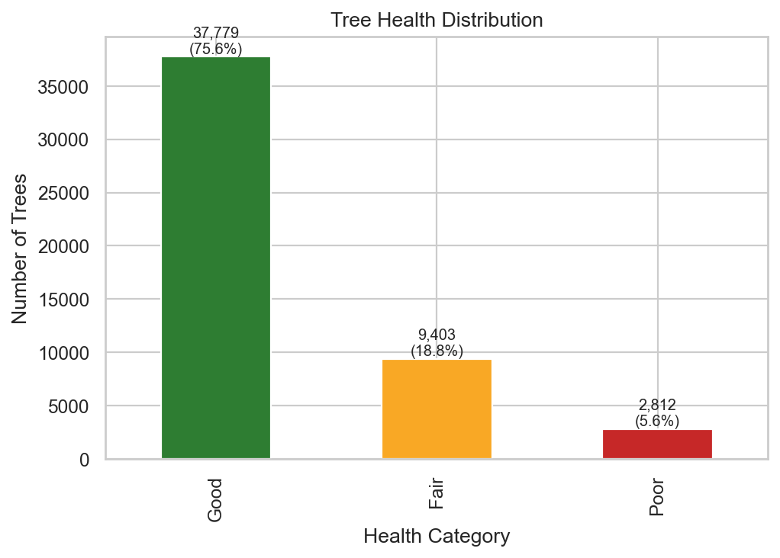
The data: 2015 NYC Street Tree Census
683K
trees in the full NYC Open Data census
~50K
cleaned rows sampled for a fast app
76%
labeled “Good” — heavy class imbalance
Health varies by borough, species, trunk size, and visible problems — the signals we feed the model.
Health distribution of the sampled trees (Member 1, EDA).
Notes:
Member 1 cleaned ~50k rows; ~76% Good. Imbalance is why accuracy alone is misleading.

Slide 4
Our approach: from classification to a triage score
Proposal: classification
Sort each tree into Good / Fair / Poor — three fixed buckets.
What we built: regression
Predict a continuous health score (Poor 0 → Good 2). A score lets the city rank trees by priority and satisfies the required linear model.
Poor ≈ 0
High priority
Fair ≈ 1
Medium priority
Good ≈ 2
Low priority
Two switchable models: a Linear Regression baseline and a tuned Random Forest — explained with SHAP, tuned with Weights & Biases.
Notes:
Be upfront: proposal said classification; we refined to regression for a rankable score that also satisfies the required linear model.

Slide 5
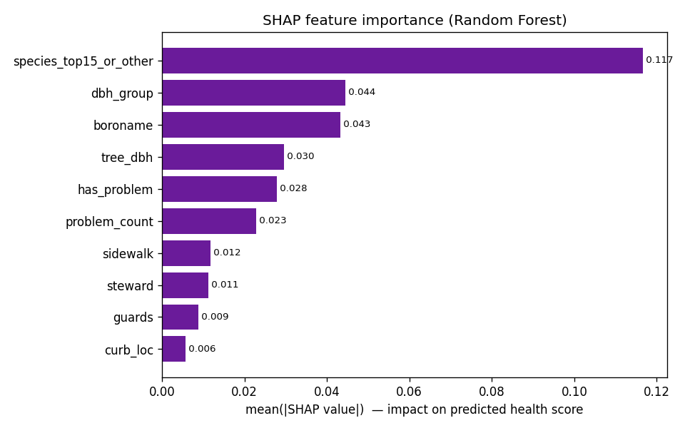
Model results — honestly reported
Model | R² | RMSE | MAE | Mapped acc.*
Linear Regression (baseline) | 0.059 | 0.551 | 0.425 | 0.739
Random Forest (tuned) | 0.087 | 0.543 | 0.416 | 0.738
*Mapped accuracy rounds the score to the nearest band. ~76% Good makes accuracy look high, so we lead with RMSE/MAE and a confusion matrix.
What it means
The Random Forest wins, but the signal is weak (R² ≈ 0.09). Visible features alone don't determine health — so the score is a ranking aid, not a measurement.
SHAP importance: species, diameter group, borough drive the score.
Notes:
RF R² ~0.09 — weak signal. Report RMSE/MAE not accuracy. Drivers: species, dbh, borough.

Slide 6
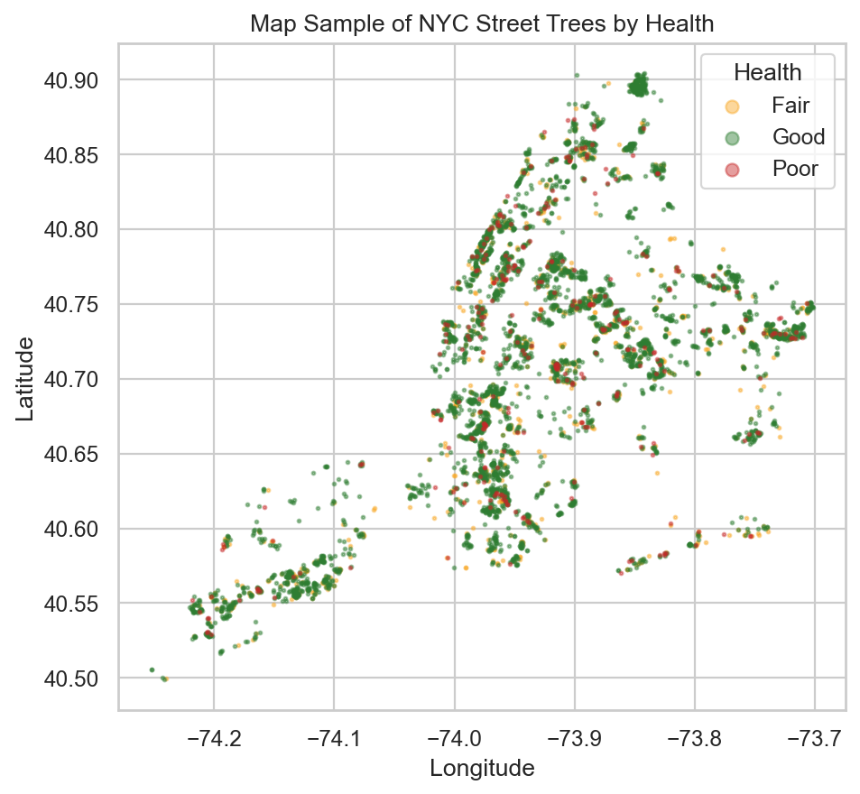
The app: a 6-page interactive tool
1
Introduction
Framing, dataset, why it matters
2
Data Visualization
Distributions, borough & species, map
3
Health-Score Prediction
Enter a tree → score + priority
4
Explainable AI (SHAP)
What drives each prediction
5
Hyperparameter Tuning
How the final model was chosen (W&B)
6
Conclusion
Interactive health map, impact, limits
Built with Streamlit. One command to run:
streamlit run streamlit_app.py
Centerpiece is page 3: enter a tree's visible features and read its score and priority.
Notes:
Walk the pages live. Page 3 is the centerpiece. Show model switch, SHAP, W&B, conclusion map.

Slide 7
Honest limitations
!
Weak signal
Best R² ≈ 0.09 — visible features don't determine health. Use the score to rank, not to diagnose.
!
Class imbalance
~76% Good inflates accuracy, so we report RMSE/MAE and a mapped confusion matrix.
!
Snapshot data
The 2015 census is a one-time snapshot, not a live health feed.
!
Correlation, not cause
Recorded problems are observational and may carry inspection or reporting bias.
An educational triage and learning tool — not an official inspection system.
Notes:
Lead with honesty — these are exactly the limitations the proposal asked us to acknowledge.

Slide 8
Next steps
1
Join newer 311 & health data
Test whether the patterns hold over time.
2
Add neighborhood features
Heat, traffic, and soil may carry more signal.
3
Deploy publicly
A Streamlit Cloud or Hugging Face Space for residents and city teams.
Thank you
Notebooks, models, and the app live in our GitHub repo — questions welcome.
Notes:
Close with next steps + repo. Invite questions. See DEMO_SCRIPT.md for anticipated Q&A.

