Slide 1



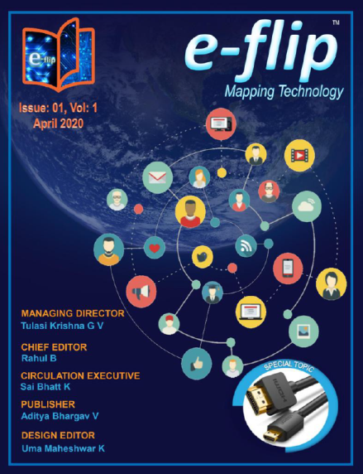






e-flip
™
About Editions Contact us
Mapping Technology
Latest Issue
Voice of People
Ttttttttttttttttttttttttttttttttttttttttttttttttttttttttttttttt
Ttttttttttttttttttttttttttttttttttttttttttttttttttttttttttttttt
Tttttttttttttttttttttttttttttttttttttttttttttttttttttttttttttttttttttttttttttttttttttttttttttttttttttttttttttttttttttttttttttt
-$$$$$$$$$$$$
$$$$$$$$$$$$
Subscribe to e-flip
CHIEF EDITOR
MANAGING DIRECTOR
Rahul B
Tulasi Krishna G V
DESIGN EDITOR
PUBLISHER
Aditya Bhargav V
CIRCULATION EXECUTIVE
Uma Maheshwar K
Sai Bhatt K

Slide 2
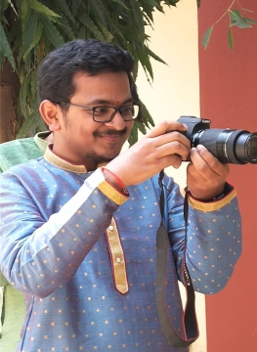
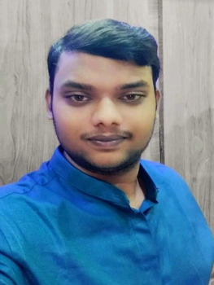
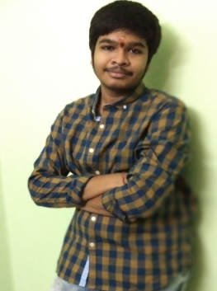
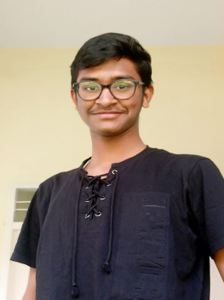


e-flip
™
About Editions Contact us
Mapping Technology
Team Talk………..
It is well known that, the cardinal virtues of human life are wisdom,
temperance, justice and courage. All these four values can be attained
through education. Education is not only for imparting knowledge but
also for learning.
Believing these base lines, our team had decided to start a tech
magazine, e–flip to disseminate ever changing technology in general and electronics in particular.A farmer just plants or sows the seed but the nature nurtures it, in the same way the idea of ours was nurtured by our teachers and stood as a support in making our thoughts into reality.
The main aim of e–flip is to deliver the state–of– art information about the existing-upcoming technologies and enlighten about working principles. Certainly our readers will be enriched with ample amount of knowledge regarding the technology stuff, supporting them to write their own articles, giving them privilege to present their articles in e–flip.
Many hurdles were surrounded on the way of refining our thoughts in publishing and marketing. But the founder’s aim and vision cleared all the hurdles and today e–flip is at its final phase. The founder's vision to compile all their editorial thoughts onto papers and the papers into e–flip.
Focusing on the riddles of technologies and solving them with similar brains is the underlying magic of e–flip. The readers feel the content to be easier and understandable.
Hope the reader community supports us in the coming journey. The editorial board promises the readers that rich and trusted content in e–flip will be delivered every month.
SAI BHATT K
TULASI KRSIHNA G V
ADITYA BHARGAV V
RAHUL B
UMA MAHESHWAR K
CHIEF EDITOR
MANAGING DIRECTOR
Tulasi Krishna G V
Rahul B
DESIGN EDITOR
PUBLISHER
Aditya Bhargav V
CIRCULATION EXECUTIVE
Uma Maheshwar K
Sai Bhatt K eflipmagazine@gmail.com +91 62814 49854
Sai Bhatt K

Slide 3

e-flip
™
About Editions Contact us
Mapping Technology
Click here to subscribe to e-flip
To Subscribe, Publish Your Article,
Feedback, Suggestions & Complaints Please Contact
Publish
Your
Article
Sai Bhatt K
eflipmagazine@gmail.com
+91 62814 49854
Quiz
MANAGING DIRECTOR
CHIEF EDITOR
Tulasi Krishna G V
Rahul B
DESIGN EDITOR
PUBLISHER
Aditya Bhargav V
CIRCULATION EXECUTIVE
Uma Maheshwar K
Sai Bhatt K

Slide 4
e-flip
™
About Editions Contact us
Mapping Technology
MANAGING DIRECTOR
CHIEF EDITOR
Tulasi Krishna G V
Rahul B
DESIGN EDITOR
PUBLISHER
Aditya Bhargav V
CIRCULATION EXECUTIVE
Uma Maheshwar K
Sai Bhatt K

