Slide 1
ScholaHub
crowdfunding for schools
Kim S., Ryan R., Jillian L., Mika K.

Slide 2
Introduction

Slide 3
Problems
Community donors are unaware of local school fundraising/volunteer events.
Most crowdfunding websites are not focused around the school funding idea.

Slide 4

What Can We Do to Help?
How can we make it easier for the community to get involved and for schools to ask for their involvement?
A “dream school” would be a community of teachers, school leaders and administrators who share a goal of nurturing, supporting and encouraging each and every one of its students. This requires components of a “dream community” as a prerequisite — with all members of a community contributing to and caring about the development of its youth.
-Rahila Simzar
Inspiration
Methods for a Deeper Dive:
Survey
Interview
Comparative Review
“[S]chool for life,” shifts the goal of schooling away from the achievement of standardized learning outcomes toward making a positive impact on the economic and social well-being of students and their communities.
-Mark J. Epstein & Kristi Yuthas

Slide 5

Research Questions
Who donates to schools?
Who doesn’t donate to schools?
Why do people choose to donate or not?
How do they feel about current means of asking for donations?
What are the challenges faced in asking for and donating to projects?
Would they like to be more involved in their local schools?
Do they feel like the school and the community are connected?
Would they like to know more about the projects requiring funding at their local schools?
Would knowing about school projects increase the likelihood of donation?
What challenges to those requesting donations face?
What tools already exist to help people get donations?

Slide 6
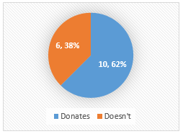
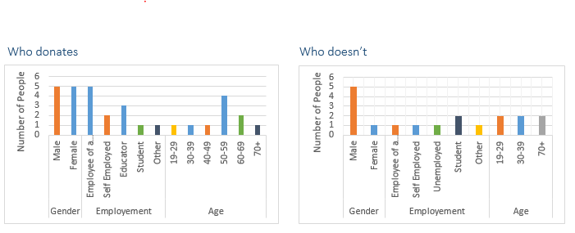
Who Donates? Who Doesn’t?
Survey
Common programs people said they would donate to:
Science
Arts
Increasing teaching quality/capability
Physical Education
Student groups (garden club, volunteering, leadership, etc…)
Most people have donated to a school fundraiser in the past. On average those who donated rated the experience of being asked to donate 3.2 on a scale of 1 (poor) to 5 (excellent).
Most criticisms of school fundraising centered around not enjoying being asked to buy things by students and not knowing where the money was going.
There was interest in knowing what the local schools were working on, 13 out of 16 people, but less interest in being more involved in local schools, 7 out of 16.
When asked about donating to a school proposing an interesting project, outside of their local area, 13 out of 16 people said they would donate.

Slide 7

Who Asks For Involvement? How? Challenges?
Who?
School Programs
Clubs
Special Trips
Sports and Academic Teams
Challenges?
Healthy food initiatives make selling junk food more difficult
Difficult to come up with fresh fundraising ideas that will consistently get results
Donors are often parents of children in the school
Online crowdfunding is a popular idea, but require someone to be familiar with an existing platform to ask for help
How?
School vending machines
Selling goods
Community Activities (car wash, yard work, etc…)

Slide 8
What Already Exists?
 | Charge fees | Education Focus? | Strengths | Weaknesses | Tools to Connect to Communities
GoFundMe | Yes | Category | Not too many restrictions. No deadlines. Ease of use. | No community connections. Fees. | No
Kickstarter | Yes | No, focused on creative projects. | Theme of everyone getting a chance. | No education support. No money if goal not reached. | No
IncitED | Yes | Yes | Various education-focused categories. Flexible fees. | No community connection. | No
USeed | No fees | Yes. College level. Community projects through schools | School profiles & application process are good for legitimacy. | Application process may be restrictive. | Easily connect to school web site
Many crowdfunding tools online
Nothing specifically for K-12
Lack of focus on fostering community
Can’t donate time, only money

Slide 9


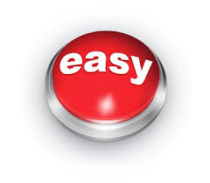
Research Summary
3 Primary Takeaways
Existing crowdfunding options don’t focus on building communities around K-12 schools
People are interested in what schools are working on
Schools need a simple, effective way to get money and volunteers

Slide 10
Target Users
School administrators.
Start school profiles.
Administer projects.
Approve volunteers through application process.
Faculty & advisors.
Propose and run projects.
Provide updates and information to donors and volunteers.
Community donors & volunteers.
Our primary target audience.
Donate money and/or time as a volunteer.
Receive information on local schools and events.

Slide 11

The Involved Local Donor
“I want to be notified of schools that need my support through the convenience of my own computer and devices.”
Tasks:
Search for local school projects.
Securely donate to projects.
Track the progress of projects donated to.
Connect with schools in her community.
Personal info:
Name:
Age:
Gender:
Race:
Family Status:
Professional Info:
Current job:
Experience:
Field:
Degree:
Helen Jenkins
59
Female
White
Married, 3 adult children
Retired
Worked in management for 20 years.
Bank management MBA
Goals:
Wants a convenient way to donate to school programs.
Wants to see children get all of the books and supplies they need.
Wants to feel like she has given back the support she has gotten.
Profile:
Helen is a retired bank manager who was able to fund her MBA through scholarships provided by generous community members. She now makes it a goal of hers to support others in their pursuit of education. Helen is looking for a convenient way to find and support the projects and needs of the schools in her own community and in the neighborhood where she grew up. Lately, she has also been considering donating her time by providing food and transportation for education-related events.
Tech usage:
Considers herself comfortable with technology.
Owns her own desktop.
Has used an android phone for 5 years.
Recently received an iPad from her youngest son and is still getting used to an Apple product.

Slide 12
User Feedback
What users liked:
Being able to search and explore without signing up.
Some users liked having monthly sign up in donation process.
The messaging feature is a convenient way to contact project leaders.

Slide 13
User Feedback
What users did not like:
Wanted to be able to donate without signing up.
Wanted a functioning search option from the Donor Dashboard.
Wanted clearer separations between donating, volunteering and monthly donation sign up.
Clarification on who is the main point of contact for certain projects or school hubs.

Slide 14
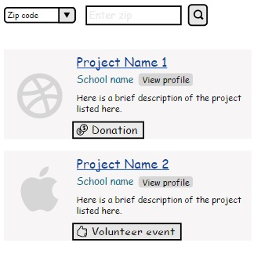
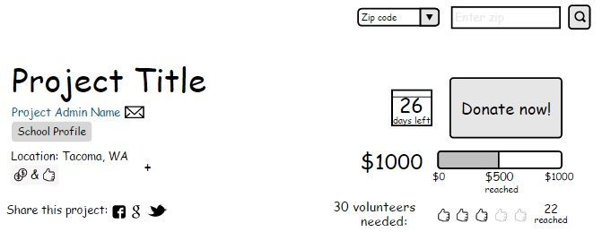
Some of the old designs:
Volunteer information was a little hard to see.
Volunteering application was included with monetary donation.
Volunteer sign up process not clear.
Not completely clear who the project admin was.
Outlines made money/volunteer labels look like clickable buttons.

Slide 15
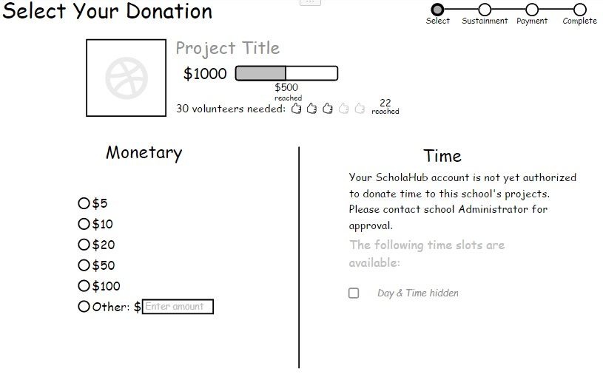
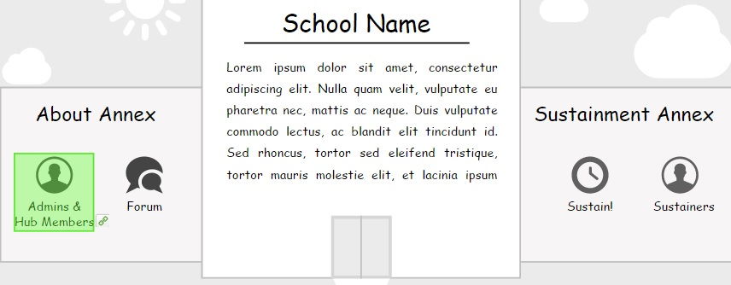
Some of the old designs:
User’s were not immediately aware of what Sustainment was.
Button selection and language of the labels were not optimized.
School vs. web site admins?
Needed a clear place to sign up to volunteer.
Money donation and volunteer signup were on the same page.
Time donation was easy to miss in the process.
Volunteer approval process was not clear.

Slide 16
Final Design
Scenarios:
Searching by zip, city and school name.
Signing up & signing in.
Completing a donation.
Viewing the donor dashboard.
Signing up to volunteer.

Slide 17
Mock Up
Link:
https://moqups.com/Rainmatter/V0gpufEI/p:a946862bc

Slide 18
Moving Forward...
Things to add in the future:
Ability to follow specific schools on dashboard.
Pages for other types of users.
More social media tools.
Tools to help schools promote projects and events.

Slide 19
Reflections
Jillian
Ryan
Mika
Kim

