Slide 1

Learning Informative Priors from Heterogeneous Domains to Improve Recommendation in Cold-Start User Domains
Presenter: Liang Hu
Liang Hu, Jian Cao, Guandong Xu, Longbing Cao, Zhiping Gu, Can Zhu: Personalized recommendation via cross-domain triadic factorization. WWW 2013
Liang Hu, Longbing Cao, Jian Cao, Zhiping Gu, Guandong Xu, Dingyu Yang: Learning Informative Priors from Heterogeneous Domains to Improve Recommendation in Cold-Start User Domains. ACM Trans. Inf. Syst., (2016)

Slide 2
Outline
Background
Current Methods
Weighted Irregular Triadic Factorization
Experimental Results
Further Discussion
Conclusion

Slide 3
Background
Current Methods
Weighted Irregular Triadic Factorization
Experimental Results
Further Discussion
Conclusion

Slide 4


Leaving From Information Age to Recommendation Age
With the information explosion, quick finding the desired information has become more important.
Modern recommender systems are the evolution of intelligent systems and information retrieval systems.
Notes:
Easily lost in huge amount of products for choices

Slide 5
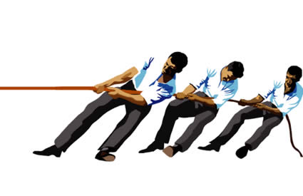


Pull Age to Push Age
Notes:
Easily lost in huge amount of products for choices

Slide 6

Data Characteristics
Power law (Long tail distribution)
Data associated with the majority of users are insufficient and even absent in real world.
Cold Start
System cannot do recommendation for new users due to the lack of data.

Slide 7
Cross-Domain Collaborative Filtering
Leverage information from multiple related domains
The basic idea is based on the assumption of the existence of multiple related domains and the user preference from each domain is not independent

Slide 8
Background
Current Methods
Weighted Irregular Triadic Factorization
Experimental Results
Further Discussion
Conclusion

Slide 9







Matrix Factorization
$$U^{T}$$
R
 |  | 5 |  |  | 4 |  | 2
 | 5 |  |  |  |  | 5 |  | 1
 |  | 4
2 |  |  | 3 |  | 5 |  |  |  | ?
 | 1 |  |  | 5 |  | 4 |  |  | 1
 |  | 4
 | 2 |  |  |  |  | 4
 |  | 3 |  |  |  |  |  |  | 5
$$R_{u,v}≈u^{T}v$$
$$u$$
users
$${\hat{R}}_{u,v′}≈u^{T}v′$$
items
$V$
$$v$$
$v$’

Slide 10
MF based CDCF
Concatenating the rating matrices for all domains

Slide 11
Disadvantages
Each domain may be quite heterogeneous
E.g. the factor of color has big impact on the user preference in the domain of cloth
but hardly has impact on the user preference in domain of book
Above methods using the single domain model implicitly assume the homogeneity of items.
Obviously, such assumption may decrease the accuracy of prediction due to the heterogeneities of different domains.

Slide 12
MF based Transfer Learning
Transfer the knowledge learned from the auxiliary domain to the target domain [Pan, et al. 2010] [Singh and Gordon, 2008].
Assume dense user data in the auxiliary domain
The user-factor vectors are co-determined by the feedback in auxiliary and target domains

Slide 13

Deficiency
Blind Transfer
If no data is available for a user in the target domain (marked with a red box), the user-factor vector $u_{i}$ is simply determined by the data in the auxiliary domain.
If $u_{i}$ is transferred to the target domain and interacts with heterogeneous item factors, it may yield a poor prediction.

Slide 14
Modeling Domain Heterogeneity
Jointly leveraging the complementary data from multiple domains
Domain factors is an essential element in cross “domain” problem to model domain heterogeneity
Triadic relation user-item-domain to reveal the domain-specific user preference

Slide 15
Background
Current Methods
Weighted Irregular Triadic Factorization
Experimental Results
Further Discussion
Conclusion

Slide 16
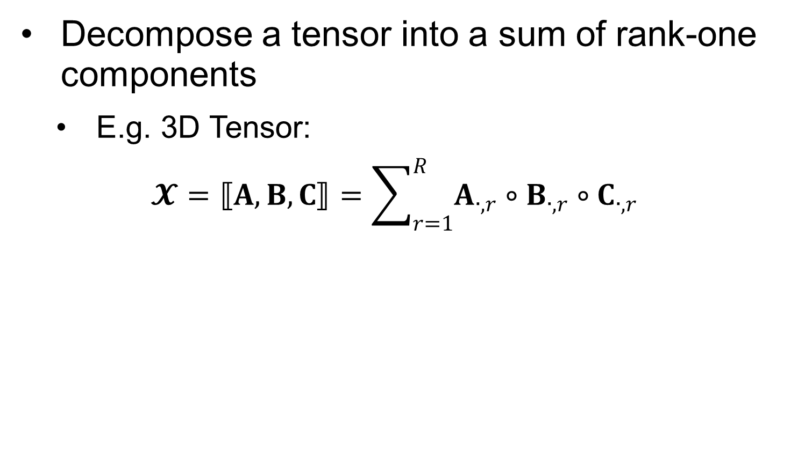
Canonical Decomposition/Parallel Factor Analysis
Decompose a tensor into a sum of rank-one components
E.g. 3D Tensor:
$$𝓧=⟦A,B,C⟧=\sum_{r=1}^{R}{A_{∙,r}∘B_{∙,r}∘C_{∙,r}}$$

Slide 17
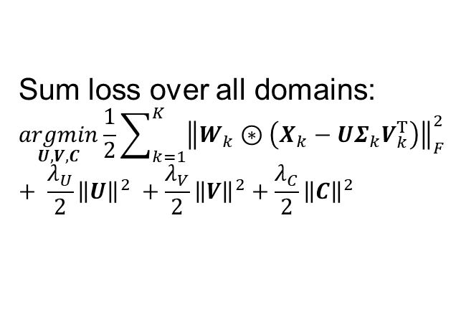

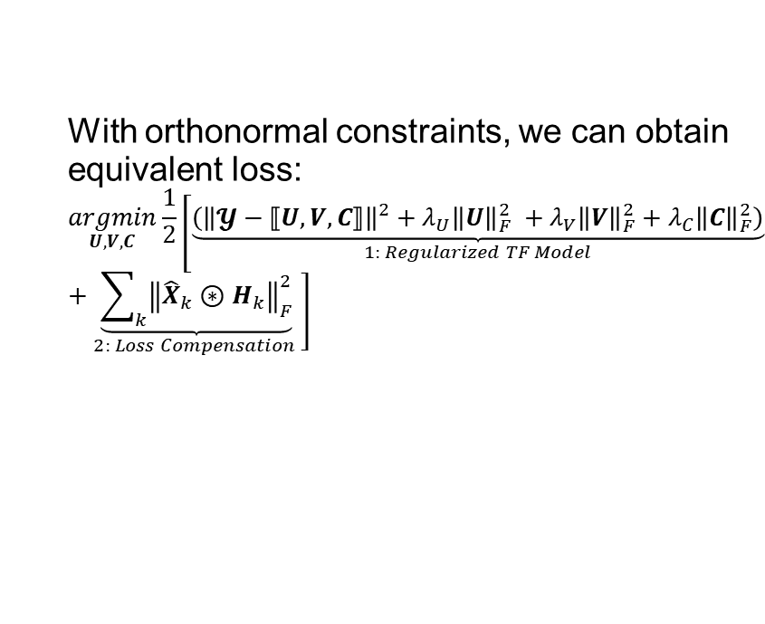
Irregular Tensor Factorization
With orthonormal constraints, we can obtain equivalent loss:
$$\underset{U,V,C}{argmin}\frac{1}{2}\left[\underset{1: Regularized TF Model}{\underbrace{\left({\left\|𝓨−⟦U,V,C⟧\right\|}^{2}+λ_{U}{\left\|U\right\|}_{F}^{2} +λ_{V}{\left\|V\right\|}_{F}^{2}+λ_{C}{\left\|C\right\|}_{F}^{2}\right)}}+\underset{2: Loss Compensation }{\underbrace{\sum_{k}{{\left\|{\hat{X}}_{k}⊛H_{k}\right\|}_{F}^{2}}}}\right]$$
Sum loss over all domains:
$$\underset{U,V,C}{argmin}\frac{1}{2}\sum_{k=1}^{K}{{\left\|W_{k}⊛\left(X_{k}−UΣ_{k}V_{k}^{T}\right)\right\|}_{F}^{2}}+ \frac{λ_{U}}{2}{\left\|U\right\|}^{2} +\frac{λ_{V}}{2}{\left\|V\right\|}^{2}+\frac{λ_{C}}{2}{\left\|C\right\|}^{2}$$
$$UΣ_{k}V_{k}^{T}$$
Unfortunately, the number of items for each domain is inconsistent to apply CP factorization.

Slide 18

Weight Matrix Configuration
Rating Data
$$w_{k,i,j}=\left\{\begin{matrix}1 & \left(k,i,j\right) is an observation \\ a & \left(k,i,j\right) is a noisy example \\ 0 & else\end{matrix}\right.$$

Slide 19
One-class Data
One-class feedback
E.g. purchase record matrix marks entries with 1 to indicate the buy and the rest of data are unknown
It does not have observed negative examples so one-class data is purely indiscriminate
Implicit feedbacks can indirectly reflect opinions through user behavior
Users may deliberately choose to access which items [Marlin et al, 2007]

Slide 20
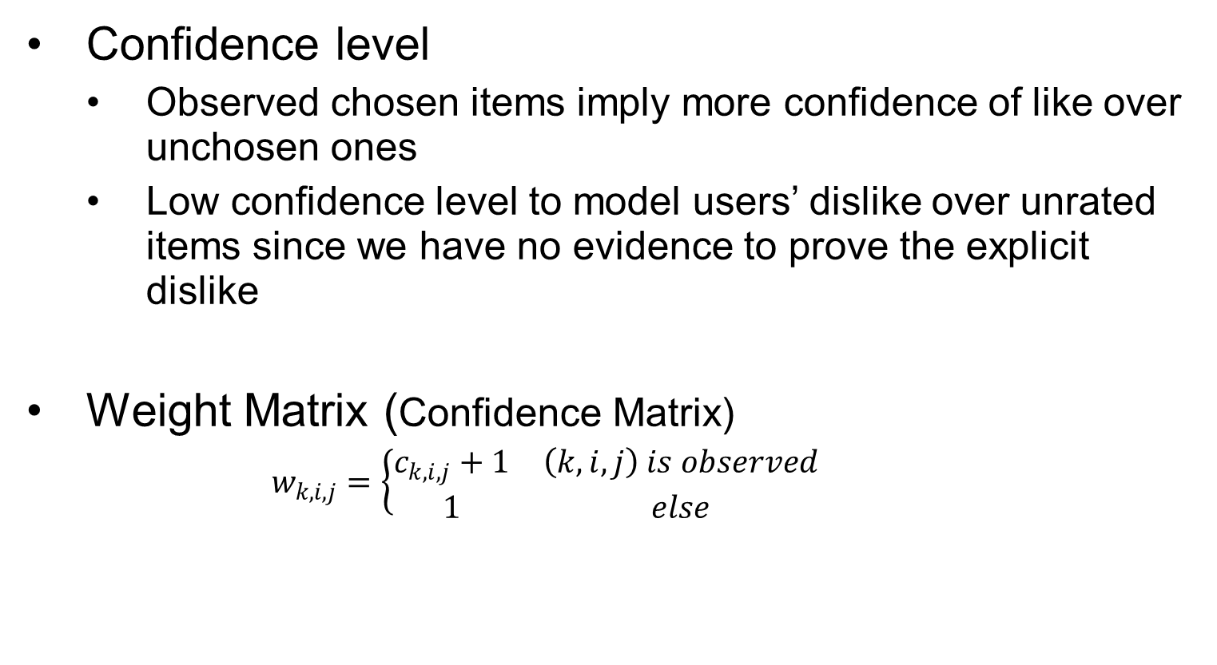
Confidence Modeling
Confidence level
Observed chosen items imply more confidence of like over unchosen ones
Low confidence level to model users’ dislike over unrated items since we have no evidence to prove the explicit dislike
Weight Matrix (Confidence Matrix)
$$w_{k,i,j}=\left\{\begin{matrix}c_{k,i,j}+1 & \left(k,i,j\right) is observed \\ 1 & else\end{matrix} \right.$$

Slide 21
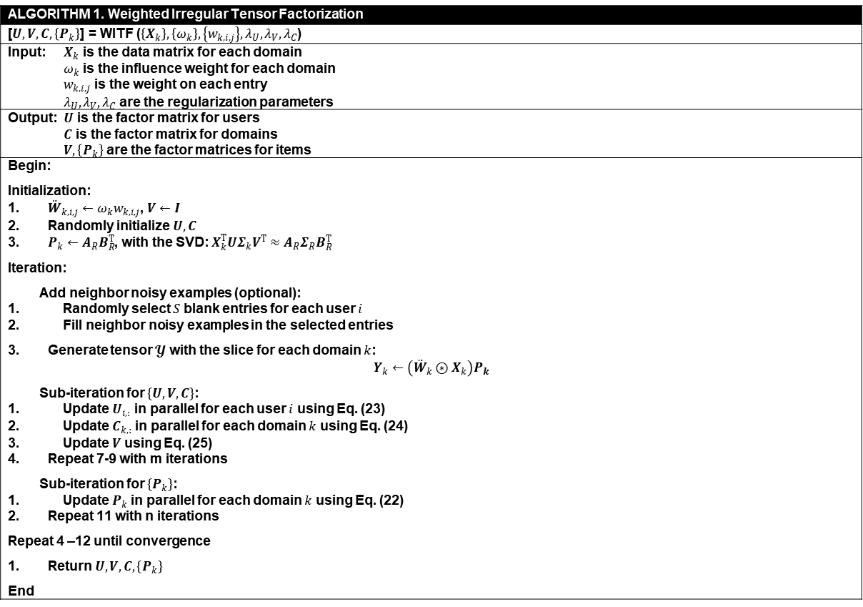
Learning Algorithm
ALGORITHM 1. Weighted Irregular Tensor Factorization
[$U,V,C,\left\{P_{k}\right\}$] = WITF ($\left\{X_{k}\right\},\left\{ω_{k}\right\},\left\{w_{k,i,j}\right\},λ_{U},λ_{V},λ_{C}$)
Input: $X_{k}$ is the data matrix for each domain $ω_{k}$ is the influence weight for each domain $w_{k,i,j}$ is the weight on each entry $λ_{U},λ_{V},λ_{C}$ are the regularization parameters
Output: $U$ is the factor matrix for users $C$ is the factor matrix for domains $V,\left\{P_{k}\right\}$ are the factor matrices for items
Begin: Initialization: ${\ddot{W}}_{k,i,j}←ω_{k}w_{k,i,j}$, $V←I$ Randomly initialize $U,C$ $P_{k}←A_{R}B_{R}^{T}$, with the SVD: $X_{k}^{T}UΣ_{k}V^{T}≈A_{R}Σ_{R}B_{R}^{T}$ Iteration: Add neighbor noisy examples (optional): Randomly select $S$ blank entries for each user $i$ Fill neighbor noisy examples in the selected entries Generate tensor $𝓨$ with the slice for each domain $k$: $$Y_{k}←\left({\ddot{W}}_{k}⊛X_{k}\right)P_{k}$$ Sub-iteration for $\left\{U,V,C\right\}$: Update $U_{i,:}$ in parallel for each user $i$ using Eq. (23) Update $C_{k,:}$ in parallel for each domain $k$ using Eq. (24) Update $V$ using Eq. (25) Repeat 7-9 with m iterations Sub-iteration for $\left\{P_{k}\right\}$: Update $P_{k}$ in parallel for each domain $k$ using Eq. (22) Repeat 11 with n iterations Repeat 4 –12 until convergence Return $U,V,C,\left\{P_{k}\right\}$ End

Slide 22



Post Learning: Refit Target Domain
$${\hat{X}}_{k}=UΣ_{k}{\left(P_{k}V\right)}^{T}=U_{k}^{T}V_{k}$$
$$μ_{i}=U_{k,:,i} ν_{j}=V_{k,:,j}$$
Refit domain data with weighted regularized MF (WRMF)
$$J=\underset{U,V}{argmin}\frac{1}{2}\left[\sum_{ij}{w_{ij}{\left(Y_{ij}−u_{i}^{T}v_{j}\right)}^{2}}+τ_{U}\sum_{i}{{\left\|u_{i}−μ_{i}\right\|}^{2}}+τ_{V}\sum_{j}{{\left\|v_{j}−ν_{j}\right\|}^{2}}\right]$$
$$u_{i}←{\left(τ_{U}I+\sum_{j}{w_{ij}v_{j}v_{j}^{T}}\right)}^{−1}\left(τ_{U}μ_{i}+\sum_{j}{w_{ij}Y_{ij}v_{j}}\right)$$
$$v_{j}←{\left(τ_{V}I+\sum_{i}{w_{ij}u_{i}u_{i}^{T}}\right)}^{−1}\left(τ_{V}μ_{j}+\sum_{i}{w_{ij}Y_{ij}u_{i}}\right)$$

Slide 23
Background
Current Methods
Weighted Irregular Triadic Factorization
Experimental Results
Further Discussion
Conclusion

Slide 24
Rating Prediction on Epinions.com
Statistics of data for evaluation
Covering 5 domains
Domain | # Items | # Ratings / # Users | # Ratings / # Items | Sparsity
Kids & Family* | 3,769 | 4.9309 | 9.9077 | 0.0013
Hotels & Travel* | 2,545 | 3.9210 | 11.6676 | 0.0015
Restaurants & Gourmet | 2,543 | 3.3394 | 9.9446 | 0.0013
Wellness & Beauty | 3,852 | 3.5481 | 6.9756 | 0.0009
Home and Garden | 2,785 | 2.6003 | 7.0707 | 0.0009

Slide 25
Rating Prediction on Epinions.com
RMSE of comparative methods (the smaller the better)
Target Domain Method | Kids & Family |  | Hotels & Travel
 | TR-80% | TR-50% | TR-80% | TR-50%
kNN-CDCF | 1.2562 | 1.3016 | 1.1605 | 1.3338
PMF-CDCF | 1.1719^ | 1.3547^ | 1.1260^ | 1.2925^
CMF | 1.1312* | 1.2908* | 1.0805* | 1.2457*
PARAFAC2 | 1.1102* | 1.1458* | 1.0647* | 1.0891*
CDTF | 1.0968* | 1.1219* | 1.0351* | 1.0585*
WITF | 1.1043* | 1.1293* | 1.0375* | 1.0619*
WITF+WRMF | 1.0563** | 1.0835** | 0.9983** | 1.0284**
RMSEs of Comparison CDCF Methods on Epinions Dataset
^ baseline, * p<0.01, ** smallest p

Slide 26
Rating Prediction on Epinions.com
Statistics of Testing Users Grouped by the Number of Ratings
Target Domain Group | # Ratings | Kids & Family | Hotels & Travel
 |  | # testing users in TS-50% | # testing users in TS-50%
Experienced | > 20 | 120 | 55
Little Experienced | 6 ~ 20 | 816 | 517
Cold-Start | 1 ~ 5 | 2,260 | 2,807
Fully Cold-Start | 0 | 695 | 1,072

Slide 27
Rating Prediction on Epinions.com
RMSE of comparative methods (the smaller the better)

Slide 28
Click Prediction on Tmall.com
One-class problem
Domain | # Items | # Clicks / # Users | # Clicks / # Items | Sparsity
D1* | 8,179 | 23.2003 | 19.7170 | 0.0028
D2* | 6,940 | 18.5455 | 18.5749 | 0.0027
D3 | 5,561 | 22.5005 | 28.1246 | 0.0040
D4 | 6,145 | 16.0606 | 18.1671 | 0.0026

Slide 29
The Mean AP@5,10 and nDCG@5,10
Target Domain Method | D1
 | TR-80% |  |  |  | TR-50%
 | AP@5 | AP@20 | nDCG@5 | nDCG@20 | AP@5 | AP@20 | nDCG@5 | nDCG@20
Most-Pop | 0.0161^ | 0.0175^ | 0.0269^ | 0.0382^ | 0.0322^ | 0.0223^ | 0.0567^ | 0.0577^
N-CDCF | 0.0252* | 0.0240* | 0.0441* | 0.0465* | 0.0352* | 0.0210 | 0.0604* | 0.0534
MF-IF | 0.0263* | 0.0293* | 0.0432* | 0.0631* | 0.0455* | 0.0324 | 0.0813* | 0.0854*
MF-IF-CDCF | 0.0242* | 0.0258* | 0.0399* | 0.0552* | 0.0431* | 0.0296 | 0.0763* | 0.0775*
PARAFAC2 | 0.0213* | 0.0226* | 0.0350* | 0.0476* | 0.0395* | 0.0267 | 0.0691* | 0.0687*
CDTF-IF | 0.0258* | 0.0276* | 0.0425* | 0.0587* | 0.0423* | 0.0294 | 0.0758* | 0.0767*
WITF | 0.0267* | 0.0285* | 0.0451* | 0.0623* | 0.0484* | 0.0340 | 0.0849* | 0.0872*
WITF+WRMF | 0.0271** | 0.0290** | 0.0462** | 0.0643** | 0.0486** | 0.0343** | 0.0851** | 0.0879**
Target Domain Method | D2
 | TR-80% |  |  |  | TR-50%
 | AP@5 | AP@20 | nDCG@5 | nDCG@20 | AP@5 | AP@20 | nDCG@5 | nDCG@20
Most-Pop | 0.0175^ | 0.0194^ | 0.0288^ | 0.0424^ | 0.0297^ | 0.0231^ | 0.0530^ | 0.0591^
N-CDCF | 0.0281* | 0.0261* | 0.0435* | 0.0520* | 0.0228 | 0.0243* | 0.0380 | 0.0357
MF-IF | 0.0320* | 0.0354* | 0.0528* | 0.0747* | 0.0501* | 0.0370* | 0.0872** | 0.0924**
MF-IF-CDCF | 0.0240* | 0.0262* | 0.0397* | 0.0563* | 0.0380* | 0.0285* | 0.0675 | 0.0724*
PARAFAC2 | 0.0215* | 0.0234* | 0.0356* | 0.0506* | 0.0327* | 0.0251* | 0.0589* | 0.0638*
CDTF-IF | 0.0326* | 0.0337* | 0.0526* | 0.0662* | 0.0454* | 0.0316* | 0.0761* | 0.0750*
WITF | 0.0338* | 0.0363* | 0.0552* | 0.0753* | 0.0538* | 0.0383* | 0.0905* | 0.0909*
WITF+WRMF | 0.0343** | 0.0369** | 0.0556** | 0.0758** | 0.0542** | 0.0386** | 0.0907** | 0.0915*

Slide 30
Background
Current Methods
Weighted Irregular Triadic Factorization
Experimental Results
Further Discussion
Conclusion

Slide 31
The way we learn English
lobster
龙虾

Slide 32
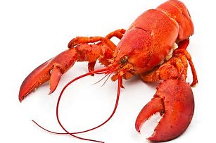
The way Sabrina learns Chinese and English
Sabrina was a girl born in Australia in a Chinese family.
She receives information from her parents in Chinese
She receives information from TV and teachers in English
lobster
龙虾

Slide 33

How to understand Alien language
a2igpfv
What’s the meaning?

Slide 34
Recall the way Sabrina learns Chinese and English
lobster
龙虾

Slide 35

Indirect Understanding by Leveraging Cross-domain Knowledge
a2igpfv
星球, 来自于
Planet, Universe

Slide 36
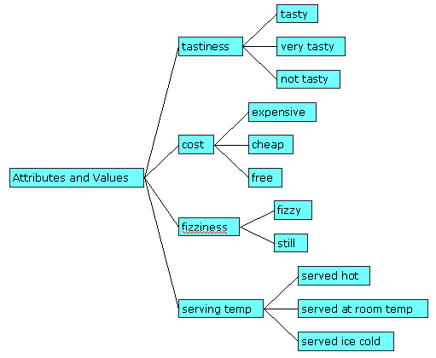







As a Transformation Component
 |  |  | h1
 |  | h2
 | h3
 | h4
$$c_{1}$$
$$c_{3}$$
$$c_{4}$$
$$c_{5}$$

Slide 37
Conclusion
We have entered recommendation age, cross domain learning is a critical task in AI age.
CDCF leverages data over multiple domains to deal with the sparsity and cold-start problems of single domain CF.
WITF addresses an irregular tensor factorization problem where each domain having their specific item set.
WITF may be extended to deal with multi-domain, multi-task learning problems, or integrated into some framework (e.g. deep networks) as a component to modeling higher order interaction over heterogeneous datasets.

Slide 38
Thanks for attention! Question?

