Slide 1
For Gods’ Name
One day of medical student
28th Nov. 2018

Slide 2
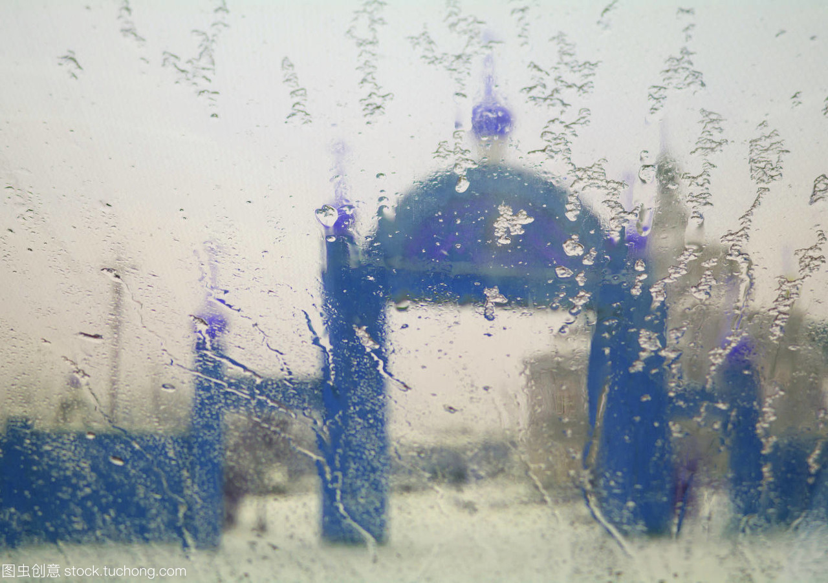
Sence 1
In a rainy afternoon,the class is over.

Slide 3
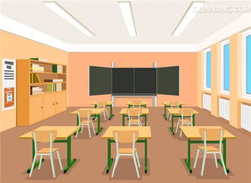
Sence 2
In a gloomy afternoon,an empty classroom

Slide 4
Acknowledgements
Illustration and script by Yanhua Zheng
1st Chinese draft by Yanhua Zheng
1st English draft translated by Yu Zhang
2nd edition & gesture design by Feifeng
3rd edition & final check by Bowen Sun
Poseidon – Weizhong Xie
Mars – Jianfan Cai
Apollo - Liang Zheng
Minerva – Shujun Lin

