Slide 1
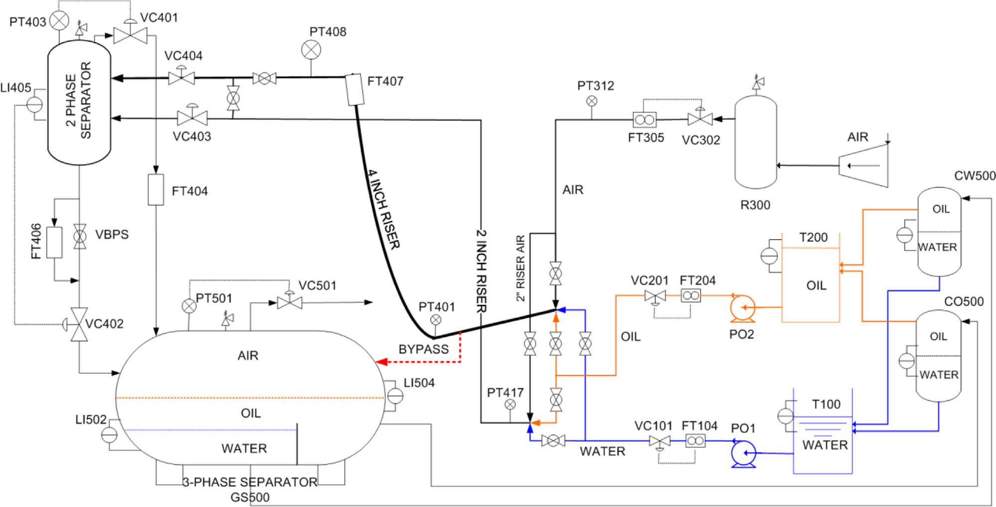
4
Pressure
Density
Flow
temperature
7
5
Level
Valve opening
3
3
10
13
16
Stream
Current
11
4
1
8
21
17
14
7
6
12
11
6
10
5
2
2
20
19
9
15
18
24
23
9
1
22
8

Slide 2
