Slide 1
WiFi Sensing
xxy

Slide 2
Contents
无线感知(CSI&应用)
SDR

Slide 3
Human sensing, recognition, and detection
基于视觉
基于传感器
基于Radio Frequency(RF)

Slide 4

基于视觉
缺点:
Line-of-Sight(LOS), no obstacles.
Lighting.
Privacy intrusion.

Slide 5

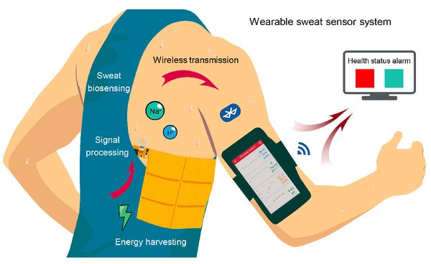
基于可穿戴传感设备
缺点: wearing a device all the time

Slide 6

Radio-Frequency
Contactless
non-LOS nature

Slide 7

Radio-Frequency
Bluetooth, and UWB, WiFi
WiFi is much more widely used in our daily lives. Besides communications, it is found that WiFi signals are sensitive to environmental dynamics caused by human motion. Therefore, WiFi provides a desirable solution for indoor human sensing, recognition, and detection.
The main benefits :
1) ubiquitously available due to the widely deployed WiFi infrastructure.
2) cost effective without hardware modification and redeployment.

Slide 8
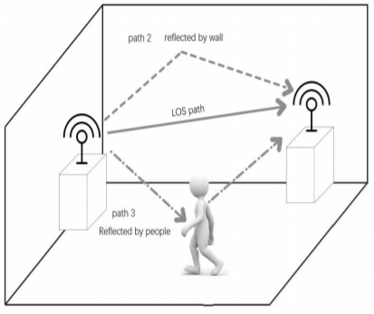
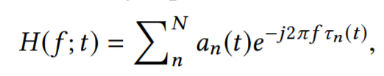
Background of CSI
More specifically, the Channel State Information (CSI )reveals how the signal propagates through the channel. The impairments that the signal undergoes due to the multipath, shadowing, and scattering, are embedded in the CSI
OFDM MIMO provide fine-grained channel measurements
y = Hx + n
Notes:
Cyclic shift diversity又称Cyclic Delay Diversity技术，将空间分集转换为频率分集，避免码间串扰，从而降低误码率，有效减少信号失真。
qi, j and ζi, j are the amplitude attenuation and phase shift of the beamforming matrix

Slide 9
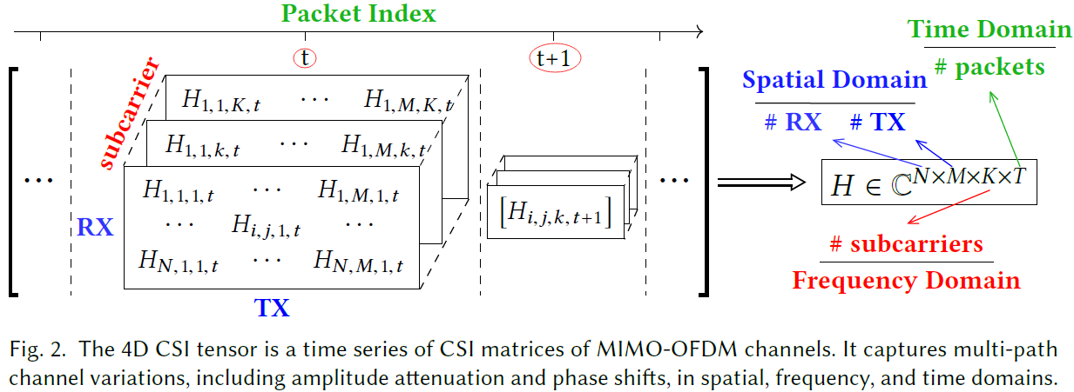
Background of CSI
Notes:
Cyclic shift diversity又称Cyclic Delay Diversity技术，将空间分集转换为频率分集，避免码间串扰，从而降低误码率，有效减少信号失真。
qi, j and ζi, j are the amplitude attenuation and phase shift of the beamforming matrix

Slide 10
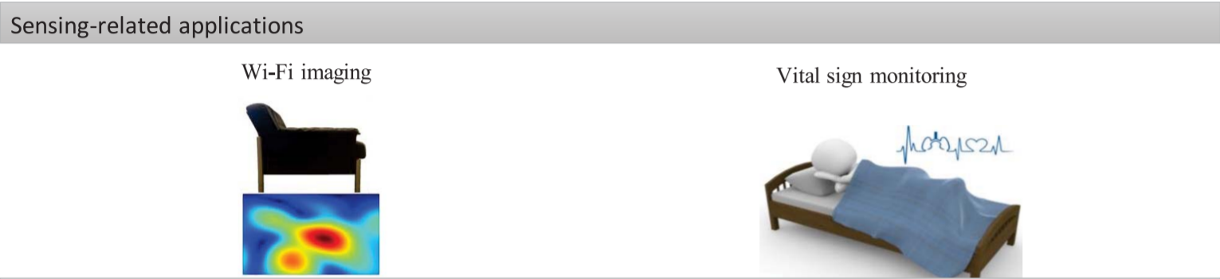
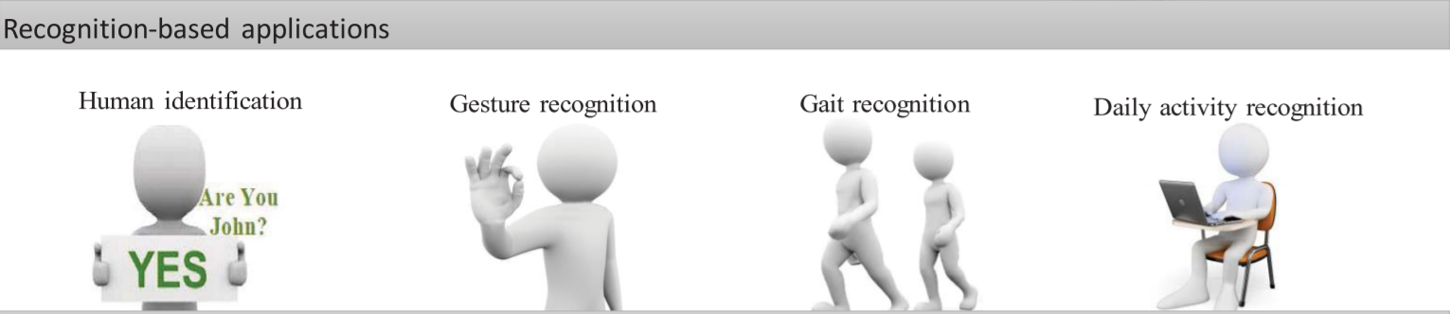
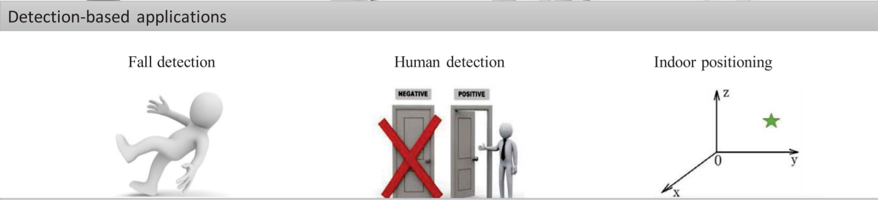
无线感知应用

Slide 11
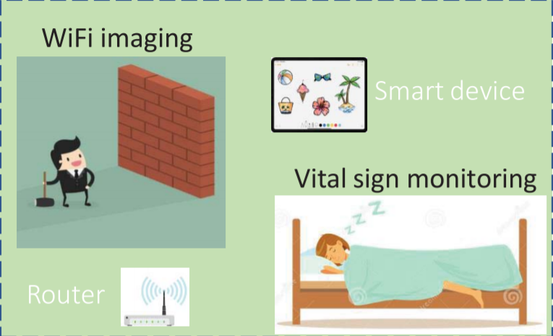
无线感知应用

Slide 12
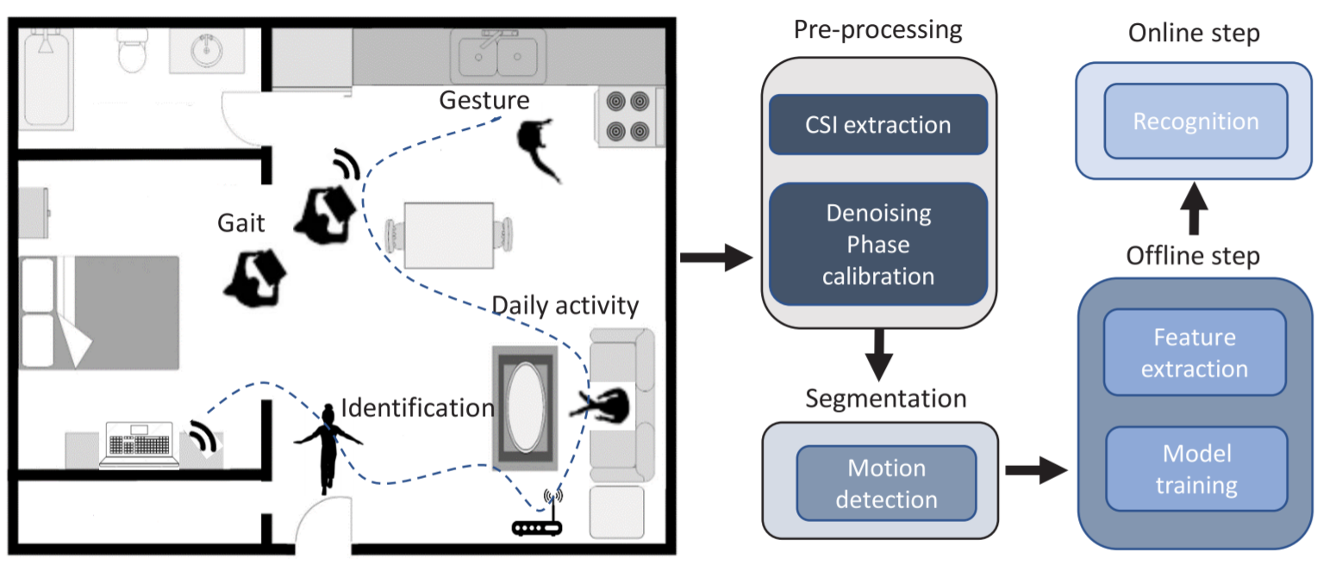
无线感知应用

Slide 13
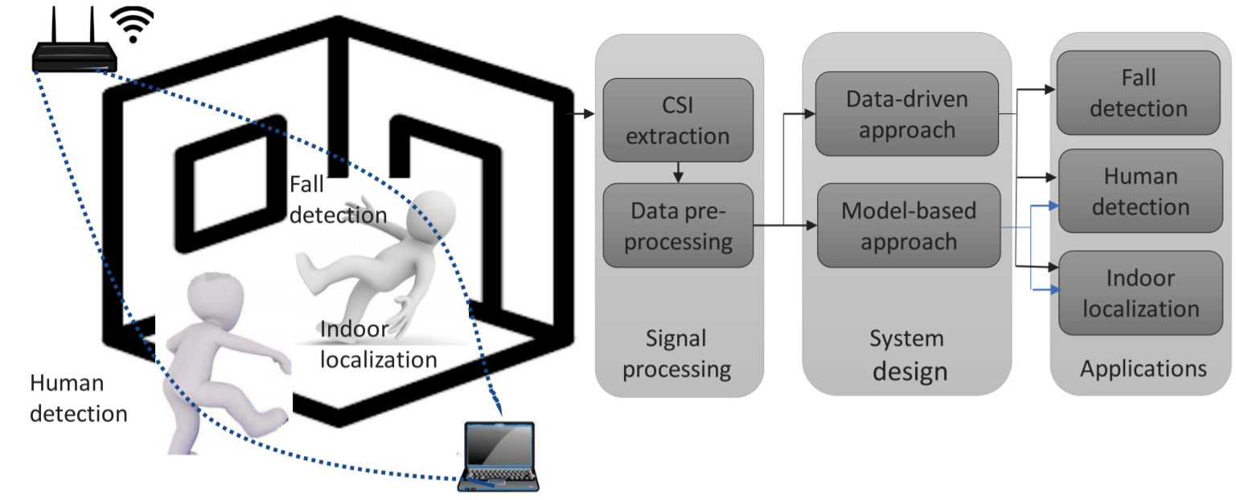
无线感知应用

Slide 14

Software Defined Radio
Software-defined radio (SDR) is a radio communication system where components that have been traditionally implemented in hardware (e.g. mixers, filters, amplifiers, modulators/demodulators, detectors, etc.) are instead implemented by means of software on a personal computer or embedded system.[1]

Slide 15
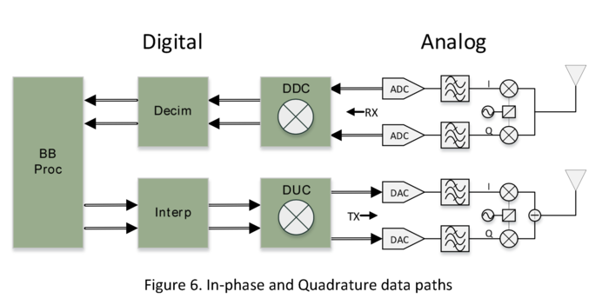
Software Defined Radio

Slide 16
Software Defined Radio
https://www.youtube.com/watch?v=vbJel_qxk5E
https://www.youtube.com/watch?v=cygDXeZaiOM&t=525s

