Slide 1
Program Optimization 15-213: Introduction to Computer Systems 10th Lecture, Oct. 1, 2015

Slide 2
Today
Overview
Generally Useful Optimizations
Code motion/precomputation
Strength reduction
Sharing of common subexpressions
Removing unnecessary procedure calls
Optimization Blockers
Procedure calls
Memory aliasing
Exploiting Instruction-Level Parallelism
Dealing with Conditionals

Slide 3
Performance Realities
There’s more to performance than asymptotic complexity
Constant factors matter too!
Easily see 10:1 performance range depending on how code is written
Must optimize at multiple levels:
algorithm, data representations, procedures, and loops
Must understand system to optimize performance
How programs are compiled and executed
How modern processors + memory systems operate
How to measure program performance and identify bottlenecks
How to improve performance without destroying code modularity and generality

Slide 4
Optimizing Compilers
Provide efficient mapping of program to machine
register allocation
code selection and ordering (scheduling)
dead code elimination
eliminating minor inefficiencies
Don’t (usually) improve asymptotic efficiency
up to programmer to select best overall algorithm
big-O savings are (often) more important than constant factors
but constant factors also matter
Have difficulty overcoming “optimization blockers”
potential memory aliasing
potential procedure side-effects

Slide 5
Limitations of Optimizing Compilers
Operate under fundamental constraint
Must not cause any change in program behavior
Except, possibly when program making use of nonstandard language features
Often prevents it from making optimizations that would only affect behavior under pathological conditions.
Behavior that may be obvious to the programmer can be obfuscated by languages and coding styles
e.g., Data ranges may be more limited than variable types suggest
Most analysis is performed only within procedures
Whole-program analysis is too expensive in most cases
Newer versions of GCC do interprocedural analysis within individual files
But, not between code in different files
Most analysis is based only on static information
Compiler has difficulty anticipating run-time inputs
When in doubt, the compiler must be conservative

Slide 6
Generally Useful Optimizations
Optimizations that you or the compiler should do regardless of processor / compiler
Code Motion
Reduce frequency with which computation performed
If it will always produce same result
Especially moving code out of loop
void set_row(double *a, double *b,
long i, long n)
{
long j;
for (j = 0; j < n; j++)
a[n*i+j] = b[j];
}
long j;
int ni = n*i;
for (j = 0; j < n; j++)
a[ni+j] = b[j];

Slide 7
Compiler-Generated Code Motion (-O1)
void set_row(double *a, double *b,
long i, long n)
{
long j;
for (j = 0; j < n; j++)
a[n*i+j] = b[j];
}
long j;
long ni = n*i;
double *rowp = a+ni;
for (j = 0; j < n; j++)
*rowp++ = b[j];
set_row:
testq %rcx, %rcx # Test n
jle .L1 # If 0, goto done
imulq %rcx, %rdx # ni = n*i
leaq (%rdi,%rdx,8), %rdx # rowp = A + ni*8
movl $0, %eax # j = 0
.L3: # loop:
movsd (%rsi,%rax,8), %xmm0 # t = b[j]
movsd %xmm0, (%rdx,%rax,8) # M[A+ni*8 + j*8] = t
addq $1, %rax # j++
cmpq %rcx, %rax # j:n
jne .L3 # if !=, goto loop
.L1: # done:
rep ; ret

Slide 8
Reduction in Strength
Replace costly operation with simpler one
Shift, add instead of multiply or divide
16*x --> x << 4
Utility machine dependent
Depends on cost of multiply or divide instruction
On Intel Nehalem, integer multiply requires 3 CPU cycles
Recognize sequence of products
int ni = 0;
for (i = 0; i < n; i++) {
for (j = 0; j < n; j++)
a[ni + j] = b[j];
ni += n;
}
for (i = 0; i < n; i++) {
int ni = n*i;
for (j = 0; j < n; j++)
a[ni + j] = b[j];
}

Slide 9
Share Common Subexpressions
Reuse portions of expressions
GCC will do this with –O1
/* Sum neighbors of i,j */
up = val[(i-1)*n + j ];
down = val[(i+1)*n + j ];
left = val[i*n + j-1];
right = val[i*n + j+1];
sum = up + down + left + right;
long inj = i*n + j;
up = val[inj - n];
down = val[inj + n];
left = val[inj - 1];
right = val[inj + 1];
sum = up + down + left + right;
3 multiplications: i*n, (i–1)*n, (i+1)*n
1 multiplication: i*n
leaq 1(%rsi), %rax # i+1
leaq -1(%rsi), %r8 # i-1
imulq %rcx, %rsi # i*n
imulq %rcx, %rax # (i+1)*n
imulq %rcx, %r8 # (i-1)*n
addq %rdx, %rsi # i*n+j
addq %rdx, %rax # (i+1)*n+j
addq %rdx, %r8 # (i-1)*n+j
imulq %rcx, %rsi # i*n
addq %rdx, %rsi # i*n+j
movq %rsi, %rax # i*n+j
subq %rcx, %rax # i*n+j-n
leaq (%rsi,%rcx), %rcx # i*n+j+n

Slide 10
Optimization Blocker #1: Procedure Calls
Procedure to Convert String to Lower Case
Extracted from 213 lab submissions, Fall, 1998
void lower(char *s)
{
size_t i;
for (i = 0; i < strlen(s); i++)
if (s[i] >= 'A' && s[i] <= 'Z')
s[i] -= ('A' - 'a');
}

Slide 11
Lower Case Conversion Performance
Time quadruples when double string length
Quadratic performance
lower1

Slide 12
Convert Loop To Goto Form
void lower(char *s)
{
size_t i = 0;
if (i >= strlen(s))
goto done;
loop:
if (s[i] >= 'A' && s[i] <= 'Z')
s[i] -= ('A' - 'a');
i++;
if (i < strlen(s))
goto loop;
done:
}
strlen executed every iteration

Slide 13
Calling Strlen
/* My version of strlen */
size_t strlen(const char *s)
{
size_t length = 0;
while (*s != '\0') {
s++;
length++;
}
return length;
}
Strlen performance
Only way to determine length of string is to scan its entire length, looking for null character.
Overall performance, string of length N
N calls to strlen
Require times N, N-1, N-2, …, 1
Overall O(N²) performance

Slide 14
Improving Performance
void lower(char *s)
{
size_t i;
size_t len = strlen(s);
for (i = 0; i < len; i++)
if (s[i] >= 'A' && s[i] <= 'Z')
s[i] -= ('A' - 'a');
}
Move call to strlen outside of loop
Since result does not change from one iteration to another
Form of code motion

Slide 15
Lower Case Conversion Performance
Time doubles when double string length
Linear performance of lower2
lower1
lower2

Slide 16
Optimization Blocker: Procedure Calls
Why couldn’t compiler move strlen out of inner loop?
Procedure may have side effects
Alters global state each time called
Function may not return same value for given arguments
Depends on other parts of global state
Procedure lower could interact with strlen
Warning:
Compiler treats procedure call as a black box
Weak optimizations near them
Remedies:
Use of inline functions
GCC does this with –O1
Within single file
Do your own code motion
size_t lencnt = 0;
size_t strlen(const char *s)
{
size_t length = 0;
while (*s != '\0') {
s++; length++;
}
lencnt += length;
return length;
}

Slide 17
Memory Matters
/* Sum rows is of n X n matrix a
and store in vector b */
void sum_rows1(double *a, double *b, long n) {
long i, j;
for (i = 0; i < n; i++) {
b[i] = 0;
for (j = 0; j < n; j++)
b[i] += a[i*n + j];
}
}
# sum_rows1 inner loop
.L4:
movsd (%rsi,%rax,8), %xmm0 # FP load
addsd (%rdi), %xmm0 # FP add
movsd %xmm0, (%rsi,%rax,8) # FP store
addq $8, %rdi
cmpq %rcx, %rdi
jne .L4
Code updates b[i] on every iteration
Why couldn’t compiler optimize this away?

Slide 18
Memory Aliasing
/* Sum rows is of n X n matrix a
and store in vector b */
void sum_rows1(double *a, double *b, long n) {
long i, j;
for (i = 0; i < n; i++) {
b[i] = 0;
for (j = 0; j < n; j++)
b[i] += a[i*n + j];
}
}
Value of B:
double A[9] =
{ 0, 1, 2,
4, 8, 16},
32, 64, 128};
double B[3] = A+3;
sum_rows1(A, B, 3);
init: [4, 8, 16]
i = 0: [3, 8, 16]
i = 1: [3, 22, 16]
i = 2: [3, 22, 224]
Code updates b[i] on every iteration
Must consider possibility that these updates will affect program behavior

Slide 19
Removing Aliasing
/* Sum rows is of n X n matrix a
and store in vector b */
void sum_rows2(double *a, double *b, long n) {
long i, j;
for (i = 0; i < n; i++) {
double val = 0;
for (j = 0; j < n; j++)
val += a[i*n + j];
b[i] = val;
}
}
# sum_rows2 inner loop
.L10:
addsd (%rdi), %xmm0 # FP load + add
addq $8, %rdi
cmpq %rax, %rdi
jne .L10
No need to store intermediate results

Slide 20
Optimization Blocker: Memory Aliasing
Aliasing
Two different memory references specify single location
Easy to have happen in C
Since allowed to do address arithmetic
Direct access to storage structures
Get in habit of introducing local variables
Accumulating within loops
Your way of telling compiler not to check for aliasing

Slide 21
Exploiting Instruction-Level Parallelism
Need general understanding of modern processor design
Hardware can execute multiple instructions in parallel
Performance limited by data dependencies
Simple transformations can yield dramatic performance improvement
Compilers often cannot make these transformations
Lack of associativity and distributivity in floating-point arithmetic

Slide 22
Benchmark Example: Data Type for Vectors
/* data structure for vectors */
typedef struct{
size_t len;
data_t *data;
} vec;
len
0
1
len-1
data
/* retrieve vector element
and store at val */
int get_vec_element
(*vec v, size_t idx, data_t *val)
{
if (idx >= v->len)
return 0;
*val = v->data[idx];
return 1;
}
Data Types
Use different declarations for data_t
int
long
float
double

Slide 23
Benchmark Computation
void combine1(vec_ptr v, data_t *dest)
{
long int i;
*dest = IDENT;
for (i = 0; i < vec_length(v); i++) {
data_t val;
get_vec_element(v, i, &val);
*dest = *dest OP val;
}
}
Compute sum or product of vector elements
Data Types
Use different declarations for data_t
int
long
float
double
Operations
Use different definitions of OP and IDENT
+ / 0
* / 1

Slide 24
Cycles Per Element (CPE)
Convenient way to express performance of program that operates on vectors or lists
Length = n
In our case: CPE = cycles per OP
T = CPE*n + Overhead
CPE is slope of line
psum1
Slope = 9.0
psum2
Slope = 6.0

Slide 25
Benchmark Performance
void combine1(vec_ptr v, data_t *dest)
{
long int i;
*dest = IDENT;
for (i = 0; i < vec_length(v); i++) {
data_t val;
get_vec_element(v, i, &val);
*dest = *dest OP val;
}
}
Compute sum or product of vector elements
Method | Integer |  | Double FP
Operation | Add | Mult | Add | Mult
Combine1 unoptimized | 22.68 | 20.02 | 19.98 | 20.18
Combine1 –O1 | 10.12 | 10.12 | 10.17 | 11.14
Notes:
编译优化可以改善2倍左右

Slide 26
Basic Optimizations
void combine4(vec_ptr v, data_t *dest)
{
long i;
long length = vec_length(v);
data_t *d = get_vec_start(v);
data_t t = IDENT;
for (i = 0; i < length; i++)
t = t OP d[i];
*dest = t;
}
Move vec_length out of loop
Avoid bounds check on each cycle
Accumulate in temporary

Slide 27
Effect of Basic Optimizations
void combine4(vec_ptr v, data_t *dest)
{
long i;
long length = vec_length(v);
data_t *d = get_vec_start(v);
data_t t = IDENT;
for (i = 0; i < length; i++)
t = t OP d[i];
*dest = t;
}
Method | Integer |  | Double FP
Operation | Add | Mult | Add | Mult
Combine1 –O1 | 10.12 | 10.12 | 10.17 | 11.14
Combine4 | 1.27 | 3.01 | 3.01 | 5.01
Eliminates sources of overhead in loop
Notes:
简单的临时变量，可以改善2~8倍性能

Slide 28
Modern CPU Design
Instruction Control
Fetch
Control
Address
Instruction
Cache
Retirement
Unit
Register
File
Instruction
Decode
Instructions
Operations
Register Updates
Prediction OK?
Execution
Functional
Units
Branch
Arith
Arith
Arith
Load
Store
Operation Results
Addr.
Addr.
Data
Data
Data
Cache
Notes:
指令执行流：流水执行-取指、译码、微操作执行
解码器：将一条指令解码成一个或者多个操作nb
如何实现分支预测执行
特点：超标量（每个周期发射多条指令）、乱序执行

Slide 29
Superscalar Processor
Definition: A superscalar processor can issue and execute multiple instructions in one cycle. The instructions are retrieved from a sequential instruction stream and are usually scheduled dynamically.
Benefit: without programming effort, superscalar processor can take advantage of the instruction level parallelism that most programs have
Most modern CPUs are superscalar.
Intel: since Pentium (1993)

Slide 30
Pipelined Functional Units
Stage 1
long mult_eg(long a, long b, long c) {
long p1 = a*b; long p2 = a*c; long p3 = p1 * p2;
return p3; }
Stage 2
Stage 3
 | Time
 | 1 | 2 | 3 | 4 | 5 | 6 | 7
Stage 1 | a*b | a*c |  |  | p1*p2
Stage 2 |  | a*b | a*c |  |  | p1*p2
Stage 3 |  |  | a*b | a*c |  |  | p1*p2
Divide computation into stages
Pass partial computations from stage to stage
Stage i can start on new computation once values passed to i+1
E.g., complete 3 multiplications in 7 cycles, even though each requires 3 cycles

Slide 31
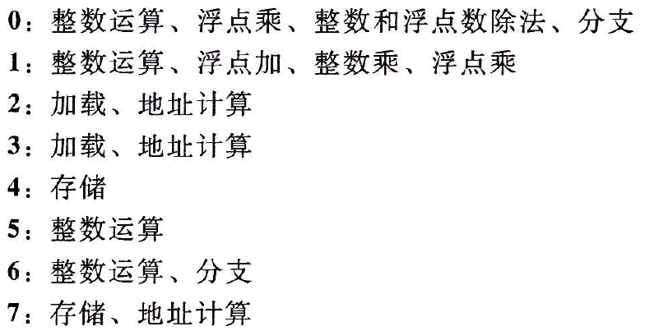
Haswell CPU
8 Total Functional Units
Multiple instructions can execute in parallel
2 load, with address computation
1 store, with address computation
4 integer
2 FP multiply
1 FP add
1 FP divide
Some instructions take > 1 cycle, but can be pipelined
Instruction Latency Cycles/Issue
Load / Store 4 1
Integer Multiply 3 1
Integer/Long Divide 3-30 3-30
Single/Double FP Multiply 5 1
Single/Double FP Add 3 1
Single/Double FP Divide 3-15 3-15
Notes:
Issue time：同一种操作的两次发射所需要的最小间隔时间 （> 1cycle，代表功能单元内部有回边）
latency：从一个操作开始执行到这个操作结束，某功能单元所需要的时间
load/store：4 cycles 解释了为什么要寄存器分配
integer multiply: full pipelined
float divide: can’t pipelined

Slide 32
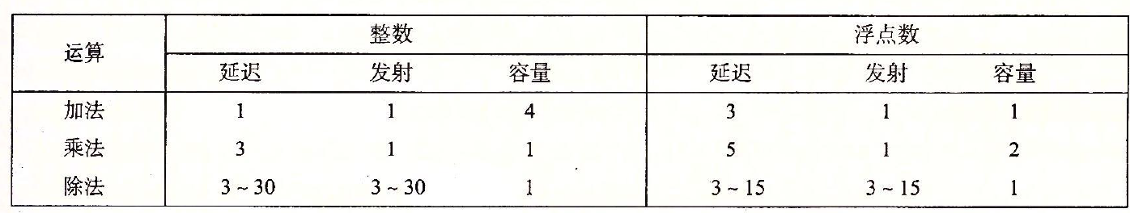
Latency bound and throughput bound
Method | Integer |  |  | Double FP
Operation | Add | Mult | Div | Add | Mult | Div
Combine4 | 1.27 | 3.01 | -- | 3.01 | 5.01 | --
Latency Bound | 1.00 | 3.00 | 16 | 3.00 | 5.00 | 8
Throughput （per cycle） | 4*1 2*1
Throughput bound (per op) | 0.5
Notes:
latency bound: 一个功能单元完成一个操作所需的执行时间不能少于该操作在物理逻辑上所需的时间
某个功能单元的throughput: 该功能单元每时钟周期能够处理的操作数，issue time的倒数（4声），所以最大吞吐量是？（1/cycle）
处理器的throughput：C/I，其中C是容量，I是issue time
Throughput bound: 一个处理器完成一个操作所需的执行时间不能小于其throughput的倒数
0.5 determined by load throughput bound, at most two data read per clock cycle
2, 1, 1/16, 1, 2, 16

Slide 33
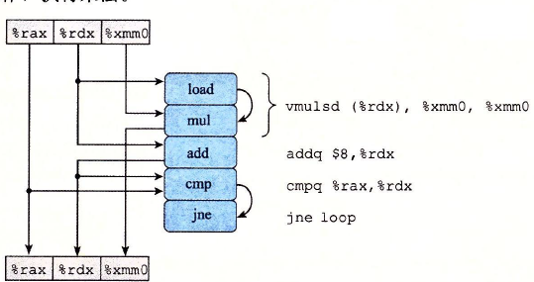
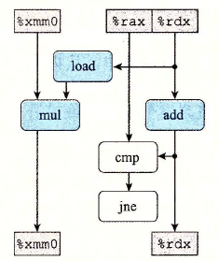
x86-64 Compilation of Combine4
Inner Loop (Case: float Multiply)
.L519: # Loop:
vmulsd (%rdx), %xmm0, %xmm0 # t = t * d[i]
addq $8, %rdx # increment data+i
cmpq %rax, %rdx # Compare data+length
jg .L519 # If !=, goto Loop
Notes:
左图是该内层循环的四条指令对应的5个操作，以及操作之间的依赖关系
这里我们可以发现，内存循环的都读取rdx、xmm0；然后更新rdx，xmm0。这里，这2个寄存器称为loop寄存器。凡是访问loop寄存器的操作，都更难实现两个迭代之间的流水并行执行，所以更可能成为关键路径，即性能瓶颈。相对而言，只访问非loop寄存器的操作，不大可能成为关键路径。
右图是将只访问非loop寄存器的操作标志为白色

Slide 34
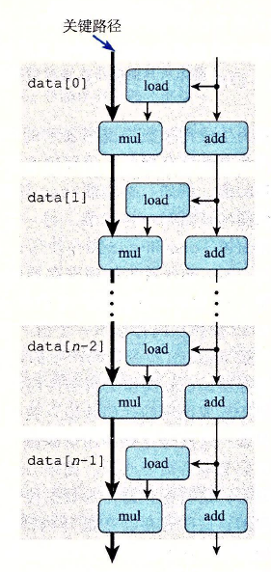
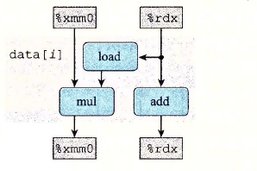
Notes:
mul形成了loop寄存器之间的依赖链条
load可以跟上一个迭代的mul并行

Slide 35
 | Time
 | 1 | 2 | 3 | 4 | 5 | 6 | 7
Stage 1 | load add |  |  |  | mul | load add |  |  |  | mul | load add
Stage 2 |  | load cmp |  |  |  | mul | load cmp |  |  |  | mul | load cmp
Stage 3 |  |  | load jne |  |  |  | mul | load jne |  |  |  | mul | load jne
Stage 4 |  |  |  | load |  |  |  | mul | load |  |  |  | mul | load
Stage 5 |  |  |  |  |  |  |  |  | mul |  |  |  |  | mul

Slide 36
Combine4 = Serial Computation (OP = *)
Computation (length=8)
((((((((1 * d[0]) * d[1]) * d[2]) * d[3]) * d[4]) * d[5]) * d[6]) * d[7])
Sequential dependence
Performance: determined by latency of OP
1
d₀
*
d₁
*
d₂
*
d₃
*
d₄
*
d₅
*
d₆
*
d₇
*
Notes:
no-piped: latency per op

Slide 37
Loop Unrolling (2x1)
void unroll2a_combine(vec_ptr v, data_t *dest)
{
long length = vec_length(v);
long limit = length-1;
data_t *d = get_vec_start(v);
data_t x = IDENT;
long i;
/* Combine 2 elements at a time */
for (i = 0; i < limit; i+=2) {
x = (x OP d[i]) OP d[i+1];
}
/* Finish any remaining elements */
for (; i < length; i++) {
x = x OP d[i];
}
*dest = x;
}
Perform 2x more useful work per iteration

Slide 38
Effect of Loop Unrolling
Method | Integer |  | Double FP
Operation | Add | Mult | Add | Mult
Combine4 | 1.27 | 3.01 | 3.01 | 5.01
Unroll 2x1 | 1.01 | 3.01 | 3.01 | 5.01
Latency Bound | 1.00 | 3.00 | 3.00 | 5.00
Throughput Bound | 0.50 | 1.00 | 1.00 | 0.50
Helps integer add
Achieves latency bound
Others don’t improve. Why?
Still sequential dependency
x = (x OP d[i]) OP d[i+1];
Notes:
loop overhead reduction explains the improvement in CPE
简单的loop unrooling不能改善性能，需要程序员辅助

Slide 39
Loop Unrolling with Reassociation (2x1a)
void unroll2aa_combine(vec_ptr v, data_t *dest)
{
long length = vec_length(v);
long limit = length-1;
data_t *d = get_vec_start(v);
data_t x = IDENT;
long i;
/* Combine 2 elements at a time */
for (i = 0; i < limit; i+=2) {
x = x OP (d[i] OP d[i+1]);
}
/* Finish any remaining elements */
for (; i < length; i++) {
x = x OP d[i];
}
*dest = x;
}
Compare to before
x = (x OP d[i]) OP d[i+1];
Can this change the result of the computation?
Yes, for FP. Why?

Slide 40
Effect of Reassociation
Method | Integer |  | Double FP
Operation | Add | Mult | Add | Mult
Combine4 | 1.27 | 3.01 | 3.01 | 5.01
Unroll 2x1 | 1.01 | 3.01 | 3.01 | 5.01
Unroll 2x1a | 1.01 | 1.51 | 1.51 | 2.51
Latency Bound | 1.00 | 3.00 | 3.00 | 5.00
Throughput Bound | 0.50 | 1.00 | 1.00 | 0.50
Nearly 2x speedup for Int *, FP +, FP *
Reason: Breaks sequential dependency
Why is that? (next slide)
2 func. units for FP *
2 func. units for load
x = x OP (d[i] OP d[i+1]);
4 func. units for int +
2 func. units for load

Slide 41
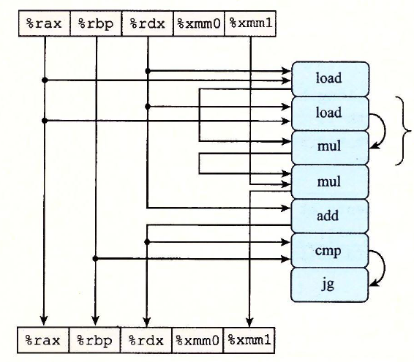
.L519:
vmovsd (%rax, %rdx, 8), %xmm0
vmulsd 8(%rax, %rdx, 8), %xmm0, %xmm0
vmulsd %xmm0, %xmm1, %xmm1
addq $2, %rdx
cmpq %rdx, %rbp
jg .L519

Slide 42
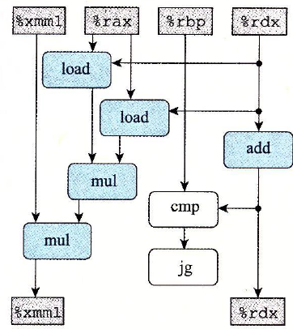
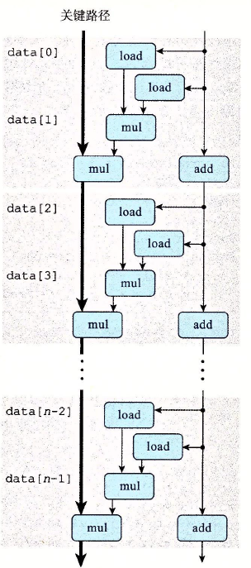
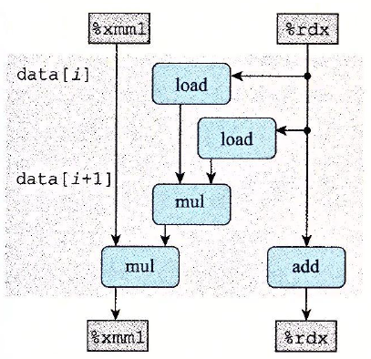
Notes:
只有第二个mul形成了loop寄存器之间的依赖链条

Slide 43
Time
1 | 2 | 3 | 4 |  | 5 | 6 | 7
load add | load |  |  |  | mul1 | load add | load |  |  | mul2 mul1 | mul1 | load |  |  |  | mul2
 | load cmp | load |  |  |  | mul1 | load cmp | load |  |  | mul2 mul1 | mul1 | load
 |  | load jne | load |  |  |  | mul1 | load jne | load |  |  | mul2 | mul1 | load
 |  |  | load | load |  |  |  | mul1 | load | load |  |  | mul2 | mul1 | load
 |  |  |  |  |  |  |  |  | mul1 |  |  |  |  | mul2 | mul1

Slide 44
Reassociated Computation
x = x OP (d[i] OP d[i+1]);
What changed:
Ops in the next iteration can be started early (no dependency)
Overall Performance
N elements, D cycles latency/op
(N/2+1)*D cycles: CPE = D/2
d₀
d₁
*
d₂
d₃
1
*
d₄
d₅
*
*
d₆
d₇
*
*
*
*

Slide 45
Loop Unrolling with Separate Accumulators (2x2)
void unroll2a_combine(vec_ptr v, data_t *dest)
{
long length = vec_length(v);
long limit = length-1;
data_t *d = get_vec_start(v);
data_t x0 = IDENT;
data_t x1 = IDENT;
long i;
/* Combine 2 elements at a time */
for (i = 0; i < limit; i+=2) {
x0 = x0 OP d[i];
x1 = x1 OP d[i+1];
}
/* Finish any remaining elements */
for (; i < length; i++) {
x0 = x0 OP d[i];
}
*dest = x0 OP x1;
}
Different form of reassociation

Slide 46
Effect of Separate Accumulators
Method | Integer |  | Double FP
Operation | Add | Mult | Add | Mult
Combine4 | 1.27 | 3.01 | 3.01 | 5.01
Unroll 2x1 | 1.01 | 3.01 | 3.01 | 5.01
Unroll 2x1a | 1.01 | 1.51 | 1.51 | 2.51
Unroll 2x2 | 0.81 | 1.51 | 1.51 | 2.51
Latency Bound | 1.00 | 3.00 | 3.00 | 5.00
Throughput Bound | 0.50 | 1.00 | 1.00 | 0.50
Int + makes use of two load units
2x speedup (over unroll2) for Int *, FP +, FP *
x0 = x0 OP d[i];
x1 = x1 OP d[i+1];

Slide 47
Separate Accumulators
x0 = x0 OP d[i];
x1 = x1 OP d[i+1];
What changed:
Two independent “streams” of operations
Overall Performance
N elements, D cycles latency/op
Should be (N/2+1)*D cycles: CPE = D/2
CPE matches prediction!
1
d₀
1
d₁
*
d₂
*
d₃
*
d₄
*
d₅
*
d₆
*
d₇
*
*
What Now?
*

Slide 48
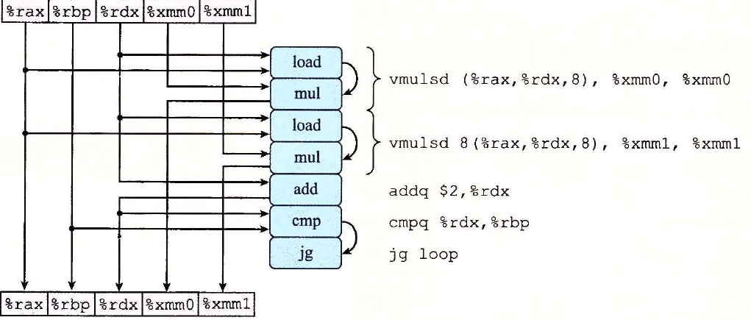

Slide 49
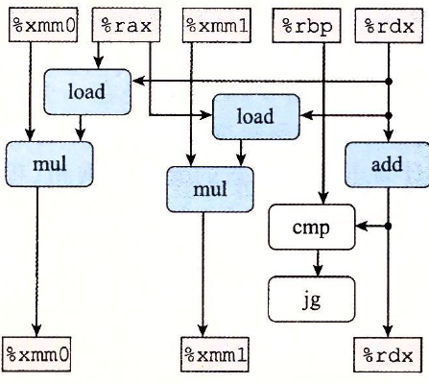
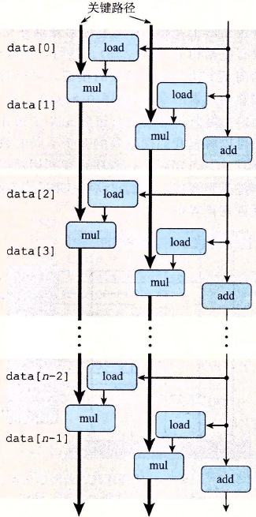
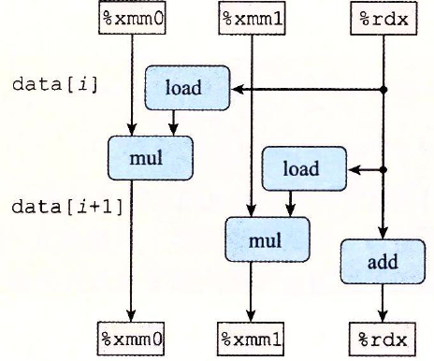
Notes:
两条关键路径可以并行

Slide 50
Time
1 | 2 | 3 | 4 | 5 | 6 | 7
load1 add | load2 |  |  | mul1 mul2 | load1 | load2 |  |  | mul1 mul2 | load1 | load2
 | load1 cmp | load2 |  |  | mul1 mul2 | load1 | load2 |  |  | mul1 mul2 | load1 | load2
 |  | load1 jne | load2 |  |  | mul1 mul2 | load1 | load2 |  |  | mul1 mul2 | load1 | load2
 |  |  | load1 | load2 |  |  | mul1 mul2 | load1 | load2 |  |  | mul1 mul2 | load1 | load2
 |  |  |  |  |  |  |  | mul1 mul2 |  |  |  |  | mul1 mul2 | load1 | load2

Slide 51
Unrolling & Accumulating
Idea
Can unroll to any degree L
Can accumulate K results in parallel
L must be multiple of K
Limitations
Diminishing returns
Cannot go beyond throughput limitations of execution units
Large overhead for short lengths
Finish off iterations sequentially

Slide 52
Unrolling & Accumulating: Double *
Case
Intel Haswell
Double FP Multiplication
Latency bound: 5.00. Throughput bound: 0.50
FP * | Unrolling Factor L
K | 1 | 2 | 3 | 4 | 6 | 8 | 10 | 12
1 | 5.01 | 5.01 | 5.01 | 5.01 | 5.01 | 5.01 | 5.01
2 |  | 2.51 |  | 2.51 |  | 2.51
3 |  |  | 1.67
4 |  |  |  | 1.25 |  | 1.26
6 |  |  |  |  | 0.84 |  |  | 0.88
8 |  |  |  |  |  | 0.63
10 |  |  |  |  |  |  | 0.51
12 |  |  |  |  |  |  |  | 0.52
Accumulators

Slide 53
Unrolling & Accumulating: Int +
Case
Intel Haswell
Integer addition
Latency bound: 1.00. Throughput bound: 1.00
FP * | Unrolling Factor L
K | 1 | 2 | 3 | 4 | 6 | 8 | 10 | 12
1 | 1.27 | 1.01 | 1.01 | 1.01 | 1.01 | 1.01 | 1.01
2 |  | 0.81 |  | 0.69 |  | 0.54
3 |  |  | 0.74
4 |  |  |  | 0.69 |  | 1.24
6 |  |  |  |  | 0.56 |  |  | 0.56
8 |  |  |  |  |  | 0.54
10 |  |  |  |  |  |  | 0.54
12 |  |  |  |  |  |  |  | 0.56
Accumulators

Slide 54
Achievable Performance
Method | Integer |  | Double FP
Operation | Add | Mult | Add | Mult
Best | 0.54 | 1.01 | 1.01 | 0.52
Latency Bound | 1.00 | 3.00 | 3.00 | 5.00
Throughput Bound | 0.50 | 1.00 | 1.00 | 0.50
Limited only by throughput of functional units
Up to 42X improvement over original, unoptimized code

Slide 55
Programming with AVX2
YMM Registers
16 total, each 32 bytes
32 single-byte integers
16 16-bit integers
8 32-bit integers
8 single-precision floats
4 double-precision floats
1 single-precision float
1 double-precision float

Slide 56
SIMD Operations
SIMD Operations: Single Precision
SIMD Operations: Double Precision
vaddsd %ymm0, %ymm1, %ymm1
%ymm0
+
+
+
+
+
+
+
+
%ymm1
vaddpd %ymm0, %ymm1, %ymm1
%ymm0
+
+
+
+
%ymm1

Slide 57
Using Vector Instructions
Method | Integer |  | Double FP
Operation | Add | Mult | Add | Mult
Scalar Best | 0.54 | 1.01 | 1.01 | 0.52
Vector Best | 0.06 | 0.24 | 0.25 | 0.16
Latency Bound | 0.50 | 3.00 | 3.00 | 5.00
Throughput Bound | 0.50 | 1.00 | 1.00 | 0.50
Vec Throughput Bound | 0.06 | 0.12 | 0.25 | 0.12
Make use of AVX Instructions
Parallel operations on multiple data elements
See Web Aside OPT:SIMD on CS:APP web page

Slide 58
What About Branches?
Challenge
Instruction Control Unit must work well ahead of Execution Unit to generate enough operations to keep EU busy
When encounters conditional branch, cannot reliably determine where to continue fetching
404663: mov $0x0,%eax
404668: cmp (%rdi),%rsi
40466b: jge 404685
40466d: mov 0x8(%rdi),%rax
. . .
404685: repz retq
Executing
How to continue?

Slide 59
Modern CPU Design
Instruction Control
Fetch
Control
Address
Instruction
Cache
Retirement
Unit
Register
File
Instruction
Decode
Instructions
Operations
Register Updates
Prediction OK?
Execution
Functional
Units
Branch
Arith
Arith
Arith
Load
Store
Operation Results
Addr.
Addr.
Data
Data
Data
Cache

Slide 60
Branch Outcomes
When encounter conditional branch, cannot determine where to continue fetching
Branch Taken: Transfer control to branch target
Branch Not-Taken: Continue with next instruction in sequence
Cannot resolve until outcome determined by branch/integer unit
404663: mov $0x0,%eax
404668: cmp (%rdi),%rsi
40466b: jge 404685
40466d: mov 0x8(%rdi),%rax
. . .
404685: repz retq
Branch Not-Taken
Branch Taken

Slide 61
Branch Prediction
Idea
Guess which way branch will go
Begin executing instructions at predicted position
But don’t actually modify register or memory data
404663: mov $0x0,%eax
404668: cmp (%rdi),%rsi
40466b: jge 404685
40466d: mov 0x8(%rdi),%rax
. . .
404685: repz retq
Predict Taken
Begin
Execution

Slide 62
Branch Prediction Through Loop
401029: vmulsd (%rdx),%xmm0,%xmm0
40102d: add $0x8,%rdx
401031: cmp %rax,%rdx
401034: jne 401029
Assume
vector length = 100
i = 98
Predict Taken (OK)
401029: vmulsd (%rdx),%xmm0,%xmm0
40102d: add $0x8,%rdx
401031: cmp %rax,%rdx
401034: jne 401029
i = 99
Predict Taken
(Oops)
401029: vmulsd (%rdx),%xmm0,%xmm0
40102d: add $0x8,%rdx
401031: cmp %rax,%rdx
401034: jne 401029
Read invalid location
Executed
i = 100
401029: vmulsd (%rdx),%xmm0,%xmm0
40102d: add $0x8,%rdx
401031: cmp %rax,%rdx
401034: jne 401029
Fetched
i = 101

Slide 63
Branch Misprediction Invalidation
401029: vmulsd (%rdx),%xmm0,%xmm0
40102d: add $0x8,%rdx
401031: cmp %rax,%rdx
401034: jne 401029
Assume
vector length = 100
i = 98
Predict Taken (OK)
401029: vmulsd (%rdx),%xmm0,%xmm0
40102d: add $0x8,%rdx
401031: cmp %rax,%rdx
401034: jne 401029
i = 99
Predict Taken
(Oops)
401029: vmulsd (%rdx),%xmm0,%xmm0
40102d: add $0x8,%rdx
401031: cmp %rax,%rdx
401034: jne 401029
i = 100
Invalidate
401029: vmulsd (%rdx),%xmm0,%xmm0
40102d: add $0x8,%rdx
401031: cmp %rax,%rdx
401034: jne 401029
i = 101

Slide 64
Branch Misprediction Recovery
401029: vmulsd (%rdx),%xmm0,%xmm0
40102d: add $0x8,%rdx
401031: cmp %rax,%rdx
401034: jne 401029
401036: jmp 401040
. . .
401040: vmovsd %xmm0,(%r12)
i = 99
Definitely not taken
Reload
Pipeline
Performance Cost
Multiple clock cycles on modern processor
Can be a major performance limiter

Slide 65
Getting High Performance
Good compiler and flags
Don’t do anything stupid
Watch out for hidden algorithmic inefficiencies
Write compiler-friendly code
Watch out for optimization blockers: procedure calls & memory references
Look carefully at innermost loops (where most work is done)
Tune code for machine
Exploit instruction-level parallelism
Avoid unpredictable branches
Make code cache friendly (Covered later in course)

