Slide 1
Linking 15-213: Introduction to Computer Systems 13th Lecture, Oct. 13, 2015

Slide 2
Today
Linking
Case study: Library interpositioning

Slide 3
Example C Program
int sum(int *a, int n);
int array[2] = {1, 2};
int main()
{
int val = sum(array, 2);
return val;
}
int sum(int *a, int n)
{
int i, s = 0;
for (i = 0; i < n; i++) {
s += a[i];
}
return s;
}
main.c
sum.c

Slide 4
Static Linking
Programs are translated and linked using a compiler driver:
linux> gcc -Og -o prog main.c sum.c
linux> ./prog
main.c
sum.c
Source files
Translators
(cpp, cc1, as)
Translators
(cpp, cc1, as)
main.o
sum.o
Separately compiled
relocatable object files
Linker (ld)
Fully linked executable object file
(contains code and data for all functions
defined in main.c and sum.c)
prog
Notes:
cpp main.c main.i
cc1 main.i –Og –o main.s
as main.s –o main.o
ld –o prog main.o sum.o

Slide 5
Why Linkers?
Reason 1: Modularity
Program can be written as a collection of smaller source files, rather than one monolithic mass.
Can build libraries of common functions (more on this later)
e.g., Math library, standard C library

Slide 6
Why Linkers? (cont)
Reason 2: Efficiency
Time: Separate compilation
Change one source file, compile, and then relink.
No need to recompile other source files.
Space: Libraries
Common functions can be aggregated into a single file...
Yet executable files and running memory images contain only code for the functions they actually use.

Slide 7
What Do Linkers Do?
Step 1: Symbol resolution
Programs define and reference symbols (global variables and functions):
void swap() {…} /* define symbol swap */
swap(); /* reference symbol swap */
int *xp = &x; /* define symbol xp, reference x */
Symbol definitions are stored in object file (by assembler) in symbol table.
Symbol table is an array of structs
Each entry includes name, size, and location of symbol.
During symbol resolution step, the linker associates each symbol reference with exactly one symbol definition.
Notes:
举例：
符号定义：学生的个人档案（姓名、籍贯、出生日期、性别、是否党员、家庭成员、有没有获奖、有没有被罚）
符号声明：有一个叫某某名字的学生，学生是类型（慢点讲）
符号解析：将这个学生名字关联到他的个人档案，以后对该学生所有访问和更新都需要落实到个人档案上（对于函数，是查询和执行；对于变量，是读和写）

Slide 8
What Do Linkers Do? (cont)
Step 2: Relocation
Merges separate code and data sections into single sections
Relocates symbols from their relative locations in the .o files to their final absolute memory locations in the executable.
Updates all references to these symbols to reflect their new positions.
Let’s look at these two steps in more detail….

Slide 9
Three Kinds of Object Files (Modules)
Relocatable object file (.o file)
Contains code and data in a form that can be combined with other relocatable object files to form executable object file.
Each .o file is produced from exactly one source (.c) file
Executable object file (a.out file)
Contains code and data in a form that can be copied directly into memory and then executed.
Shared object file (.so file)
Special type of relocatable object file that can be loaded into memory and linked dynamically, at either load time or run-time.
Called Dynamic Link Libraries (DLLs) by Windows

Slide 10
常见的二进制代码文件格式
Windows:
Portable Executable format (PE)
Mac OS-X:
Mach-O format
Unix/Linux:
Executable and Linkable Format (ELF)

Slide 11
Executable and Linkable Format (ELF)
Standard binary format for object files
One unified format for
Relocatable object files (.o),
Executable object files (a.out)
Shared object files (.so)
Generic name: ELF binaries

Slide 12
ELF Object File Format
Elf header
Word size, byte ordering, file type (.o, exec, .so), machine type, etc.
Segment header table
Page size, virtual addresses memory segments (sections), segment sizes.
.text section
Code
.rodata section
Read only data: jump tables, ...
.data section
Initialized global or static variables
.bss section
Uninitialized global or static variables
“Block Started by Symbol”
“Better Save Space”
Has section header but occupies no space
0
ELF header
Segment header table
(required for executables)
.text section
.rodata section
.data section
.bss section
.symtab section
.rel.txt section
.rel.data section
.debug section
Section header table
Notes:
In disk, after linking: ELF
in memory:
.rodata: jump tables, string constants (“hello”, “%d”),
.data section vs .bss section:
initialized, needs space for storage
uninitialized or initialized to zero, no need of storage, initialized to zero at run time

Slide 13
Jump Table
Carnegie Mellon
Jump table
switch(x) {
case 1: // .L3
w = y*z;
break;
case 2: // .L5
w = y/z;
/* Fall Through */
case 3: // .L9
w += z;
break;
case 5:
case 6: // .L7
w -= z;
break;
default: // .L8
w = 2;
}
.section .rodata
.align 8
.L4:
.quad .L8 # x = 0
.quad .L3 # x = 1
.quad .L5 # x = 2
.quad .L9 # x = 3
.quad .L8 # x = 4
.quad .L7 # x = 5
.quad .L7 # x = 6
Notes:
a map of (case-value, code-block)
indirect jump: L4.(%RDI, 8)

Slide 14
ELF Object File Format (cont.)
0
.symtab section
Symbol table
Procedure and static variable names
Section names and locations
.rel.text section
Relocation info for .text section
Addresses of instructions that will need to be modified in the executable
Instructions for modifying.
.rel.data section
Relocation info for .data section
Addresses of pointer data that will need to be modified in the merged executable
.debug section
Info for symbolic debugging (gcc -g)
Section header table
Offsets and sizes of each section
ELF header
Segment header table
(required for executables)
.text section
.rodata section
.data section
.bss section
.symtab section
.rel.txt section
.rel.data section
.debug section
.line section
.strtab section
Section header table
Notes:
.symtab section:
unlike the symbol table in compiler, not including entries for local variabes
.rel.text:
instruction relocation info(offset, size, ref): instruction refs global/static or external functions ( ??? what is the difference between local defined global data and functions?)
.rel.data:
data relocation info(offset, size, ref): data value is the address of global/static value or external function
.debug:
debugging symbol table with entries for locals, typedefs, globals, functions
.line:
map between lines in C and in machine code
.strtab:
strings for .symtab, .deug, and section names

Slide 15
Linker Symbols
Global symbols
Symbols defined by module m that can be referenced by other modules.
E.g.: non-static C functions and non-static global variables.
External symbols
Global symbols that are referenced by module m but defined by some other module.
Local symbols
Symbols that are defined and referenced exclusively by module m.
E.g.: C functions and global variables defined with the static attribute.
Local linker symbols are not local program variables
Notes:
In .symtab:
three kinds of symbols

Slide 16
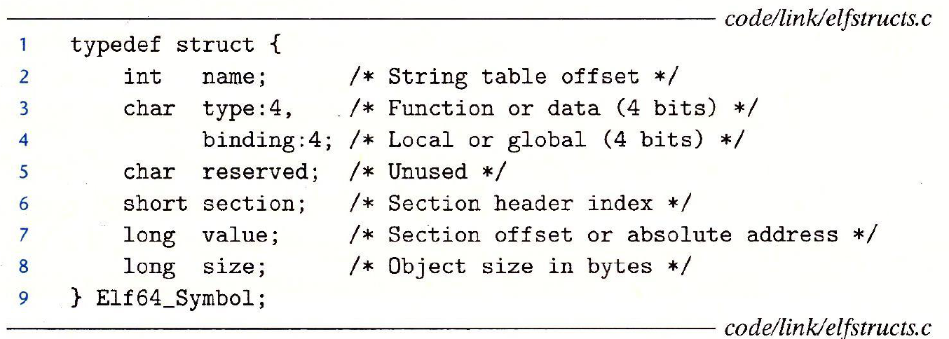
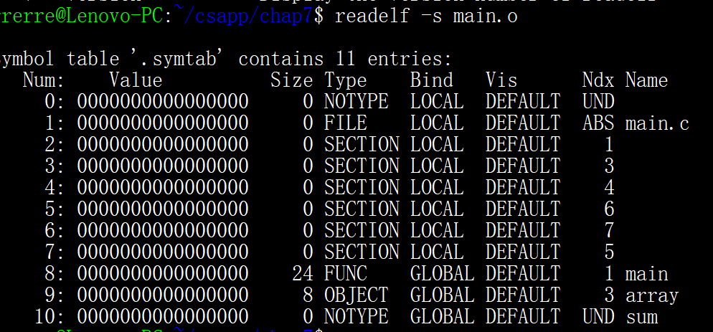
Symbol table entry

Slide 17
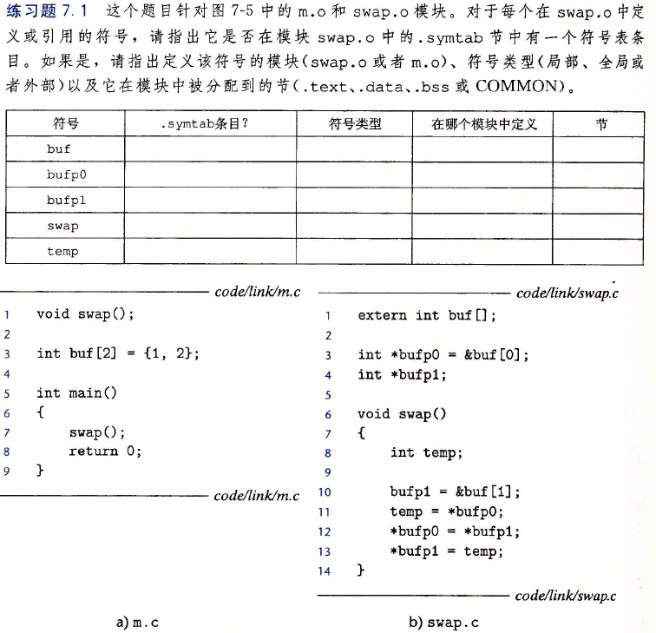

Slide 18
Step 1: Symbol Resolution
Referencing
a global…
…that’s defined here
int sum(int *a, int n);
int array[2] = {1, 2};
int main()
{
int val = sum(array, 2);
return val;
}
int sum(int *a, int n)
{
int i, s = 0;
for (i = 0; i < n; i++) {
s += a[i];
}
return s;
}
main.c
sum.c
Defining
a global
Referencing
a global…
Linker knows
nothing of i or s
Linker knows
nothing of val
…that’s defined here

Slide 19
Local Symbols
Local non-static C variables vs. local static C variables
local non-static C variables: stored on the stack
local static C variables: stored in either .bss, or .data
int f()
{
static int x = 0;
return x;
}
int g()
{
static int x = 1;
return x;
}
Compiler allocates space in .data for each definition of x
Creates local symbols in the symbol table with unique names, e.g., x.1 and x.2.
Why differs in static locals and non-static locals?

Slide 20
How Linker Resolves Duplicate Symbol Definitions
Program symbols are either strong or weak
Strong: procedures and initialized globals
Weak: uninitialized globals
p1.c
p2.c
strong
int foo=5;
p1() {
}
int foo;
p2() {
}
weak
strong
strong

Slide 21
Linker’s Symbol Rules
Rule 1: Multiple strong symbols are not allowed
Each item can be defined only once
Otherwise: Linker error
Rule 2: Given a strong symbol and multiple weak symbols, choose the strong symbol
References to the weak symbol resolve to the strong symbol
Rule 3: If there are multiple weak symbols, pick an arbitrary one
Can override this with gcc –fno-common

Slide 22
Linker Puzzles
int x;
p1() {}
p1() {}
Link time error: two strong symbols (p1)
int x;
p1() {}
int x;
p2() {}
References to x will refer to the same
uninitialized int. Is this what you really want?
int x;
int y;
p1() {}
double x;
p2() {}
Writes to x in p2 might overwrite y!
Evil!
int x=7;
int y=5;
p1() {}
double x;
p2() {}
Writes to x in p2 will overwrite y!
Nasty!
int x=7;
p1() {}
int x;
p2() {}
References to x will refer to the same initialized
variable.
Nightmare scenario: two identical weak structs, compiled by different compilers
with different alignment rules.

Slide 23
Global Variables
Avoid if you can
Otherwise
Use static if you can
Initialize if you define a global variable
Use extern if you reference an external global variable
gcc –fno-common

Slide 24
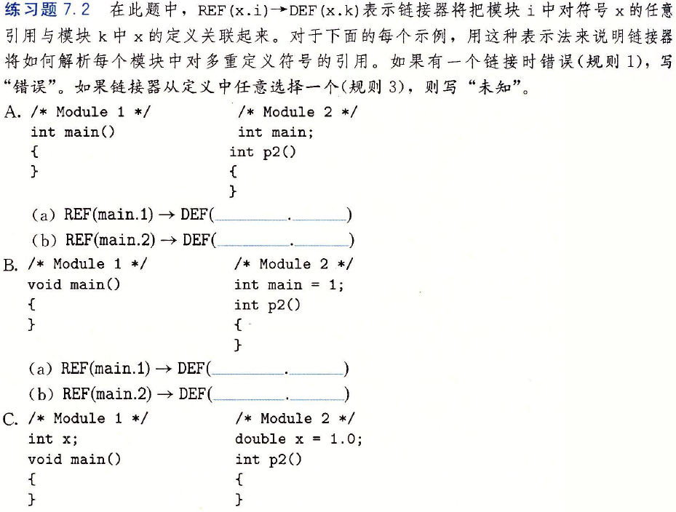


Slide 25
Step 2: Relocation (symbol -> address)
Relocatable Object Files
Executable Object File
System code
.text
0
Headers
System data
.data
System code
main()
.text
main.o
swap()
main()
.text
.data
More system code
int array[2]={1,2}
System data
.data
sum.o
sum()
int array[2]={1,2}
.text
.symtab
.debug

Slide 26
Two steps of relocation
definition → address
Merge sections and give definitions a runtime address
reference → address
update reference into definition-address based on relocation entries

Slide 27
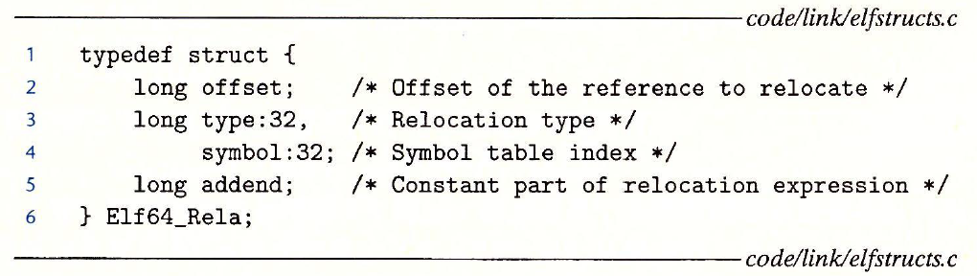
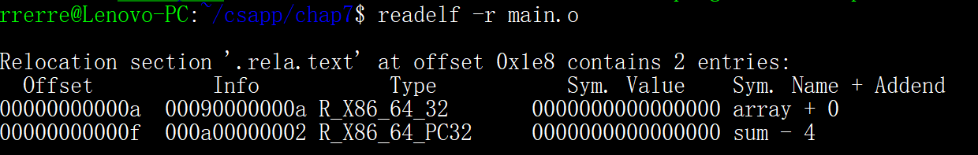
Relocation Entries
main.o
Source: objdump –r –d main.o

Slide 28
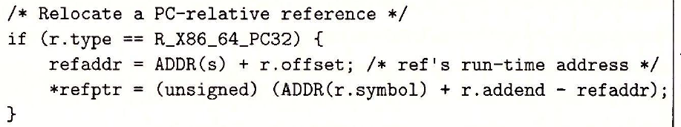
Relocation Entries
int array[2] = {1, 2};
int main()
{
int val = sum(array, 2);
return val;
}
relocation entry for sum at 0xf: offset = f;
addend = -4; (next instruction address offset)
symbol = sum;
type = PC32
main.c
0000000000000000 <main>:
0: 48 83 ec 08 sub $0x8,%rsp
4: be 02 00 00 00 mov $0x2,%esi
9: bf 00 00 00 00 mov $0x0,%edi # %edi = &array
a: R_X86_64_32 array # Relocation entry
e: e8 00 00 00 00 callq 13 <main+0x13> # sum()
f: R_X86_64_PC32 sum-0x4 # Relocation entry
13: 48 83 c4 08 add $0x8,%rsp
17: c3 retq
main.o
Source: objdump –r –d main.o
Notes:
See 7.7.2 for algorithm

Slide 29
Relocation Entries
relocation entry for sum at 0xf: offset = 0xf;
addend = -4; (next instruction address offset)
symbol = sum;
type = PC32
0000000000000000 <main>:
0: 48 83 ec 08 sub $0x8,%rsp
4: be 02 00 00 00 mov $0x2,%esi
9: bf 00 00 00 00 mov $0x0,%edi # %edi = &array
a: R_X86_64_32 array # Relocation entry
e: e8 00 00 00 00 callq 13 <main+0x13> # sum()
f: R_X86_64_PC32 sum-0x4 # Relocation entry
13: 48 83 c4 08 add $0x8,%rsp
17: c3 retq
main.o
Source: objdump –r –d main.o
Notes:
See 7.7.2 for algorithm
refAddr: 4004d0+e = 4004de
r.symbol: 4004e8
r.addend: -4
value: 4004e8 + (-4) – 4004de = 5
r.symbol = value + refAddr – r.addend

Slide 30
Relocated .text section
00000000004004d0 <main>:
4004d0: 48 83 ec 08 sub $0x8,%rsp
4004d4: be 02 00 00 00 mov $0x2,%esi
4004d9: bf 18 10 60 00 mov $0x601018,%edi # %edi = &array
4004de: e8 05 00 00 00 callq 4004e8 <sum> # sum()
4004e3: 48 83 c4 08 add $0x8,%rsp
4004e7: c3 retq
00000000004004e8 <sum>:
4004e8: b8 00 00 00 00 mov $0x0,%eax
4004ed: ba 00 00 00 00 mov $0x0,%edx
4004f2: eb 09 jmp 4004fd <sum+0x15>
4004f4: 48 63 ca movslq %edx,%rcx
4004f7: 03 04 8f add (%rdi,%rcx,4),%eax
4004fa: 83 c2 01 add $0x1,%edx
4004fd: 39 f2 cmp %esi,%edx
4004ff: 7c f3 jl 4004f4 <sum+0xc>
400501: f3 c3 repz retq
Using PC-relative addressing for sum(): 0x4004e8 = 0x4004e3 + 0x5
Source: objdump -dx prog

Slide 31
Relocation Entries
relocation entry for array at 0xf: offset = 0xa;
addend = 0; (next instruction address offset)
symbol = array;
type = Abs32
array: 0x601018
0000000000000000 <main>:
0: 48 83 ec 08 sub $0x8,%rsp
4: be 02 00 00 00 mov $0x2,%esi
9: bf 00 00 00 00 mov $0x0,%edi # %edi = &array
a: R_X86_64_32 array # Relocation entry
e: e8 00 00 00 00 callq 13 <main+0x13> # sum()
f: R_X86_64_PC32 sum-0x4 # Relocation entry
13: 48 83 c4 08 add $0x8,%rsp
17: c3 retq
main.o
Source: objdump –r –d main.o
Notes:
See 7.7.2 for algorithm

Slide 32
Relocated .text section
00000000004004d0 <main>:
4004d0: 48 83 ec 08 sub $0x8,%rsp
4004d4: be 02 00 00 00 mov $0x2,%esi
4004d9: bf 18 10 60 00 mov $0x601018,%edi # %edi = &array
4004de: e8 05 00 00 00 callq 4004e8 <sum> # sum()
4004e3: 48 83 c4 08 add $0x8,%rsp
4004e7: c3 retq
00000000004004e8 <sum>:
4004e8: b8 00 00 00 00 mov $0x0,%eax
4004ed: ba 00 00 00 00 mov $0x0,%edx
4004f2: eb 09 jmp 4004fd <sum+0x15>
4004f4: 48 63 ca movslq %edx,%rcx
4004f7: 03 04 8f add (%rdi,%rcx,4),%eax
4004fa: 83 c2 01 add $0x1,%edx
4004fd: 39 f2 cmp %esi,%edx
4004ff: 7c f3 jl 4004f4 <sum+0xc>
400501: f3 c3 repz retq
Using PC-relative addressing for sum(): 0x4004e8 = 0x4004e3 + 0x5
Source: objdump -dx prog

Slide 33
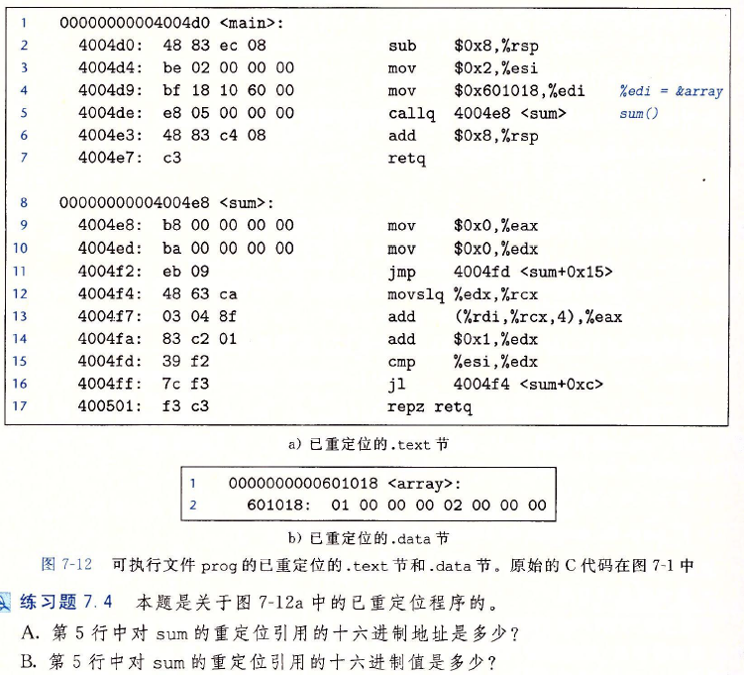

Slide 34
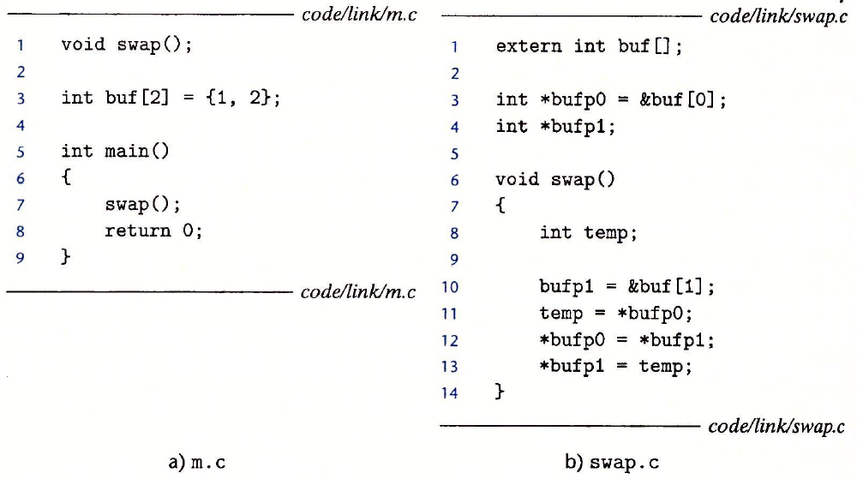
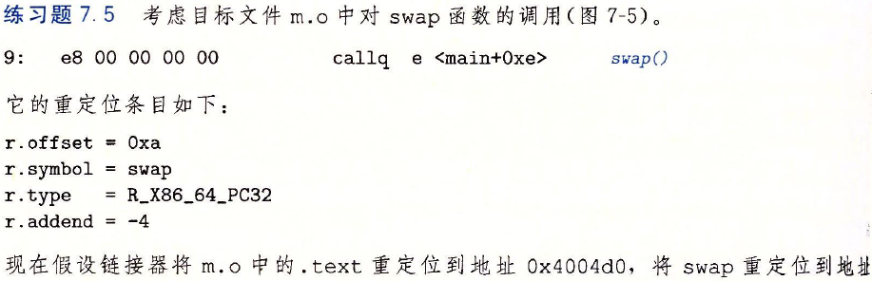

Slide 35
Loading Executable Object Files
Memory
invisible to user code
Executable Object File
Kernel virtual memory
0
ELF header
User stack
(created at runtime)
Program header table
(required for executables)
%rsp
(stack
pointer)
.init section
.text section
load into memory
Memory-mapped region for
shared libraries
.rodata section
.data section
.bss section
brk
.symtab
Run-time heap
(created by malloc)
.debug
Read/write data segment
(.data, .bss)
Loaded
from
the
executable
file
.line
.strtab
Read-only code segment
(.init, .text, .rodata)
Section header table
(required for relocatables)
0x400000
Unused
0
Notes:
yellow and above: read only
purple: read/write
others: not loaded into memory
.init section: added by linker, initialization of globals, getting args for main function

Slide 36
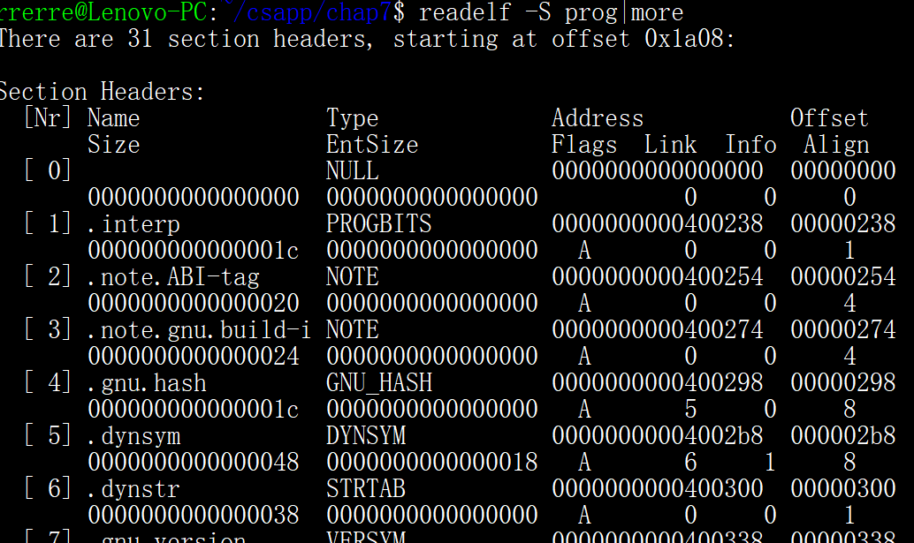
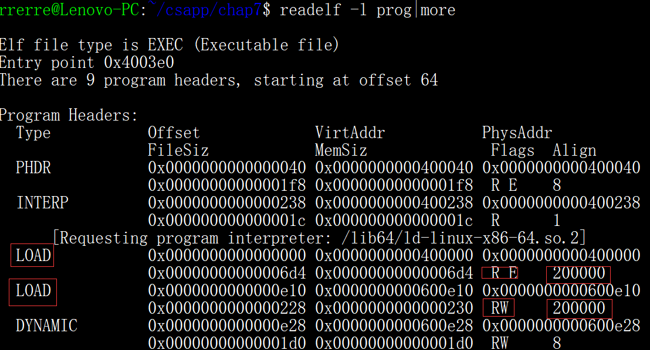
Program header table
in place of section header table, for loading
Load type
Code segment: R/E (.init, .text, .rodata), memSize == file size, alignment
data segment: R/W(.data, .bbs), memSize > filesize

Slide 37
Load and running
loader (execve system call)copy code & data from disk into memory
running the code by jumping to its entry point
_start (from crt1.o, runtime)
→__libc_start_main (from libc.so, libc)
→main

Slide 38
Packaging Commonly Used Functions
How to package functions commonly used by programmers?
Math, I/O, memory management, string manipulation, etc.
Awkward, given the linker framework so far:
Option 1: Put all functions into a single source file
Programmers link big object file into their programs
Space and time inefficient
Option 2: Put each function in a separate source file
Cons & Pros?
Notes:
Programmers explicitly link appropriate binaries into their programs
More efficient, but burdensome on the programmer

Slide 39
Old-fashioned Solution: Static Libraries
Static libraries (.a archive files)
Concatenate related relocatable object files into a single file with an index (called an archive). For ex: libm, liba
Enhance linker so that it tries to resolve unresolved external references by looking for the symbols in one or more archives.
If an archive member file resolves reference, link it into the executable.
Why need explicitly specify the libraries? For ex: -lm, import package
Why not automatively search for used API?

Slide 40
Creating Static Libraries
atoi.c
printf.c
random.c
Translator
Translator
...
Translator
atoi.o
printf.o
random.o
Archiver (ar)
unix> ar rs libc.a \
atoi.o printf.o … random.o
libc.a
C standard library
Archiver allows incremental updates
Recompile function that changes and replace .o file in archive.

Slide 41
Commonly Used Libraries
libc.a (the C standard library)
4.6 MB archive of 1496 object files.
I/O, memory allocation, signal handling, string handling, data and time, random numbers, integer math
libm.a (the C math library)
2 MB archive of 444 object files.
floating point math (sin, cos, tan, log, exp, sqrt, …)
% ar –t libc.a | sort
…
fork.o
…
fprintf.o
fpu_control.o
fputc.o
freopen.o
fscanf.o
fseek.o
fstab.o
…
% ar –t libm.a | sort
…
e_acos.o
e_acosf.o
e_acosh.o
e_acoshf.o
e_acoshl.o
e_acosl.o
e_asin.o
e_asinf.o
e_asinl.o
…

Slide 42
Linking with Static Libraries
libvector.a
void addvec(int *x, int *y,
int *z, int n) {
int i;
for (i = 0; i < n; i++)
z[i] = x[i] + y[i];
}
#include <stdio.h>
#include "vector.h"
int x[2] = {1, 2};
int y[2] = {3, 4};
int z[2];
int main()
{
addvec(x, y, z, 2);
printf("z = [%d %d]\n”,
z[0], z[1]);
return 0;
}
addvec.c
void multvec(int *x, int *y,
int *z, int n)
{
int i;
for (i = 0; i < n; i++)
z[i] = x[i] * y[i];
}
main2.c
multvec.c

Slide 43
Linking with Static Libraries
addvec.o
multvec.o
main2.c
vector.h
Archiver
(ar)
Translators
(cpp, cc1, as)
libvector.a
libc.a
Static libraries
Relocatable
object files
main2.o
addvec.o
printf.o and any other
modules called by printf.o
Linker (ld)
Fully linked
executable object file
prog2c
“c” for “compile-time”

Slide 44
Using Static Libraries
Linker’s algorithm for resolving external references:
Scan .o files and .a files in the command line order.
During the scan, keep a list of the current unresolved references.
As each new .o or .a file, obj, is encountered, try to resolve each unresolved reference in the list against the symbols defined in obj.
If any entries in the unresolved list at end of scan, then error.
Problem:
Command line order matters!
Moral: put libraries at the end of the command line.
Problem: each archive member or object file may includes more functions than referenced, still suboptimally linked.
unix> gcc -L. main2.o –libvector.a
unix> gcc -L. –libvector.a main2.o
main2.o: In function `main':
main2.o(.text+0x18): undefined reference to `addvec'

Slide 45
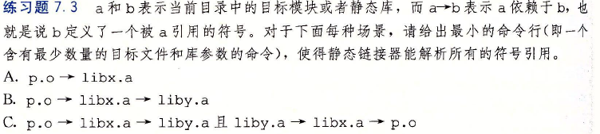

Slide 46
Modern Solution: Shared Libraries
Static libraries have the following disadvantages:
Duplication in the stored executables (every function needs libc)
Duplication in the running executables
Minor bug fixes of system libraries require each application to explicitly relink
Modern solution: Shared Libraries
Object files that contain code and data that are loaded and linked into an application dynamically, at either load-time or run-time
Also called: dynamic link libraries, DLLs, .so files

Slide 47
Shared Libraries (cont.)
Dynamic linking can occur when executable is first loaded and run (load-time linking).
Common case for Linux, handled automatically by the dynamic linker (ld-linux.so).
Standard C library (libc.so) usually dynamically linked.
Dynamic linking can also occur after program has begun (run-time linking).
In Linux, this is done by calls to the dlopen() interface.
Distributing software.
High-performance web servers.
Runtime library interpositioning.
Shared library routines can be shared by multiple processes.
More on this when we learn about virtual memory

Slide 48
Dynamic Linking at Load-time
main2.c
vector.h
unix> gcc -shared -o libvector.so \
addvec.c multvec.c
Translators
(cpp, cc1, as)
libc.so
libvector.so
Relocatable
object file
main2.o
Relocation and symbol table info
Linker (ld)
Partially linked
executable object file
prog2l
Loader (execve)
libc.so
libvector.so
Code and data
Fully linked
executable
in memory
Dynamic linker (ld-linux.so)
Notes:
linker: partially link--- instead of link code/data of libc/libvector into prog21, just add some relocation and symbol table info
loader(execve) finds that prog21 has a special segment .interp ( which contains the path name of dynamic linker: ld-linux.so)
loader loads and runs dynamic linker, which
relocating text/data of libc.so/libvector.so
relocating references in prog21 to symbols in libc.so/libvector.so
pass control to prog21

Slide 49
Dynamic Linking at Run-time
#include <stdio.h>
#include <stdlib.h>
#include <dlfcn.h>
int x[2] = {1, 2};
int y[2] = {3, 4};
int z[2];
int main()
{
void *handle;
void (*addvec)(int *, int *, int *, int);
char *error;
/* Dynamically load the shared library that contains addvec() */
handle = dlopen("./libvector.so", RTLD_LAZY);
if (!handle) {
fprintf(stderr, "%s\n", dlerror());
exit(1);
}
dll.c

Slide 50
Dynamic Linking at Run-time
...
/* Get a pointer to the addvec() function we just loaded */
addvec = dlsym(handle, "addvec");
if ((error = dlerror()) != NULL) {
fprintf(stderr, "%s\n", error);
exit(1);
}
/* Now we can call addvec() just like any other function */
addvec(x, y, z, 2);
printf("z = [%d %d]\n", z[0], z[1]);
/* Unload the shared library */
if (dlclose(handle) < 0) {
fprintf(stderr, "%s\n", dlerror());
exit(1);
}
return 0;
}
dll.c

Slide 51
Linking Summary
Linking is a technique that allows programs to be constructed from multiple object files.
Linking can happen at different times in a program’s lifetime:
Compile time (when a program is compiled)
Load time (when a program is loaded into memory)
Run time (while a program is executing)
Understanding linking can help you avoid nasty errors and make you a better programmer.

Slide 52
Today
Linking
Case study: Library interpositioning

Slide 53
Case Study: Library Interpositioning
Library interpositioning : powerful linking technique that allows programmers to intercept calls to arbitrary functions
Interpositioning can occur at:
Compile time: When the source code is compiled
Link time: When the relocatable object files are statically linked to form an executable object file
Load/run time: When an executable object file is loaded into memory, dynamically linked, and then executed.

Slide 54
Some Interpositioning Applications
Security
Confinement (sandboxing)
Behind the scenes encryption
Debugging
In 2014, two Facebook engineers debugged a treacherous 1-year old bug in their iPhone app using interpositioning
Code in the SPDY networking stack was writing to the wrong location
Solved by intercepting calls to Posix write functions (write, writev, pwrite)
Source: Facebook engineering blog post at https://code.facebook.com/posts/313033472212144/debugging-file-corruption-on-ios/

Slide 55
Some Interpositioning Applications
Monitoring and Profiling
Count number of calls to functions
Characterize call sites and arguments to functions
Malloc tracing
Detecting memory leaks
Generating address traces

Slide 56
Example program
Goal: trace the addresses and sizes of the allocated and freed blocks, without breaking the program, and without modifying the source code.
Three solutions: interpose on the lib malloc and free functions at compile time, link time, and load/run time.
#include <stdio.h>
#include <malloc.h>
int main()
{
int *p = malloc(32);
free(p);
return(0);
}
int.c

Slide 57
Compile-time Interpositioning
#ifdef COMPILETIME
#include <stdio.h>
#include <malloc.h>
/* malloc wrapper function */
void *mymalloc(size_t size)
{
void *ptr = malloc(size);
printf("malloc(%d)=%p\n",
(int)size, ptr);
return ptr;
}
/* free wrapper function */
void myfree(void *ptr)
{
free(ptr);
printf("free(%p)\n", ptr);
}
#endif
mymalloc.c

Slide 58
Compile-time Interpositioning
#define malloc(size) mymalloc(size)
#define free(ptr) myfree(ptr)
void *mymalloc(size_t size);
void myfree(void *ptr);
malloc.h
linux> make intc
gcc -Wall -DCOMPILETIME -c mymalloc.c
gcc -Wall -I. -o intc int.c mymalloc.o
linux> make runc
./intc
malloc(32)=0x1edc010
free(0x1edc010)
linux>

Slide 59
Link-time Interpositioning
#ifdef LINKTIME
#include <stdio.h>
void *__real_malloc(size_t size);
void __real_free(void *ptr);
/* malloc wrapper function */
void *__wrap_malloc(size_t size)
{
void *ptr = __real_malloc(size); /* Call libc malloc */
printf("malloc(%d) = %p\n", (int)size, ptr);
return ptr;
}
/* free wrapper function */
void __wrap_free(void *ptr)
{
__real_free(ptr); /* Call libc free */
printf("free(%p)\n", ptr);
}
#endif
mymalloc.c

Slide 60
Link-time Interpositioning
linux> make intl
gcc -Wall -DLINKTIME -c mymalloc.c
gcc -Wall -c int.c
gcc -Wall -Wl,--wrap,malloc -Wl,--wrap,free -o intl int.o mymalloc.o
linux> make runl
./intl
malloc(32) = 0x1aa0010
free(0x1aa0010)
linux>
The “-Wl” flag passes argument to linker, replacing each comma with a space.
The “--wrap,malloc ” arg instructs linker to resolve references in a special way:
Refs to malloc should be resolved as __wrap_malloc
Refs to __real_malloc should be resolved as malloc

Slide 61
Load/Run-time Interpositioning
#ifdef RUNTIME
#define _GNU_SOURCE
#include <stdio.h>
#include <stdlib.h>
#include <dlfcn.h>
/* malloc wrapper function */
void *malloc(size_t size)
{
void *(*mallocp)(size_t size);
char *error;
mallocp = dlsym(RTLD_NEXT, "malloc"); /* Get addr of libc malloc */
if ((error = dlerror()) != NULL) {
fputs(error, stderr);
exit(1);
}
char *ptr = mallocp(size); /* Call libc malloc */
printf("malloc(%d) = %p\n", (int)size, ptr);
return ptr;
}
mymalloc.c

Slide 62
Load/Run-time Interpositioning
/* free wrapper function */
void free(void *ptr)
{
void (*freep)(void *) = NULL;
char *error;
if (!ptr)
return;
freep = dlsym(RTLD_NEXT, "free"); /* Get address of libc free */
if ((error = dlerror()) != NULL) {
fputs(error, stderr);
exit(1);
}
freep(ptr); /* Call libc free */
printf("free(%p)\n", ptr);
}
#endif
mymalloc.c

Slide 63
Load/Run-time Interpositioning
linux> make intr
gcc -Wall -DRUNTIME -shared -fpic -o mymalloc.so mymalloc.c -ldl
gcc -Wall -o intr int.c
linux> make runr
(LD_PRELOAD="./mymalloc.so" ./intr)
malloc(32) = 0xe60010
free(0xe60010)
linux>
The LD_PRELOAD environment variable tells the dynamic linker to resolve unresolved refs (e.g., to malloc)by looking in mymalloc.so first.

Slide 64
Interpositioning Recap
Compile Time
Apparent calls to malloc/free get macro-expanded into calls to mymalloc/myfree
need to relinking
Link Time
Use linker trick to have special name resolutions
malloc → __wrap_malloc
__real_malloc → malloc
Load/Run Time
Implement custom version of malloc/free that use dynamic linking to load library malloc/free under different names

Slide 65
Next lecture
a lecture on《Optimization for Android System》from an excellent scientist/engineer from Huawei (about one hour)
Questions answering
Questions about labs and exams
Which subsection needs more clarification?
Homework:
7.7, 7.8, 7.9, 7.12

