Slide 1
Chapter 3
FORMALISM
3.1 Hilbert Space 93
3.2 Observables 96
3.3 Eigenfunction of a Hermitian Operator 100
3.4 Generalized Statistical Interpretation 106
3.5 The Uncertainty Principle 110
3.6 Dirac Notation 118

Slide 2
3.1 Hilbert Space
More general theoretical theory of quantum mechanics
Quantum theory is based on two constructs: wave functions and operators.
Physical
Mathematical
Wave functions: the state of a system
Vectors
Operators: observables
Linear transformations
Quantum mechanics is linear algebra.

Slide 3
1. Vector:
In an N-dimensional space, the vector is represented by a N-number of its components, with respect to a specified orthonormal basis:
the addition and
We can define operations on vectors:
the inner product
The inner product of two vectors, which generalizes the dot product in three dimensions, is defined by

Slide 4
2. Linear transformations
Linear transformations, T, are presented by matrices, which can act on vectors as
But the wave function we encounter in QM are functions not vectors
?
functions
vectors

Slide 5
3. Hilbert space
The collection of all functions of x constitutes a vectors space. But to present a possible physical state, the wave functions must be normalized:
Therefore, the set of all square-integrable functions, on a specified
interval,
constitutes a (much smaller) vector space.
Mathematicians call it L₂(a,b), while physicists call it Hilbert space.

Slide 6
The inner product of two functions is defined as follows:
Schwarz inequality:
In particular

Slide 7
4. Normalization, orthogonal and complete
If a set of functions, {f_{n}}, is orthonormal if they are normalized and mutually orthogonal:
Finally, a set of functions is complete if any other function can be expressed as a linear combination of them:

Slide 8
3.2 Observables
3.2.1 Hermitian Operators
(1) The expectation value of an observable can be expressed
The outcome of measurement has got to be real:
But the complex conjugate of an inner product reverse the order, so

Slide 9
Thus operators representing observables have the very special property that
or
We call such operators hermitian.

Slide 10
For example, the momentum operator

Slide 11
3.2.2 Determinate States
Some important concepts
On state
we measure an observable Q.
We can not get the same result in each measurement
This is the indeterminacy of QM.
Question: Would it be possible to prepare a state such that every measurement of Q is certain to return the same value q?
That is, in such determinate state, the standard deviation of Q, would be zero, which is to say,

Slide 12
Therefore
This the eigenvalue equation for the operator
is an eigenfunction of the operator
q is the corresponding eigenvalue, which is a real number.
Determinate states are eigenfunctions of Q.

Slide 13
Operator Q acting on different eigenfunctions gives different eigenvalues.
The collection of all the eigenvalues of an Operator Q is called its spectrum.
Some times two or more linearly independent eigenfunctions share the same eigenvalue:
In this case the spectrum is said to be degenerate.

Slide 14
Example 3.1:
Consider the operator
where is the usual polar coordinate in two dimensions.
Question: Is the operator hermitian? Find the eigenfunctions and eigenvalues.
Solution:
(1) hermitian?
In this case:
As is the usual polar coordinate:

Slide 15
On the interval
(2) The eigenvalue equation,
The general solution is
By using periodic boundary condition
we have

Slide 16
3.3 Eigenfunctions of a Hermitian Operator
The eigenfunctions of a Hermitian Operator fall into two categories.
Discrete spectrum
Two categories:
of the operator
Continuous spectrum
(1) Discrete spectrum:
The eigenfunctions are normalizable.
The eigenfunctions are physically realizable states
(2) Continuous spectrum
The eigenfunctions are not normalizable.
The eigenfunctions do not represent possible wave states, but the linear combination of them may be normalizable.

Slide 17
3.3.1 Discrete Spectra
Mathematically, the normalizable eigenfunctions of a hermitian operator have two important properties:
Theorem 1: Their eigenvalues are real.
Proof: Suppose
and
Physical sense: If you measure an observable on a particle in a determinate state, you will at least get a real number.

Slide 18
Theorem 2: Eigenfunctions belonging to distinct eigenvalues are orthogonal.
Proof: Suppose
distinct eigenvalues:

Slide 19
Axiom:
The eigenfunctions of an observable operator are complete.
Any function (in Hilbert space) can be expressed as a linear combination of them.

Slide 20
3.3.2 Continuous Spectra
If the spectrum of a Hermitian operator is continuous, the eigenfunctions are not normalizable, and the proofs of Theorems 1 and 2 fail, because the inner products may not exist. Nevertheless, there is a sense in which the three essential properties (reality, orthogonality, and completeness) still hold.
Specific examples:
Example 3.2: Find the eigenfunctions and eigenvalues of the momentum operator.
Let f_{p}(x) is the eigenfunction of momentum operator and the eigenvalue is p.

Slide 21
Then
the general solution is
Above function is not square-integrable, for any value of p, that is the momentum operator has no eigenfunctions in Hilbert space.
However if we restrict p to be real eigenvalues, we can get the following orthonormality.

Slide 22
If we set
, so that
and
At last we get a Delta orthonormality equation, which can be called Dirac orthonormality.
Further important, the eigenfunctions of momentum operator are complete, in the sense that any function f(x) can be expressed by

Slide 23
That is
Which is nothing but a Fourier transformation, and c_{p} is determined by
Use
Dirac orthonormality:

Slide 24
Discussion :
The wave length is
De Broglie formula

Slide 25
Example 3.3: Find the eigenfunctions and eigenvalues of the position operator.
Let g_{y}(x) is the eigenfunction of position operator and the eigenvalue is y.
That clearly is
Above eigenfunction is not square-integrable, but again they admit following Dirac orthonormality,

Slide 26
If we pick A=1, so
Then
These eigenfunctions are also complete:
Conclusion:
If the spectrum of a hermitian operator is continuous (so the eigenvalues are continuous and labeled by a continuous variable), the eigenfunctions are not normalizable, they are not in the Hilbert space and they do not represent possible physical states; nevertheless, the eigenfunctions with real eigenvalues are Dirac orthonormalizable and complete.

Slide 27
3.4 Generalized Statistical Interpretation
If you measure an observable Q(x,p) on a particle in the state
you are certain to get one of the eigenvalues of the hermitian operator
If the spectrum of Q is discrete, the probability of getting the particular eigenvalue q_{n} associated with the orthonormalized eigenfunction f_{n}(x) is
If the spectrum is continuous, with real eigenvalues q(z) and associated Dirac orthonormalized eigenfunctions f_{z}(x), the probability of getting a result in the range dz is
Upon measurement, the wave function “collapses” to the corresponding eigen-state!

Slide 28
Discrete spectrum
1. As the eigenfunctions f_{n} of an observable operator Q are complete, the wave function can be written as a linear combination of them:
Here
is the probability that a measurement of Q would
yield the value q_{n} .

Slide 29
2. The total probability has got to be one:
This comes from the normalization of

Slide 30
3. The expectation value of Q should be the sum over all possible outcomes of the eigenvalue times the probability of getting that eigenvalue:
Proof:

Slide 31
Continuous spectrum
1. Position measurement
A measurement of position x on a particle in state Ψ must return one of the eigenvalues of the position operator . In Example 3.3 we know that every real number y is an eigenvalue of , and its corresponding eigenfunction is
Evidently, the measurement probability of getting y is related to
Then, the probability of getting a result around y in the range of dy is

Slide 32
2. Momentum measurement
The eigenfunction of the momentum operator with eigenvalue p is
so
Then, the probability of getting a result around p in the range of dp is

Slide 33
Because c(p) is such an important quantity that we give it a special name and symbol:
the momentum space wave function,
Actually, the momentum space wave function is the Fourier transform of the position space wave function
According to the generalized statistical interpretation, the probability that a measurement of momentum would yield a result in the range dp is

Slide 34
Example 3.4: A particle of mass m is bound in the delta function well V(x)=-αδ(x). What is the probability that a measurement of its momentum would yield a value greater than p₀=mα/h ?
Solution: The (position space) wave function is therefore
Then the momentum space wave function is therefore

Slide 37
The probability greater than p₀ is

Slide 38

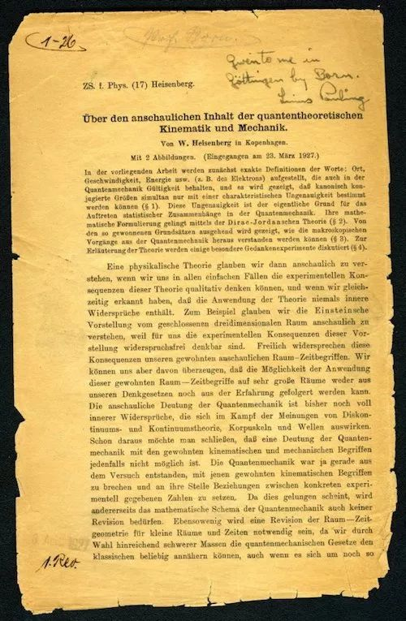
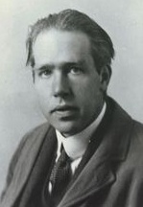
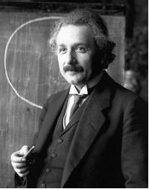
3.5 The Uncertainty Principle
3.5.1 lead-in of uncertainty principle
Werner Karl Heisenberg 1927
Earl Kennard 1927
Because of measurement?
Or intrinsic property?

Slide 39
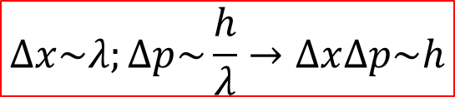
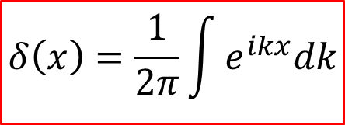


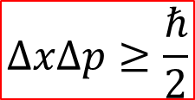
????

Slide 40
Making a particle out of waves
440 Hz + 439 Hz
440 Hz + 439 Hz + 438 Hz
440 Hz + 439 Hz + 438 Hz + 437 Hz + 436 Hz

Slide 41
Spatial extent of localized wave
Δx = spatial spread of ‘wave packet’
Spatial extent decreases as the spread in included wavelengths increases.

Slide 42

3.5.2 Proof of the general uncertainty principle
For any two observables F and G
$$[\hat{F},\hat{G}]=i\hat{k}$$
Define:

Slide 43

An integral with a parameter ξ:
$$[∆\hat{F},∆\hat{G}]=i\hat{k}$$

Slide 44

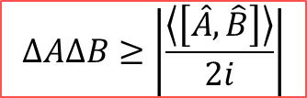

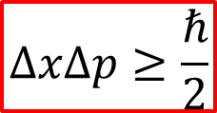
Conclusion:
The standard deviation of any observable A is:
This is the generalized uncertainty principle.
As an example,

Slide 45
There is, in fact, an “uncertainty principle” for every pair of observables whose operators do not commute.
We call them incompatible observables
Incompatible observables
Do not have shared eigenfunctions. At least they can not have a complete set of common eigenfunctions.
Compatible observables
Have shared eigenfunctions. They do admit complete sets of simultaneous eigenfunctions.

Slide 46
Another proof, for any observable A, we have
Hermitian
Define

Slide 47
Likewise, for any observable, B,
Hermitian
Define
Therefore, by using the Schwarz inequality,

Slide 48
For any complex number z,
Letting

Slide 49
And we have

Slide 50
Similarly
We also have
Where
is the commutator of the two operators.

Slide 51
Conclusion:
This is the generalized uncertainty principle.
As an example,

Slide 52
3.5.2 The Minimum-Uncertainty Wave Packet
For harmonic oscillator, we have:
Problem: What is the most general minimum-uncertainty wave packet?

Slide 53
Therefore,
c must be purely imaginary.
Then the necessary and sufficient condition for minimum uncertainty is
Recall
If we set and then, for the position-
momentum uncertainty principle this criterion becomes:

Slide 54
Evidently the minimum-uncertainty wave packet is gaussian.

Slide 55

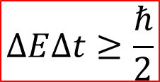
3.5.3 The Energy-Time Uncertainty Principle
The position-momentum uncertainty principle is often written in the form：
Similarly, the energy-time uncertainty principle can be written by
In non-relativistic QM, we must derive the energy-time uncertainty principle。

Slide 56


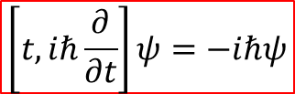

Right or wrong?

Slide 57


What is time?
quid est ergo tempus?
si nemo ex me quaerat, scio;
si quaerenti explicare velim, nescio.
------The Confessions of Saint Augustine
Time is not an observable, but standard of change of observable!

Slide 58
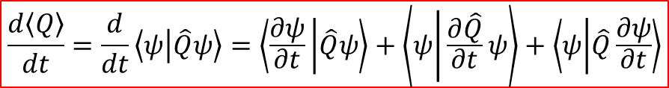

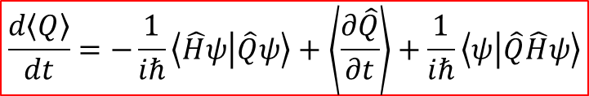

Derivation of the energy-time uncertainty relation:
let us compute the time derivative of the expectation value of some observable, Q(x,p) :

Slide 59
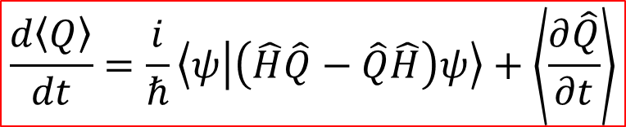

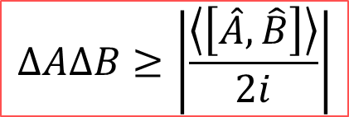

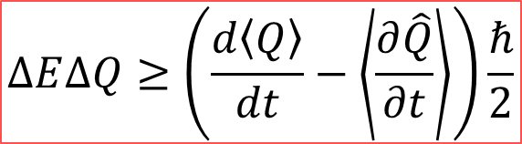

assume that Q does not depend explicitly on t, and then:

Slide 60
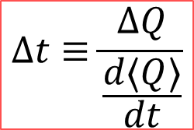

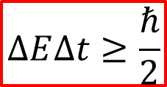
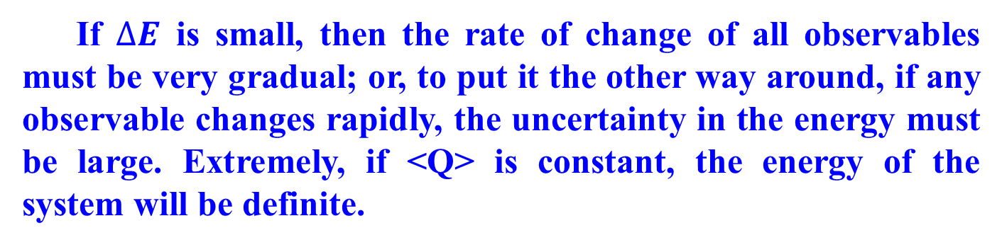
Time is standard of change of observable,then:

Slide 61

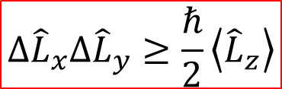
Example:

Slide 62
Example 3.5: In the extreme case of a stationary state, for which the energy is uniquely determined, all expectation values are constant in time ( )——as in fact we noticed some time ago. To make something happen you must take a linear combination of at least two stationary states——say:
In this state, the period of oscillation is

Slide 63
3.6 Dirac Notation
1. Expansion of vector in Hilbert space by different basis
(1) Imagine an ordinary vector A in two real dimensions.
In the system S : coefficients
Two independent bases, two components.
In the basis S’ : coefficients

Slide 64
(2) Imagine an state vector in Hilbert space. We can also express it with respect to any number of different bases. The dimension of the Hilbert space is determined by the number of the independent bases.
In the basis of position eigenfunctions: coefficients
where
is the eigenfunction of the with eigenvalue x.
In the basis of momentum eigenfunctions: coefficients
where
is the eigenfunction of the with eigenvalue p.
In the basis of energy eigenfunctions: coefficients
where
is the eigenfunction of the with eigenvalue E_{n}.

Slide 65
(3) Equivalence of them

Slide 66
(4) Transformation

Slide 67
In Hilbert space, operator are linear transformation acting on a vector to get another vector, that is,
With respect to a particular basis , they can be expanded by
Taking the inner product with

Slide 68
Here the operators are represented (with respect to a particular basis) by their matrix elements Q_{mn}.
Then we have
That means the matrix elements tell you how the components transform.
In Hilbert space, if we choose a certain basis which admits only a finite number N of linearly independent bases, then any vector will live in an N-dimensional vector space, which can be represented as a column of N components with respect to this basis:

Slide 69
Vector (state/wave function)
The operators will take the form of ordinary matrices with N-dimension.
Operators
But for many systems, there are often exist infinite dimensional vector spaces.

Slide 70
Example 3.5: Imagine a system in which there are two linearly independent states:
The most general state in this space is a normalized linear combination of them:
The Hamiltonian can be expressed as a Hermitian matrix; suppose it has the specific form
where g and h are real constants. If the system starts out (at t=0) in state |1>, what is its state at time t ?

Slide 71
Solution: The evolutionary equation says
(1) We solve it: time-independent Schrodinger equation:
We write it in the form of :
that is, the eigen-equation of H is
The characteristic equation is to used to calculate eigenvalues

Slide 72
Now to determine the eigenvectors:
So the normalized eigenvectors are

Slide 73
(2) We expand the initial state as a linear combination of eigenvectors of Hamiltonian:
Then we tack on the standard time-dependent terms
Neutrino oscillation: |1> electron neutrino |2> muon neutrino
Rabi oscillation: |1> excited state |2> ground state

Slide 74
2. Dirac’s bracket notation
(1) Dirac’s bra and ket
Inner product bracket:
bracket
bra
c
ket
is a vector, but what is ?
Any can be thought of as an instruction to integrate:

Slide 75
In a finite-dimensional vector space, the vectors or kets expressed as a columns,
and its corresponding bra is a row vector:
The collection of all bras constitutes another vector space---the so-called dual space.

Slide 76
(2) The powerful of Dirac’s notation
Inner product:
Projection operator:
If is a normalized vector, the operator P picks out the portion of any other vector that “lies along”
Completeness condition:
If is a discrete orthonormal basis,

Slide 77
Then any vector can be expanded by
Then the operator:
Similarly, if is a Dirac orthonormalized continuous basis,
Then the completeness condition will be

Slide 78
Representation transform

