Slide 1
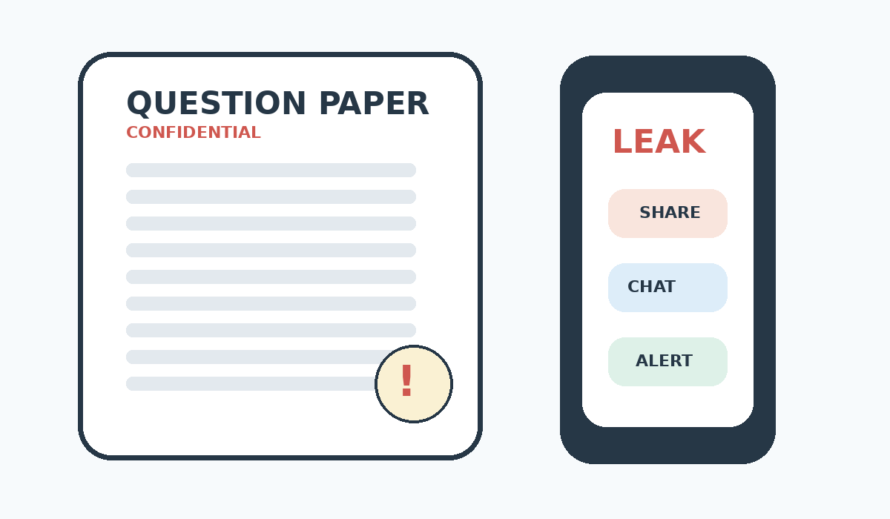
PAPER LEAKS
IN RECENT TIMES
A current-affairs presentation on exam integrity, the NEET-UG 2026 case, and prevention.
EMPLOYABILITY SKILLS
PRESENTED BY
PRABHAT RAI
FAIRNESS • TRUST • RESPONSIBILITY • SECURITY
CURRENT-AFFAIRS PRESENTATION

Slide 2
WHAT IS A PAPER LEAK?
A clean 5W1H overview
WHAT
Unauthorized access
Exam material is obtained or circulated before the scheduled test.
WHO
People involved
Investigations may examine insiders, intermediaries, candidates or networks.
WHEN
Before the exam
The key issue is access to confidential content before candidates sit the paper.
WHERE
Physical + digital
Material can move through secure rooms, phones or messaging platforms.
WHY
Why it happens
Possible motives include money, unfair advantage or organized cheating.
HOW
How to prevent it
Restrict access, keep audit trails, strengthen cybersecurity and act quickly.
CORE IDEA
An exam should measure preparation—not access to confidential material.
EMPLOYABILITY SKILLS • PAPER LEAKS IN RECENT TIMES • 2/5 | General definition; examination-security principles

Slide 3
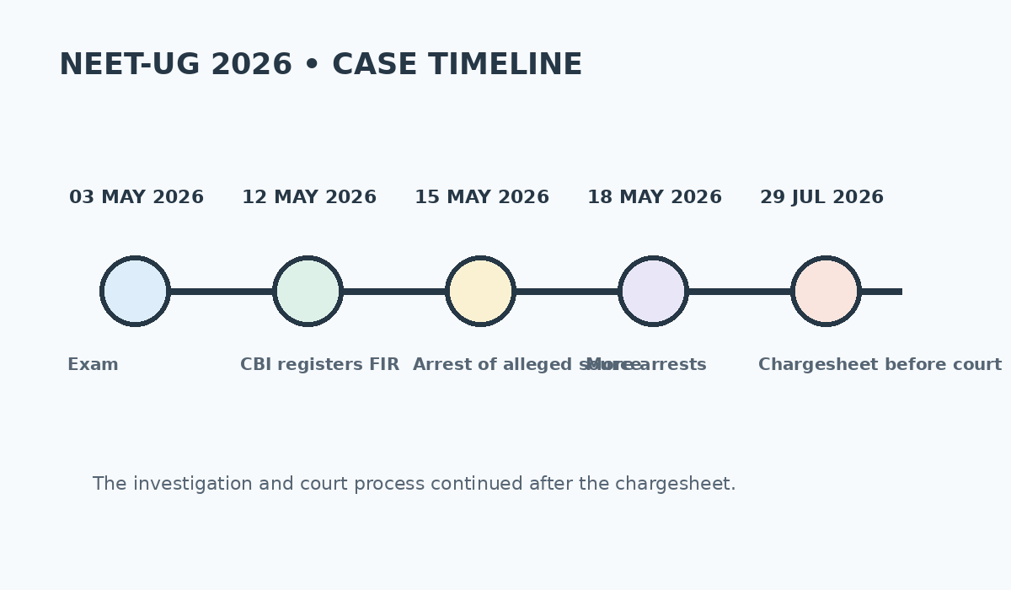
RECENT CASE: NEET-UG 2026
Key dates from the CBI investigation and court process
03 MAY 2026
Exam held
NEET-UG 2026 was conducted by NTA.
12 MAY 2026
CBI registers FIR
CBI opened a case over alleged leak and irregularities.
28 JUL 2026
Chargesheet filed
CBI filed a chargesheet naming 13 accused before a Delhi fast-track court.
STATUS
The case continued through judicial proceedings; allegations and investigative findings are not the same as a final conviction.
EMPLOYABILITY SKILLS • PAPER LEAKS IN RECENT TIMES • 3/5 | PIB/CBI releases; The Indian Express, Jul–Sep 2026

Slide 4
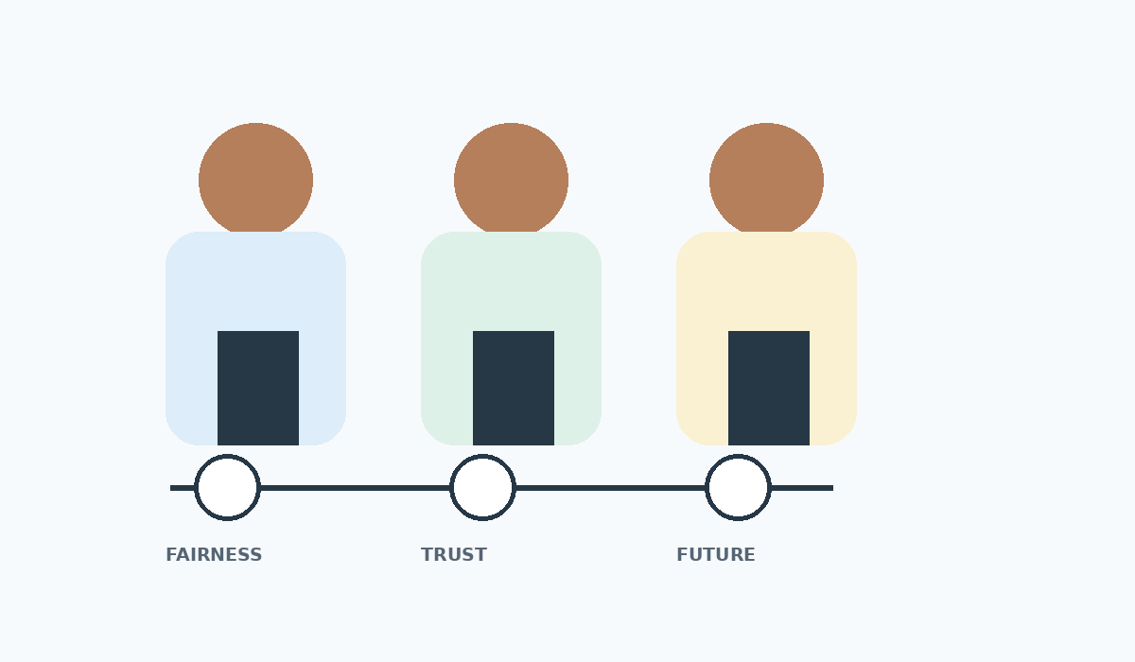
WHY PAPER LEAKS MATTER
The impact reaches students, institutions and public trust
STUDENTS
Fairness
Honest candidates can feel disadvantaged when confidential material is leaked.
TRUST
Confidence
Irregularities can weaken confidence in examination systems.
RESULTS
Disruption
Cancellations, investigations or re-tests can affect schedules and admissions.
SOCIETY
Merit
Competitive exams influence education and career opportunities.
EMPLOYABILITY CONNECTION
Integrity • responsibility • accountability • trust
EMPLOYABILITY SKILLS • PAPER LEAKS IN RECENT TIMES • 4/5 | Impact summary; current-case facts on Slide 3

Slide 5
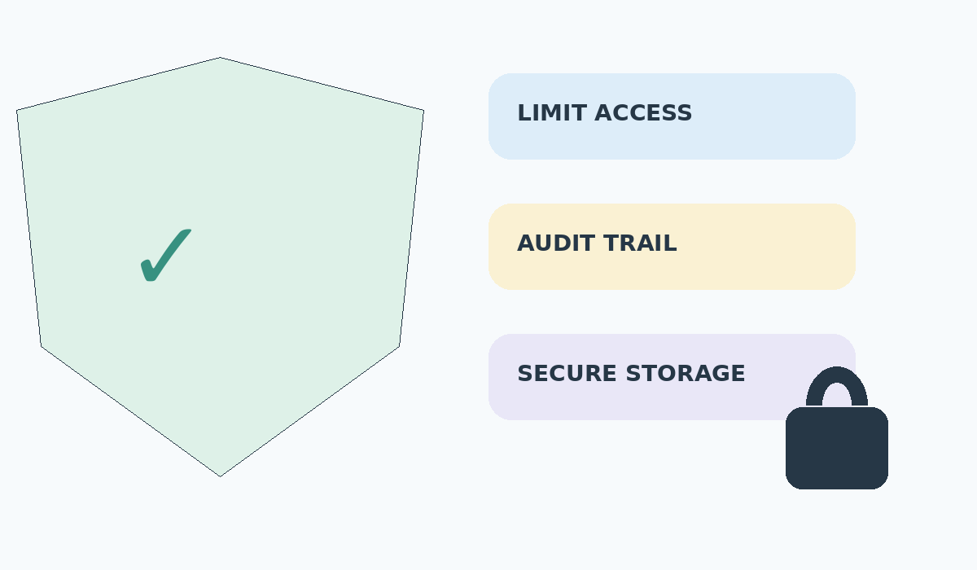
HOW CAN PAPER LEAKS BE PREVENTED?
Technology + process discipline + accountability
01
Limit access
Only authorized personnel should access confidential exam material.
02
Audit activity
Track access, movement, printing and unusual activity.
03
Secure channels
Use strong cybersecurity and controlled communication systems.
04
Act on evidence
Investigate allegations fairly and apply the law where wrongdoing is established.
KEY MESSAGE
A secure exam system protects fairness, trust and opportunity.
THANK YOU • ANY QUESTIONS?
EMPLOYABILITY SKILLS • PAPER LEAKS IN RECENT TIMES • 5/5 | Exam-security best practices; NEET-UG sources above

