Slide 1

Audio Amplifier
Electronics Workshop
Team:
Rohan Gupta - 2020112022
Pranav Manu – 2020112019

Slide 2
Audio Amplifier
The goal of audio amplifiers is to reproduce input audio signals at sound-producing output elements, with desired volume and power levels—faithfully, efficiently, and at low distortion.
Audio frequencies range from about 20 Hz to 20 kHz, So the amplifier must have good frequency response over this range (less when driving a band-limited speaker, such as a woofer or a tweeter).
Following are the stages of a general audio Amplifier:
Mic
Pre-Amp
Gain
Filter
Power Amp
Load

Slide 3
Mic
A transducer which converts sound to voltage.
Microphones produce very small ac signals that have to travel across long wires to the preamplifier; therefore, impedance is vital at this first stage to prevent signal loss

Slide 4
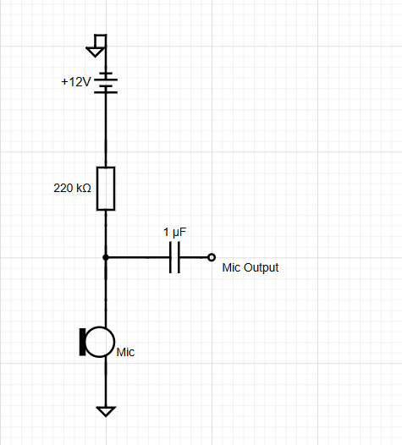
Mic Circuit
As we can see that this circuit consists of simple components like a resistor and capacitor, here resistor is used to limit current and the capacitor is responsible for amplifier gain which you can connect with this circuit to amplify the signals. This simple condenser mic circuit is to convert the acoustic sound signal into an electric audio signal.

Slide 5
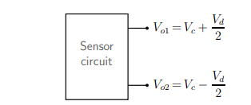
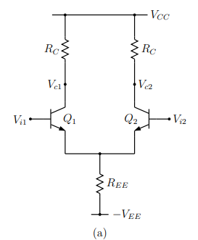

Pre-Amp
Preamplifier is a type of electronic amplifier. It doesn't have enough power to feed speakers. Rather a preamplifier amplifies weak signals, for example from a microphone, and removes noise for electronic processing or distribution.
Preamp boosts a low-level signal, making it line level.
A typical sensor circuit produces an output voltage between nodes A and B (see Fig. 1), where Vc is called the “common-mode” voltage and Vd the “difference-mode” or “differential” voltage. The common-mode voltage is a result of the biasing arrangement used within the sensor
We don’t require common mode voltage, so we use differential amplifier circuit as pre-amp to amplify differential mode voltage which is the quantity of actual interest.
The output of differential amplifier is given by:
$$V_{out }= A_{d}V_{id}+ A_{C}V_{ic}$$
where Ad is the differential gain, and Ac is the common-mode gain. A good differential amplifier should reject Vic entirely, i.e., it should have Ac = 0. In reality, Ac for a differential amplifier is small but finite, and a figure of merit called the “Common-Mode Rejection Ratio” (CMRR) is used to indicate the effectiveness of the amplifier in rejecting common-mode inputs. The CMRR is defined as
$CMRR= \left|\frac{A_{d}}{A_{c}}\right|$.
Fig. Example of common-mode and difference-mode voltages.
Fig. Practical implementation of BJT differential amplifier.

Slide 6
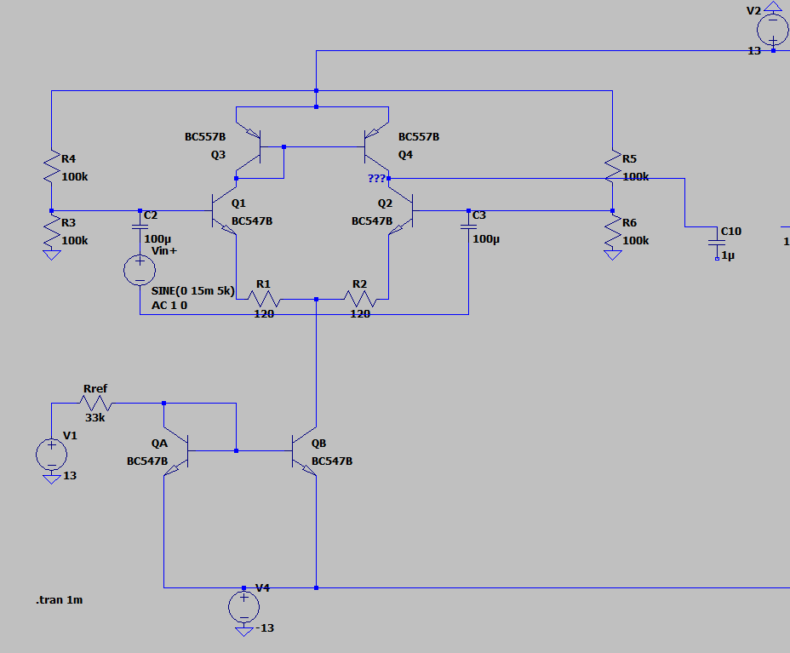

Pre-Amp circuit
A differential amplifier is designed to give the difference between two input signals. We have used differential amplifier with active load because Higher load resistance, higher output gain.
Q3 and Q4 are connected in a current mirror configuration. ·If no input signal is applied, that is, both bases are grounded. I(through diff amp) is split into equal between Q1 and Q2.
By increasing REE(Fig), the CMRR can be improved; however, this will reduce the bias current I0 and therefore the differential gain, so to solve this we use current source to bias, which makes I_{o} independent of the voltage at Node---.
$A_{d}=31.8 dB$
$A_{c}=−80 dB$,
$∴CMRR=111.8$

Slide 7
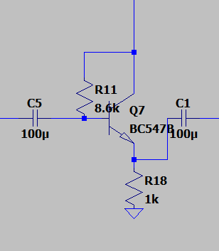

Buffer
The gain obtained in the differential amplifier stage is affected by the stages ahead, because of the changes in current drawn and reactance of further stages.
To make the differential amplifier stage independent of the other stages, we can use a buffer stage, also called a Source Follower.
The gain of a source follower is ideally equal to 1, and has a high input resistance (behaves like a voltmeter to previous stage), and a low output impedance (behaves like a voltage source to next stage).
$R_{in}=8380.7 Ω$
$R_{out}=2.11 Ω$
$Gain=0.998$

Slide 8
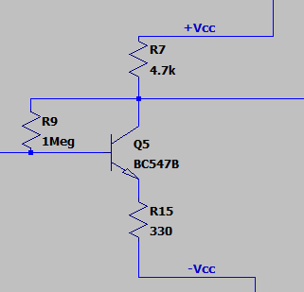
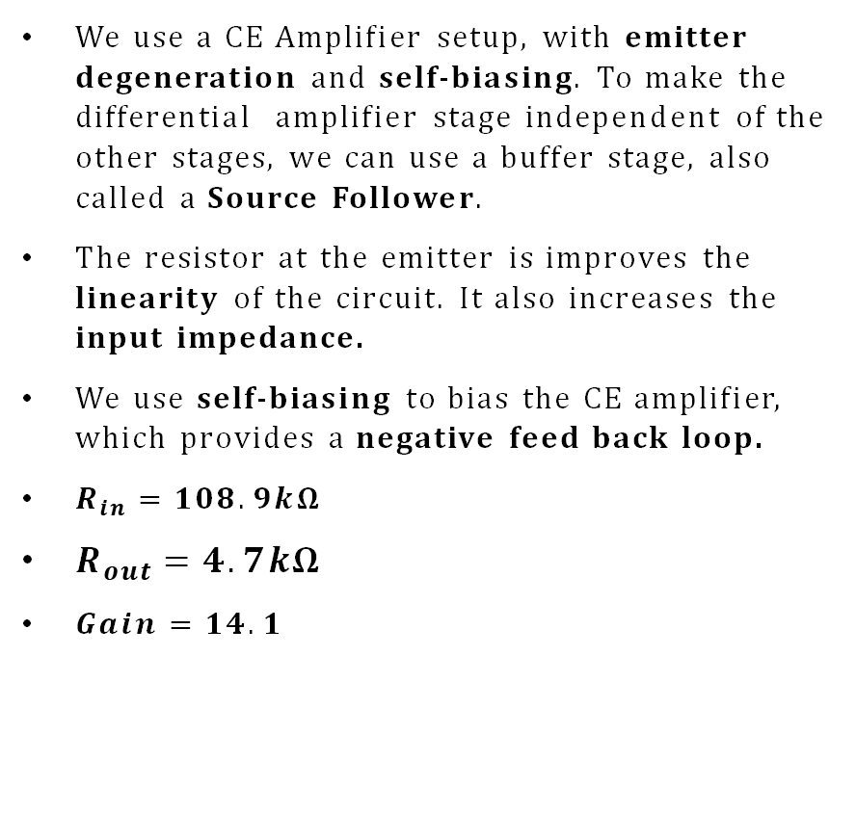
Gain Stage
We use a CE Amplifier setup, with emitter degeneration and self-biasing. To make the differential amplifier stage independent of the other stages, we can use a buffer stage, also called a Source Follower.
The resistor at the emitter is improves the linearity of the circuit. It also increases the input impedance.
We use self-biasing to bias the CE amplifier, which provides a negative feed back loop.
$R_{in}=108.9kΩ$
$R_{out}=4.7kΩ$
$Gain=14.1$

Slide 9
Types of Filters
Low Pass Filter: It allows lower frequencies to pass, but attenuates frequencies higher than a threshold.
High Pass Filter: It allows higher frequencies to pass, but attenuates frequencies lower than a threshold.
Band Pass Filter: It attenuates all frequencies except those in a particular range.
Band Stop Filter: It attenuates frequencies in a particular range.

Slide 10
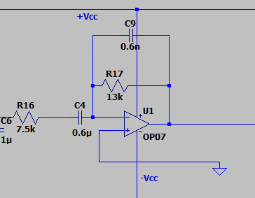
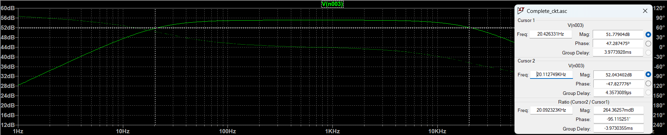
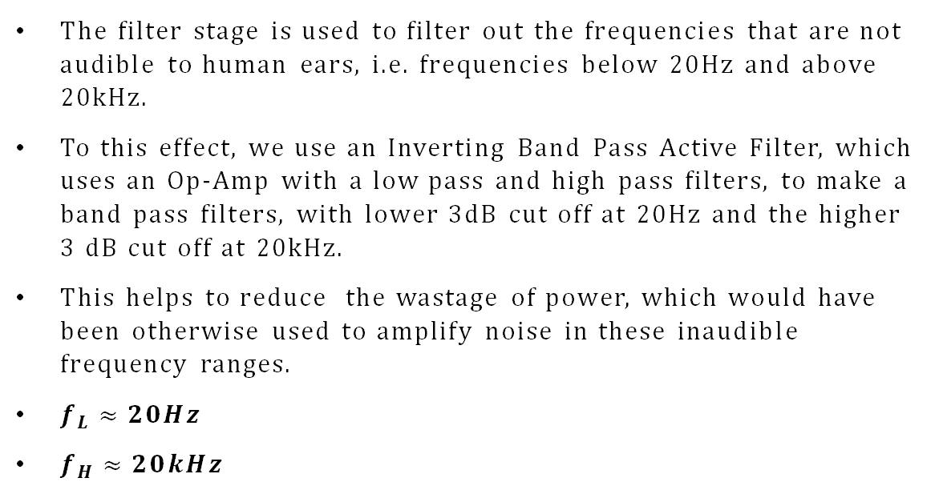
Filter Stage
The filter stage is used to filter out the frequencies that are not audible to human ears, i.e. frequencies below 20Hz and above 20kHz.
To this effect, we use an Inverting Band Pass Active Filter, which uses an Op-Amp with a low pass and high pass filters, to make a band pass filters, with lower 3dB cut off at 20Hz and the higher 3 dB cut off at 20kHz.
This helps to reduce the wastage of power, which would have been otherwise used to amplify noise in these inaudible frequency ranges.
$f_{L}≈20Hz$
$f_{H}≈20kHz$

Slide 11
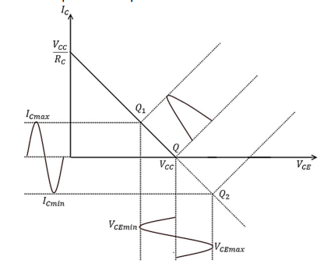
Power Amplifier
The power amplifier amplifies the Power of the signal to drive loads of output devices like speakers and headphones.
Class B amplifier is a type of power amplifier where the active device (transistor) conducts only for one half cycle of the input signal. That means the conduction angle is 180° for a Class B amplifier. Since the active device is switched off for half the input cycle, the active device dissipates less power and hence the efficiency is improved. Theoretical maximum efficiency of Class B power amplifier is 78.5%.
Fig.- Output characteristics Curve

Slide 12
Types of Power Amplifier
Type A: A Class A power amplifier is one in which the output current flows for the entire cycle of the AC input supply. The amplifiers single output transistor conducts for the full 360º of the cycle of the input waveform.
Type B: A Class B power amplifier is one in which the output current flows only during the positive half cycle of the input signal. The amplifiers two output transistors only conduct for one-half, that is, 180º of the input waveform.
Type AB: The amplifiers two output transistors conduct somewhere between 180º and 360º of the input waveform.

Slide 13
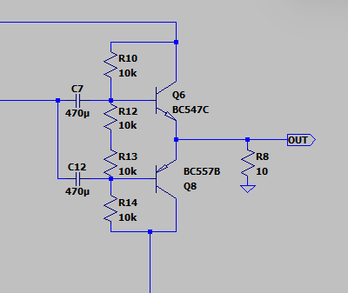

Power-Amplifier Circuit
To realize a practical Class B amplifier is to use a pair of active devices (transistors) arranged in push-pull mode where one transistor conducts one half cycle, and the other transistor conducts the other half cycle
The output from both transistors are then combined to get power amplified replica of the input.
$Current Gain=\frac{I_{c}}{I_{b}}=β_{ac} ; {C.G}_{ max}=650$
$I_{b}=\frac{V_{bb}−V_{be}}{R_{B}}$

Slide 14
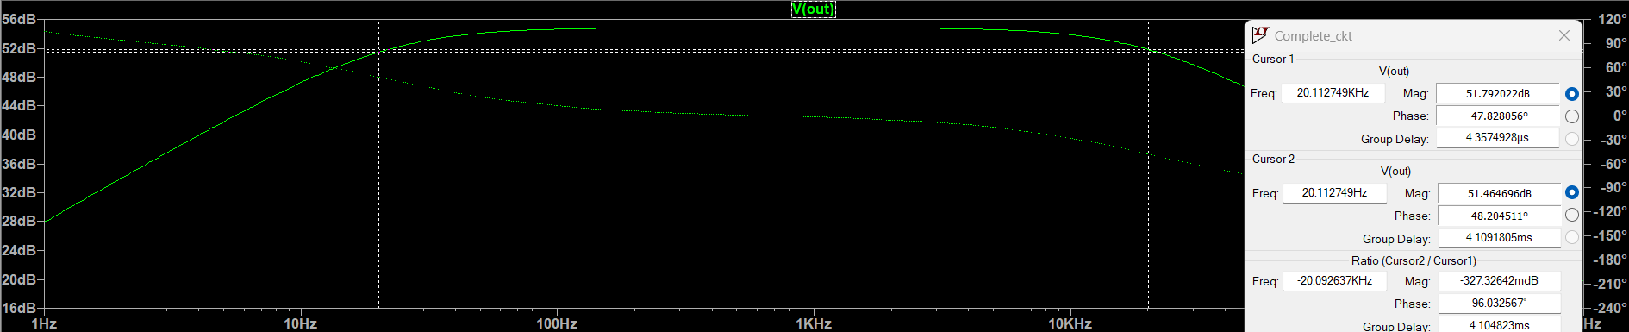
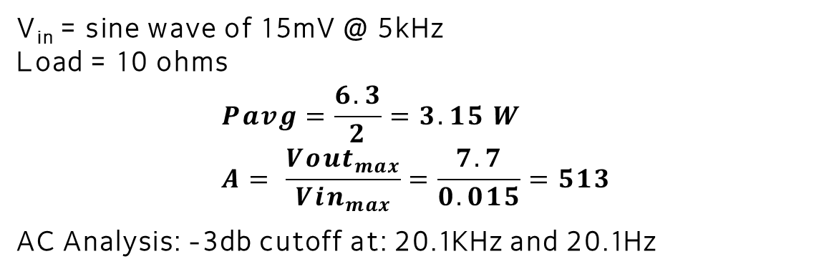
Final output
V_{in} = sine wave of 15mV @ 5kHz Load = 10 ohms $$Pavg=\frac{6.3}{2}=3.15 W \\ A= \frac{{Vout}_{max}}{{Vin}_{max}}=\frac{7.7}{0.015}=513$$
AC Analysis: -3db cutoff at: 20.1KHz and 20.1Hz

Slide 15
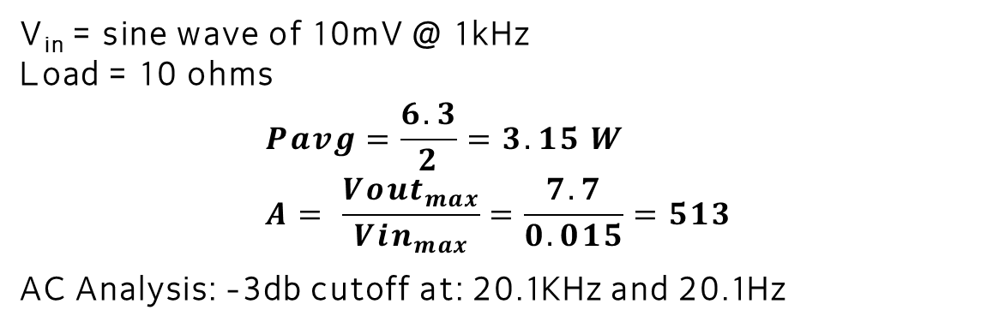
Hardware output
V_{in} = sine wave of 10mV @ 1kHz Load = 10 ohms $$Pavg=\frac{6.3}{2}=3.15 W \\ A= \frac{{Vout}_{max}}{{Vin}_{max}}=\frac{7.7}{0.015}=513$$
AC Analysis: -3db cutoff at: 20.1KHz and 20.1Hz

