Slide 1
GESTURE BASED WEB BROWSER
Under the guidance of
Ms. Roohi Sille
Assistant Professor
Department of Systemics
School of Computer Science and Engineering
Submitted by,
Pawan Chaturvedi
Pradeep Yadav
Pranjal Rai
Raghwandra Singh

Slide 2
ABSTRACT
These days scientists around the globe are effectively occupied with improvement of vigorous and productive sign language framework, all the more extraordinarily, hand gesture based human-machine interface for different applications.
Internet Browsers is an exceptionally regular programming application which we utilize each day, consistently. Utilization of innovation can utilize internet browsers more and simpler.
The Internet is developing at an exceptionally quick pace. The utilization of internet browser is likewise developing. The Internet is an answer for everything. Presently, everybody has at any rate 2-3 most often visited site. Presently, imagine a scenario in which visits on those destinations can be made more straightforward. Gesture recognition helps in the environment known to be HMI (humans communication with the machine and interact) and that does not include touch of mechanical devices. Our project aims to address the current situation and tried to make the use of a web browser easier.

Slide 3
INTRODUCTION
This project is able to open your favourite websites using image processing techniques and controlling your browser using the hand gestures like two finger, three finger, four finger. First we are taking the variable and then user needs to enter the name of his favourite websites for the three of the variable and with the help of opencv library a frame will open up and user have to show the particular hand gesture for which he wants to open the website on showing the hand gesture browser will automatically opens the assigned website in the new tab.

Slide 4
OBJECTIVES
The Objective of our project is to design a robust and efficient system which will be able to control the browser via hand gestures i.e. different hand gestures will be assigned to different sites. So, if we show a particular hand gesture, a particular site will open up in a new tab.

Slide 5
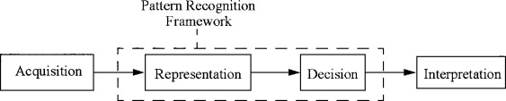
PROPOSED SYSTEM
Recognition of human gestures comes within the more general framework of pattern recognition. In this framework, systems consist of two processes: the representation and the decision processes. The representation process converts the raw numerical data into a form adapted to the decision process which then classifies the data.
PATTERN RECOGNITION

Slide 6
PROCEDURE
1) First we import opencv library
2) Then we use cv2.VideoCapture() to capture a video image by image from Camera.
3) We use a loop till the frame is opened.
4) Then we read a image from the video frame, crop the image, convert this image to
grayscale, apply gaussian blur onto the image, apply threshold technique onto the image.
5) After that we will check the version of the openCV library.
6) After that we will find the contours, max area , convex hull , find the convexity
Defects.
7) After this we will come on the mathematical part of the code which is for the
Counting the number of fingers we will apply Cosine rule and if the angle is less
Then 90 then we will count it as finger.
8) After reading the number of finger we will open the tab in the default browser.

Slide 7
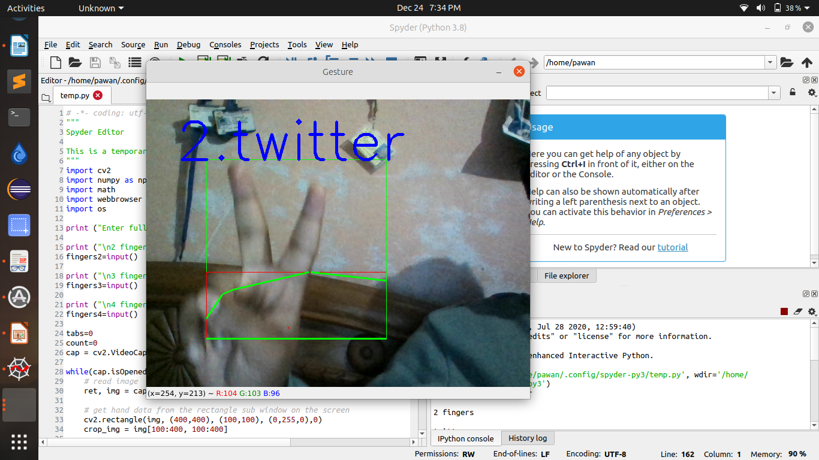
OUTPUT

Slide 8
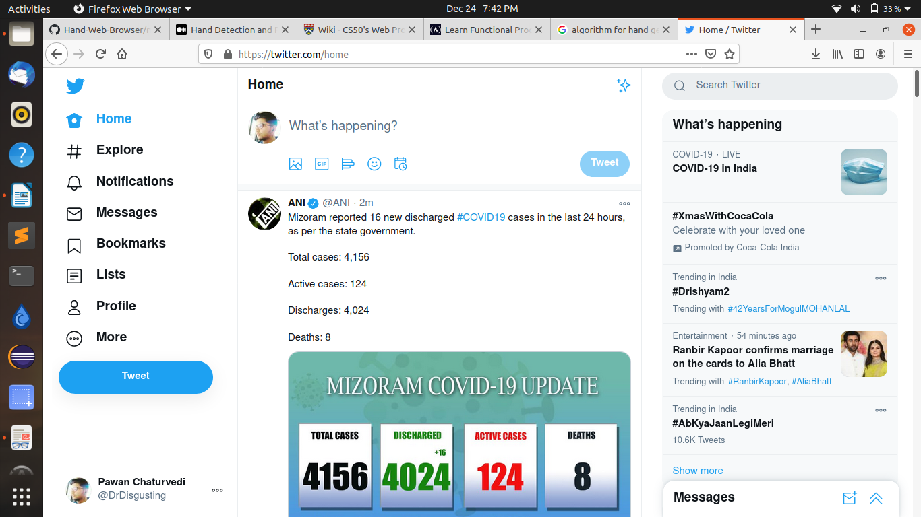
OUTPUT
FRAME SNAPSHOT

Slide 9
THANK YOU

