Slide 1
GESTURE BASED WEB BROWSER
Under the guidance of
Ms. Roohi Sille
Assistant Professor
Department of Systemics
School of Computer Science and Engineering
Submitted by,
Pawan Chaturvedi
Pradeep Yadav
Pranjal Rai
Raghwandra Singh

Slide 2
ABSTRACT
These days scientists around the globe are effectively occupied with improvement of vigorous and productive sign language framework, all the more extraordinarily, hand gesture based human-machine interface for different applications.
Internet Browsers is an exceptionally regular programming application which we utilize each day, consistently. Utilization of innovation can utilize internet browsers more and simpler.
The Internet is developing at an exceptionally quick pace. The utilization of internet browser is likewise developing. The Internet is an answer for everything. Presently, everybody has at any rate 2-3 most often visited site. Presently, imagine a scenario in which visits on those destinations can be made more straightforward. Gesture recognition helps in the environment known to be HMI (humans communication with the machine and interact) and that does not include touch of mechanical devices. Our project aims to address the current situation and tried to make the use of a web browser easier.

Slide 3
INTRODUCTION
This project is able to open your favourite websites using image processing techniques and controlling your browser using the hand gestures like two finger, three finger, four finger. First we are taking the variable and then user needs to enter the name of his favourite websites for the three of the variable and with the help of opencv library a frame will open up and user have to show the particular hand gesture for which he wants to open the website on showing the hand gesture browser will automatically opens the assigned website in the new tab.

Slide 4
OBJECTIVES
The Objective of our project is to design a robust and efficient system which will be able to control the browser via hand gestures i.e. different hand gestures will be assigned to different sites. So, if we show a particular hand gesture, a particular site will open up in a new tab.

Slide 5
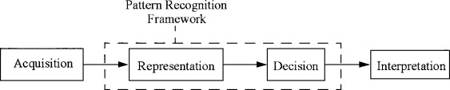
PROPOSED SYSTEM
Recognition of human gestures comes within the more general framework of pattern recognition. In this framework, systems consist of two processes: the representation and the decision processes. The representation process converts the raw numerical data into a form adapted to the decision process which then classifies the data.
PATTERN RECOGNITION

Slide 6
PROCEDURE
Python OpenCV: Capture Video from Camera
1) First we import opencv library
2) Then we use cv2.VideoCapture() to capture a video from camera.
3) We use a infinite loop using while(True)
4) The read() method to read frames using the defined object
5) imshow() method is used to show the frames in the video
6) If the user wants to break the infinite loop then he has to click on a specific key.

Slide 7
# import the opencv library import cv2 # define a video capture object vid = cv2.VideoCapture(0) while(True): # Capture the video frame # by frame ret, frame = vid.read() # Display the resulting frame cv2.imshow('frame', frame) # the 'p' button is set as the # quitting button you may use any # desired button of your choice if cv2.waitKey(1) & 0xFF == ord('p'): break # After the loop release the cap object vid.release() # Destroy all the windows cv2.destroyAllWindows()
CODE

Slide 8
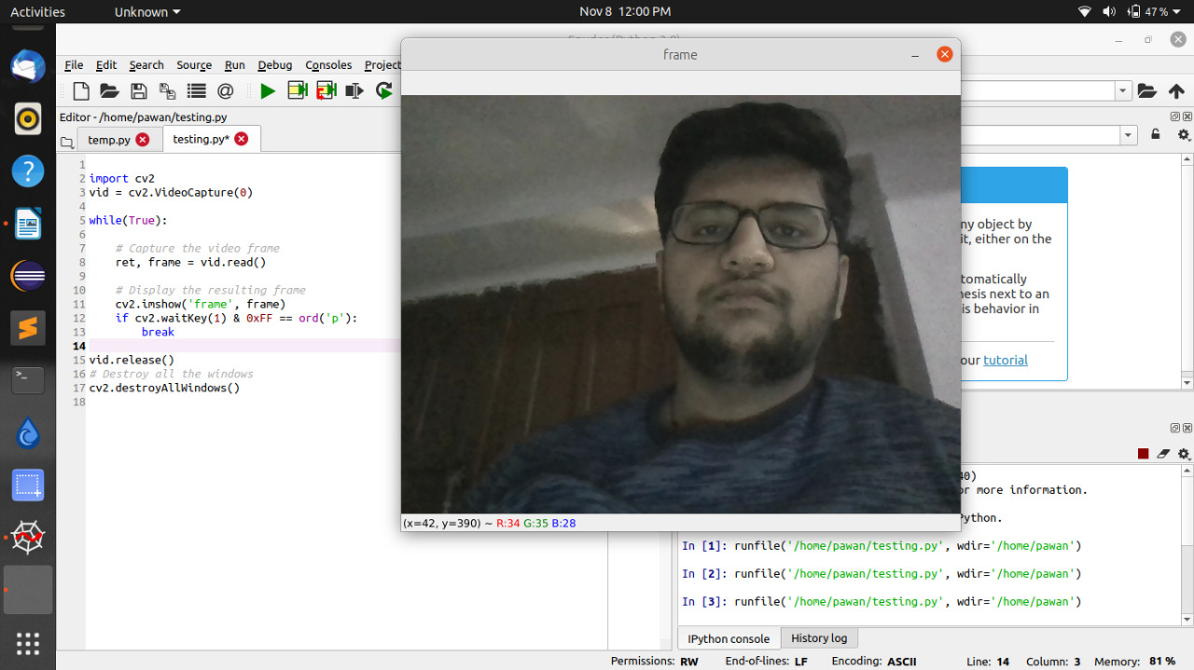
OUTPUT
FRAME SNAPSHOT

Slide 9
THANK YOU

