Slide 1
DevOps

Slide 2
Agenda
DevOPS Principle
Application Lifecycle
Quality Analysis
Why DevOPS ?
Understand System Flow
Goal

Slide 3
DevOPS Principles
Better Software , Faster Solution
Movement comes from OPEN SOURCE
When Development and Operations Synergize
Covers the “ENTIRE*” Application LifeCycle

Slide 4
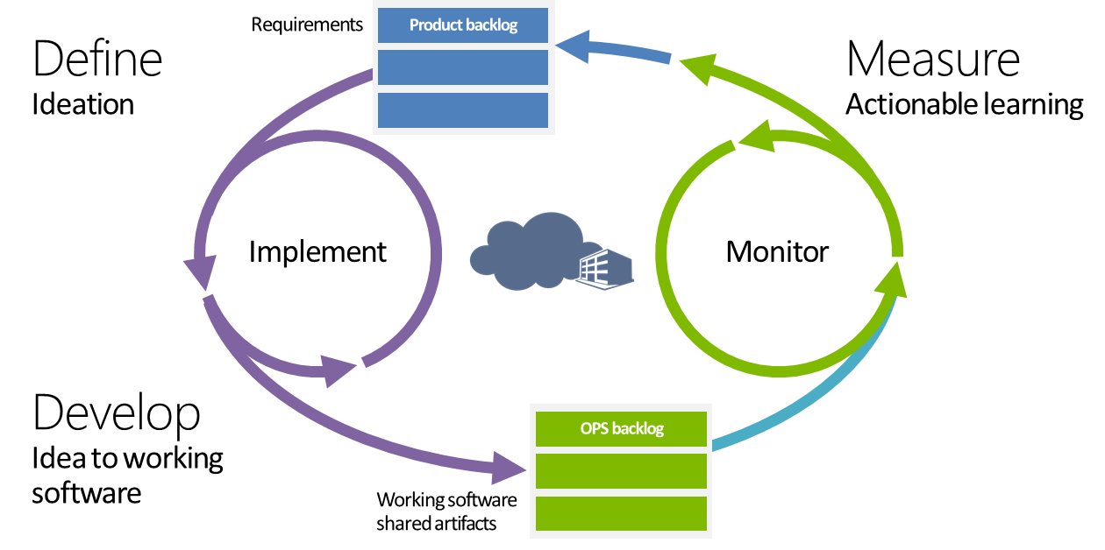
Application Lifecycle

Slide 5
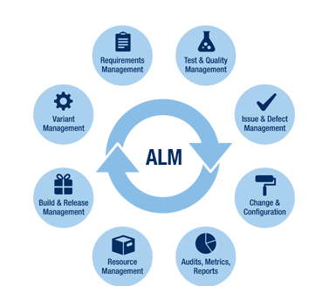
Application Lifecycle Management

Slide 6
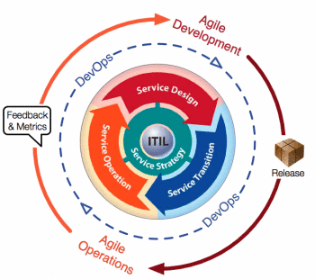
DevOPS and Agile

Slide 7


What Companies want to achieve
Communication of Knowledge and Integration of People
Better Process
Reality-based Measurements
What companies encounter instead
Distracted by day-to-day delivery pressures – 78%
Tools don’t integrate properly – 62%
Lack the necessary internal expertise – 56%

Slide 8
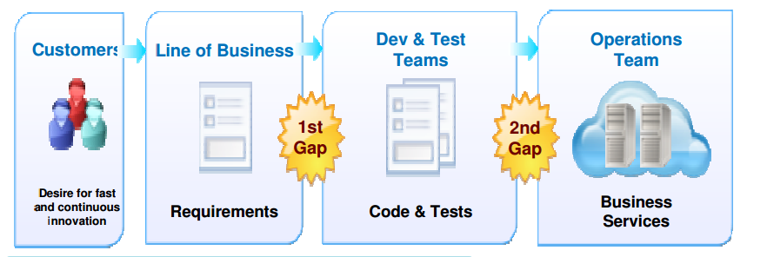
Delivery Challenges
Today’s business and technical needs are
pushing traditional delivery approaches to the
breaking point

Slide 9
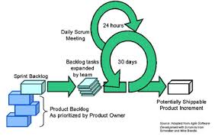
Addressing the gaps

Slide 10
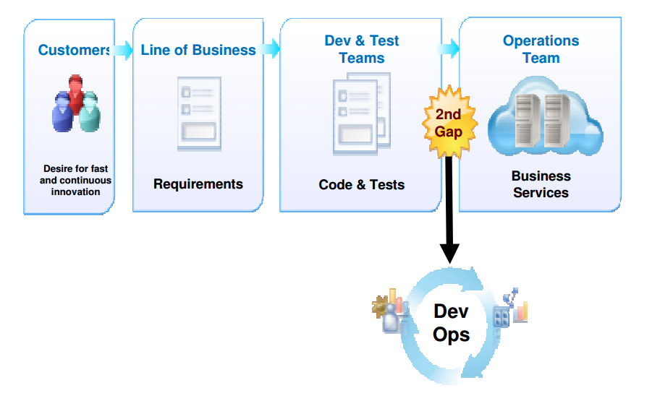
Addressing Application Lifecycle Management gaps

Slide 11
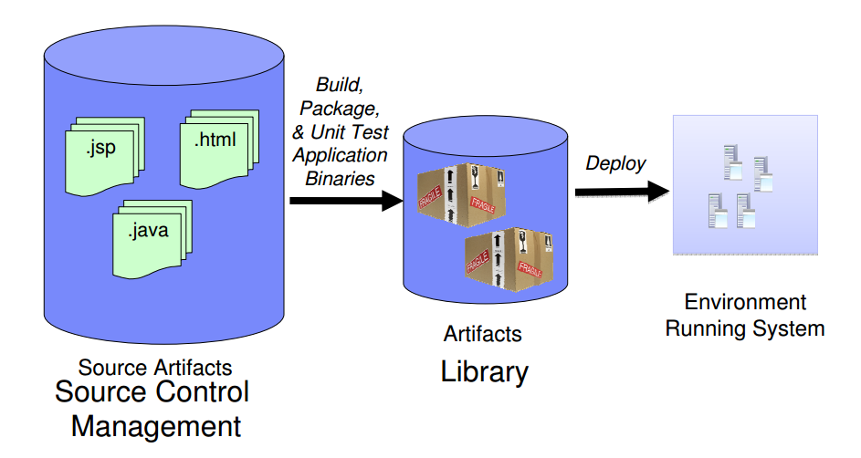
Automating development hand off today

Slide 12
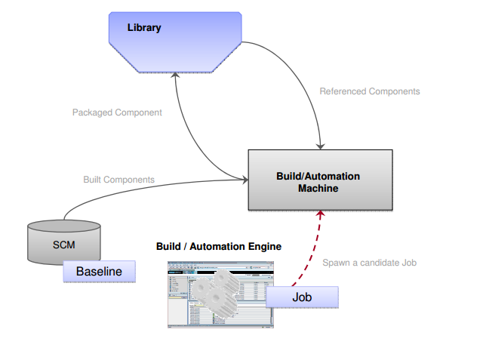
Build / Automation Phase
Track the Bill of Materials used in a build
Manage which build move onto the next stage

Slide 13
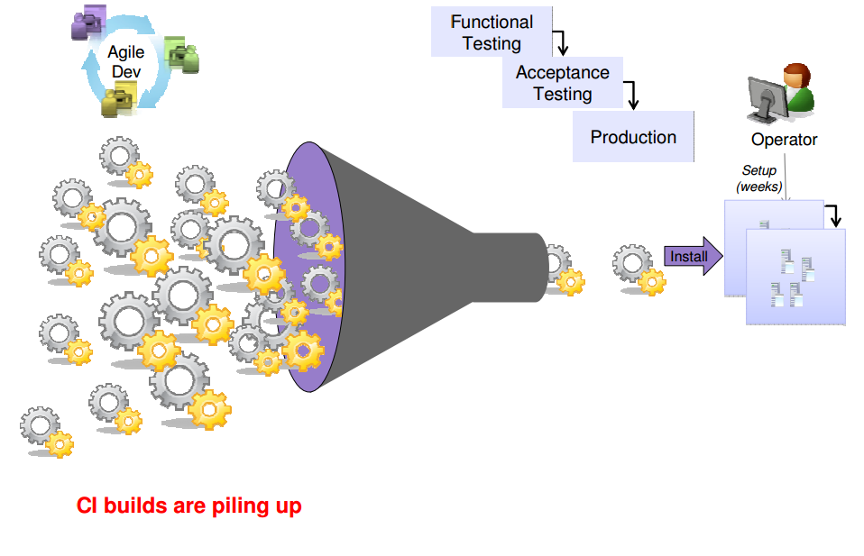
With only Agile Development improvements…
Test and Ops teams have increased pressures to keep up with increased loads but continue to use waterfall approaches and traditional tools.

Slide 14
Adjusting Delivery Mindset
Infrastructure Developer vs. Operator/Administrator
Need to bring a software development mindset to the operational areas
Replicate, where appropriate, standard architecture/development tools and methodologies
Use an Agile approach to delivery of routines
Continuous, incremental improvements and delivery of new functionality
Automated unit and integration testing improves operational runtimes
Source Control Management
Automation routines and scripts are fundamental to Operations
Managing Operations routines like source code offers several benefits:
Central point of truth as routines and environments change
Backup in case of loss
Identify possible regressions by comparing with prior versions
Example Managed Assets:
Perl, Jython, WSADMIN, ANT scripts, Service orchestration routines (opsware, buildforge, etc), Infrastructure Gold copies components

Slide 15
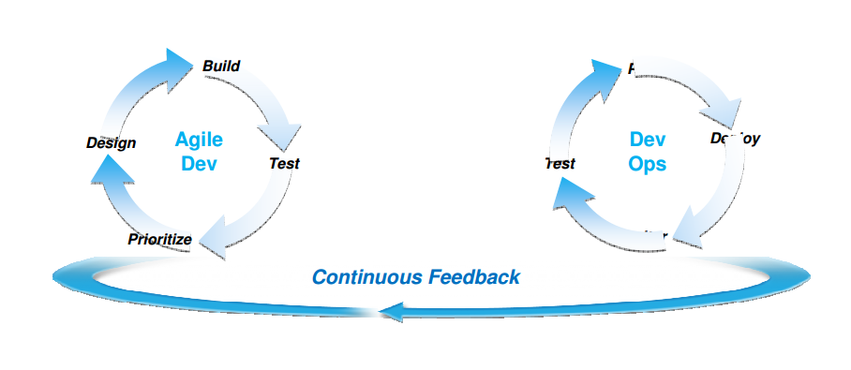
Agile Development and Delivery
Continuous Integration extends to Continuous Delivery
DevOps: Tighter alignment between Development & Operations
to increase application velocity with managed risk

Slide 16
DevOps Principles & Values
Collaborate across disciplines
Develop and test against a production-like system
Deploy frequently
Continuously validate operational quality characteristics

Slide 17
Principles for Better DevOps*
Collaborate
Do your Ops and Dev teams collaborate? Regularly?
Do you have agreed upon patterns for apps and platforms?
Do you have well defined delivery pipeline for apps and platforms?
Automate
Do your operation engineers understand how to developed well-structured reusable system configuration scripts?
Can you deploy a system in one step?
Do you provide Infrastructure and Platform as a Service for your development teams?
Can your developers launch, use, and destroy representative environments on demand without operator support?
Validate
Do you have automated tests to validate your application and platform function and security?
Do you validate platform software against expected KPIs, before deploying your application?
Do you deploy your applications daily and verify them?
Manage and Control
Do you use source control?
Do you have an issue tracking system for operations, linked to a bug database used for development?

Slide 18
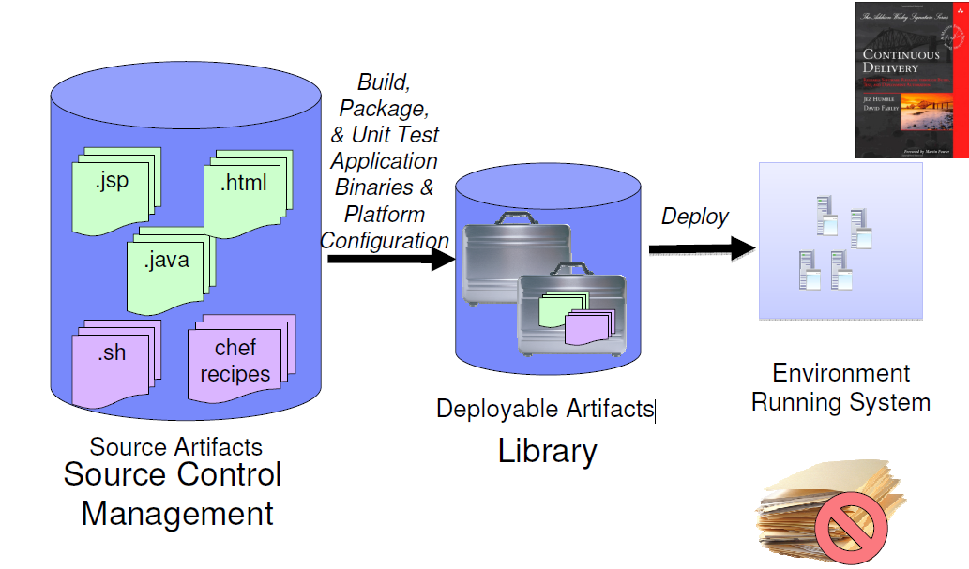
Delivery Pipeline
Using the same tools and methodologies to manage and deliver software and deployment configuration changes.

Slide 19
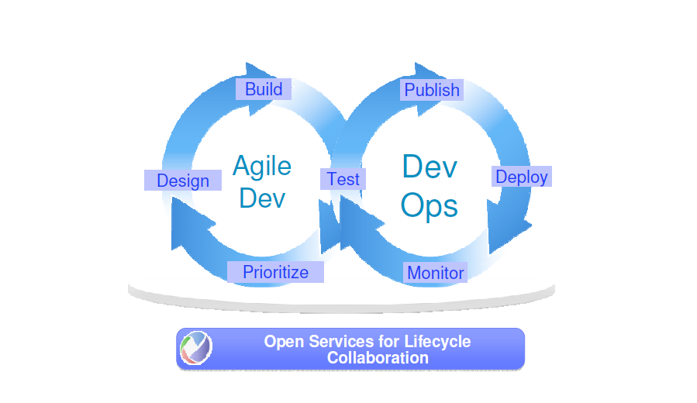
End-to-End Lifecycle Optimization

Slide 20
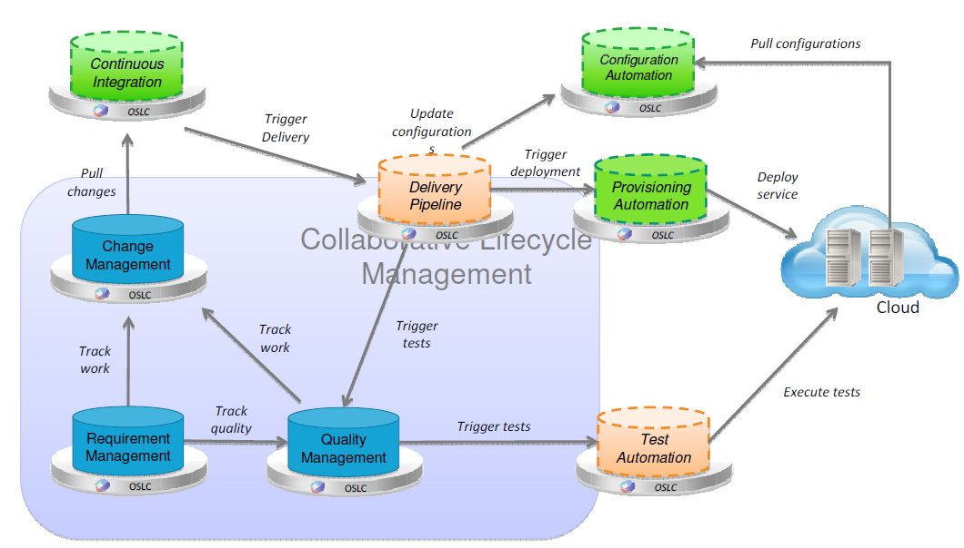
Lifecycle Management Reference Architecture

Slide 21
Any Questions?

Slide 22
Thank you!

