Slide 1
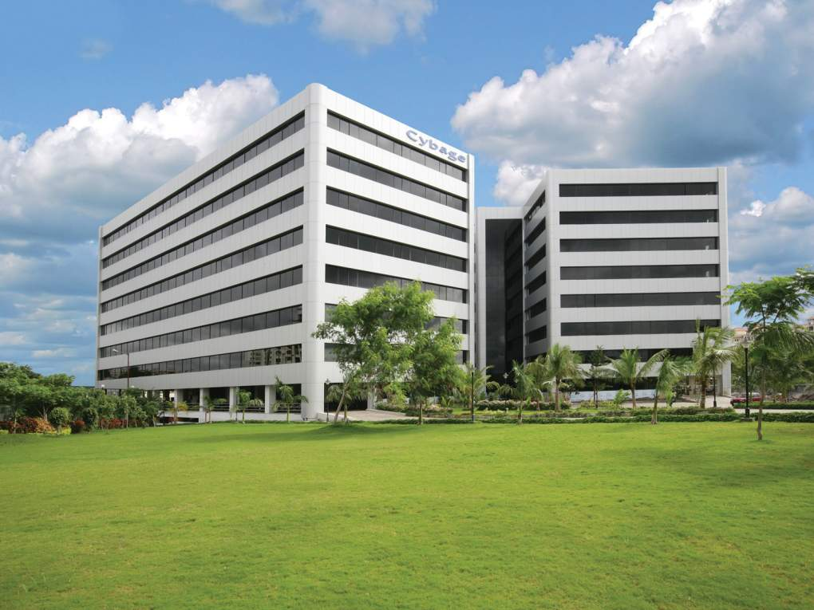

Welcome to Cybage
This document and all its contents contain information from Cybage Software Private Limited which may be privileged, confidential,
or otherwise protected from disclosure. The information is intended to be for the addressee(s) only. Any unauthorized disclosure,
copy, distribution, or use of the contents of this message is strictly prohibited.
Notes:
<number>

Slide 2
Authored and Presented by : Rajiv Rai
<number>

Slide 3
Monitoring
To monitor or monitoring generally means to be aware of the state of a system, to observe a situation for any changes which may occur over time, using a monitor or measuring device of some sort
Application performance monitoring
Network monitoring
System monitoring
Website monitoring
<number>

Slide 4
Nagios
Nagios monitors your entire IT infrastructure to ensure systems, applications, services, and business processes are functioning properly. In the event of a failure.
Capabilities to monitor applications, services, operating systems, network protocols, system metrics and infrastructure components with a single tool
Scalable: Can support up to thousands of devices and services.
<number>
Notes:
<number>

Slide 5
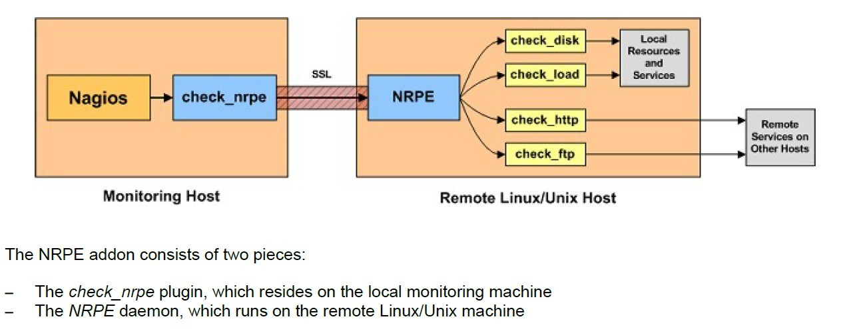
Architecture
<number>
Notes:
<number>

Slide 6
Benefits
Plan for infrastructure upgrades before outdated system cause failures
Respond to issues at the first sign of a problem
Automatically fix problems when they are detected
Coordinate technical team responses
Ensure your organization’s SLAs are being met
Ensure IT infrastructure outages have a minimal effect on your organization’s bottom line
Monitor your entire infrastructure and business processes
<number>
Notes:
<number>

Slide 7
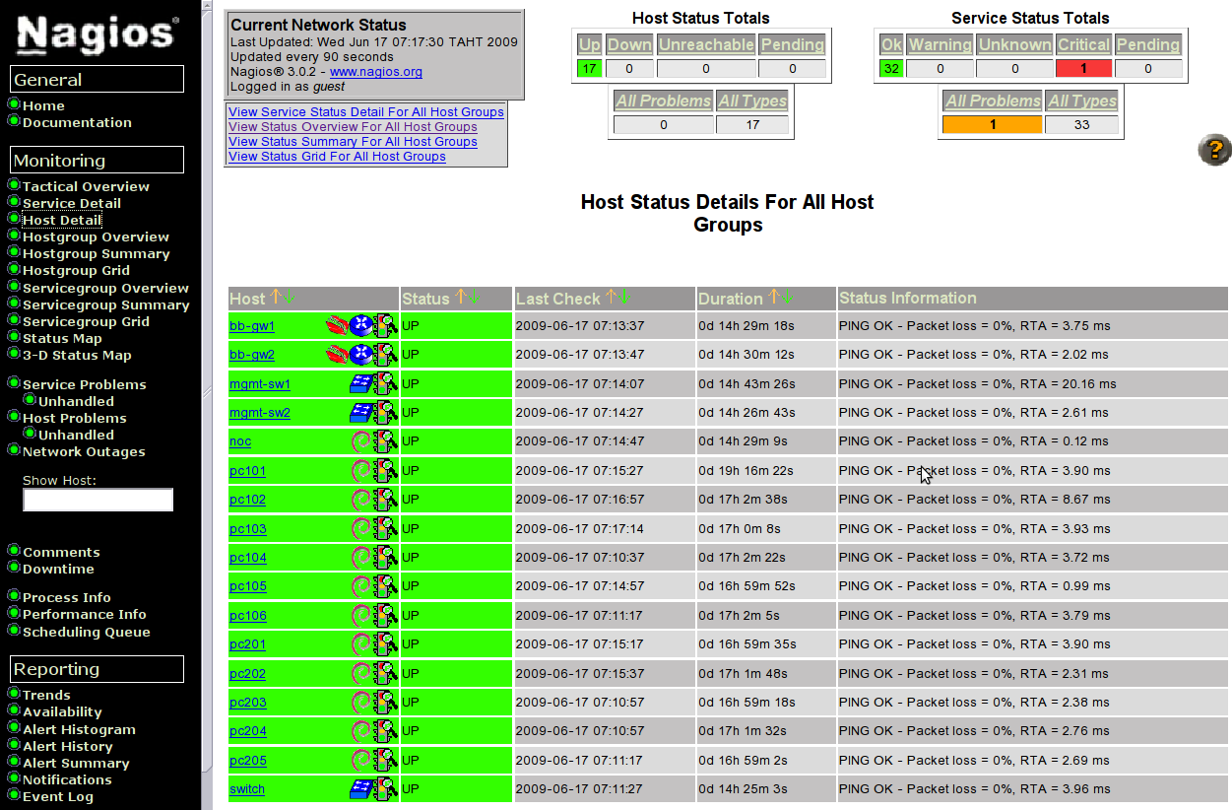
Snapshot
Configuration management is the process of configuring machines/servers/virtual machines,etc in order to bring them under desired software specifications and enforcing their state across IT infrastructure in an automated yet agile manner.
Configuration Management is the art of identifying, organizing and controlling modifications to the software being built by a programming team.
Goal is to maximize productivity by minimizing mistakes arising due to manual operations.
<number>

Slide 8
Any Questions?
<number>

Slide 9
Thank you!
<number>

