Slide 1
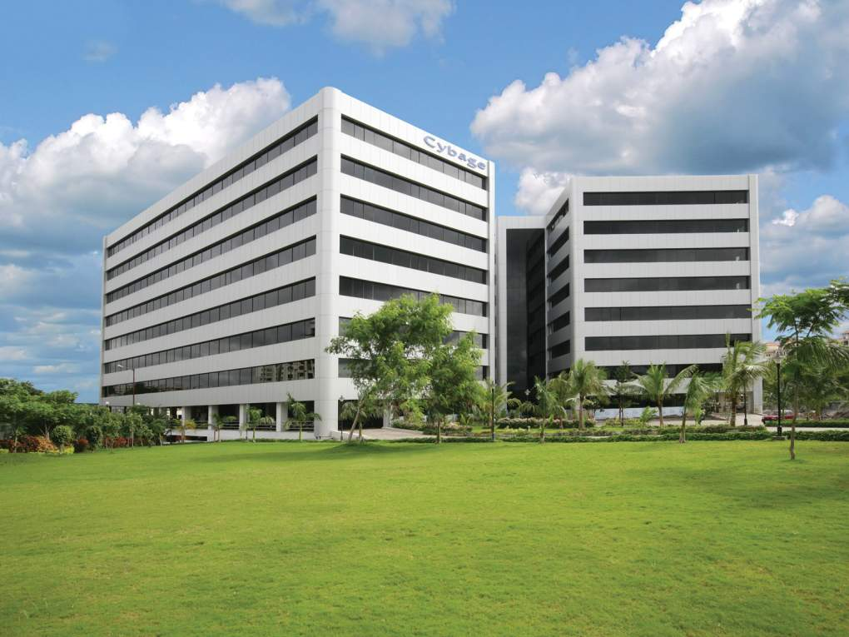

Title : Ant
Authored and Presented by : Cybage Software Pvt. Ltd.
This document and all its contents contain information from Cybage Software Private Limited which may be privileged, confidential,
or otherwise protected from disclosure. The information is intended to be for the addressee(s) only. Any unauthorized disclosure,
copy, distribution, or use of the contents of this message is strictly prohibited.

Slide 2
Agenda
  What’s Ant, and why to use it
  Installing and executing Ant
  Ant terminology and concepts
  Core Ant tasks

Slide 3
What’s ANT?
  Ant is a Java-based build tool with the full portability of pure Java code.
  According to Ant's original author, James Duncan Davidson. The name is an acronym for "Another Neat Tool".
  Ant is implemented in Java.
  Ant is Open Source, maintained by Apache.
  Ant is cross platform and portable.
  Ant is not a programming language

Slide 4
Ant is Operating System and Language Neutral
  Builds run on both Windows and UNIX/Linux systems
  Should run anywhere a Java VM runs
  Build targets can still do OS-specific tasks
  Works with anything that can be done from the command line
  Easy to extend (with Java)
  It is possible to extend with other languages as long as they have Java bindings but in practice, most people use Java to extend Ant

Slide 5
What can Ant do?
Ant can get source code from version control
      CVS, Subversion, Synergy, Perforce, ClearCase and many more
Ant can compile source code
Ant can run unit tests
      JUnit3, JUnit4, TestNG, or any arbitrary test application
Ant can package compiled code and resources
        jars, wars, ears, tars, zips, whatever

Slide 6
Limitation of IDE
IDE's are hard to automate
IDE's are harder to setup
IDE's are not ubiquitous
Not everyone likes the same IDE
All IDE's provide Ant integration, some even use Ant internally
Ant is the least common denominator, it can be relied upon to work in all scenario

Slide 7
Build Automation
Automated build procedures are a best practice
Manual procedures are mistake prone
Automated builds are self documenting
Automated builds improve productivity
Automated builds can be triggered by other tools
  Nightly builds using cron
  Continuous integration using CruiseControl

Slide 8
ANT software
Apache Ant is a software tool for automating software build processes. It is similar to Make but is implemented using the Java language, requires the Java platform, and is best suited to building Java projects.
-Wikipedia
Website to Download Windows Ant http://code.google.com/p/winant/
Download Apache Ant http://ant.apache.org/bindownload.cgi

Slide 9
Setup
Download latest stable zip file from http://ant.apache.org/bindownload.cgi
Unzip downloaded file into a directory
Setup Environment Variables
  Define ANT_HOME to be the location where Ant was unzipped

Slide 10
Setup continued…
  Define JAVA_HOME to be the location where the JDK is installed
  Add %ANT_HOME%\bin to the PATH
  External tools can be integrated with Ant
  http://ant.apache.org/external.html

Slide 11
Structure of a typical build.xml file
<?xml version="1.0"?>
<project name="MyFirstAntProject” default="MyTarget">
<target name="init">
<echo>Running target init</echo>
</target>
<target name="MyTarget" depends="init">
<echo>Running target MyTarget</echo> </target>
</project>

Slide 12
Best Practices
The Begin and End tags for project (<project> and </project>) MUST start and end the file.
The Begin <project> MUST have an attribute called default which is the name of one of the targets
Each build file must have at least one target
The Begin and End tags for <target> and </target> must also match EXACTLY.
Each target MUST have a name
Target depends are optional

Slide 13
Best Practices contd..
Anything between <echo> and </echo> tags is outputted to the console if the surrounding target is called
You can execute this from a DOS or UNIX command prompt by creating a file called build.xml and typing:
-Ant
Ant will search for the build file in the current directory and run the build.xml file:

Slide 14
Sample Output
Buildfile: C:\AntClass\Lab01\build.xml
init:
[echo] Running target init
MyTarget:
[echo] Running target MyTarget
BUILD SUCCESSFUL
Total time: 188 milliseconds

Slide 15
Ant Terminology
Ant Project – a collection of named targets that can run in any order depending on the time stamps of the files in the file system. Each build file contains one project.
Ant Target – a fixed series of ant tasks in a specified order that can depend on other named targets. Targets can depend only on other targets, not on projects or tasks. A target represents a particular item to be created, it can be a single item like a jar, or a group of items, like classes.
Ant Task – something that ant can execute such as a compile, copy or replace. Most tasks have very convenient default values.

Slide 16
Ant Project
<project> is the top level element in an Ant script
<project> has three optional attributes:
→name: the name of the project
→default: the default target to use when no target is supplied
→basedir: the base directory from which all path calculations are don

Slide 17
Target
Each project defines zero or more targets
A target is a set of tasks you want to be executed
When starting Ant, you can select which target(s) you want to have executed
When no target is given, the project's default is used
Targets can be conditionally executed (using if/unless)
A target can depend on other targets
Target dependencies are transitive

Slide 18
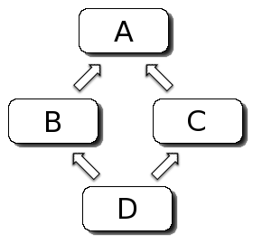
Target Example
<target name="A"/>
<target name="B" depends="A"/>
<target name="C" depends="A"/>
<target name="D" depends="B,C"/>
Suppose we want to execute target D, which depends upon B and C
C depends on A
B depends on A
so first A is executed, then B, then C, and finally D

Slide 19
Tasks
File Tasks
<copy>, <concat>, <delete>, <filter>, <fixcrlf>, <get>
Compile Tasks
<javac>
Compiles the specified source file(s) within the running (Ant) VM, or in another VM if the fork attribute is specified.
<apt>
Runs the annotation processor tool (apt), and then optionally compiles the original code, and any generated source code.
<rmic>
Runs the rmic compiler

Slide 20
Archive Tasks
<zip>, <unzip>
Creates a zipfile.
<jar>, <unjar>
Jars a set of files.
<war>, <unwar>
An extension of the Jar task with special treatment web archive dirs.
<ear>
An extension of the Jar task with special treatment enterprise archive dirs.
Testing Tasks
<junit>
Runs tests from the JUnit testing framework.
<junitreport>
Merges the individual XML files generated by the Junit task and applies a stylesheet on the resulting merged document to provide a browsable report of the test cases results

Slide 21
Property Tasks
<dirname>
Sets a property to the value excluding the last path element.
<loadfile>
Loads a file into a property.
<propertyfile>
Creates or modifies property files.
<uptodate>
Sets a property if a given target file is newer than a set of source files.

Slide 22
MISCELLANEOUS TASKS
<echo> Echoes text to System.out or to a file.
<javadoc> Generates code documentation using the javadoc tool.
<sql> Executes a series of SQL statements via JDBC to a database. Statements can either be read in from a text file using the src attribute, or from between the enclosing SQL tags.
Optionally you can also pass ant the name of the target to run as a command line argument
- ant init
Ant does not have variables like in most standard programming languages. Ant has a structure called properties.

Slide 23
Ant Properties
Ant properties are immutable meaning that once they are set they can not be changed within a build process!
This may seem somewhat odd at first, but it is one of the core reasons that once targets are written they tend to run consistently without side effects. This is because targets only run if they have to and you can not predict the order a target will run
Properties do not have to be used only inside a target. They can be set anywhere in a build file (or an external property file) and referenced anywhere in a build file after they are set.

Slide 24
Example: immutable
<project name="My Project" default="MyTarget">
<target name="MyTarget">
<property name="MyProperty" value="One"/> <!-- check to see that the property gets set --> <echo>MyProperty = ${MyProperty}</echo>
<!-- now try to change it to a new value --> <property name="MyProperty" value="Two"/> <echo>MyProperty = ${MyProperty}</echo> </target>
</project>

Slide 25
Apache Ant/Depends
The depends attribute can be included in the target tag to specify that this target requires another target to be executed prior to being executed itself. Multiple targets can be specified and separated with commas.
<target name="one" depends="two, three">
Here, target "one" will not be executed until the targets named "two" and "three" are, first.

Slide 26
Example: Ant Depends
<?xml version="1.0" encoding="UTF-8"?> <project default="three">
<target name="one">
<echo>Running One</echo>
</target>
<target name="two" depends="one"> <echo>Running Two</echo>
</target>
<target name="three" depends="two"> <echo>Running Three</echo>
</target>
</project>

Slide 27
Wildcards
Wildcards are used by ant to specify groups of files that have a pattern to their names.
- ? is used to match any character.
- * is used to match zero or more characters.
- ** is used to match zero or more directories.
Example :
<fileset dir="${server.src}" casesensitive="yes"> <include name="**/*.java"/>
<exclude name="**/*Test*"/>
</fileset>

Slide 28
References
Links
→ant.apache.org
→http://www.exubero.com/ant/antintro-s5.html
→Wikipedia.org
→WikiBooks
Books
→Ant: The Definitive Guide, 2nd Edition by Holzner Steve (April 14, 2005)
→Pro Apache Ant by Matthew Moodie (Nov 16, 2005)
→Java Development with Ant by Erik Hatcher and Steve Loughran (Aug 2002)
→Ant Developer's Handbook by Allan Williamson, et al. (Nov 1, 2002)

Slide 29
Thank You!

