Slide 1
Title: JIRA Agile
Authored and Presented by : Prashant Gore

Slide 2
Agenda
What is JIRA Agile?
Creating Project Board
Board Configuration
Ending a sprint
Scrum Project Reports

Slide 3

What is ?
A JIRA plugin for project Management Created by Atlassian
Born in September 2007
Interactive and simple interface
Provides ongoing Visibility and traceability
High level overview of Issues
Supports Scrum, Kanban methodologies

Slide 4
Creating Project Board
What is board?
Sets of Issues used by Agile Teams
No “one size fits all” approach
Plan, Work, Report modes
Board Types (Scrum and Kanban)

Slide 5
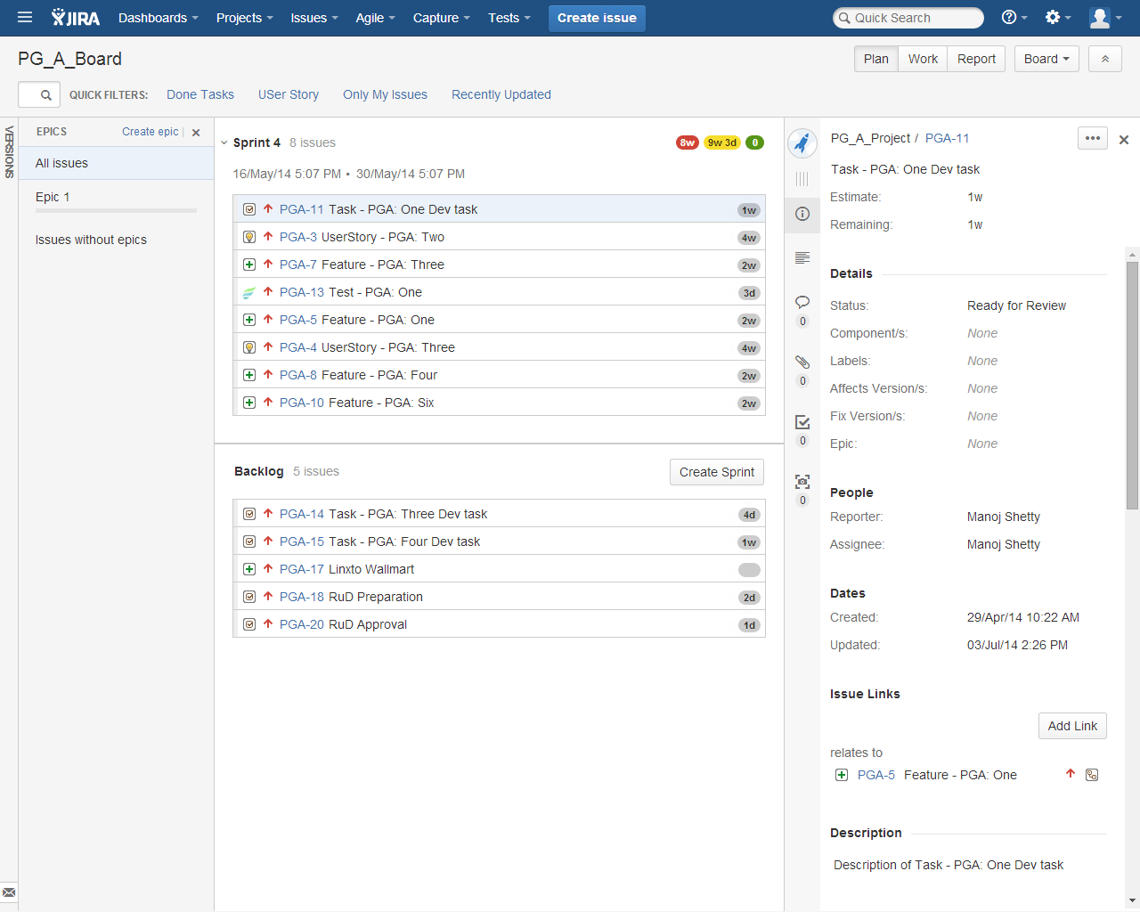
Creating Project Board… Plan Mode

Slide 6
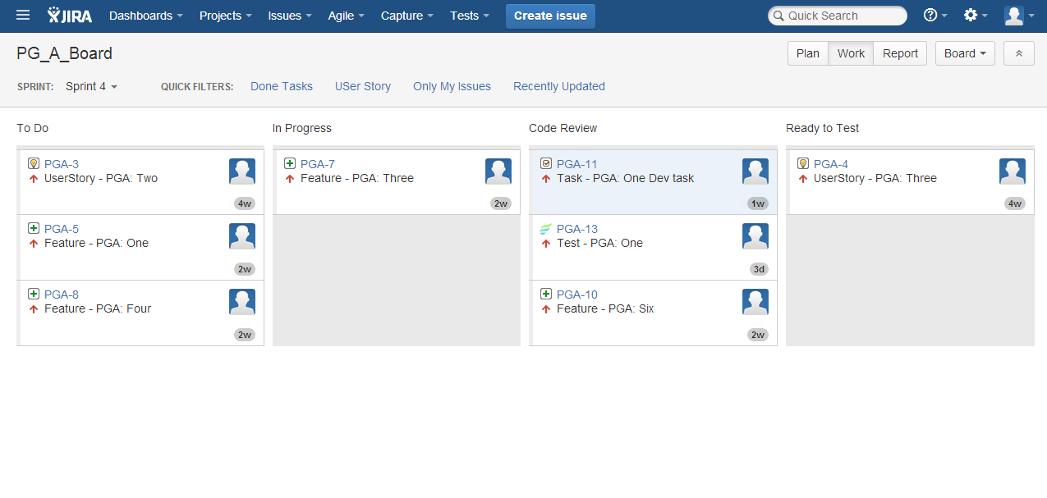
Creating Project Board… Work Mode

Slide 7
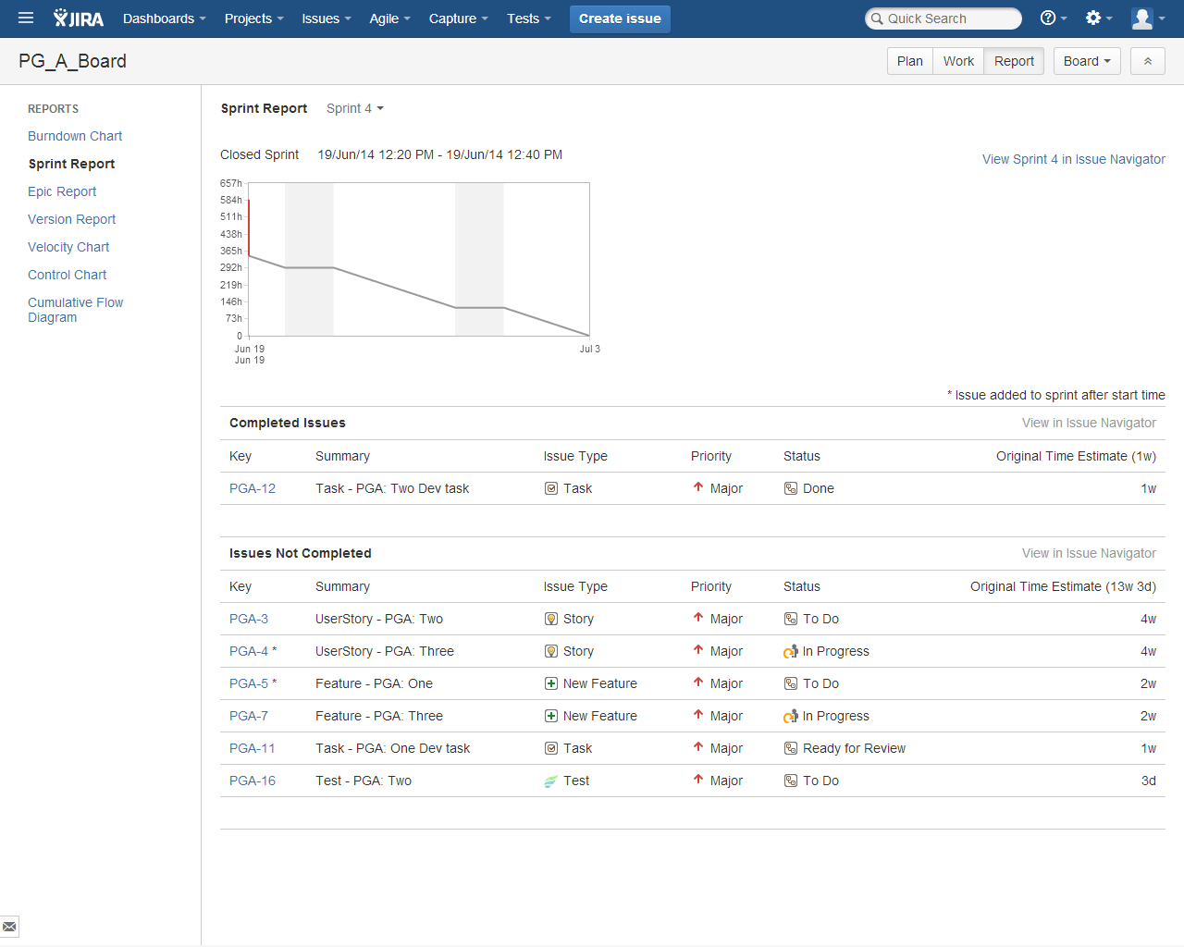
Creating Project Board… Report Mode

Slide 8
Board Configuration
Following point can be configured for a board
Filter
Column
Swimlines
Quick filters
Card colors
Estimation
Working Days
Issue Details View

Slide 9
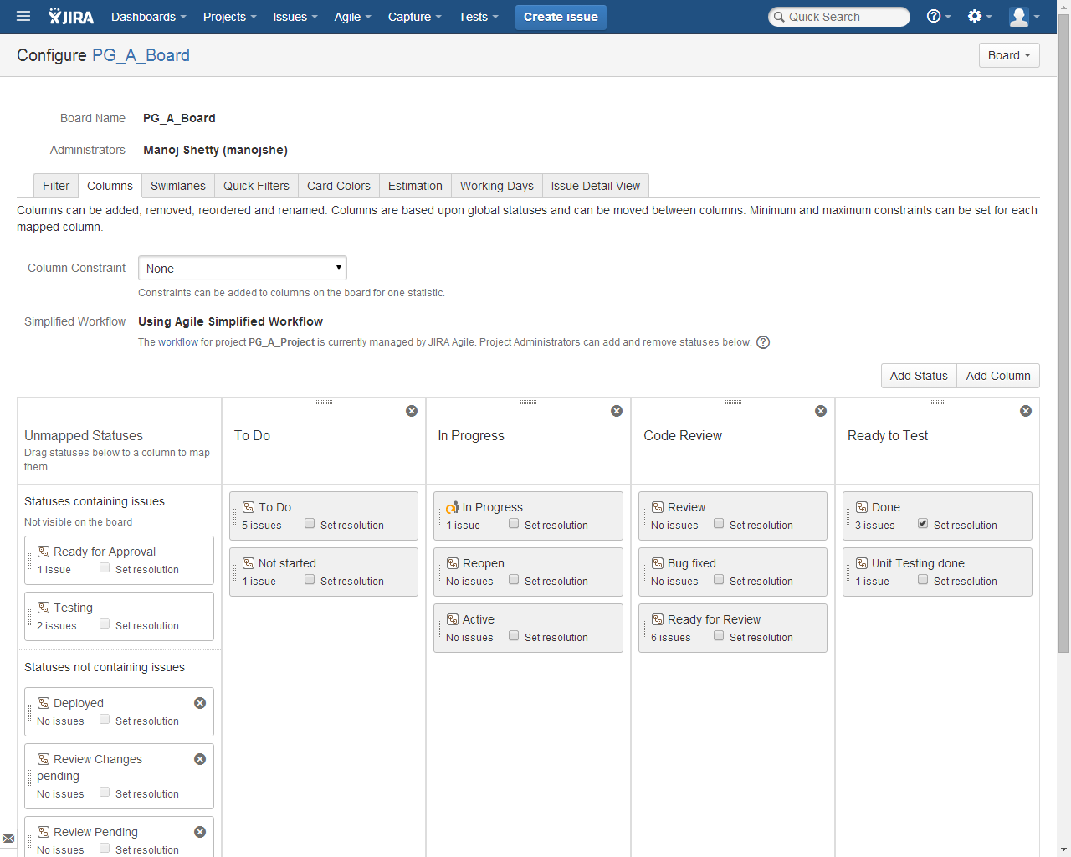
Board Configuration…cond.

Slide 10
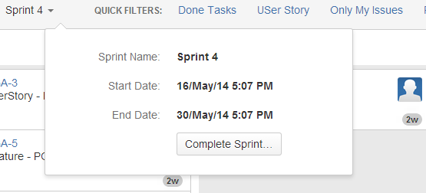
Ending a sprint
When the Sprint duration is finished it can be completed
Done issues are associated with the Sprint
Other issues are moved to the top of the backlog
Only one active sprint at a time

Slide 11
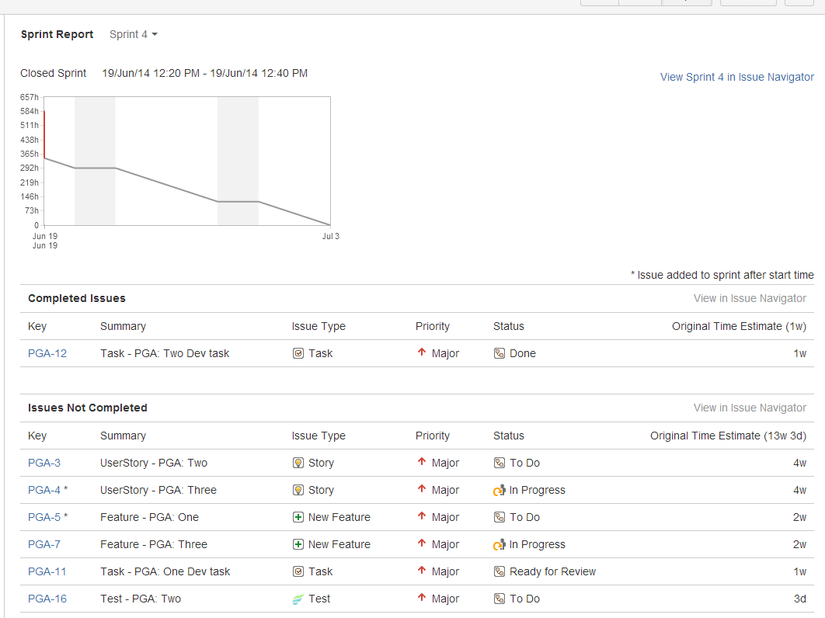
Scrum Project Reports…Sprint Report

Slide 12
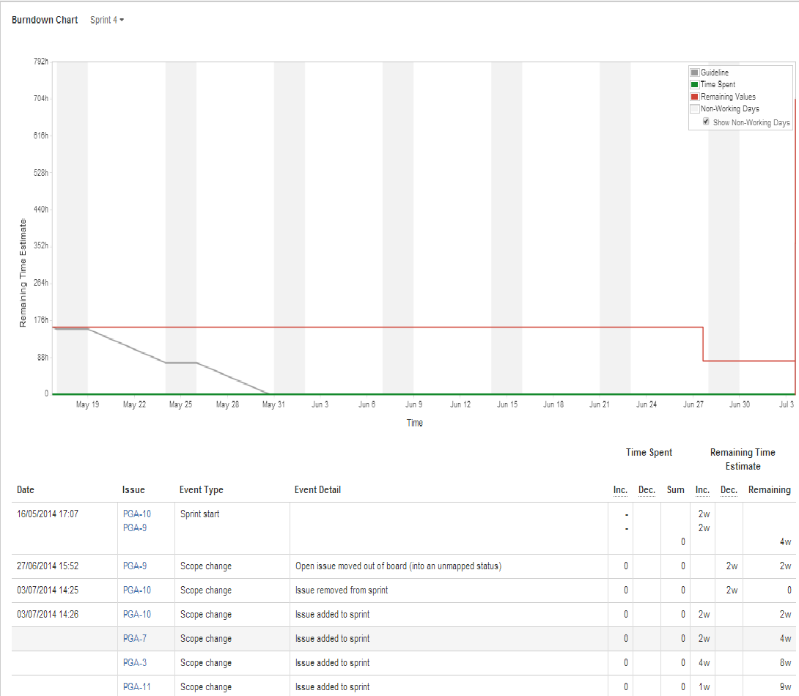
Scrum Project Reports…Burndown chart

Slide 13
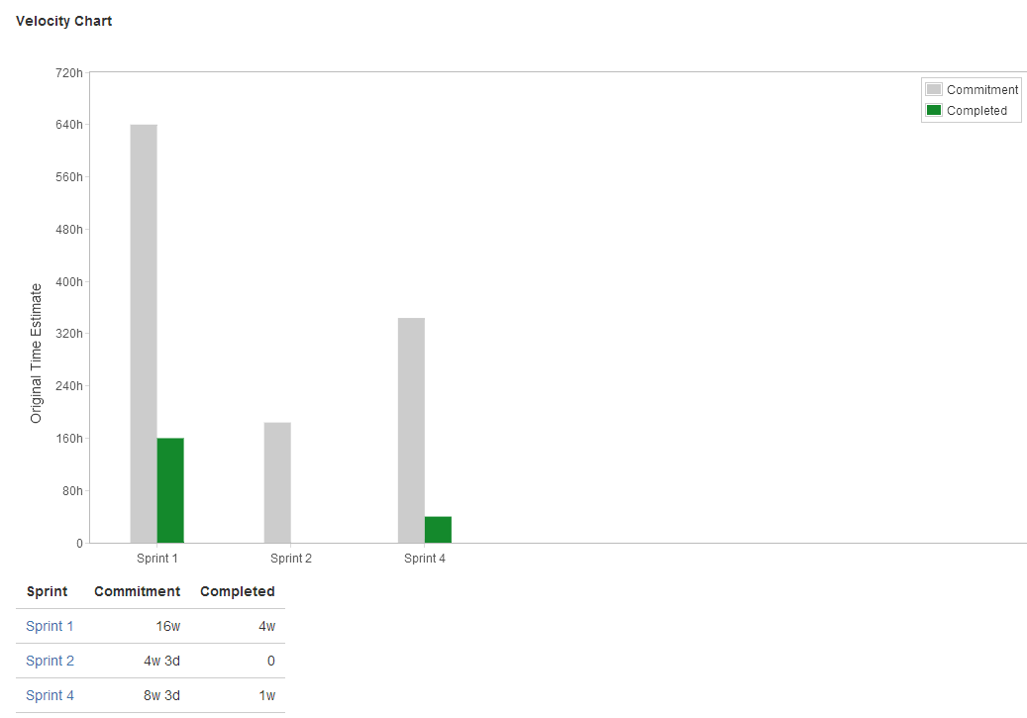
Scrum Project Reports…Velocity Chart

Slide 14
Any Questions?

Slide 15
Thank you!

