Slide 1

By ALM Team

Slide 2
Agenda
Why Stash?
Workflow
Pull Requests
Enterprise

Slide 3
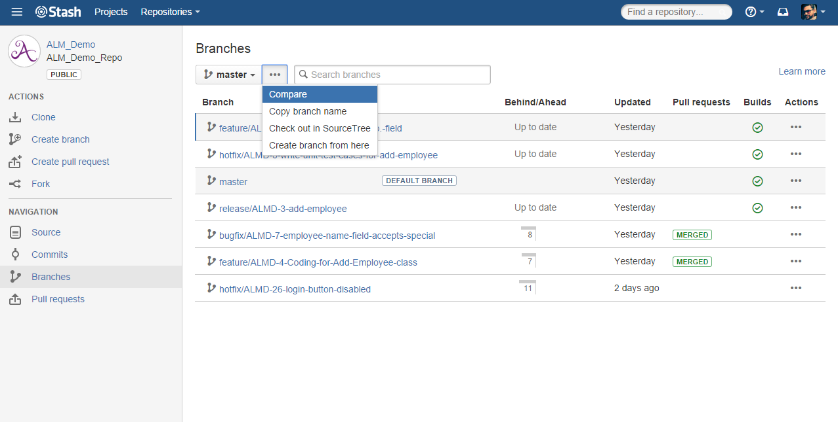
Why Stash? | Workflow | Pull Requests | Enterprise
Git Your Way
Code review
Traceability
Branches and Forks
Administration
Git repository management: Stash supports your growing Git repositories within the safety of your firewall.

Slide 4
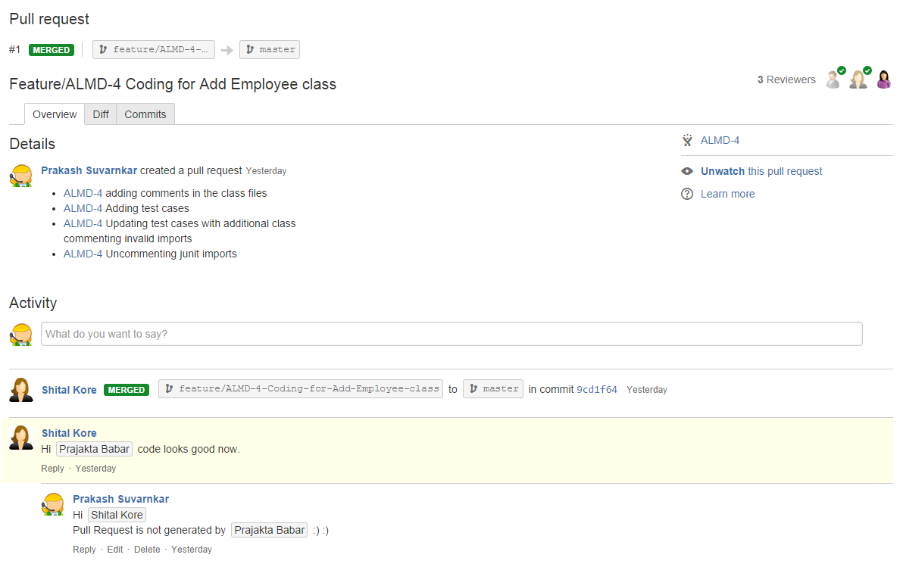
Why Stash? | Workflow | Pull Requests | Enterprise
Git Your Way
Code review
Traceability
Branches and Forks
Administration
Code collaboration and code reviews: Stash offers lightweight code reviews via pull requests, making this best practice easy for developers to incorporate.

Slide 5
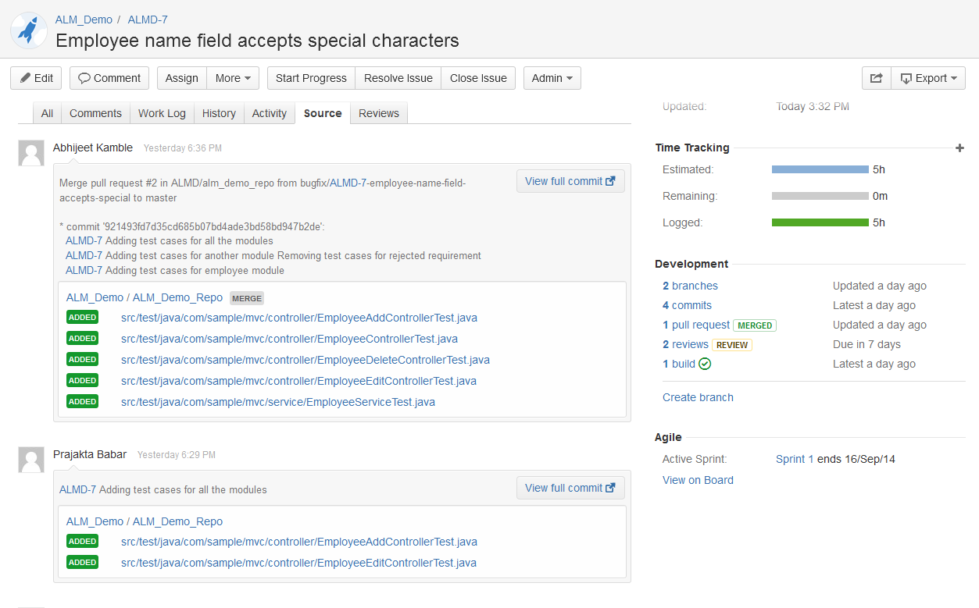
Why Stash? | Workflow | Pull Requests | Enterprise
Git Your Way
Code review
Traceability
Branches and Forks
Administration
Traceability across issues and source: Connect Stash to JIRA for complete traceability of your team's development cycle.

Slide 6
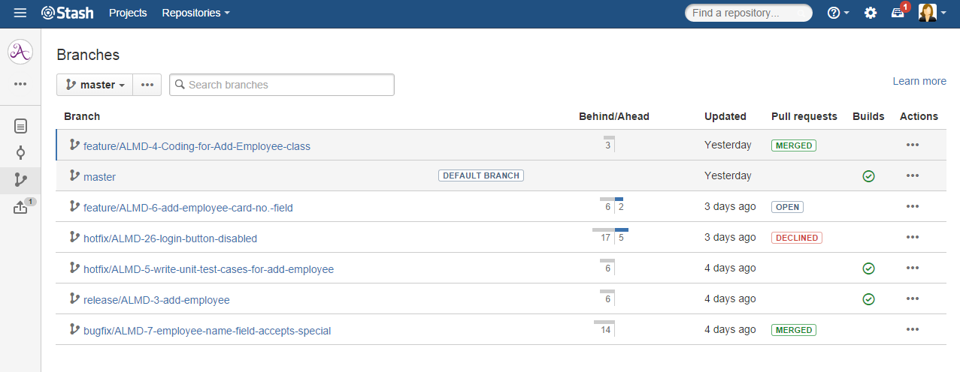
Why Stash? | Workflow | Pull Requests | Enterprise
Git Your Way
Code review
Traceability
Branches and Forks
Administration
Branching and forking workflows: Common practices have emerged using branch-based and fork-based workflows, and Stash works for both.

Slide 7
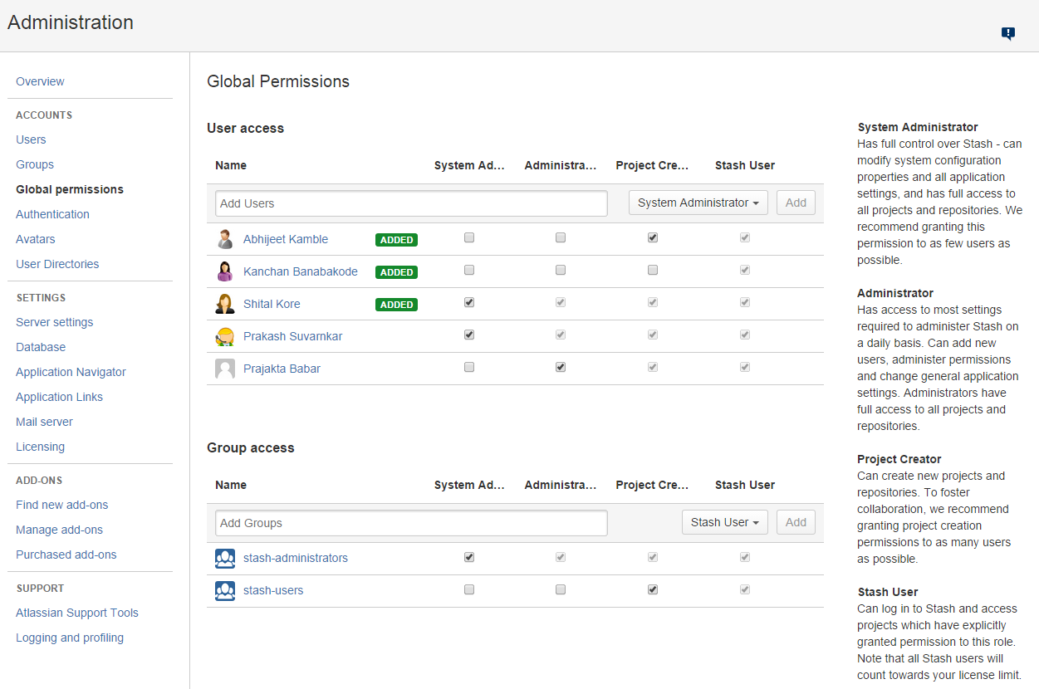
Why Stash? | Workflow | Pull Requests | Enterprise
Git Your Way
Code review
Traceability
Branches and Forks
Administration
Enterprise-grade security and administration: Stash's user management and permissions are flexible enough to cater to any environment.

Slide 8
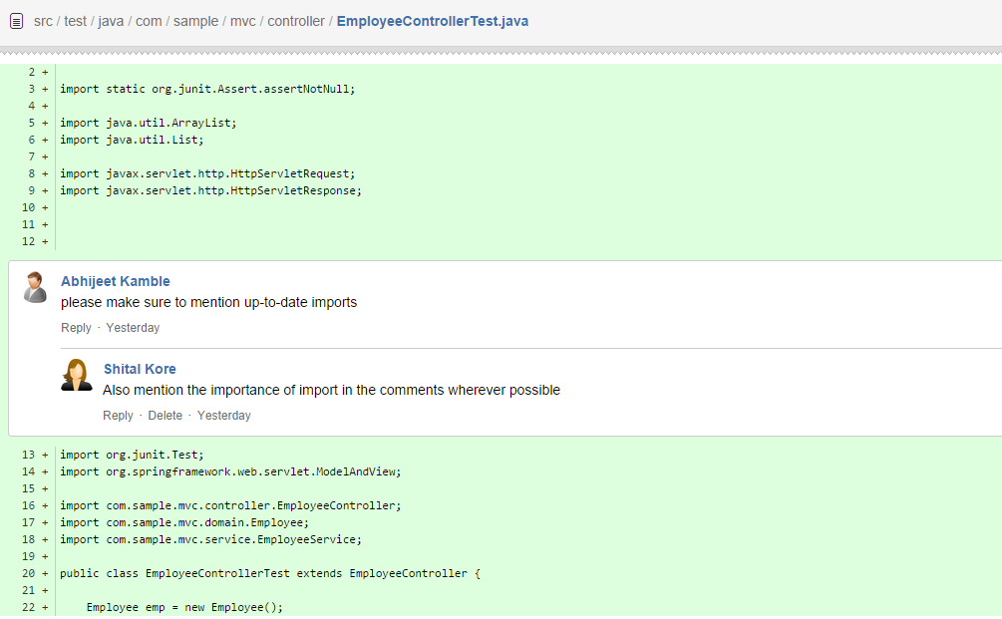
Why Stash? | Workflow | Pull Requests | Enterprise
Workflow
Branch Creation
JIRA Issues
Git + CI
Git Client
Upgrade your development workflow: Stop fretting over the small stuff, and spend time being a developer.

Slide 9
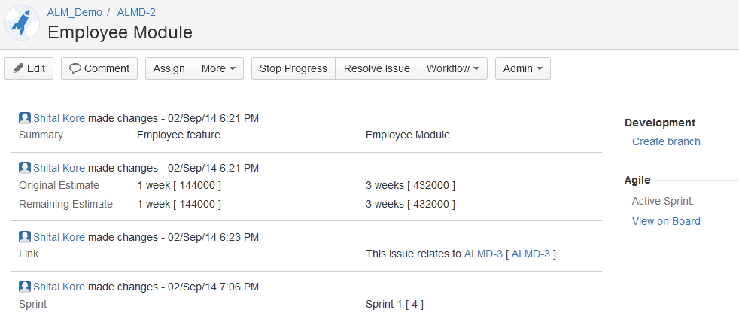
Why Stash? | Workflow | Pull Requests | Enterprise
Workflow
Branch Creation
JIRA Issues
Git + CI
Git Client
Create a branch from JIRA: One-click branching from issues guides your team quickly and easily through the software development workflow.

Slide 10
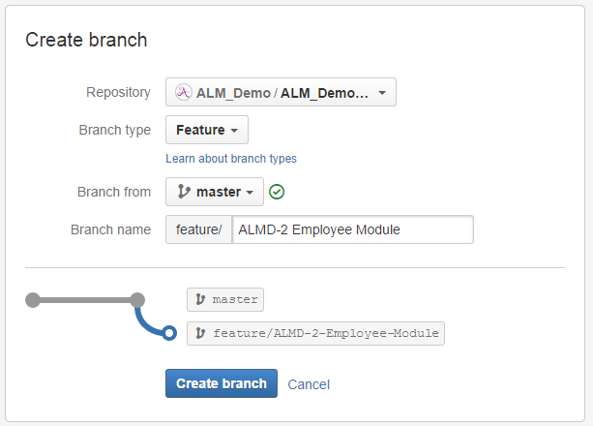
Why Stash? | Workflow | Pull Requests | Enterprise
Workflow
Branch Creation
JIRA Issues
Git + CI
Git Client
Create a branch from JIRA: One-click branching from issues guides your team quickly and easily through the software development workflow.

Slide 11
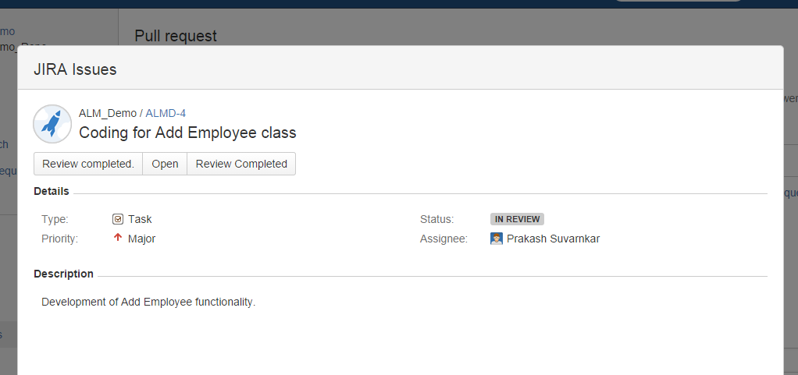
Why Stash? | Workflow | Pull Requests | Enterprise
Workflow
Branch Creation
JIRA Issues
Git + CI
Git Client
Resolve JIRA issues: JIRA issues accessible from inside pull requests when you include the JIRA issue keys in your commit messages.

Slide 12
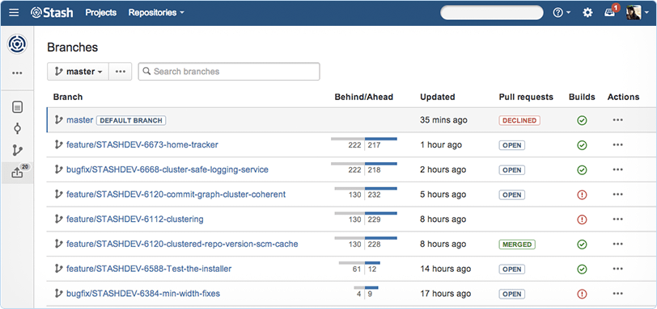
Why Stash? | Workflow | Pull Requests | Enterprise
Workflow
Branch Creation
JIRA Issues
Git + CI
Git Client
No more build concerns: Stash integrates with Bamboo to automatically apply CI to new branches based on what’s running against master.

Slide 13
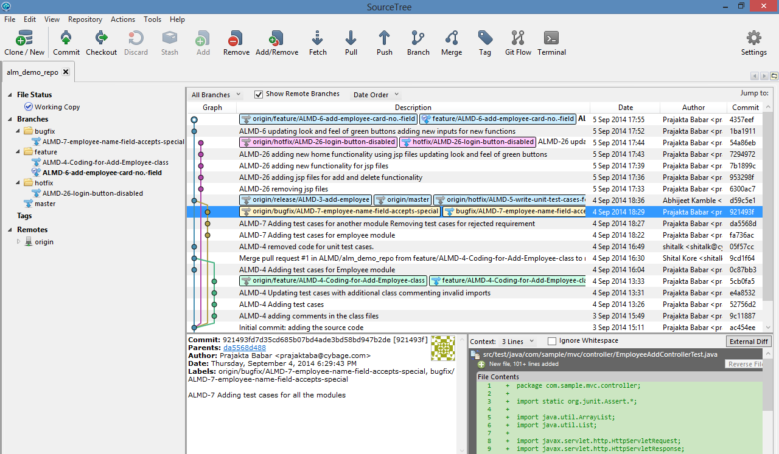
Why Stash? | Workflow | Pull Requests | Enterprise
Workflow
Branch Creation
JIRA Issues
Git + CI
Git Client
Free Git client: Simplify Git for your team. Connect Stash with SourceTree to learn and use Git from a simple user interface.

Slide 14
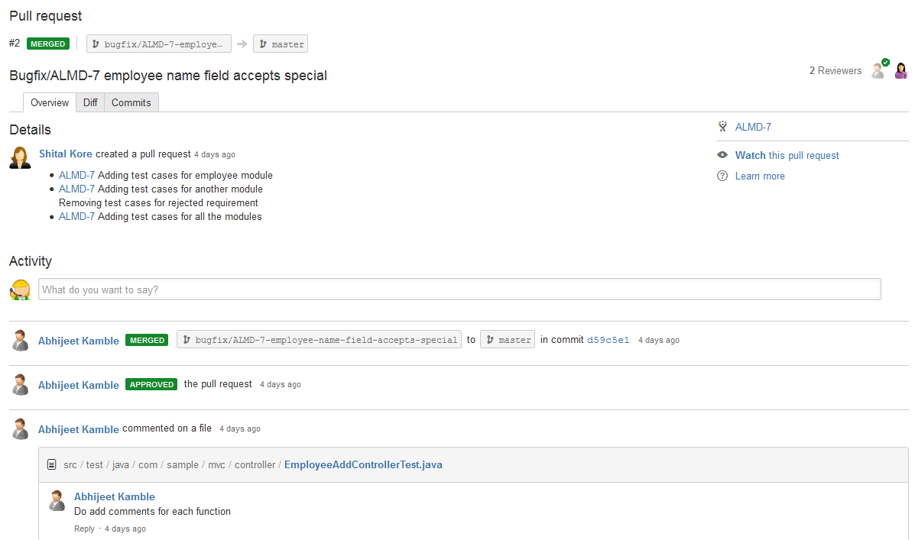
Why Stash? | Workflow | Pull Requests | Enterprise
Code Review
Approvals
Permissions
Conditions
Merging
Lightweight code review: Stash offers pull requests, which encourage peer review and gets teams talking about their code.

Slide 15
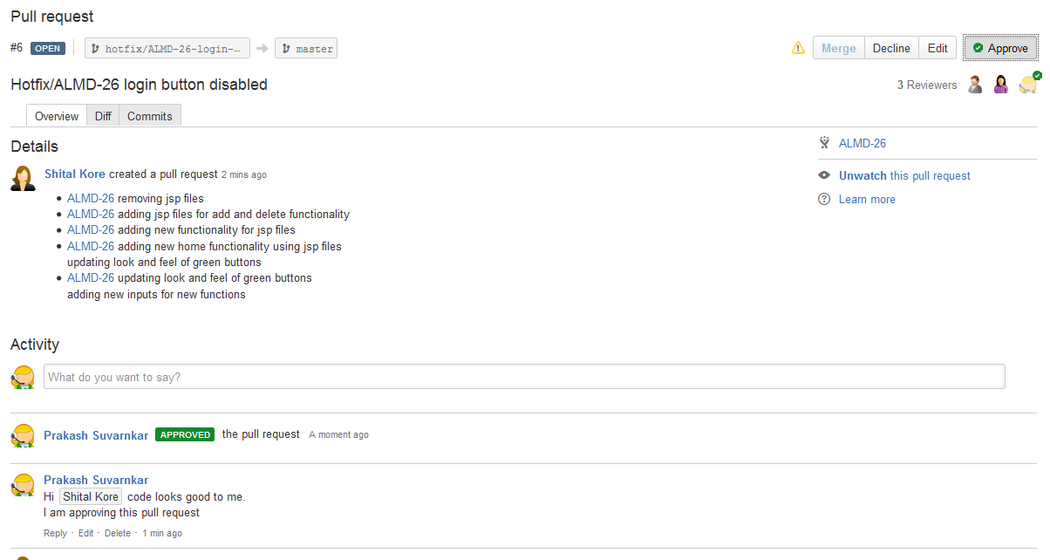
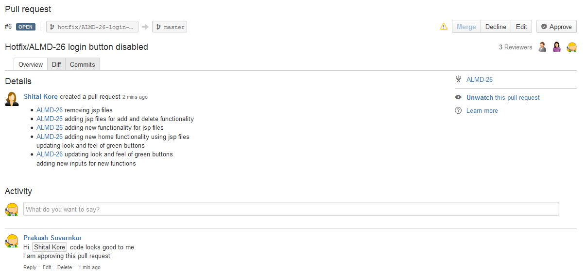
Why Stash? | Workflow | Pull Requests | Enterprise
Code Review
Approvals
Permissions
Conditions
Merging
Approval process: Pull requests are visible to all team members, but the approvals can be limited to a globally set number of reviewers.

Slide 16
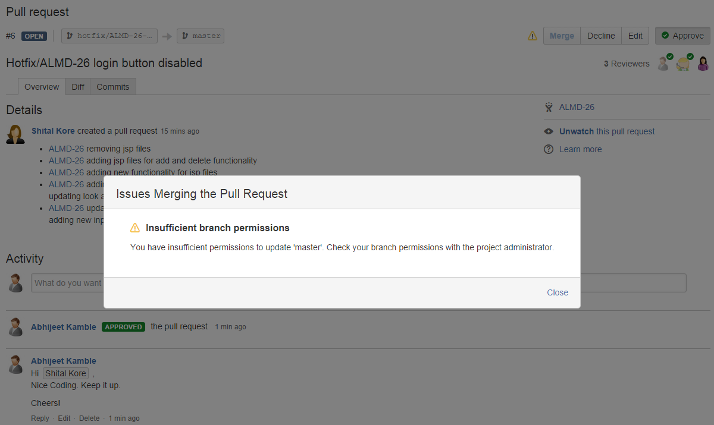
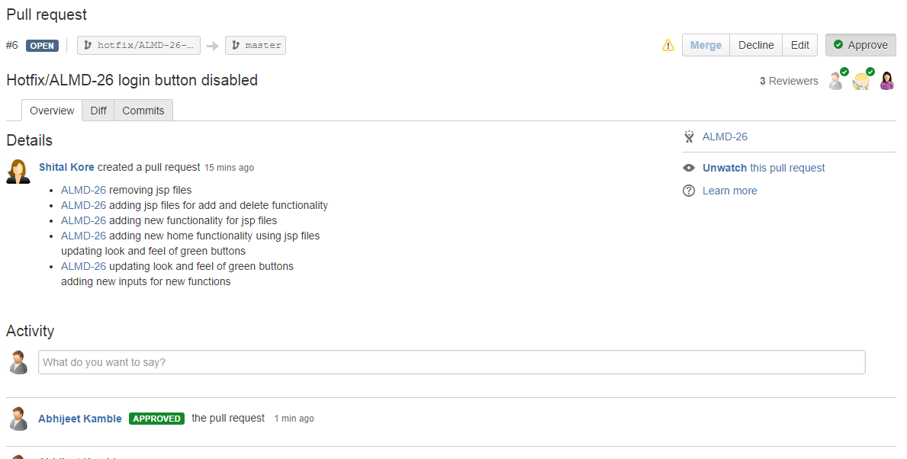
Why Stash? | Workflow | Pull Requests | Enterprise
Code Review
Approvals
Permissions
Conditions
Merging
Per-branch permissions: Stash notifies the gatekeepers of new changes, and they decide whether the code is ready to be merged.

Slide 17
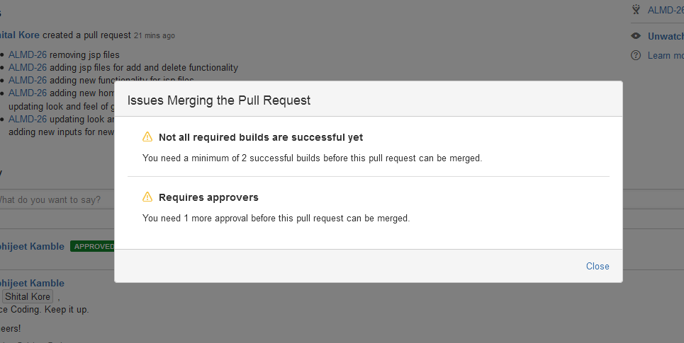
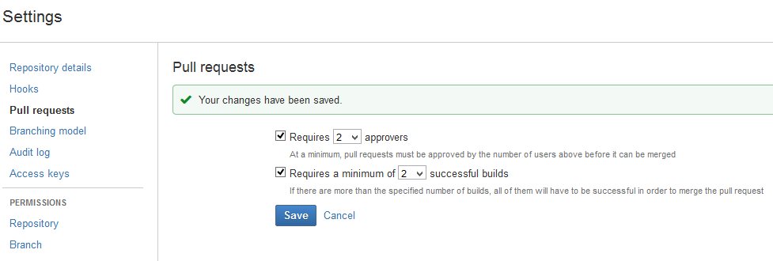
Why Stash? | Workflow | Pull Requests | Enterprise
Code Review
Approvals
Permissions
Conditions
Merging
Pull requests conditions: Set per-repository checks to control when a pull request can be merged.

Slide 18
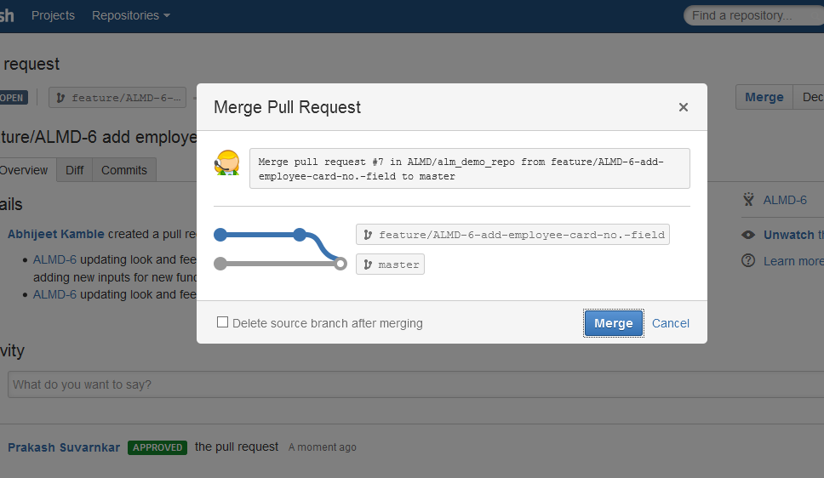
Why Stash? | Workflow | Pull Requests | Enterprise
Code Review
Approvals
Permissions
Conditions
Merging
Automatic merges: The automatic merge process will create a pull request and notify you of the conflict.

Slide 19

Why Stash? | Workflow | Pull Requests | Enterprise
Your Servers
Security
Administration
Migration
Your servers, your rules: Built with infrastructure flexibility needs in mind, administrators have full control over how Stash fits into their environment.

Slide 20
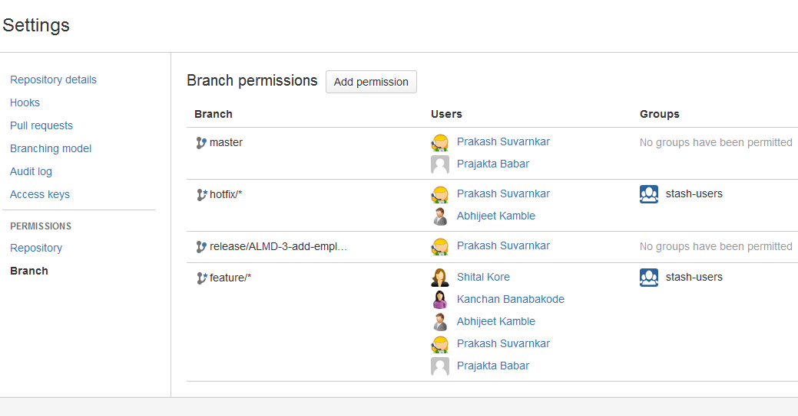
Why Stash? | Workflow | Pull Requests | Enterprise
Your Servers
Security
Administration
Migration
Permissions that work for you: Stash's permissions levels make sure that the right people always have access to the right code.

Slide 21
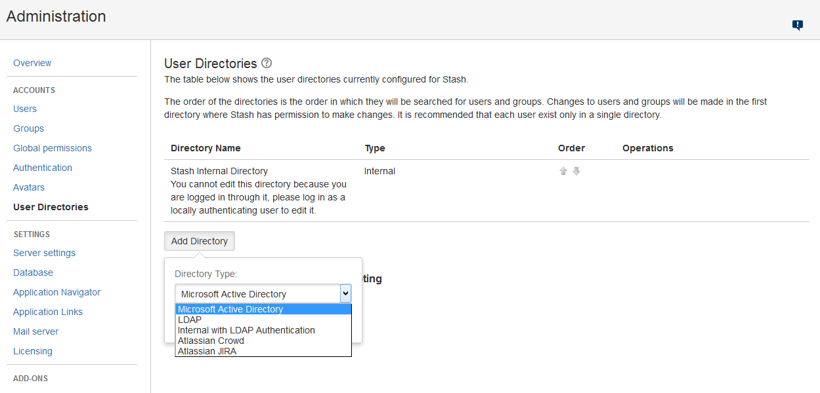
Why Stash? | Workflow | Pull Requests | Enterprise
Your Servers
Security
Administration
Migration
Centralized user management: Stash's flexible user management caters to your company's use case, regardless of size.

Slide 22
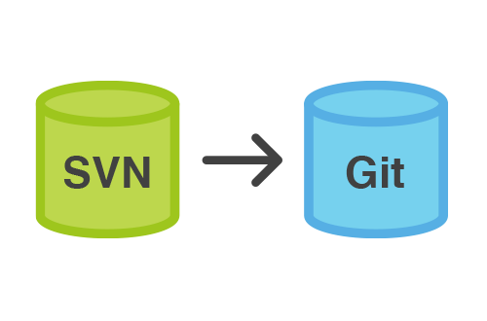
Why Stash? | Workflow | Pull Requests | Enterprise
Your Servers
Security
Administration
Migration
Migrating to Git?: Keep your current workflow style while enjoying the lightweight and feature-rich benefits that Git has to offer.

Slide 23

Any Questions?

Slide 24
Glossary
Atlassion Stash : https://www.atlassian.com/software/stash

Slide 25
Thank You!

