Slide 1

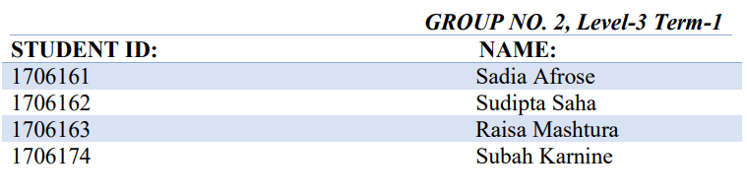
PRESENTED TO: Arik Subhana Satyaki Banik Md. Sadman Sakib PRESENTED ON: 24/07/2021 COURSE: EEE 306: Power Systems I Laboratory
Investigating the effect of HVDC connection and large industrial loads in IEEE 39-bus network
PRESENTED BY:

Slide 2
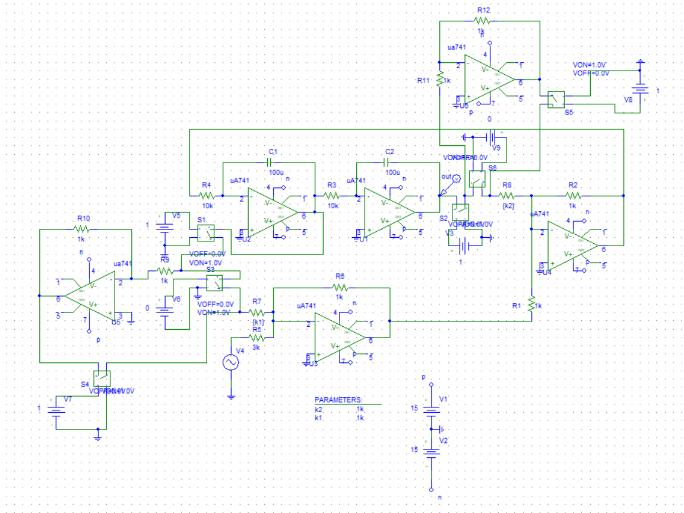

About the Project
Electrically solves any second order differential equation using uA741 op-amps.
$\frac{d^{2}v}{dt^{2}}+K_{1}\frac{dv}{dt}+K_{2}v−K_{3}v_{1}\left(t\right)$=0
Includes initial conditions $\frac{dv(0)}{dt}$ and $v (0)$
Ensures maximum stability of output (solution).

Slide 3
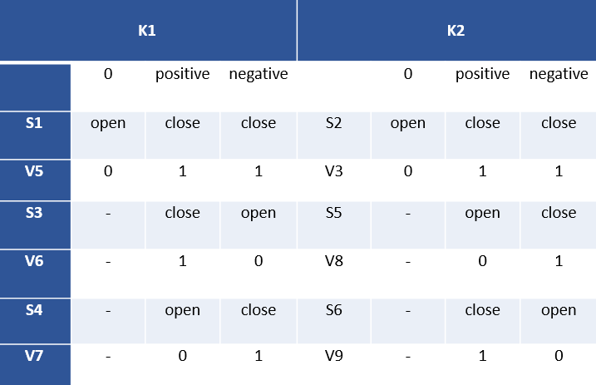

User Guide
In parameter box, k1=1k/K₁ and k2=1k/K₂. In case of K₁ and/or K₂ equals zero, any arbitrary value.
Adjust initial conditions of capacitors with IC of C1=$\frac{dv(0)}{dt}$ and IC of C2= $−v(0)$.
User adjusts the switch settings as required as shown in the table.

Slide 4
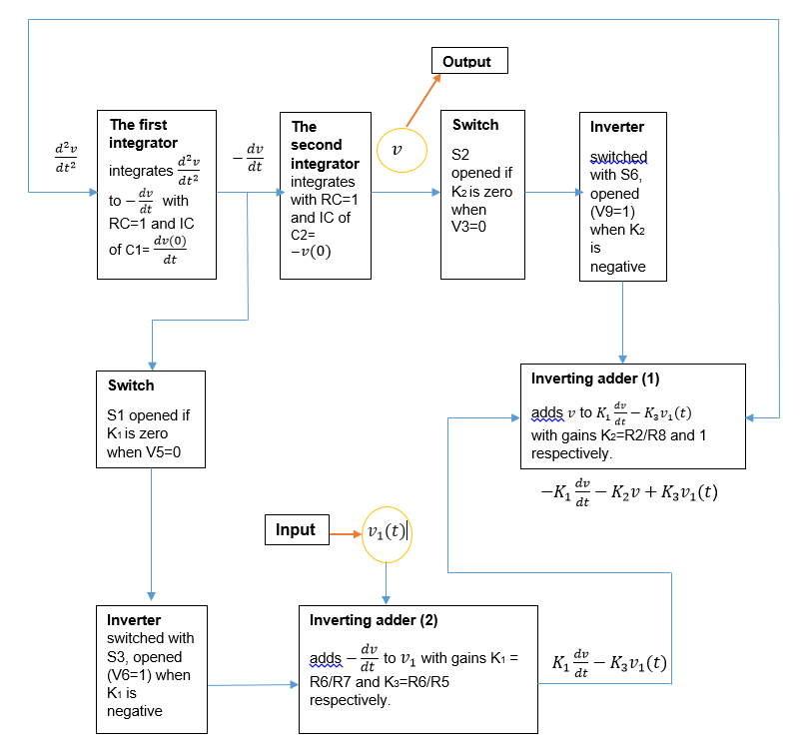
Procedure

Slide 5
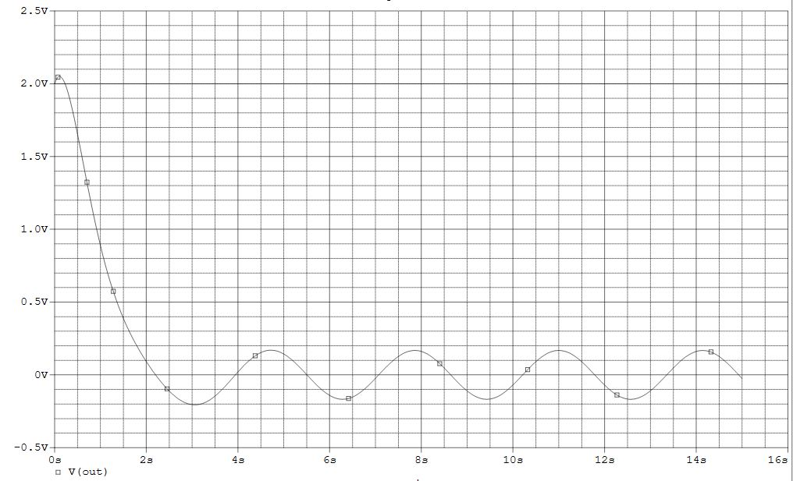
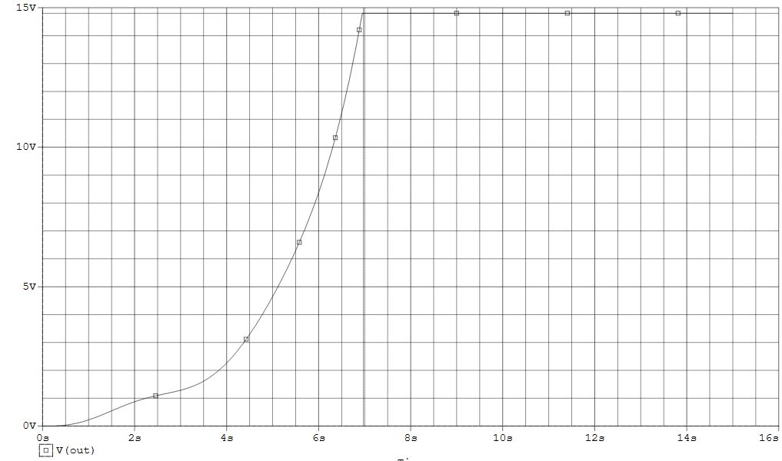


Simulation results
Here, we simulate results for various forms of the second order differential equation
Case 1
K₁=positive, K₂=positive, Dy(0)=1, y(0)=2
Case 2
K₁=positive, K₂=negative, Dy(0)=0, y(0)=0
$$\frac{d^{2}v}{dt^{2}}+3\frac{dv}{dt}+4v−sin(2x)=0$$
$$\frac{d^{2}v}{dt^{2}}+\frac{dv}{dt}−v−sin(2x)=0$$

Slide 6
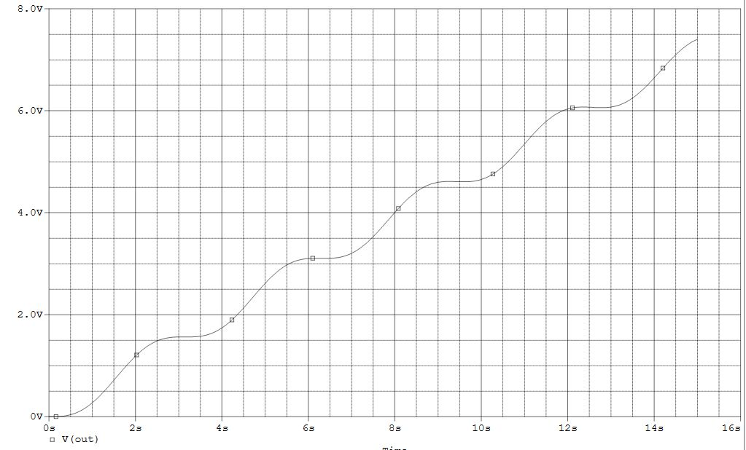
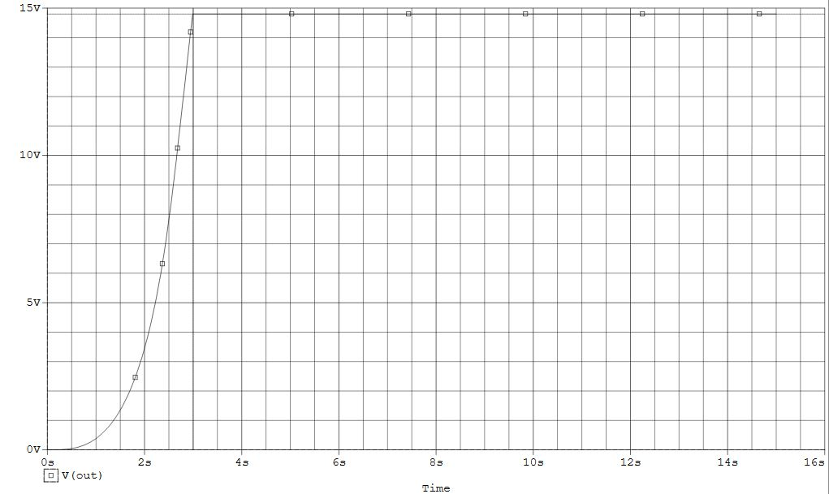


Simulation results
Case 3
K₁=0, K₂=0, Dy(0)=0, y(0)=0
Case 4
K₁=negative, K₂=negative, Dy(0)=0, y(0)=0
$$\frac{d^{2}v}{dt^{2}}+−sin(2x)=0$$
$$\frac{d^{2}v}{dt^{2}}−\frac{dv}{dt}−v−sin(2x)=0$$

Slide 7
Co
Limitations:
1
Saturation voltage
If the output voltage is such that it increases with time, it will get clipped off at the saturation voltages too.
2
Slew rate
uA741 op-amps have a maximum slew rate of 0.5V/us. Unity gain amplifiers have the slowest slew rate in our project.
3
Time constant of Capacitors
In order to avoid distortion of output waveform due to transient response of capacitors, time period of input is kept was kept as bigger as possible.
Conclusion:
Employs integrators instead of differentiators
gain of integrators decrease with frequency; less sensitive; helps stabilize response
Voltage controlled switches
A circuit model is specific for a specific differential equation, so no transient switch used
Useful in observing mathematical solutions in oscilloscope
provide an accurate solution for real life input signals, observed in indicators like cathode-ray tube ,recorder or, for qualitative analysis with slowly varying quantities, a high-impedance voltmeter, etc.
1
2
3

Slide 8
THANK YOU!

