Slide 1
SHOP INVENTORY MANAGEMENT SYSTEM
PRESENTED BY
KARUNA DEY (20)
SAMIKSHA RAI (30)

Slide 2
Introduction
Our project on “Inventory Management System” helps to store records.
Our software is developed for Om Sai watches shop located in Ulhasnagar.
It automates the entire manual workflow to an easy functioning software.

Slide 3

Existing system (What is being currently used)
Manual work.
Bills and Reports.
Work Overload.
Time consuming.

Slide 4
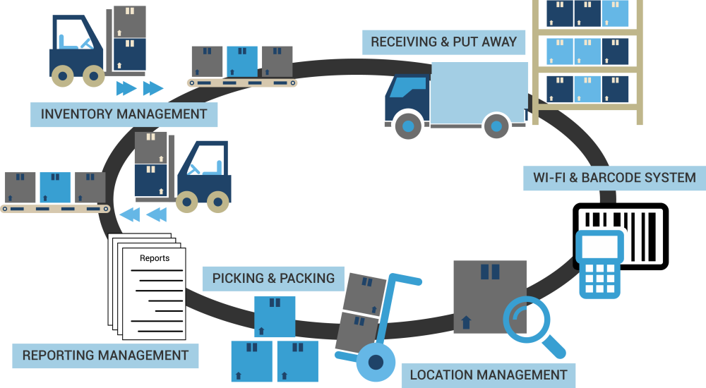
PROPOSED SYSTEM
To overcome the drawbacks of the present system, a user friendly software was developed.
Record and updation.
High end data security
Saves time and user friendly
Data validation
Bill report generation
No data loss
No data redundancy

Slide 5
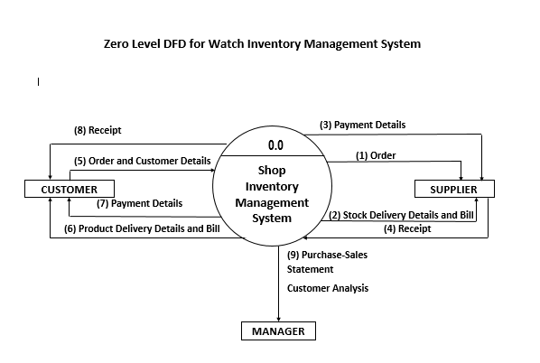

Slide 6
DATA DICTIONARY
Field Name | Data Type | Descriptions
Cust_id | Autonumber | A unique ID given to every customer
Cust_name | Long text | Name of the customer
Cust_add | Long text | Customer’s address
Cust_contact | Number | Contact number of the customer
Email_id | Short Text | Email-id of the customer
cost | Currency | The cost of the product that the customer purchased
Serv_ch | Number | Service charges on a customer
Bill_id | Autonumber | Primary key
Date | Date/Time | Date of the customer’s bill

Slide 7
THANK YOU

