Slide 1


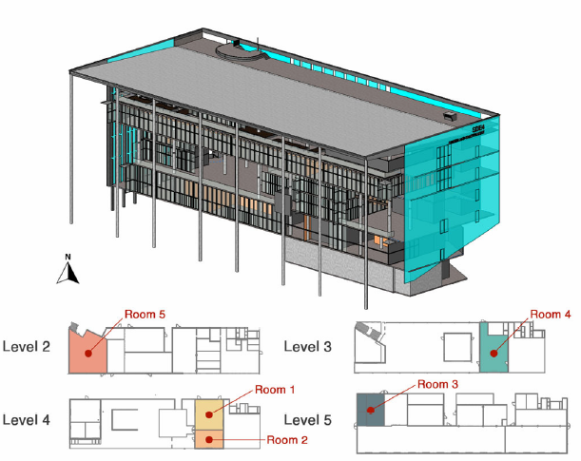
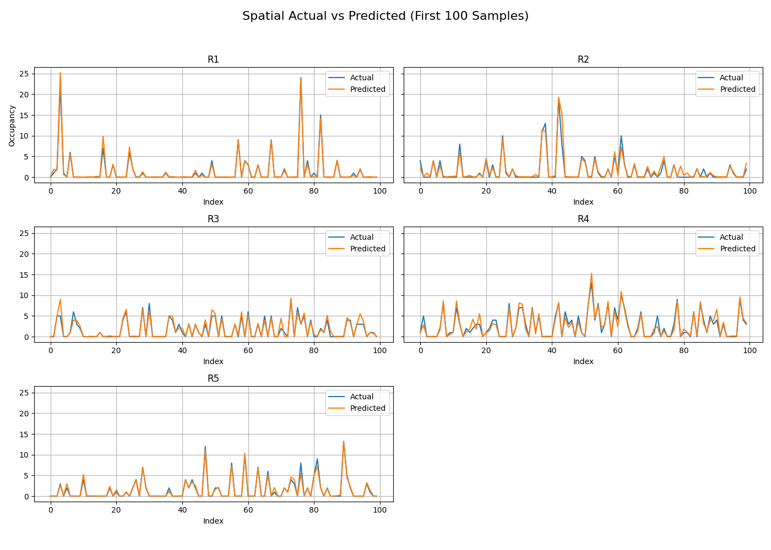
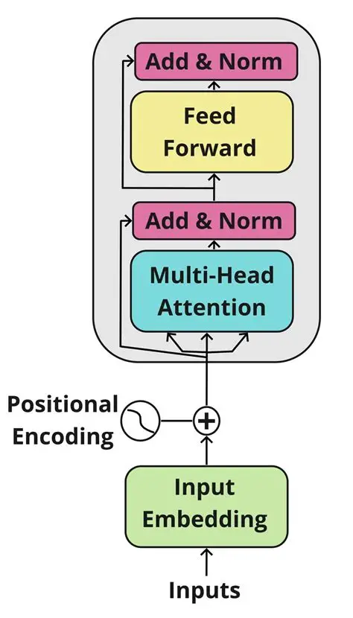
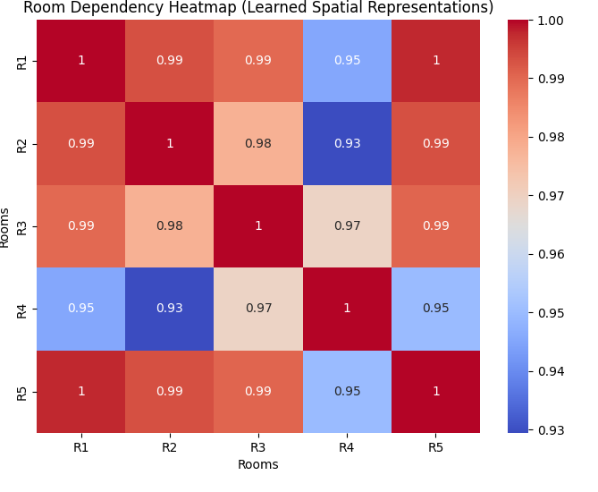
Temporal-Spatial Occupancy Estimation Using Transformer Encoders
Somaya Ahmadi
Faculty Mentor: Sanish Rai
Department of Math and Computer Science, Longwood University
Background
Experiment Results
Conclusions
Occupancy Estimation [1] uses: energy saving, evacuation planning, crowd management, smart home.
Transformer is a neural network architecture used for performing machine learning tasks . It is used in natural language processing and occupancy estimation.
For this project, we used an encoder-only Transformer model to estimate the number of occupants in multiple rooms based on environmental sensor data.
The model captures both temporal patterns from each room and spatial dependencies across rooms and it is highly parallelizable.
The motivation was to predict occupancy across rooms and understand the temporal context within the data and the spatial context among the rooms.
We were able to achieve accuracies as high as 92% for 5 rooms.
Experiments for finding the best hyperparameters
Sequence length
Overlap
Hidden dimensions (temporal & spatial)
Number of layers (temporal & spatial)
Number of heads (temporal & spatial)
Epochs
Batch size (temporal and spatial)
Dropout rate (temporal & spatial)
Best hyperparameters:
Sequence Length:
Each input sequence, contains 60 time samples of sensor data.
Overlap:
Each subsequent pair of sequences overlaps by 59 time samples.
Hidden Dimensions:
The temporal encoder uses a hidden size of 64 and the spatial encoder uses a hidden size of 32.
Number of Layers:
The temporal encoder has 3 layers, and the spatial encoder has 1 layer.
Number of Heads:
The temporal encoder uses 4 attention heads, and the spatial encoder uses 2 attention heads.
Epochs: 30
The training loop was run 30 times.
Batch Size: 64
For each training loop, data is fed into the machine at batches of 64 data inputs at a time.
Dropout:
Both temporal and spatial encoders use 10% dropout.
Using temporal and spatial encoders, we achieved up to 92% accuracy for the model we created.
We used a temporal transformer encoder to help each room learn patterns over time.
We added Spatial encoder to understand relationship and dependency between rooms.
Even though the accuracy drops compared to non-transformer models, this model retains the time and space context, which can be useful to estimate occupancy when sensor data is missing for certain timesteps.
The estimation will also use the spatial context for better occupancy in future.
The training time is comparable to other models since transformers are highly parallelizable with GPU.
After training the model, we predicted occupancy one step into the future and achieved an average spatial accuracy of 92% across all rooms. We used 75% of the data for training and 25% for testing.
Dataset Information
We used ROBOD dataset [2] which contains data from 5 rooms in a university building in Singapore.
Each room has environmental sensors (HVAC, lighting, plug loads and fans, weather conditions) data collected over a total of 181 days at a resolution of 5 minutes.
Room 1 and 2 are lecture rooms, Room 3 and 4 are office spaces, and room 5 is a library space.
Dataset also contains ground truth occupancy count.
Results using the best hyperparameters
Temporal (Single-Room) Transformer Evaluation
Rooms | RMSE | MAE | R²
Room1 (R1) | 0.7645 | 0.2504 | 0.9793
Room2 (R2) | 0.8487 | 0.3060 | 0.9396
Room3 (R3) | 0.5894 | 0.2803 | 0.9439
Room4 (R4) | 0.7828 | 0.5002 | 0.9482
Room5 (R5) | 0.6718 | 0.3177 | 0.9392
Future Directions
Experiment Setup
Spatial (Multi-Room) Transformer Evaluation
For the future, here are some things we can do to improve:
Use better hyperparameters to achieve higher accuracy.
Test the model on a raspberry pi.
Attempt to forecast multiple timesteps per prediction.
Transformer Models (Encoder-Only)
Transformer models are designed to capture patterns in data using self-attention, which helps the model focus on important parts of the input sequence.
In our framework, we use temporal encoding to extract time-series context from the room’s sensors and spatial encoding to extract spatial context among the rooms.
Room1 (R1) | 1.0163 | 0.3649 | 0.9635
Room2 (R2) | 1.4141 | 0.5537 | 0.8323
Room3 (R3) | 0.5975 | 0.3229 | 0.9423
Room4 (R4) | 0.8898 | 0.5867 | 0.9331
Room5 (R5) | 0.6577 | 0.3417 | 0.9417
Total Runtime: 587.49 seconds (9.79 minutes)
Spatial Actual VS Predicted (First 100 Samples)
Temporal-Spatial Encoder
Data collection and Preprocessing
Handling missing values, normalizing features, creating sequences
Acknowledgements
Room1
Room2
Room3
Room4
Room5
I want to thank Longwood University and the PRISM Program for providing this research opportunity for me.
Temporal encoding
Temporal encoding
Temporal encoding
Temporal encoding
Temporal encoding
Data formatting
Construct dataset and dataloader, select hyperparameters
Temporal context vector
Temporal context vector
Temporal context vector
Temporal context vector
Temporal context vector
Training and Evaluation
Train temporal and spatial encoder
Evaluate train & test loss and accuracy
References
Mean of the vector
Mean of the vector
Mean of the vector
Mean of the vector
Mean of the vector
Figure 2. Transformer Encoder-Only [3]
[1] Aliero, Muhammad S., et al. “Non-Intrusive Room Occupancy Prediction Performance Analysis Using Different Machine Learning Techniques.” MDPI, Multidisciplinary Digital Publishing Institute, 6 Dec. 2022, doi.org/10.3390/en15239231.
[2] Tekler, Zeynep Duygu, et al. "ROBOD, room-level occupancy and building operation dataset." Building Simulation. Vol. 15. No. 12. Beijing: Tsinghua University Press, 2022.
[3] Delovski, B. “Intro to Transformers: The Encoder Block,” Edlitera, May 3, 2023. [Online]. Available: https://www.edlitera.com/blog/posts/transformers-encoder-block
Results and Visualization
Plot RMSE, MAE, R²
Plot context heatmaps
Spatial encoding
Occupancy Estimation
Context vector to show the relationship between the data of the rooms
Figure 3. Model training and evaluation
Figure 1. Temporal-Spatial Encoder framework
The Experiment
We took training data and feed it to the model.
We then made predictions using the testing data and compared the results.
We can use the trained model for real-world applications.
Data Sequencing
We wanted our data to be compatible with a time-series based machine to predict occupancy.
We converted the data into a series of sequences with a fixed size, an overlap, and a specified timestep to predict.
Contact
Contact Information
somaya.ahmadi@live.longwood.edu
rais@longwood.edu

