Slide 1
Presentation
TDD Talk
TDD Talk
2026-10-28
Costin Grigore
DB Engineering Coach
TDD Talk
1 / 26
Notes:
Source: tdd4.md
TDD Talk
2026-10-28
Costin Grigore
DB Engineering Coach

Slide 2
Presentation
TDD Talk · continued 2
Test Infected 2001 through XP.
Test Infected = I need tests to clarify when is done: the bug, the feature.
TDD Talk
2 / 26
Notes:
Source: tdd4.md
Test Infected 2001 through XP.
Test Infected = I need tests to clarify when is done: the bug, the feature.

Slide 3
Presentation
Topics
1. What is TDD? RED > GREEN > REFACTOR cycle
2. TDD in the Agentic Era
3. TDD The Good, the Bad and the Ugly
4. Beyond TDD
5. Complementing Practices
TDD Talk
3 / 26
Notes:
Source: tdd4.md
1. What is TDD? RED > GREEN > REFACTOR cycle
2. TDD in the Agentic Era
3. TDD The Good, the Bad and the Ugly
4. Beyond TDD
5. Complementing Practices

Slide 4
1. What is TDD? The purpose of TDD and the RED > GREEN > REFACTOR cycle.
Why tests? Do we need them?
• Code -> Tests
• scafolding to help out
• quality
• acceptance
• post change tests
• There are many ways to pair code with tests
TDD Talk
4 / 26
Notes:
Source: tdd4.md
- Code -> Tests
- scafolding to help out
- quality
- acceptance
- post change tests
- There are many ways to pair code with tests

Slide 5
1. What is TDD? The purpose of TDD and the RED > GREEN > REFACTOR cycle.
Why tests? Do we need them? · continued 2
• Human
• Code
• On every change we throw away past manual testing.
• Tests
• Fragile.
• Tests are tightly coupled to the implementation.
• Too many.
• Coverage. Proper coverage?
• Tedious.
• Copy-paste: breaks DRY (Don't Repeat Yourself).
• Too complex: conditionals inside tests.
• Take time.
• Need external dependencies.
• AI
• Code
• More code.
• Better quality?
• Bugs fixed through regeneration.
• Prompt is the new spec. Is it better?
• Manual testing?
• No test if it is regenerated?
• Tests
• No abstraction.
• Deleting/changing regression tests just to pass.
• Reflection-based tests to circumvent private methods.
TDD Talk
5 / 26
Notes:
Source: tdd4.md
- Human
- Code
- On every change we throw away past manual testing.
- Tests
- Fragile.
- Tests are tightly coupled to the implementation.
- Too many.
- Coverage. Proper coverage?
- Tedious.
- Copy-paste: breaks DRY (Don't Repeat Yourself).
- Too complex: conditionals inside tests.
- Take time.
- Need external dependencies.
- AI
- Code
- More code.
- Better quality?
- Bugs fixed through regeneration.
- Prompt is the new spec. Is it better?
- Manual testing?
- No test if it is regenerated?
- Tests
- No abstraction.
- Deleting/changing regression tests just to pass.
- Reflection-based tests to circumvent private methods.

Slide 6
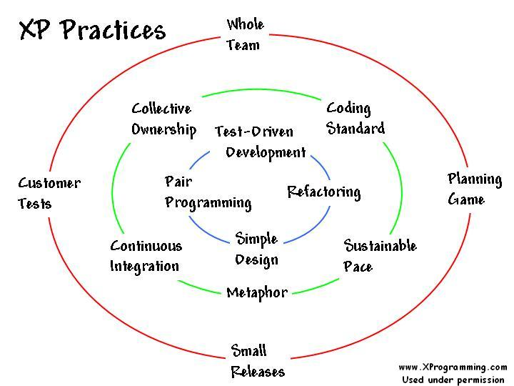
1. What is TDD? The purpose of TDD and the RED > GREEN > REFACTOR cycle.
Were did all started?
• Agile movement
• Test-driven development : by example : Beck, Kent 2002
• Kent Beck — Test-Driven Development by Example
• Still works now, also with AI
• Part of eXtreme Programming practices:
TDD Talk
6 / 26
Notes:
Source: tdd4.md
- Agile movement
- Test-driven development : by example : Beck, Kent 2002
- https://archive.org/details/est-driven-development-by-example/test-driven-development-by-example/
- Still works now, also with AI
- Part of eXtreme Programming practices:
![xp practices](xp-practices)

Slide 7
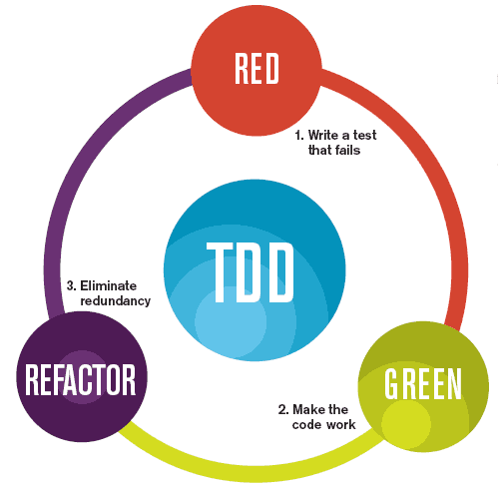
1. What is TDD? The purpose of TDD and the RED > GREEN > REFACTOR cycle.
TDD Cycle: RED-GREEN-REFACTOR
TDD is practice
RED - Write a test, make it compile, run to confirm it fails.
• There are tests that always pass. We want to be sure we first fail (including compilation errors).
GREEN - Write the simplest code to make the test pass.
• Sins allowed: hacks, duct tape programming, copy-paste, and other shortcuts are allowed.
• YAGNI. Don't overengineer. No analysis paralysis.
REFACTOR - Refactor the code to remove duplication.
• Keep the test green.
• Respect: YAGNI, OCP, and other principles, no code smells, and other good practices.
TDD Talk
7 / 26
Notes:
Source: tdd4.md
TDD is practice - https://newsletter.kentbeck.com/p/canon-tdd
![red green refactor cycle](red-green-refactor.png)
RED - Write a test, make it compile, run to confirm it fails.
- There are tests that always pass. We want to be sure we first fail (including compilation errors).
GREEN - Write the simplest code to make the test pass.
- Sins allowed: hacks, duct tape programming, copy-paste, and other shortcuts are allowed.
- YAGNI. Don't overengineer. No analysis paralysis.
REFACTOR - Refactor the code to remove duplication.
- Keep the test green.
- Respect: YAGNI, OCP, and other principles, no code smells, and other good practices.

Slide 8
1. What is TDD? The purpose of TDD and the RED > GREEN > REFACTOR cycle.
TDD Cycle: RED-GREEN-REFACTOR · continued 2
Different phases have different purposes/focus:
• RED: prove missing functionality without knowing/passing implementation details
• GREEN: add new functionality as fast as possible (hacking around, duplicate code, whatever works to fix)
• REFACTOR: clean up the solution (good practices, remove code smells, clean code, clean design)
TDD Talk
8 / 26
Notes:
Source: tdd4.md
Different phases have different purposes/focus:
- RED: prove missing functionality without knowing/passing implementation details
- GREEN: add new functionality as fast as possible (hacking around, duplicate code, whatever works to fix)
- REFACTOR: clean up the solution (good practices, remove code smells, clean code, clean design)

Slide 9
1. What is TDD? The purpose of TDD and the RED > GREEN > REFACTOR cycle.
What is the unit fron unit testing ?
A good/canon TDD
• design tool
• grows a regression test suite
• feel safe to refactor (enables YAGNI and OCP) - refactoring is first class concept
TDD Talk
9 / 26
Notes:
Source: tdd4.md
A good/canon TDD
- design tool
- grows a regression test suite
- feel safe to refactor (enables YAGNI and OCP) - refactoring is first class concept

Slide 10
1. What is TDD? The purpose of TDD and the RED > GREEN > REFACTOR cycle.
What is the unit fron unit testing ?
• Steve Sanderson — Writing Great Unit Tests
A facade to something that acts as a unit. A responsibility.
TDD Talk
10 / 26
Notes:
Source: tdd4.md
- https://blog.stevensanderson.com/2009/08/24/writing-great-unit-tests-best-and-worst-practises/
A facade to something that acts as a unit. A responsibility.

Slide 11
1. What is TDD? The purpose of TDD and the RED > GREEN > REFACTOR cycle.
Where do we cut?
Top-down units ⇒ Test-Driven Design.
• Split it when it breaks and when we need to search through it.
• We don't want to know the details: whatever works for the unit.
TDD Talk
11 / 26
Notes:
Source: tdd4.md
Top-down units ⇒ Test-Driven Design.
- Split it when it breaks and when we need to search through it.
- We don't want to know the details: whatever works for the unit.

Slide 12
Presentation
Principles
• Encapsulation.
• Divide and conquer.
• YAGNI.
• Tell, Don't Ask.
TDD Talk
12 / 26
Notes:
Source: tdd4.md
- Encapsulation.
- Divide and conquer.
- YAGNI.
- Tell, Don't Ask.

Slide 13
Presentation
Units
Unit 1
Unit 1.1
Unit 1.2
Unit 1.3
Unit 1.4
Unit 1.3.1
Unit 1.3.2
Unit 1.3.2b
TDD Talk
13 / 26
Notes:
Source: tdd4.md
```mermaid
flowchart TD
U1[Unit 1] --> U11[Unit 1.1]
U1 --> U12[Unit 1.2]
U1 --> U13[Unit 1.3]
U1 --> U14[Unit 1.4]
U13 --> U131[Unit 1.3.1]
U13 --> U132[Unit 1.3.2]
U132 -.-> U132b[Unit 1.3.2b]
style U132 text-decoration:line-through
```

Slide 14
Presentation
A good unit test
With a real database:
• Minimal input information, expressed in concepts ⇒ no accidental complexity.
• Clear output.
TDD Talk
14 / 26
Notes:
Source: tdd4.md
With a real database:
- Minimal input information, expressed in concepts ⇒ no accidental complexity.
- Clear output.

Slide 15
Presentation
Emergent properties
• Testable code.
• Composable.
• Instantiable.
• Fast.
• Focus on the first problem.
Opens doors for explorable code.
Clear errors provide guidance. See Git errors.
TDD Talk
15 / 26
Notes:
Source: tdd4.md
- Testable code.
- Composable.
- Instantiable.
- Fast.
- Focus on the first problem.
Opens doors for explorable code.
Clear errors provide guidance. See Git errors.

Slide 16
Presentation
Addendum
• Use AssertJ in Java and Kotlin.
• Don't mock, stub, or fake ⇒ lazy-load and inject dependencies manually.
• Use a facade to instantiate the unit.
TDD Talk
16 / 26
Notes:
Source: tdd4.md
- Use AssertJ in Java and Kotlin.
- Don't mock, stub, or fake ⇒ lazy-load and inject dependencies manually.
- Use a facade to instantiate the unit.

Slide 17
Presentation
Trim down information
TRIM Down Info.
TDD Talk
17 / 26
Notes:
Source: tdd4.md
**TRIM Down Info.**

Slide 18
Study
Ideas
Test in TDD is developer test.
The unit is the thing that has a facade.
With a test we want to exercise the behavior of the system.
Some classes are implementation details of the unit and some advocate to delete tests used for the internal implementation.
The facade/API has usually 4 types of operations that act in concert:
• factory/lookup - to get access to a unit
• functions - compute something
• query - to observe the state
• commands - to change the state
Usually our tests need first to get access to a unit, then to query it, and finally to command it.
TDD Talk
18 / 26
Notes:
Source: tdd4.md
Test in TDD is **developer test**.
The unit is the thing that has a facade.
With a test we want to exercise the behavior of the system.
Some classes are implementation details of the unit and some advocate to delete tests used for the internal implementation.
The facade/API has usually 4 types of operations that act in concert:
- factory/lookup - to get access to a unit
- functions - compute something
- query - to observe the state
- commands - to change the state
Usually our tests need first to get access to a unit, then to query it, and finally to command it.

Slide 19
Study / Ideas
A anathomy of a good test
1. Get access to the unit.
2. Move the unit to a known state
• Should not depend on past runs (the test before could even crash so the cleanup before is not guaranteed to be executed).
3. Query the unit to assert the state is as expected.
4. Command the unit to change its state.
5. Query the unit to assert the state is as expected.
6. Cleanup the unit to a known state.
• Cleanup is not warranted (the system could crash, or end in the middle of the test).
• Cleanup would create the impression that the other tests are safe to run after this one and that they don't need to be isolated. But they do.
• Cleanup will block investigations of the state of the unit after a test has run.
TDD Talk
19 / 26
Notes:
Source: tdd4.md
1. Get access to the unit.
2. Move the unit to a known state
- Should not depend on past runs (the test before could even crash so the cleanup before is not guaranteed to be executed).
3. Query the unit to assert the state is as expected.
4. Command the unit to change its state.
5. Query the unit to assert the state is as expected.
6. ~~Cleanup the unit to a known state.~~
- Cleanup is not warranted (the system could crash, or end in the middle of the test).
- Cleanup would create the impression that the other tests are safe to run after this one and that they don't need to be isolated. But they do.
- Cleanup will block investigations of the state of the unit after a test has run.

Slide 20
Study / Ideas
Spawning a unit test
So we have a test that fails.
We might want to expose an internal detail of the unit and make assertions on it. Is thightly coupled to the implementation internal details. If that sub-unit component is complex or is used in other parts of the system it can become a unit on its own. If is simple the current test should be enough definition of success.
So naturally we will grow the tests on the most complex parts of the unit.
TDD Talk
20 / 26
Notes:
Source: tdd4.md
So we have a test that fails.
We might want to expose an internal detail of the unit and make assertions on it. Is thightly coupled to the implementation internal details. If that sub-unit component is complex or is used in other parts of the system it can become a unit on its own. If is simple the current test should be enough definition of success.
So naturally we will grow the tests on the most complex parts of the unit.

Slide 21
Study / Ideas
Testign Myths
• We have a battery of tests and on mutation we can pinpoint the mutation by just looking at the tests. With what price? In writing tests and in maintaining them?
• Test coverage will help. Maybe if 100%, and maybe if we also have 100% branch coverage. That is not practical and rarely achievable. So we need strategic testing. Top down?
TDD Talk
21 / 26
Notes:
Source: tdd4.md
- We have a battery of tests and on mutation we can pinpoint the mutation by just looking at the tests. With what price? In writing tests and in maintaining them?
- Test coverage will help. Maybe if 100%, and maybe if we also have 100% branch coverage. That is not practical and rarely achievable. So we need strategic testing. Top down?

Slide 22
Study / Ideas
Things that go well with TDD
• DDD (Domain Driven Design) & Hexagonal Architecture.
• we could use a persistance layer (whatever is faster to run and use)
• database: embedded, in memory or a real one
• real SQL queries/CRUD also get tested (think that native sql querries)
• in memory data structures
• Clean Code
• Refactoring of Code Smells
• Open Closed Principle. If we break tests then we don't respect the OCP.
• A refactor keeps the tests green.
• We are free to change the implementation details if the tests are green.
TDD Talk
22 / 26
Notes:
Source: tdd4.md
- DDD (Domain Driven Design) & Hexagonal Architecture.
- we could use a persistance layer (whatever is faster to run and use)
- database: embedded, in memory or a real one
- real SQL queries/CRUD also get tested (think that native sql querries)
- in memory data structures
- Clean Code
- Refactoring of Code Smells
- Open Closed Principle. If we break tests then we don't respect the OCP.
- A refactor keeps the tests green.
- We are free to change the implementation details if the tests are green.

Slide 23
Study / Ideas
Things that are exposed as bad practices by TDD
• testing implementation details
• mocking
• testing query and command separately
• changing internal state via methods that are not part of the facade (is a white-box testing smell)
• tests that are not isolated and depend on the order of execution of other tests (is a white-box testing smell)
TDD Talk
23 / 26
Notes:
Source: tdd4.md
- testing implementation details
- mocking
- testing query and command separately
- changing internal state via methods that are not part of the facade (is a white-box testing smell)
- tests that are not isolated and depend on the order of execution of other tests (is a white-box testing smell)

Slide 24
Presentation
Resources
• Search: TDD, Where Did It All Go Wrong?
• TDD, Where Did It All Go Wrong (Ian Cooper)
• Discussion: Ian Cooper — TDD, Where Did It All Go Wrong?
• Kent Beck — Test-Driven Development by Example
• Dan North
TDD Talk
24 / 26
Notes:
Source: tdd4.md
- https://www.google.com/search?q=TDD%2C+Where+Did+It+All+Go+Wrong&sourceid=chrome&ie=UTF-8&source=chrome.ctxt
- TDD, Where Did It All Go Wrong (Ian Cooper) - https://www.youtube.com/watch?v=EZ05e7EMOLM
- https://www.reddit.com/r/programming/comments/21fhy7/ian_cooper_tdd_where_did_it_all_go_wrong/
- https://archive.org/details/est-driven-development-by-example/test-driven-development-by-example/
- Dan North - https://dannorth.net/

Slide 25
Resources
To study
• Martin Fowler — Are Harnesses Worth the Cost?
TDD Talk
25 / 26
Notes:
Source: tdd4.md
- https://martinfowler.com/articles/are-harnesses-worth-the-cost.html

Slide 26
Presentation
Ideas
• maybe is better to talk about test anti-patterns and TDD good patterns?
TDD Talk
26 / 26
Notes:
Source: tdd4.md
- maybe is better to talk about test anti-patterns and TDD good patterns?

