Slide 1
Kuhner Felsenstein metric algorithm
Raisha K
AM.LS.P2BIF23011

Slide 2
Robinson Foulds metric algorithm
Limitation:
Doesn't consider the branch lengths (evolutionary distances between species) within a tree.
The Robinson-Foulds (RF) metric provides a quantitative measure to assess the dissimilarity between two phylogenetic trees. It essentially counts the minimum number of evolutionary events (like lineage splitting or merging) needed to reconcile the two trees.

Slide 3
Kuhner Felsenstein metric algorithm
Limitation:
The algorithm assumes that the trees have identical structures (topologies). In practice, evolutionary trees often differ in topology, making direct comparison challenging.
The Kuhner-Felsenstein (KF) algorithm is a method used to measure the distance between two phylogenetic trees. It was developed by Mary Kuhner and Joseph Felsenstein. This algorithm compares the branch lengths of trees to quantify how different they are, which is crucial in evolutionary biology for comparing different hypotheses about the evolutionary history of species

Slide 4
Framework of the algorithm
Function to count number of nodes in a tree.
Function to get branch lengths from a tree
Function to compare the structure of two trees
Function to calculate the Kuhner-Felsenstein distance between two trees
Implementing the functions

Slide 5
Count nodes
Sum, sapply
Calculate KF
Steps of calculation
Branch length
Branches are extracted from index 1 and 2 respectively.
Branch length extracted from index 3.
Implement
Call function to implement
Compare structures
Length of list is compared and seen if they are equal.

Slide 6

Input to the algorithm
tree1 <- list(list(list(1, 2, 0.1), list(3, 4, 0.2), 0.3), list(5, 6, 0.4), 0.5)
tree2 <- list(list(list(1, 2, 0.5), list(3, 4, 0.35), 0.44), list(5, 6, 0.9), 0.33)

Slide 7
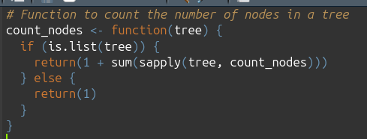
Function to count the number of nodes
in a tree

Slide 8
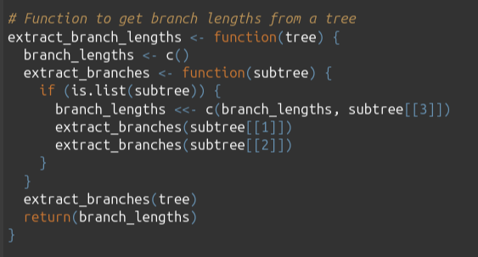
Function to get branch lengths from a tree

Slide 9
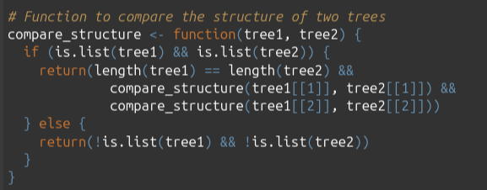
Function to compare the structure of two trees

Slide 10
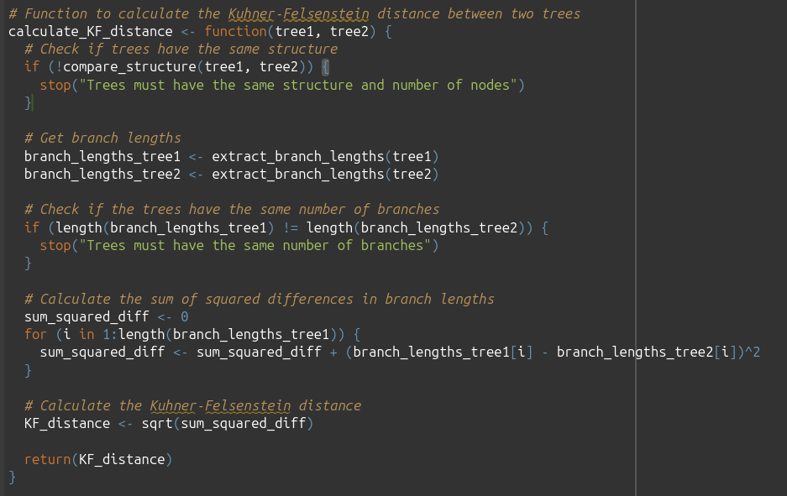
Function to calculate the Kuhner Felsenstein distance between two trees

Slide 11
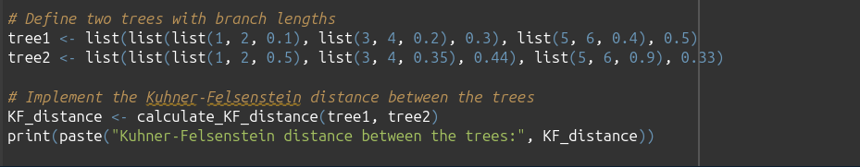
Input entry space and implementation:

Slide 12
Output to the algorithm:
Kuhner-Felsenstein distance between the trees: 0.693541635375988

Slide 13
THANK YOU!

