Slide 1

INTERNSHIP REPORT PRESENTATION
Social Service Internship
Elderly Care & Animal Welfare Program
Four-Week Internship at Ram Lal Vriddhashram Evam Gaushala, Greater Noida, Uttar Pradesh
Shourya Rai
Roll No. 25SCSS1003001695 | B.Tech CSE (Cloud Computing)
June 2026 • Duration: Four Weeks

Slide 2
ABOUT THE STUDENT
Internship Overview
🎓
🆔
ROLL NUMBER
🏛
UNIVERSITY
Shourya Rai
25SCSS1003001695
IILM University, Greater Noida
B.Tech — Computer Science & Engineering
(Cloud Computing Specialization)
📘
BRANCH & SPECIALIZATION
🎓
SEMESTER
Computer Science Engg. — Cloud Computing
3rd Semester, 2nd Year
📆
INTERNSHIP DURATION
📍
INTERNSHIP LOCATION
Four Weeks — June 2026
Greater Noida, Uttar Pradesh
Four-Week Social Service Internship • Shourya Rai
02

Slide 3
ABOUT THE ORGANIZATION
Ram Lal Vriddhashram Evam Gaushala
Ram Lal Vriddhashram Evam Gaushala is a social welfare institution with a centre located in Greater Noida, Uttar Pradesh. It combines an elderly care home (vriddhashram) with a gaushala (cow shelter), operating as a centre for elderly care, animal welfare, and community service.
❤️
🐾
📍
Elderly Care Home
Gaushala (Animal Shelter)
Location
Provides shelter, daily care, and support to elderly residents living at the facility.
Houses and cares for cows kept at the facility, alongside other animals on the premises.
Located near Amity Road, Knowledge Park-2, Greater Noida, Uttar Pradesh.
Four-Week Social Service Internship • Shourya Rai
03

Slide 4
PURPOSE & CONTEXT
A Hands-On Social Service Experience
As part of the B.Tech curriculum, this four-week internship provided an opportunity to step outside the classroom and engage directly in social-service work — supporting elderly residents and helping care for cows at a community welfare institution in Greater Noida. The experience centered on responsibility, teamwork, empathy, and social awareness, rather than any technical or software-development activity.
This internship focused on three connected areas of engagement:
Elderly Care
→
Cow Care
→
Personal Growth
Four-Week Social Service Internship • Shourya Rai
04

Slide 5
OBJECTIVES
Core Internship Objectives
🤲
🐄
👥
Support Elderly Residents
Cow Care & Feeding
Community Service
Assist elderly residents with daily activities and routine tasks.
Participate responsibly in the daily feeding and general care of cows.
Contribute to the day-to-day functioning of a community welfare institution.
👥
❤️
🛡
Teamwork & Collaboration
Empathy & Compassion
Social Awareness
Work alongside staff and fellow volunteers to share daily responsibilities.
Build empathy through direct, personal interaction with elderly residents.
Develop a deeper understanding of social responsibility and community needs.
Four-Week Social Service Internship • Shourya Rai
05

Slide 6
ELDERLY CARE
Assisting Elderly Residents
👥
Direct Assistance
Remained available to assist elderly residents of the ashram whenever required.
Patience • Empathy
Respect • Responsibility
⏰
Daily Routine Support
Helped residents with day-to-day routine activities as part of the daily schedule.
👥
Respectful Interaction
Focused on patient, respectful communication in every interaction with residents.
Key learning: respectful communication is essential in an elderly-care setting — assistance should be provided with patience, dignity, and awareness of individual needs.
Four-Week Social Service Internship • Shourya Rai
06

Slide 7
ANIMAL CARE
Caring for the Gaushala's Cows
A dedicated part of the internship, spread across four weeks of hands-on daily involvement
Daily Cow Feeding & Care
🐄
🧹
⏱
Feeding & General Care
Cleanliness & Upkeep
Consistency & Routine
Helped prepare and distribute fodder and ensured the cows had access to water each day.
Supported the general upkeep and cleanliness of the area where the cows were kept.
Contributed to the same daily routine required to care for a large number of animals.
My role was limited to feeding and general care support — no veterinary or medical procedures were performed.
Four-Week Social Service Internship • Shourya Rai
07

Slide 8
INTERNSHIP TIMELINE
Four-Week Internship Journey — June 2026
1
2
3
4
WEEK
WEEK
WEEK
WEEK
Orientation & Settling In
Elderly Care Focus
Cow Care Focus
Reflection & Conclusion
Introduced to the organization, its residents, and its daily cow-care routine.
Engaged in daily assistance and routine-task support for the ashram's residents.
Participated in feeding, cleaning, and general care of the cows at the gaushala.
Continued combined elderly and cow-care duties, reflecting on the experience.
Four-Week Social Service Internship • Shourya Rai
08

Slide 9
PERSONAL DEVELOPMENT
Skills and Personal Development
✓
Empathy & Compassion
✓
Patience
✓
Responsibility
✓
Teamwork
✓
Communication
✓
Time Management
✓
Discipline
These personal qualities were built through daily, hands-on engagement with elderly residents and cows — beyond anything a classroom setting alone could offer.
Four-Week Social Service Internship • Shourya Rai
09

Slide 10
LEARNING OUTCOMES
Key Learning Outcomes
🐄
🛡
👥
Cow-Care Experience
Social Awareness
Community-Service Experience
Direct, hands-on exposure to the daily feeding and general care of cows at a gaushala.
A stronger understanding of social responsibility, built through service to elderly residents.
Practical experience contributing to the daily functioning of a community welfare institution.
Overall, the internship strengthened both personal values and a sense of social responsibility.
Four-Week Social Service Internship • Shourya Rai
10

Slide 11
REFLECTION
Challenges and Learning Experience
💡
A Different Kind of Environment
🐄
Consistency of Daily Care
Adjusting to a hands-on, non-technical service setting, quite different from regular academic coursework.
Maintaining patience and consistency in the daily feeding and care of the cows required regular attention.
⏰
Balancing Responsibilities
❤️
Building Confidence & Comfort
Managing time between elderly-assistance duties and cow-care activities within the same day.
Growing more comfortable and confident while interacting closely with elderly residents.
Four-Week Social Service Internship • Shourya Rai
11

Slide 12
OVERALL EXPERIENCE
A Meaningful Month of Growth
The four-week internship was a meaningful and enriching experience. It gave me an opportunity to work in an environment centred on care, welfare, and community participation — different from my regular B.Tech coursework and a valuable practical addition to my personal development.
Confidence
Responsibility
Patience
Communication
Teamwork
Social Awareness
“Overall, the internship improved my confidence and helped me appreciate the value of contributing positively through practical service — reinforcing that education develops not only academic knowledge but also personal values and transferable skills.”
Four-Week Social Service Internship • Shourya Rai
12

Slide 13
VERIFICATION
Internship Verification
🏠
ORGANIZATION
Ram Lal Vriddhashram Evam Gaushala
📍
LOCATION
Greater Noida, Uttar Pradesh
📆
DURATION
Four Weeks — June 2026
🛡
NATURE OF INTERNSHIP
Social Service — Elderly Care & Animal Welfare
✅
VERIFICATION
Certificate of completion issued by the organization confirming participation
Four-Week Social Service Internship • Shourya Rai
Four-Week Social Service Internship • Shourya Rai
13
13

Slide 14
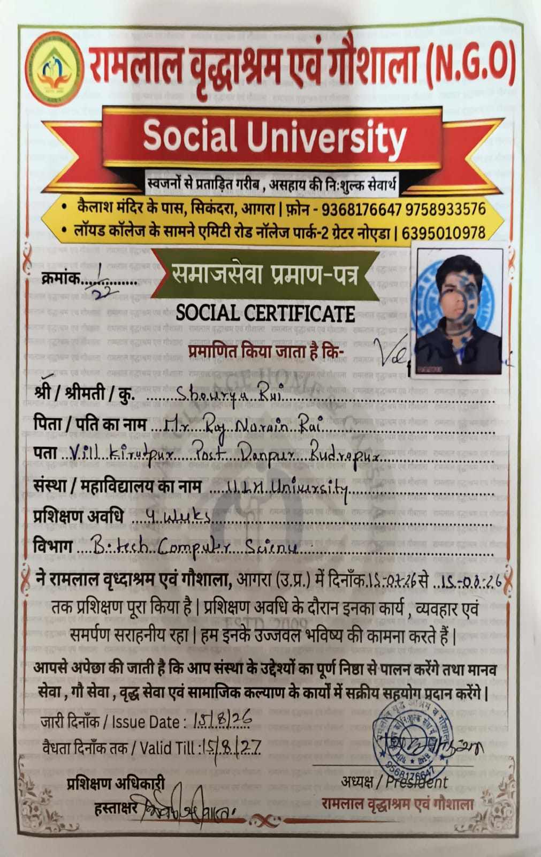
CERTIFICATE & VERIFICATION
Internship Certificate & Verification
VERIFICATION DETAILS
🆔
STUDENT
Shourya Rai
🎓
ROLL NUMBER
25SCSS1003001695
🏠
INTERNSHIP ORGANIZATION
Ram Lal Vriddhashram Evam Gaushala
📆
INTERNSHIP DURATION
Four Weeks — June 2026
📄
DOCUMENT
Internship Completion Certificate
Four-Week Social Service Internship • Shourya Rai
14

Slide 15
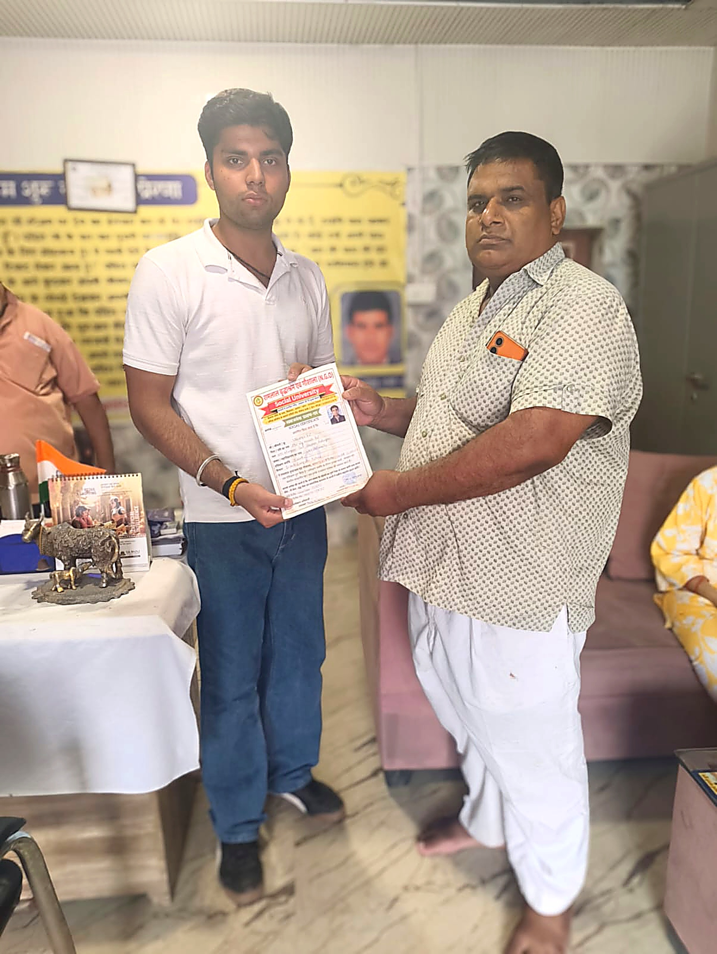
CERTIFICATE & VERIFICATION
Receiving the Internship Certificate
Photograph taken at the time of receiving the certificate from the organization.
Four-Week Social Service Internship • Shourya Rai
15

Slide 16
Thank You
A rewarding month of empathy, responsibility, and community service
Shourya Rai
Roll No. 25SCSS1003001695 | IILM University, Greater Noida
Internship: Ram Lal Vriddhashram Evam Gaushala, Greater Noida

