Slide 1
Real Or Fake News Analysis
Group 3
P272

Slide 2
Business Objective
Need to classify the fake and real news accurately through the given dataset.
Fake news and real news can have significant effects on individuals, society, and even businesses. The impact of both types of news can vary based on factors such as the credibility of the news source, the dissemination channels, and the susceptibility of the audience.
It's important to critically evaluate information sources, fact-check claims, and rely on reputable news outlets to minimize the negative effects of fake news.
Hence, we will build and train our model so that it can correctly predict whether a given piece of news is real or fake by using the given dataset and applying different machine learning techniques.

Slide 3
Project Architecture/Project Flow
Acquiring and loading dataset
Data transformation/Text processing (EDA) using Python
Removing extra symbols, punctuations, stop words
Stemming, Tokenization, Feature Extractions
TF vectorizer
Counter vectorizer with TF-IDF transformer
Model Building
Model Evaluation
Deployment through R Shiny or Flask/ Streamlit

Slide 4
DATA SETS
2 Separate dataset given for fake and real news namely Fake.csv and True.csv.
Fake.csv contains 23481 rows/instances
True.csv contains 21417 rows/instances
This dataset contains about 40000 articles consisting of fake as well as real news.
Both files contains 4 features namely title, text, subject, date.
The popular python libraries and packages we’ll use in this project are namely:
NumPy
Pandas
Seaborn
Matplotlib and many more as per the requirement…

Slide 5
Exploratory Data Analysis(EDA)

Slide 6
EDA
Under EDA we performed:
Removed duplicate values from both fake and real data
Extracted year from date feature of real data
Created new feature 'year' in real data.
Concatenated real and fake data
Performed Visualizations Techniques like bar plot, strip plot, histogram, etc.
Checked for null values
Checked data type

Slide 7
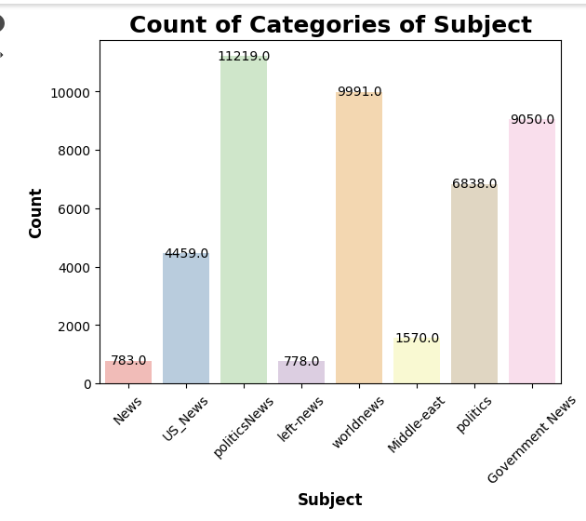
EDA
Checking Count of categories present in subject feature from concatenated data.
From the given plot we can see that data contains more number of politicsNews in the given data.

Slide 8
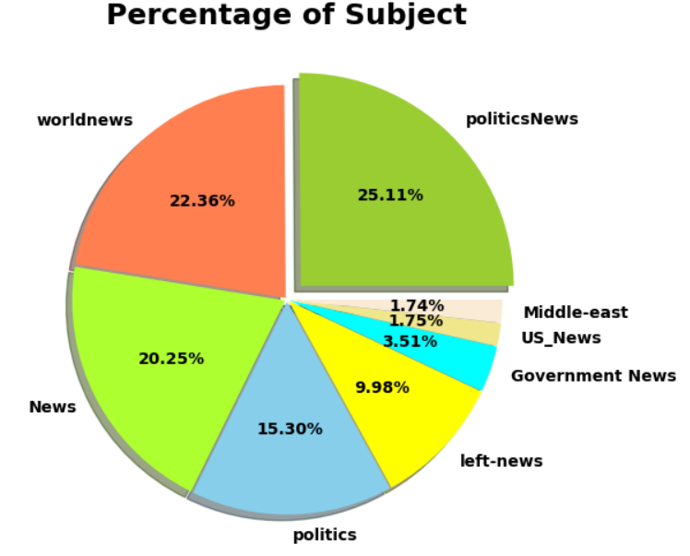
EDA
Distribution of subject percentage wise in concatenated data.

Slide 9
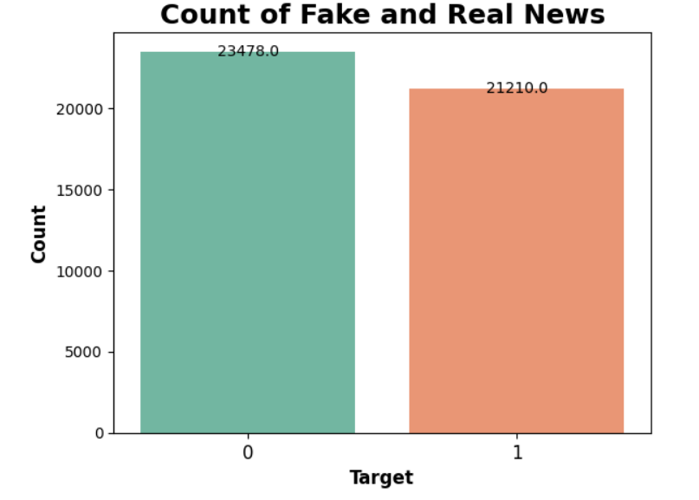
EDA
Given plot is about count of Real & Fake News in concatenated data.
0 represents Fake data and 1 represents Real data.
From this plot we can see that the data is almost balanced.

Slide 10
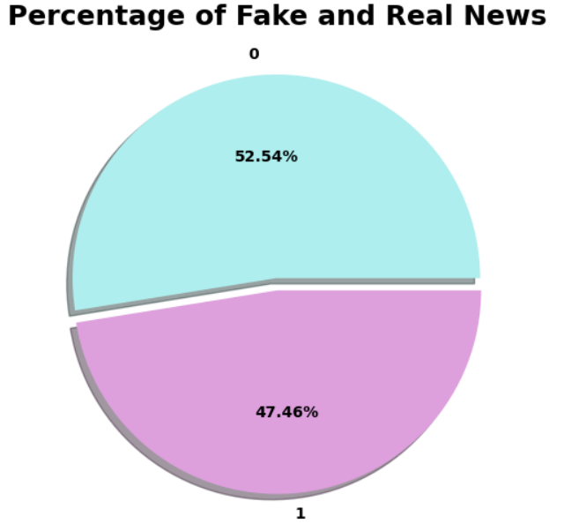
EDA
Distribution of Fake & Real News Percentage Wise.
We have 52.54% fake news of the whole data, while 47.46% real news of the whole data.

Slide 11
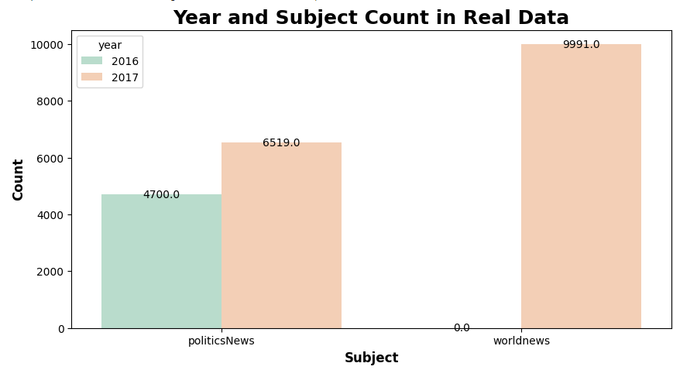
EDA
Distribution of the subject according to year from real data.
From this plot we understood that we received politicsNews in both the years, that is 2016 and 2017. While we received worldnews only in the year of 2017

Slide 12
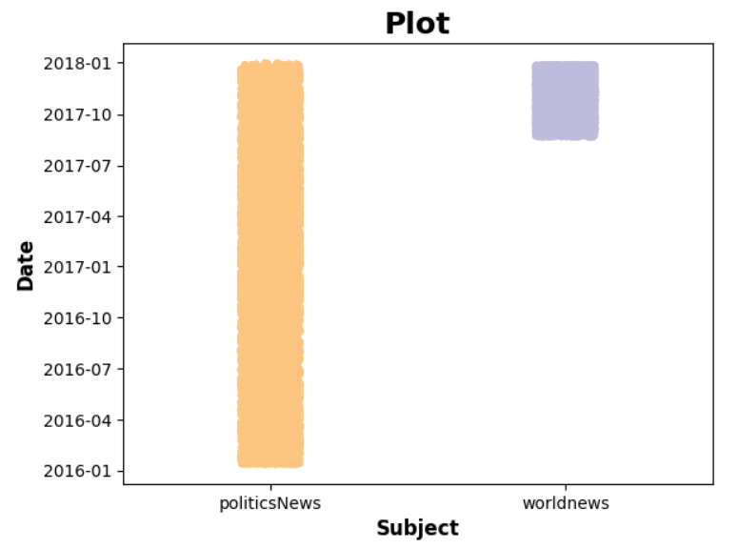
EDA
Distribution of the subject according to year from real data.
From the given plot we can see that politicsNews we received from Jan 2016 to Jan 2018.
While worldnews we received probably from Aug 2017 to Jan 2018.

Slide 13
DATA PREPROCESSING
Data processing is a crucial step in text mining that involves transforming raw text data into a format suitable for analysis and modeling.
In data processing we processed our data by performing:
Changed text into Lowercase
Removed Punctuations
Removed Special Characters
Removed URLs
Removed Stop Words
Tokenization
Lemmatization

Slide 14
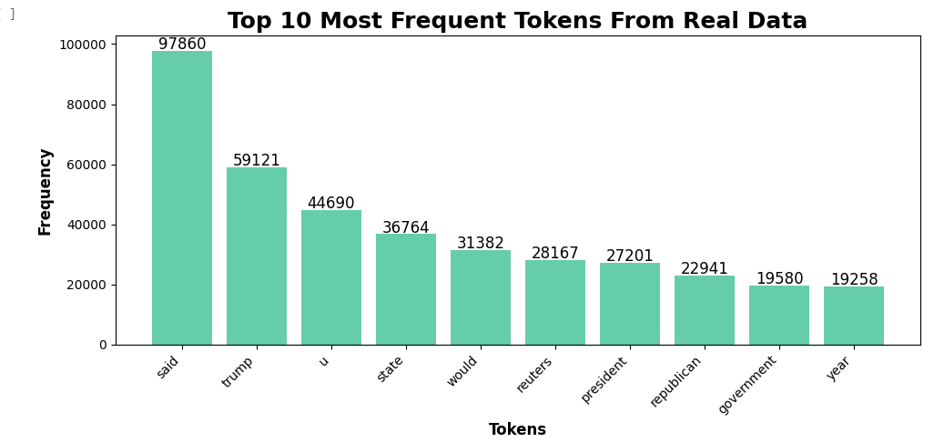

Slide 15
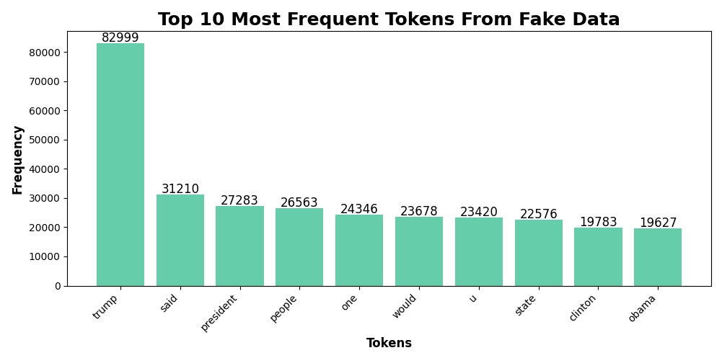

Slide 16
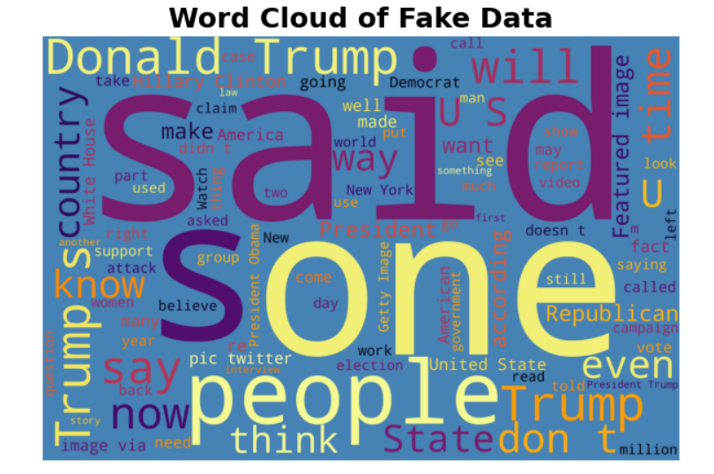
WORD CLOUD

Slide 17
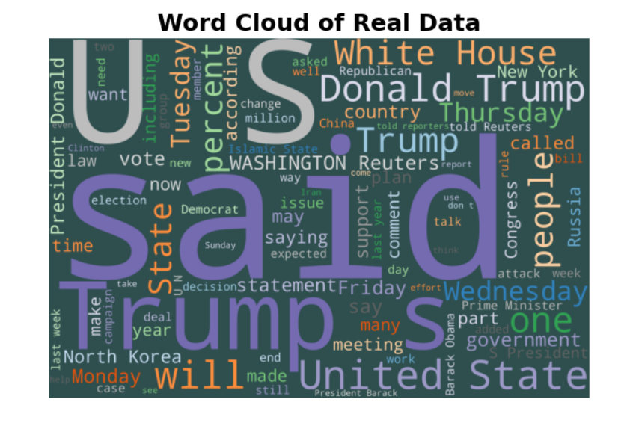
WORD CLOUD

Slide 18
Vectorization
We performed TF-IDF vectorization to map words or phrases from vocabulary to a corresponding vector of real numbers which is used to find word predictions, word similarities/semantics.
TF-IDF vectorizer provides a matrix representing the text from the data. It will be a sparse matrix with a large number of elements in a Compressed Sparse Row format.
After vectorization, we split the data into test and train data.
We split our data such that, 70% of data will be train data and 30% will be of test data.

Slide 19
Model Building
We fitted six Machine Learning models to the data as given below:
Naive Bayes
Logistic Regression
Decision Tree
KNN
Random Forest
SVM

Slide 20
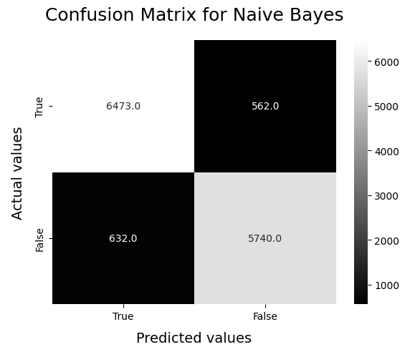
1. Naive Bayes
Through Naïve Bayes, we are getting the accuracy of 91.09%. Below is the image of number of correct and wrong predictions. Correct Predictions: 12213, Wrong Predictions: 1194

Slide 21
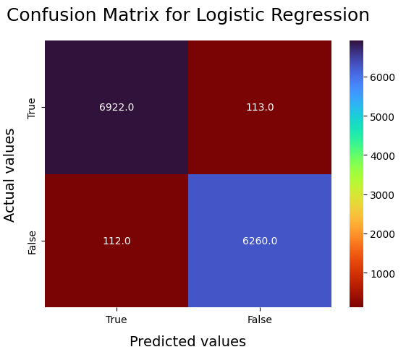
2. Logistic Regression
Through Logistic Regression, we are getting the accuracy of 98.32%. Below is the image of number of correct and wrong predictions. Correct Predictions: 13182, Wrong Predictions: 225

Slide 22
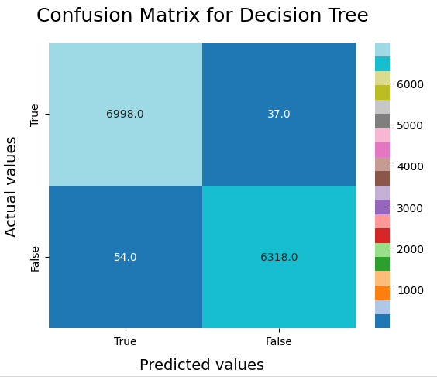
3. Decision Tree
Through Decision Tree, we are getting the accuracy of 99.32%. Below is the image of number of correct and wrong predictions. Correct Predictions: 13316, Wrong Predictions: 91

Slide 23
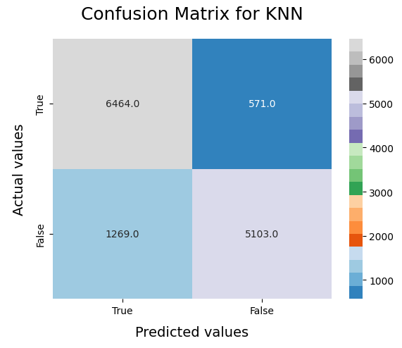
4. KNN
Through KNN, we are getting the accuracy of 86.28%. Below is the image of number of correct and wrong predictions. Correct Predictions: 11567, Wrong Predictions: 1840

Slide 24
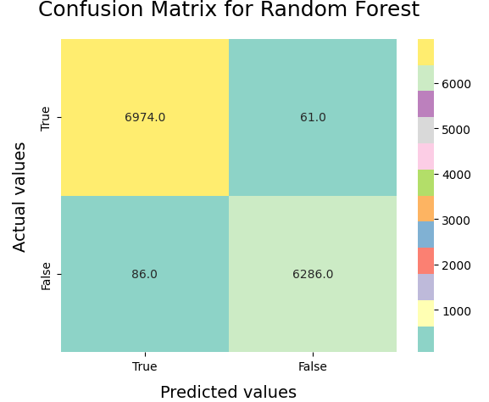
5. Random Forest
Through Random Forest, we are getting the accuracy of 98.9%. Below is the image of number of correct and wrong predictions. Correct Predictions: 13260, Wrong Predictions: 147

Slide 25
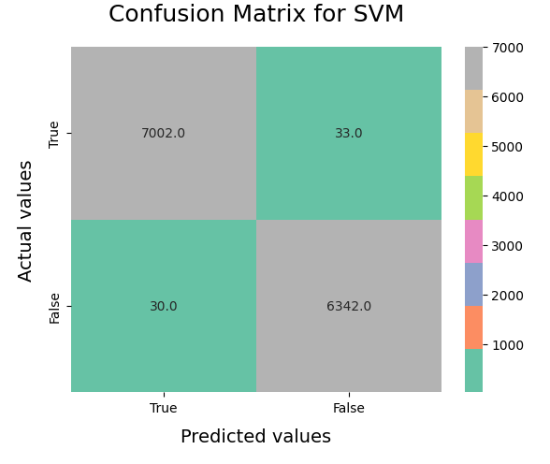
6.SVM
Through SVM, we are getting the accuracy of 99.53%. Below is the image of number of correct and wrong predictions. Correct Predictions: 13344, Wrong Predictions: 63

Slide 26
Randomized Search CV
We have performed Randomized Search CV for tuning hyperparameters for the below algorithms:
KNN (for n_neighbors)
Random Forest (for random_state, n_estimators and max_features)
SVM (for kernel, gamma and C)

Slide 27
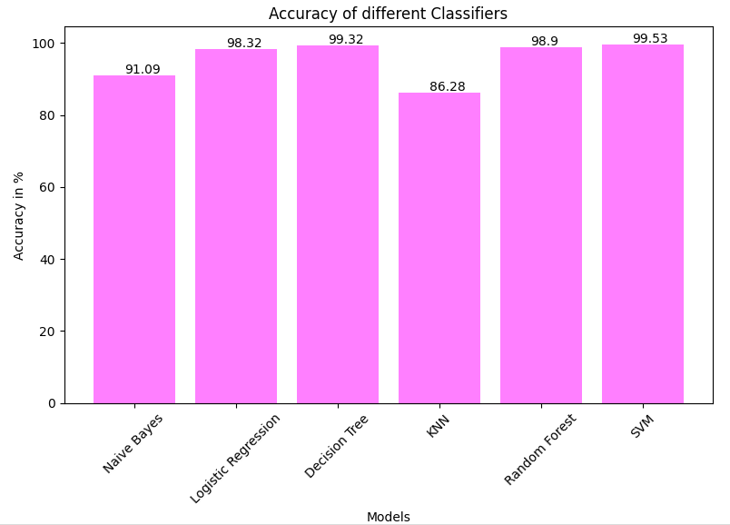
Bar Plot of Accuracies
Bar plot to show the comparison of accuracies among different classifiers.

Slide 28
Model Evaluation
We performed below model evaluation techniques for each model:
Recall
Precision
F1 Score
Confusion Matrix
Specificity
Accuracy Score

Slide 29
Model Deployment
As Support Vector Machine was giving highest accuracy, we finalized SVM model to predict real and fake news.
For model deployment we performed:
Saved the trained model (saved .pkl files)
Wrote a deployment code in Spyder (referring .pkl files)
Added wordcloud for the input text
Model Deployment through Spyder

Slide 30
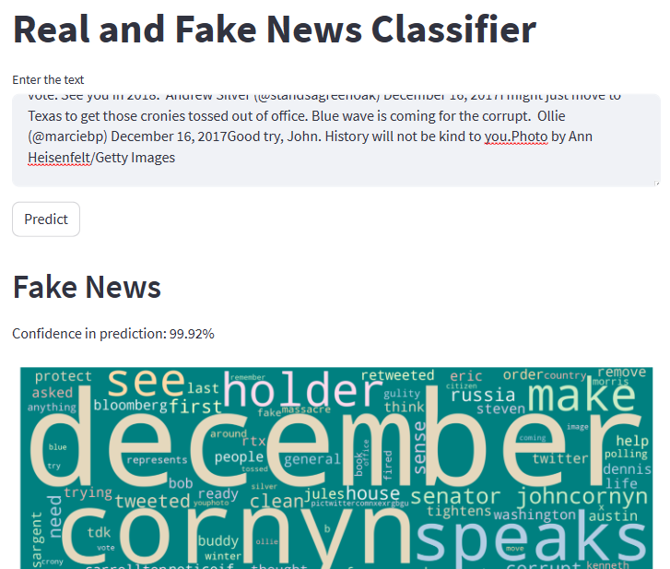
Model After Deployment
This is how model is predicting Fake News, by giving 99.92% of ‘Confidence in prediction’.
Below the predicted value, wordcloud is shown for the given input.

Slide 31

Model After Deployment
This is how model is predicting Real News, by giving 100% of ‘Confidence in prediction’.
Below the predicted value, wordcloud is shown for the given input.

Slide 32
Challenges Faced While Building a Model
Dataset
Both the datasets were having some discrepancy due to which loading datasets and analyzing the issue took time. From this we can say that the quality of the data impact the model’s performance.
Feature Extraction
Extracting meaningful features from text data requires careful preprocessing and consideration of techniques like tokenization, lemmatization and vectorization.
Model and Hyperparameter Tuning
Choosing the right algorithm considering accuracy as well as precision. Hyperparameter tuning, to achieve optimal performance was quite time and memory consuming.

Slide 33


