Slide 1
The Analytics Team
Sprocket Central Pty Ltd
Data analytics approach
Presented by – Sinora Rai

Slide 2

AGENDA
Introduction
Data Transformation and Exploration
Model Development
Data Interpretation

Slide 3
Note: The data and information in this document is reflective of a hypothetical situation and client. This document is to be used for KPMG Virtual Internship purposes only.
Sprocket Central Pty Ltd
Sprocket Central Pty Ltd is a long-standing KPMG client whom specializes in high-quality bikes and accessible cycling accessories to riders.
Data Transformation
Removing NaN values
Converting data into more useful format
Data modelling
Finding and Selecting the
Finding out hidden trends
Data Interpretation
Deriving out new model to boost the business

Slide 4
Data Transformations & Data Exploration
Data exploration is the first step of data analysis used to explore and visualize data to uncover insights from the start or patterns to dig deeper.
Data transformation is the process of changing the format, structure, or values of data.
Significance of performing an EDA:
Reduces the risk of imbalance distribution of the dataset by checking the skewness of a particular field.
High Correlation between multiple variables can lead to overfitting problem which can be checked using correlation analysis.
To Infer better variables/predictors out of the existing variables that can turn out to be a good predictor if it correlates with the output variable.
Removes the redundant values from the dataset by treating missing values and outliers.

Slide 5
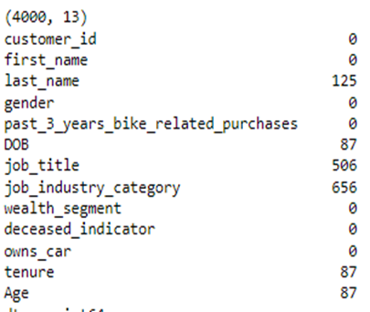
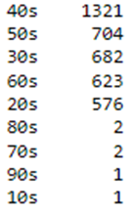
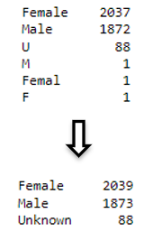
Customer demographic Dataset
Feature column and the count of missing values in each columns
Converting Age from continuous to categorical value.
Correcting gender columns categories.

Slide 6
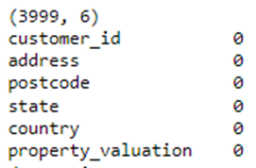
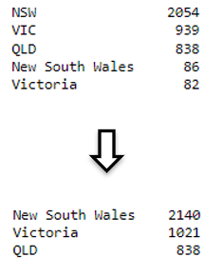
Transaction Dataset
Feature column and the count of missing values in each columns
Correcting state columns
categories.

Slide 7
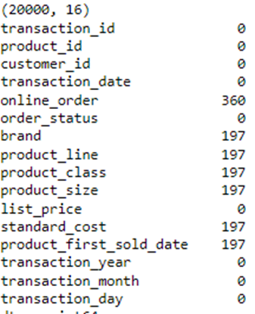
Customer Address Dataset
Feature column and the count of missing values in each columns

Slide 8
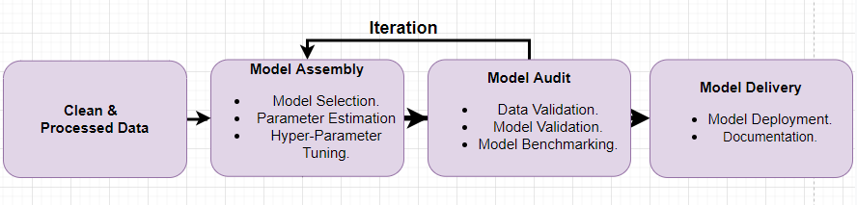
Model Development
Model development is an iterative process, in which many models are derived, tested and built upon until a model fitting the desired criteria is built.

Slide 9
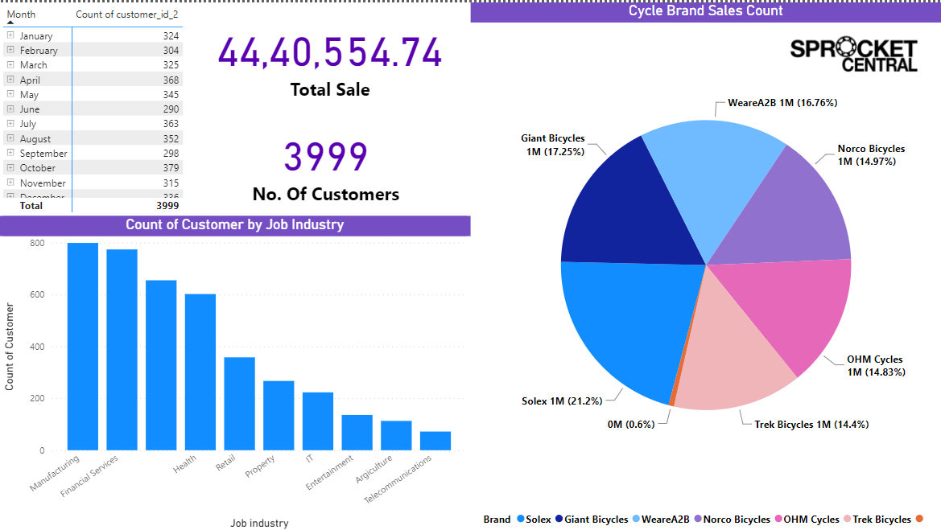
Sales Report

Slide 10
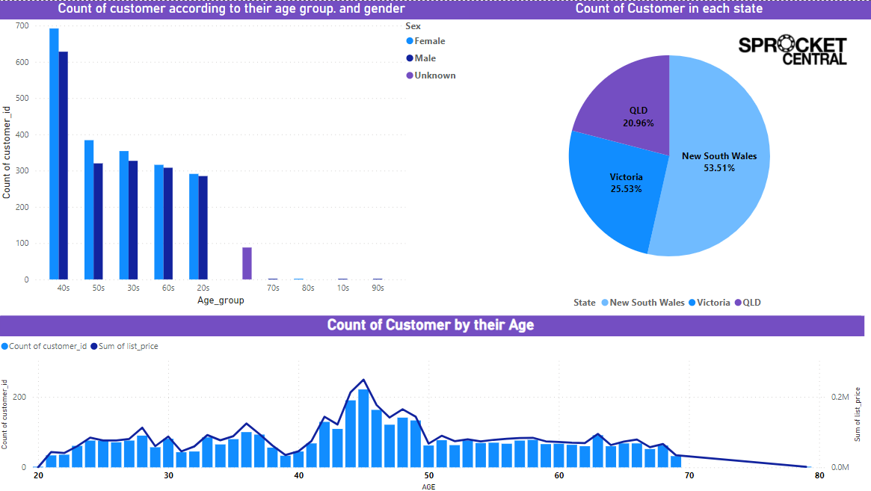
Sales Report

Slide 11
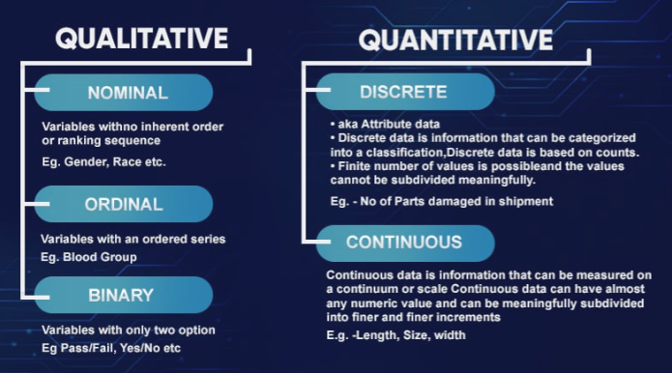
Data Interpretation
Data interpretation refers to the process of using diverse analytical methods to review data and arrive at relevant conclusions.

Slide 12
Data Interpretation
Solex 849 is the highest selling Bicycles and Trek Bicycles are the least selling ones.
Manufacturing and financial services industry people are one of the largest customer
Most of the buyers comes under the age group of 20-40 .
Highest number of buyers are at their 40s.
New south Wales has the largest number of bike buyers.

Slide 13

THANK
YOU

