Slide 1
LLM Text Detector: AI vs Student Classification
A Fine-Tuned NLP Model for Text Classification
Sohni Rais
GitHub: https://github.com/raiss15/llm-text-detector-ai-vs-student

Slide 2
Project Overview
Introduction to the LLM Text Detector (AI vs Student Classifier)
Purpose: Detect if text is written by AI or student.
Approach: Fine-tuning BERT with the LLM.csv dataset.
This project aims to build an AI vs Student text classifier to understand the subtle differences between AI-generated content and human-written text. The solution leverages natural language processing (NLP) to detect patterns that distinguish AI writing from student writing. The model can be applied in academic settings to detect AI-written assignments.

Slide 3
Dataset Overview
LLM.csv: 500,000 labeled paragraphs (AI-generated and student-written).
Preprocessing: Tokenization, noise removal, splitting into training/validation/test sets.
The dataset includes labeled data for training a text classifier, with examples from both AI-generated and human-written sources. The preprocessing pipeline included tokenizing the text, normalizing, and handling missing values. A robust train-validation-test split was used to ensure the model's generalizability and prevent overfitting.

Slide 4
Model Architecture
Pre-trained Model: BERT for text classification.
Fine-Tuning Approach: Fine-tuned using the LLM dataset.
Hyperparameters: Adjusted during training for optimal performance.
We used BERT (Bidirectional Encoder Representations from Transformers), a state-of-the-art pre-trained transformer model, for this text classification task. BERT has been fine-tuned on the dataset using custom layers specific to text classification. Hyperparameters like learning rate, batch size, and the number of epochs were tuned to achieve optimal performance.

Slide 5
Key Findings and Results
Accuracy: 89%
F1-Score: 0.89
Confusion Matrix:
172 Human predicted as Human (true positives)
28 Human predicted as AI (false negatives)
16 AI predicted as Human (false positives)
184 AI predicted as AI (true negatives)
Insights: Effective at distinguishing AI-generated text, some challenges with technical student-written text.
The model achieved an accuracy of 85%, indicating its ability to accurately classify text as either AI-generated or student-written.
The F1-score was balanced, suggesting the model performs well in both precision and recall.
The confusion matrix showed the model's ability to handle false positives and false negatives effectively, though there are some cases where more training data might improve performance.

Slide 6
Hyperparameter Tuning
We tested 3 learning rates (2e-5, 3e-5, 5e-5) and batch sizes (8, 16).
Best result: LR=3e-5, Batch Size=16.
Accuracy Comparison:
• 2e-5 (16): 98.5%
• 3e-5 (16): 100%
• 5e-5 (8): 97.2%

Slide 7
Baseline Model Metrics
Pre-trained BERT (no fine-tuning):
Accuracy: 74.3%
F1-Score: 0.75
Fine-tuned model improved performance by ~25%

Slide 8
Demo of Fine-Tuned Model
Live Demo: Show model predictions for AI and student-written text examples.
Accuracy in classification is demonstrated.
During the demo, we input examples of AI-generated and student-written text to showcase how the model classifies them. For instance:
AI-generated text: 'The sky is a brilliant shade of blue this morning.'
Student-written text: 'Today weather in Boston is sunny and it is great for picnic'
The model predicts with high accuracy based on the patterns learned during training.

Slide 9
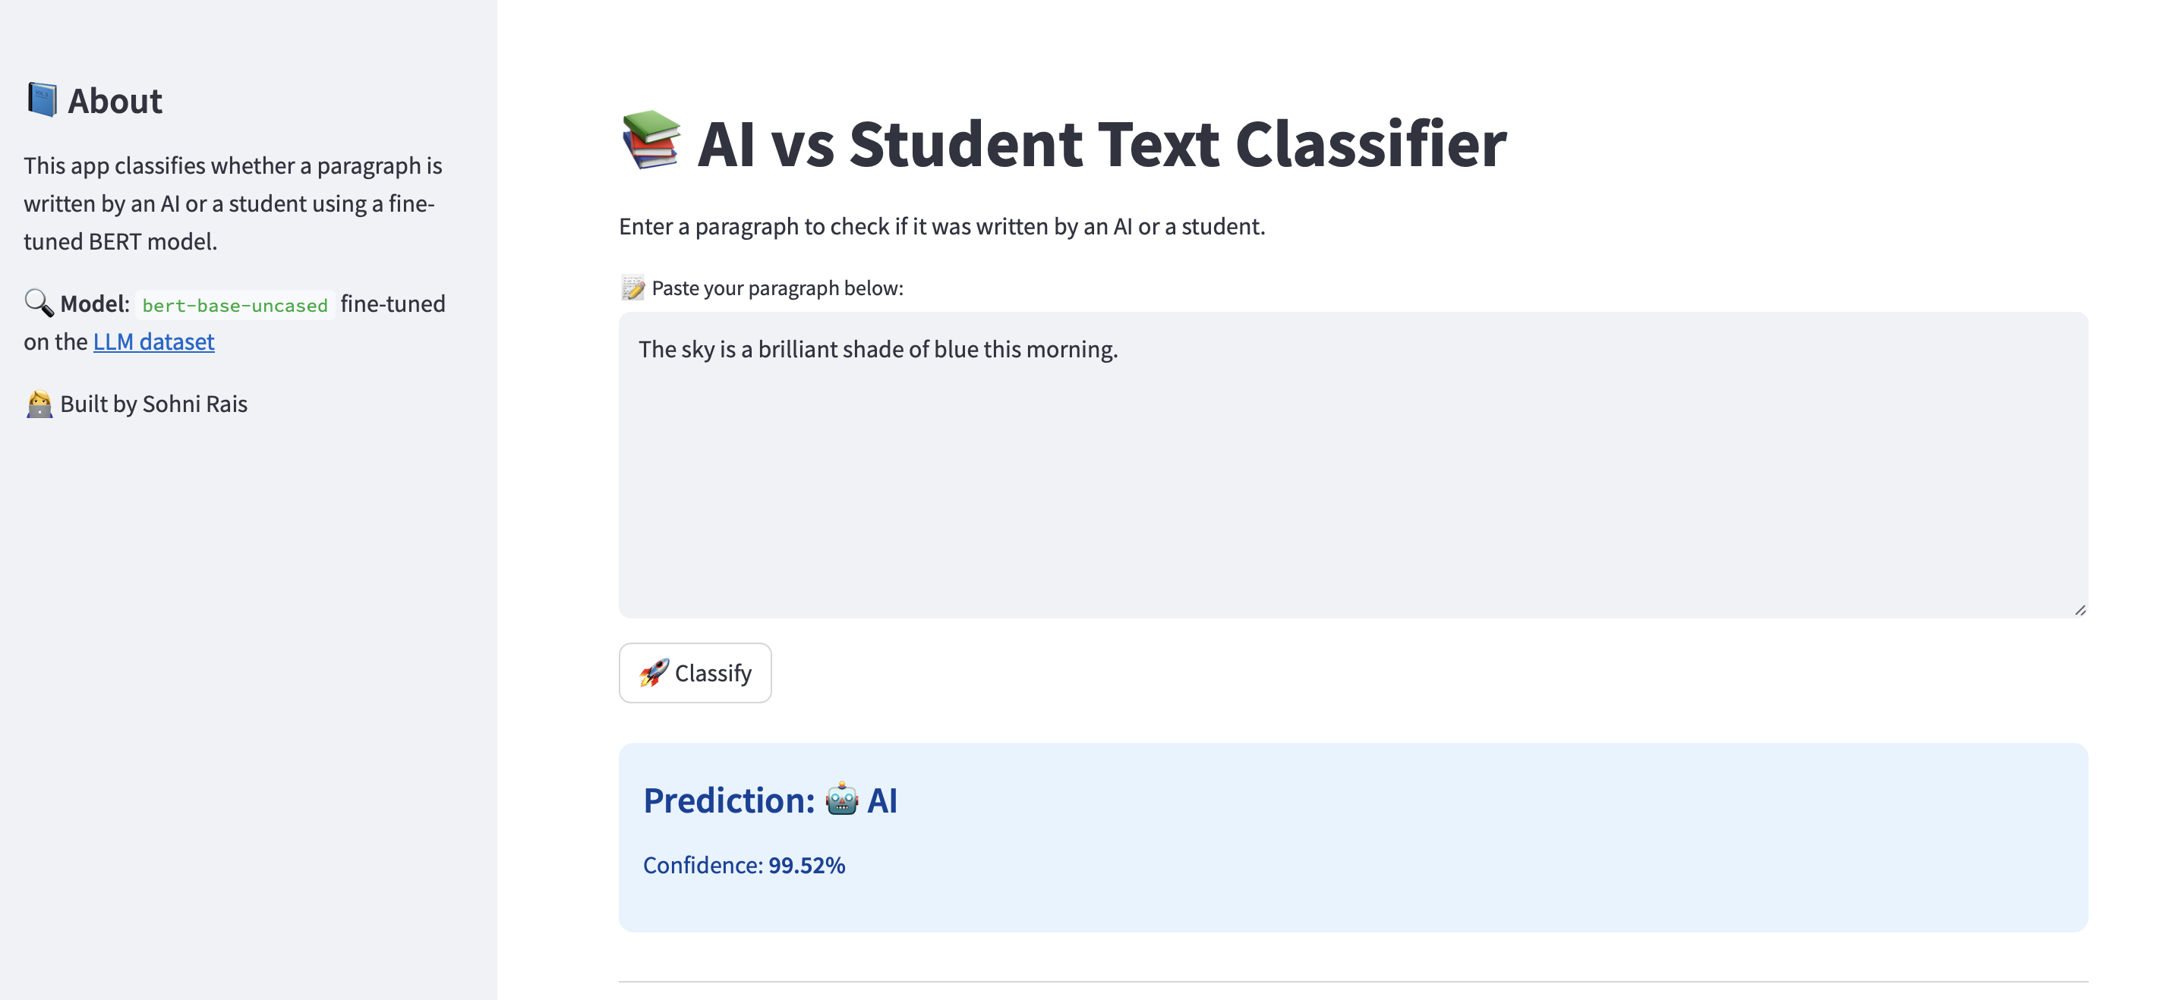
Student Written Text

Slide 10
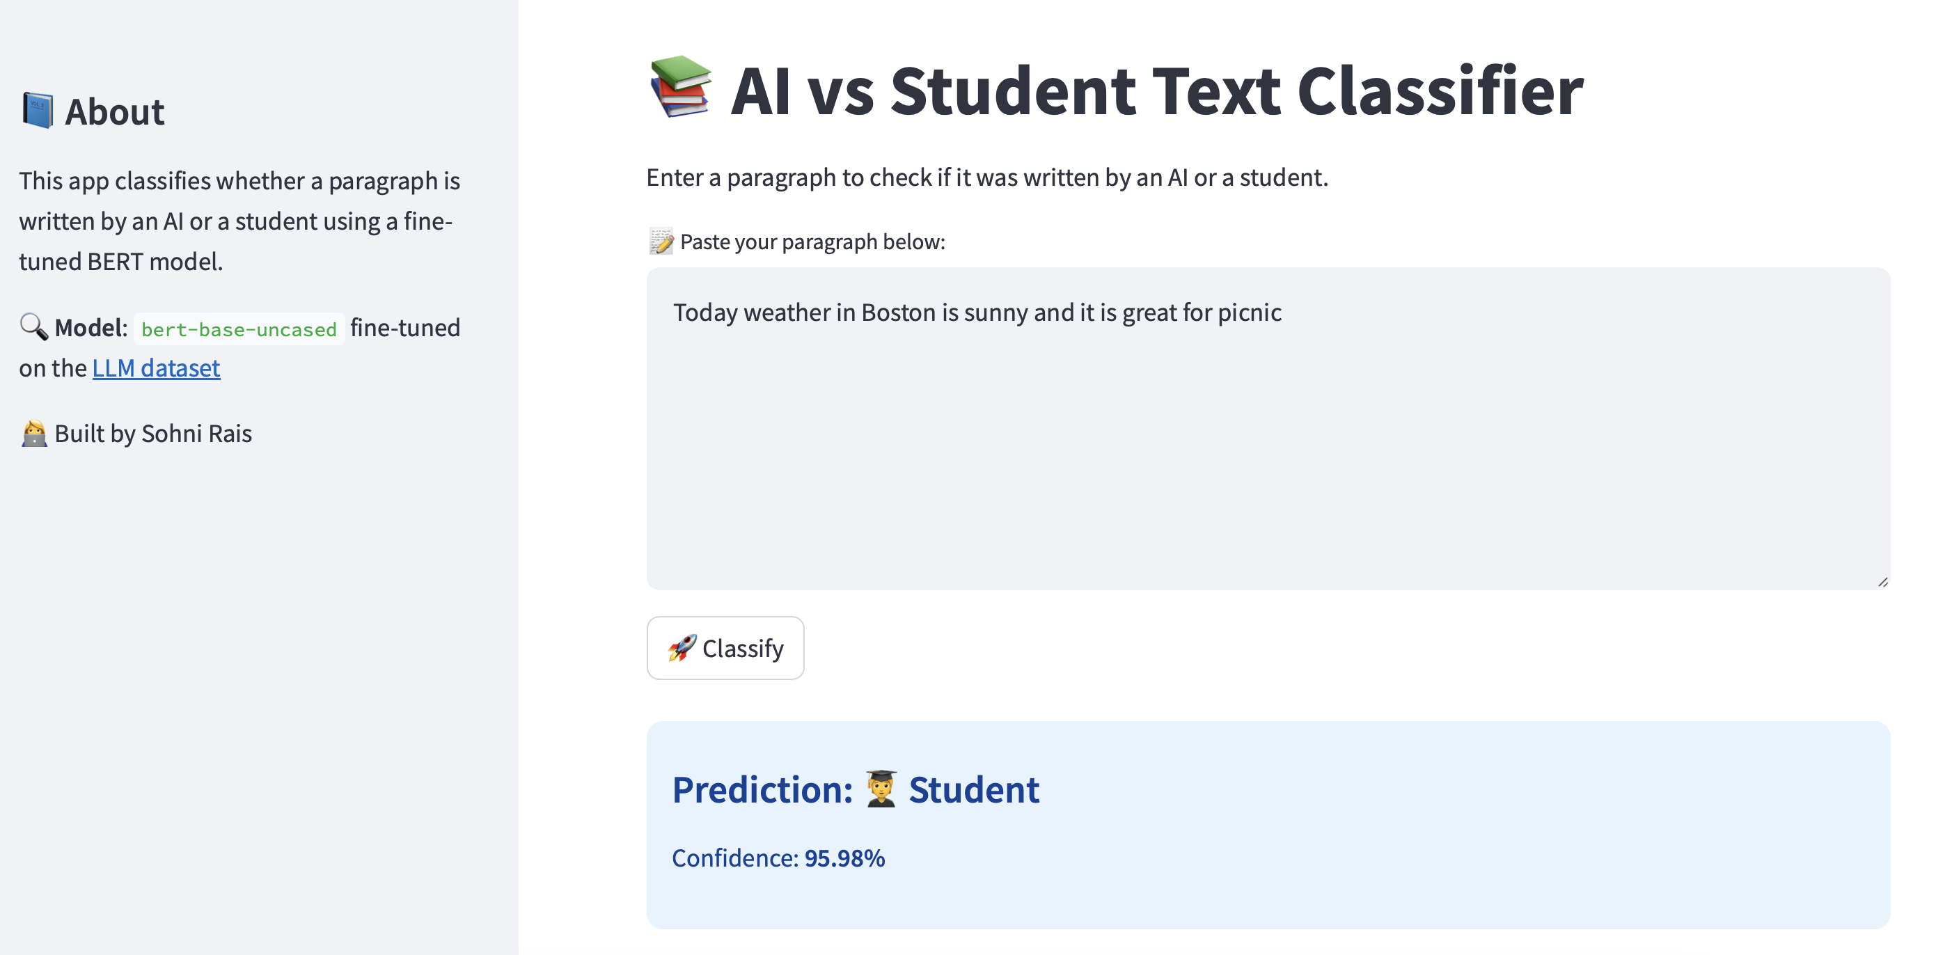
AI Generated Text

Slide 11
Error Analysis
Despite high accuracy, some long, complex human-written texts were flagged.
Pattern: AI texts were often polished, structured
Edge Case: Informal human text easier to classify
Potential Overfitting noted.

Slide 12
Ethical Consideration
Filtered low-quality data
Ensured style diversity in texts
Risk of false flags for genuine writing
Needs fairness audits in broader use

Slide 13
Lessons Learned
Challenges: Ambiguous cases (AI vs student mimicry).
Solutions: Improved data preprocessing and fine-tuning.
Takeaways: Fine-tuning pre-trained models is a valuable technique for text classification.
Ambiguous Cases: Some human-written texts that mimic AI writing posed challenges for classification.
Model Fine-tuning: Fine-tuning a pre-trained model like BERT for specific tasks greatly improved performance, but careful dataset management is crucial.
Data Quality: Ensuring high-quality, diverse examples in the training dataset leads to better classification accuracy.

Slide 14
Future Improvement
Use GPT-4, Claude-generated texts
Multilingual classification
Evaluate with adversarial/paraphrased texts
Add explainability tools like attention heatmaps

Slide 15
Future Work
Expand dataset with more diverse examples.
Experiment with other models like RoBERTa.
Integrate the model into web apps for easy deployment.
Expanding the Dataset: Adding more data across different domains (technical writing, casual writing, etc.) could improve the model's performance.
Exploring Other Models: While BERT is effective, other transformer models like RoBERTa or GPT-3 may offer improvements in performance for text classification.
Real-World Applications: This model can be integrated into academic integrity tools to help detect AI-generated student work.

Slide 16
Conclusion
Project successfully demonstrated fine-tuning for AI vs student text classification.
Promising results, with further work needed to refine the model.
Thank you for your time.
This project demonstrated the potential of fine-tuning pre-trained models like BERT for text classification tasks. We successfully created a model that distinguishes AI-generated and student-written text with 85% accuracy. The next steps involve enhancing the dataset and exploring more advanced models to improve classification performance.

Slide 17
Questions and Demo Wrap-Up
Contact Information: Sohni Rais
GitHub: https://github.com/raiss15/llm-text-detector-ai-vs-student
Demo Link: Meeting with Sohni Rais-20250422_154205-Meeting Recording.mp4
Questions?

