Slide 1

Profiling in Java with JProfiler

Slide 2
Before we start
git clone https://github.com/raitraidma/profiling.git
mvn clean install
mvn spring-boot:run
Do not peek into presentation folder!
https://www.ej-technologies.com/download/jprofiler/files

Slide 3
Why and when?

Slide 4
Why and when?
You are here
Something is slow
Something uses too much memory
Need to optimize

Slide 5
Java optimizations
Optimizations you get for free!

Slide 6
Compilation time optimization (1.1)
public class CompilerOptimizationWithFinalExample { private static final boolean IS_PRINTING = false; public static void main(String[] args) { for (int i = 0; i < 100_000_000; i++) { if (IS_PRINTING) { System.out.println("i = " + i); } } } }

Slide 7
Compilation time optimization (1.2)
public class CompilerOptimizationWithFinalExample { private static final boolean IS_PRINTING = false; public CompilerOptimizationWithFinalExample() { } public static void main(String[] args) { for(int i = 0; i < 100000000; ++i) { } } }

Slide 8
Compilation time optimization (2.1)
public class CompilerOptimizationWithoutFinalExample { private static boolean IS_PRINTING = false; public static void main(String[] args) { for (int i = 0; i < 100_000_000; i++) { if (IS_PRINTING) { System.out.println("i = " + i); } } } }

Slide 9
Compilation time optimization (2.2)
public class CompilerOptimizationWithoutFinalExample { private static boolean IS_PRINTING = false; public CompilerOptimizationWithoutFinalExample() { } public static void main(String[] args) { for(int i = 0; i < 100000000; ++i) { if (IS_PRINTING) { System.out.println("i = " + i); } } } }

Slide 10
Compilation time optimization (3.1)
public class LiteralConstantExample { public static void main(String[] args) { int age = 3 * 7 + 1; final String firstName = "Jon"; final String lastName = "Snow"; String fullName = firstName + " " + lastName; String firstName2 = "Daenerys"; String lastName2 = "Targaryen"; String fullName2 = firstName2 + " " + lastName2; System.out.println(fullName + " is " + age + " years old"); System.out.println(fullName2 + " is also " + age + " years old"); } }

Slide 11
Compilation time optimization (3.2)
public class LiteralConstantExample { public LiteralConstantExample() { } public static void main(String[] args) { int age = 22; String firstName = "Jon"; String lastName = "Snow"; String fullName = "Jon Snow"; String firstName2 = "Daenerys"; String lastName2 = "Targaryen"; String fullName2 = firstName2 + " " + lastName2; System.out.println(fullName + " is " + age + " years old"); System.out.println(fullName2 + " is also " + age + " years old"); } }

Slide 12
Runtime optimization
Hotspot JIT can detect what kind of processor you have and generates code accordingly.

Slide 13
Own intelligence
public class GarbageCollectorExample { public static void main(String[] args) { Long count = 0L; for (int i = 0; i < 100_000_000; i++) { count++; } } }

Slide 14
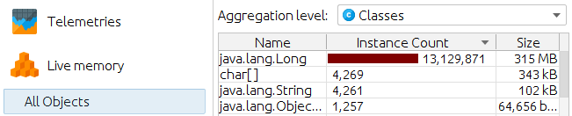
Own intelligence
Took 519 ms

Slide 15
Own intelligence
public class GarbageCollectorFixExample { public static void main(String[] args) { long count = 0L; for (int i = 0; i < 100_000_000; i++) { count++; } } }

Slide 16
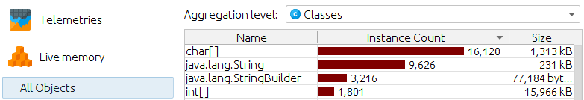
Own intelligence
Took 5 ms

Slide 17
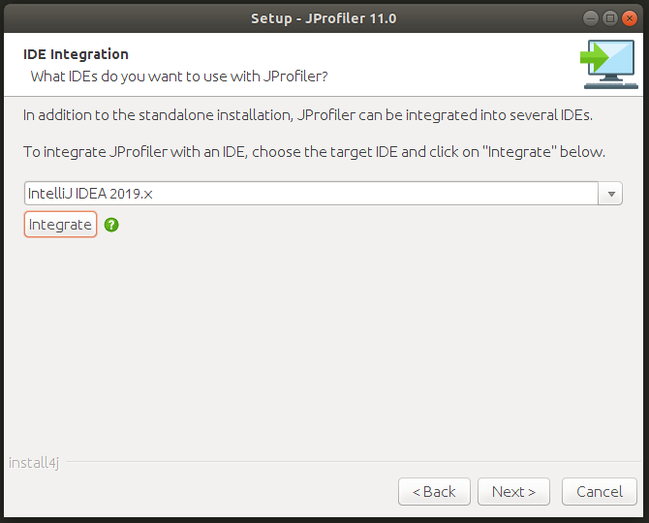
Install JProfiler
Download
https://www.ej-technologies.com/download/jprofiler/files
IDE integration
Close IDE
Select IDE configuration folder

Slide 18
Attach JProfiler
-agentpath VM parameter
-agentpath:/opt/jprofiler/bin/linux-x64/libjprofilerti.so=port=8849,nowait

Slide 19
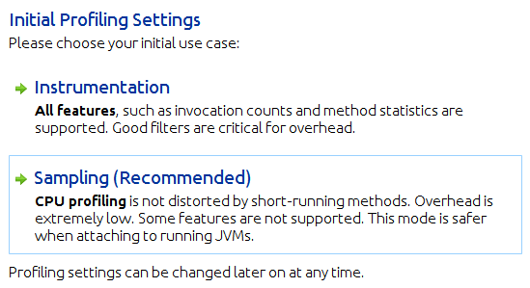
Instrumentation vs Sampling

Slide 20
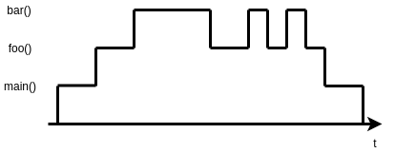
Instrumentation vs Sampling

Slide 21
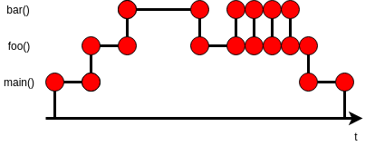
Instrumentation
All features.
Filters must be used correctly. Otherwise overhead.

Slide 22
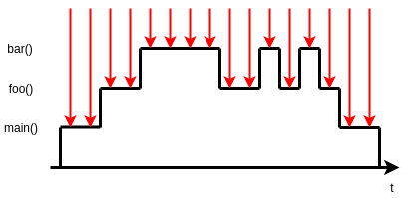
Sampling
When you do not know where the bottlenecks are.
Less overhead.

Slide 23
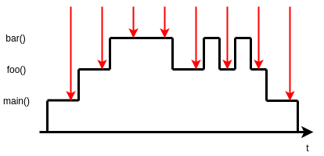
Sampling
Sampling rate

Slide 24
Instrumentation vs Sampling - Example
GarbageCollectorExample
CPU recording enabled

Slide 25
Memory profiling
Memory leak

Slide 26
Memory profiling
Memory leak: unused objects cannot be garbage collected.

Slide 27
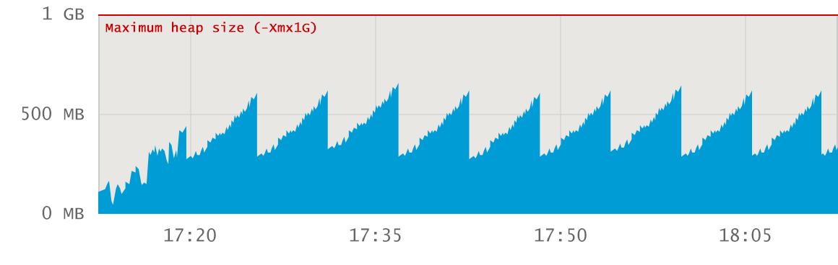
Memory profiling

Slide 28
Memory profiling – Healthy JVM
No memory leak. Flat baseline trend.

Slide 29
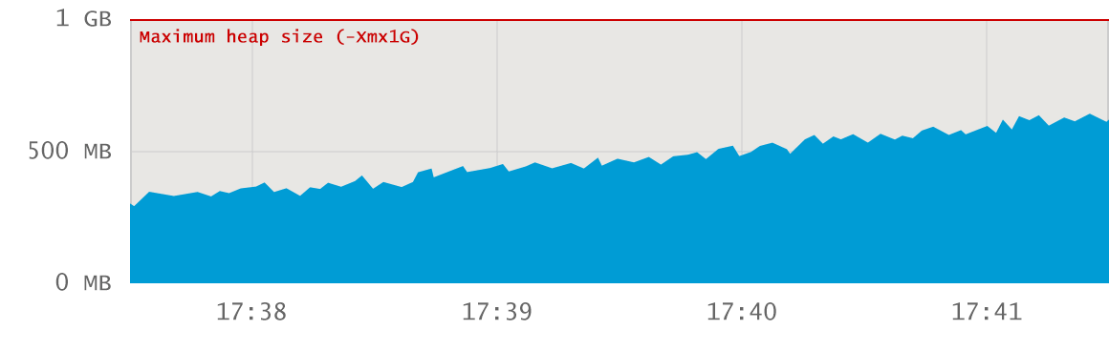
Memory profiling

Slide 30
Memory profiling – Healthy JVM
No memory leak. Period does not contain major GC events.

Slide 31
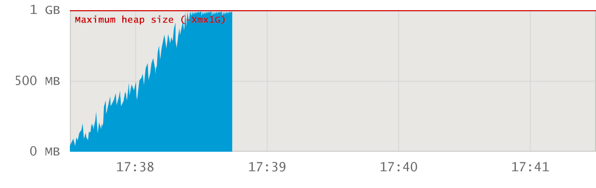
Memory profiling

Slide 32
Memory profiling –
Memory explosion at startup
Probably not a memory leak. Big application has not given enough heap space.

Slide 33
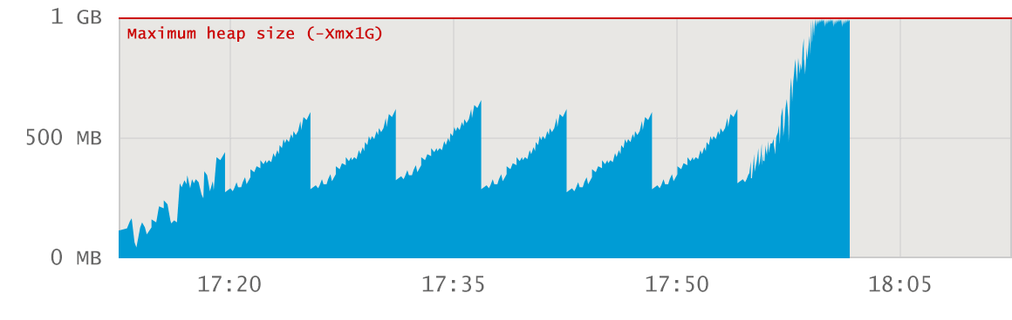
Memory profiling

Slide 34
Memory profiling – Surge allocation
Probably not a memory leak. Too much data is loaded via specific action.

Slide 35
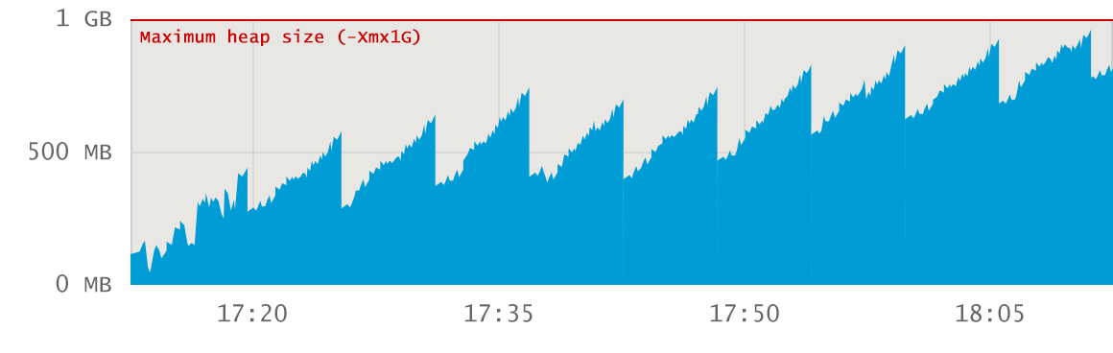
Memory profiling

Slide 36
Memory profiling –
Leaking application
Memory leak. Baseline growth.

Slide 37
Memory profiling – Example
Call tree Recording: `Instrumentation`
Initial recording profile: `Allocation call stacks`
`Heap Walker`
Pin `Mark Heap`
`Take a Snapshot`
`Use new` > `Classes` > `Ok`
Double-click on "interesting" class name
`References` > `Incoming references`
Select "interesting" object
`Show Paths To GC Root` > `Single root`
Now you see where leaked objects are stored
Select `Merged incoming references`
Allocations
Show code

Slide 38
CPU profiling
Issues:
Frequently invoked
Inefficient code/algorithm

Slide 39
CPU profiling - Example
Call tree Recording: `Instrumentation`
Initial recording profile: `CPU recording`
`CPU views`
`Hot Spots`
Thread status: All states
Watch `Self Time`, `Average Time` and `Invocations`

Slide 40
Hands on!
Run application: ProfilingApplication
Create load:
mvn gatling:test

Slide 41
Happy Profiling!

