Slide 1

Profiling in Java with JProfiler

Slide 2
Before we start
git clone https://github.com/raitraidma/profiling.git
  mvn clean install
  mvn spring-boot:run
  Do not peek into presentation folder!
https://www.ej-technologies.com/download/jprofiler/files

Slide 3
Versions
Java 8
JProfiler 11

Slide 4
Why and when?

Slide 5
Why and when?
Something is slow
Something uses too much memory
There’s no one else to delegate it to

Slide 6
Java optimizations
Optimizations you get for free!

Slide 7
Compilation time optimization (1.1)
public class CompilerOptimizationWithFinalExample {
private static final boolean IS_PRINTING = false;
public static void main(String[] args) {
for (int i = 0; i < 100_000_000; i++) {
if (IS_PRINTING) {
System.out.println("i = " + i);
}
}
}
}

Slide 8
Compilation time optimization (1.2)
public class CompilerOptimizationWithFinalExample {
private static final boolean IS_PRINTING = false;
public CompilerOptimizationWithFinalExample() {
}
public static void main(String[] args) {
for(int i = 0; i < 100000000; ++i) {
}
}
}

Slide 9
Compilation time optimization (2.1)
public class CompilerOptimizationWithoutFinalExample {
private static boolean IS_PRINTING = false;
public static void main(String[] args) {
for (int i = 0; i < 100_000_000; i++) {
if (IS_PRINTING) {
System.out.println("i = " + i);
}
}
}
}

Slide 10
Compilation time optimization (2.2)
public class CompilerOptimizationWithoutFinalExample {
private static boolean IS_PRINTING = false;
public CompilerOptimizationWithoutFinalExample() {
}
public static void main(String[] args) {
for(int i = 0; i < 100000000; ++i) {
if (IS_PRINTING) {
System.out.println("i = " + i);
}
}
}
}

Slide 11
Compilation time optimization (3.1)
public class LiteralConstantExample {
public static void main(String[] args) {
int age = 3 * 7 + 1;
final String firstName = "Jon";
final String lastName = "Snow";
String fullName = firstName + " " + lastName;
String firstName2 = "Daenerys";
String lastName2 = "Targaryen";
String fullName2 = firstName2 + " " + lastName2;
System.out.println(fullName + " is " + age + " years old");
System.out.println(fullName2 + " is also " + age + " years old");
}
}

Slide 12
Compilation time optimization (3.2)
public class LiteralConstantExample {
public LiteralConstantExample() {
}
public static void main(String[] args) {
int age = 22;
String firstName = "Jon";
String lastName = "Snow";
String fullName = "Jon Snow";
String firstName2 = "Daenerys";
String lastName2 = "Targaryen";
String fullName2 = firstName2 + " " + lastName2;
System.out.println(fullName + " is " + age + " years old");
System.out.println(fullName2 + " is also " + age + " years old");
}
}

Slide 13
Runtime optimization
Hotspot JIT can detect what kind of processor you have and generates code accordingly.
Inline methods – copy method to caller code
Eliminate dead code
...

Slide 14
Own intelligence
public class GarbageCollectorExample {
public static void main(String[] args) {
Long count = 0L;
for (int i = 0; i < 100_000_000; i++) {
count++;
}
}
}

Slide 15
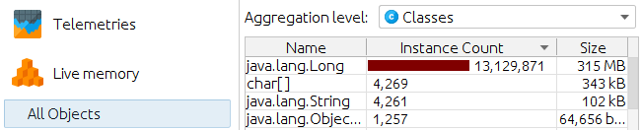
Own intelligence
Took 519 ms

Slide 16
Own intelligence
public class GarbageCollectorFixExample {
public static void main(String[] args) {
long count = 0L;
for (int i = 0; i < 100_000_000; i++) {
count++;
}
}
}

Slide 17
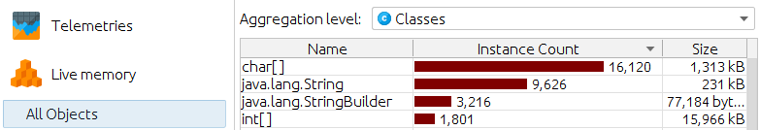
Own intelligence
Took 5 ms

Slide 18
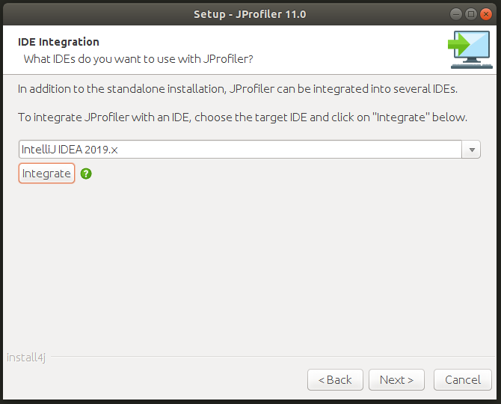
Install JProfiler
Download
https://www.ej-technologies.com/download/jprofiler/files
IDE integration
Close IDE
Select IDE configuration folder

Slide 19
Attach JProfiler
-agentpath VM parameter
  -agentpath:/opt/jprofiler/bin/linux-x64/libjprofilerti.so=port=8849,nowait
  If you run from IDE, then it will be added automatically

Slide 20
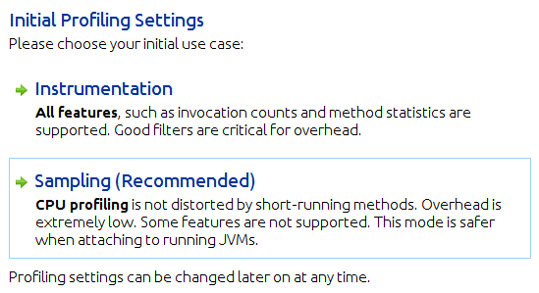
Instrumentation vs Sampling

Slide 21
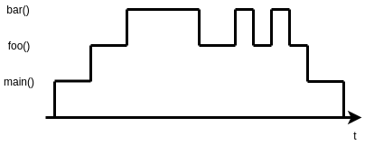
Instrumentation vs Sampling

Slide 22
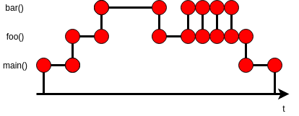
Instrumentation
All features.
Filters must be used correctly. Otherwise overhead.

Slide 23
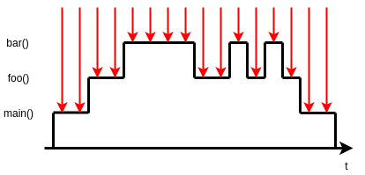
Sampling
When you do not know where the bottlenecks are.
Less overhead.

Slide 24
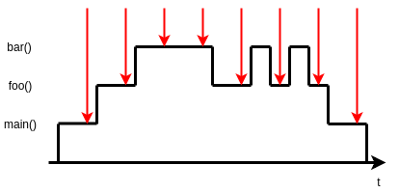
Sampling
Sampling rate

Slide 25
Instrumentation vs Sampling - Example
GarbageCollectorExample
CPU recording enabled

Slide 26
Memory profiling
Memory leak

Slide 27
Memory profiling
Memory leak: unused objects cannot be garbage collected.

Slide 28
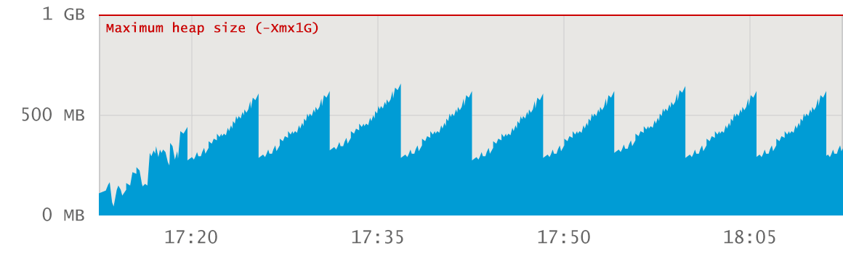
Memory profiling

Slide 29
Memory profiling – Healthy JVM
No memory leak. Flat baseline trend.

Slide 30
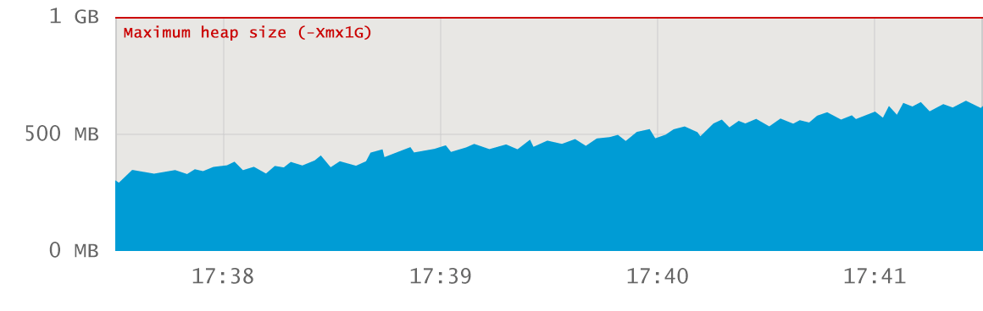
Memory profiling

Slide 31
Memory profiling – Healthy JVM
No memory leak. Period does not contain major GC events.

Slide 32
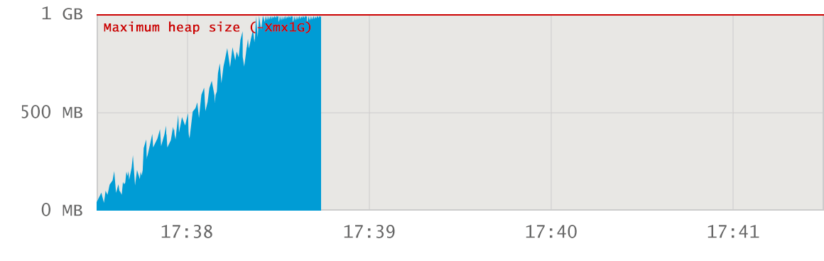
Memory profiling

Slide 33
Memory profiling –
Memory explosion at startup
Probably not a memory leak. Big application has not given enough heap space.

Slide 34
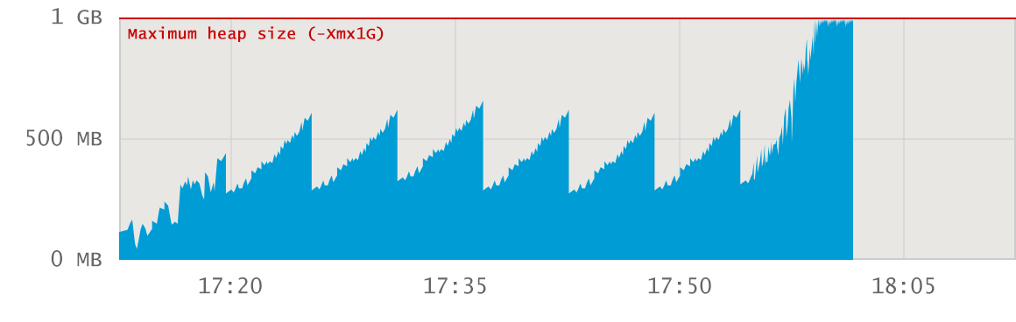
Memory profiling

Slide 35
Memory profiling – Surge allocation
Probably not a memory leak. Too much data is loaded via specific action.

Slide 36
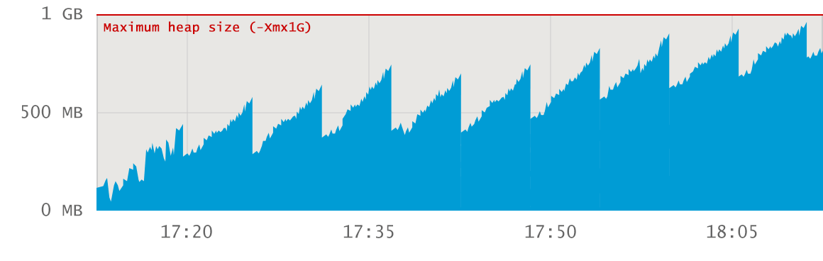
Memory profiling

Slide 37
Memory profiling –
Leaking application
Memory leak. Baseline growth.

Slide 38
Memory profiling – Example
Call tree Recording: `Instrumentation`
Initial recording profile: `Allocation call stacks`
`Heap Walker`
Pin `Mark Heap`
`Take a Snapshot`
`Use new` > `Classes` > `Ok`
Double-click on "interesting" class name
  `References` > `Incoming references`
Select "interesting" object
  `Show Paths To GC Root` > `Single root`
  Now you see where leaked objects are stored
Select `Merged incoming references`
Allocations
  Show code

Slide 39
CPU profiling
Issues:
  Frequently invoked
  Inefficient code/algorithm

Slide 40
CPU profiling - Example
Call tree Recording: `Instrumentation`
Initial recording profile: `CPU recording`
`CPU views`
  `Hot Spots`
    Thread status: All states
Watch `Self Time`, `Average Time` and `Invocations`

Slide 41
Hands on!
Run application: ProfilingApplication
Create load:
  mvn gatling:test

Slide 42
Happy Profiling!

