Slide 1
Pg**** https://github.com/raitraidma/tex

Slide 2

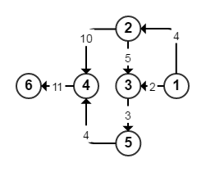
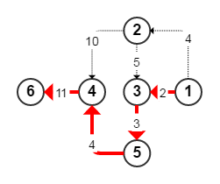
PgRouting
http://pgrouting.org/
pgr_dijkstra(edges_sql, start_vid, end_vid, directed);

Slide 3
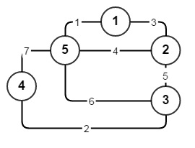
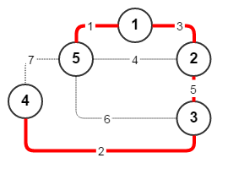
PgGraph
https://github.com/raitraidma/pggraph
MST
pggraph.kruskal(edges_sql);

Slide 4
PlPythonu
CREATE OR REPLACE FUNCTION f_http_get(s_url TEXT)
RETURNS text AS
$$
import urllib2
try:
result = urllib2.urlopen(s_url).read()
except:
result = ''
return result
$$
LANGUAGE 'plpythonu'
SECURITY DEFINER
SET search_path=public, pg_temp;

Slide 5
PlPythonu
CREATE OR REPLACE FUNCTION f_geocode_lng_lat(
IN s_address TEXT
, s_api_key VARCHAR
) RETURNS text ARRAY[2] AS
$$
from geopy.geocoders import GoogleV3
try:
geolocator = GoogleV3(api_key=s_api_key)
location = geolocator.geocode(s_address)
lat, lng = location.latitude, location.longitude
except:
lat, lng = 0, 0
return lng, lat
$$
LANGUAGE 'plpythonu'
SECURITY DEFINER
SET search_path=public, pg_temp;

Slide 6
PlPythonu
CREATE OR REPLACE FUNCTION f_geocode_address(
IN d_latitude DOUBLE PRECISION
, IN d_longitude DOUBLE PRECISION
, s_api_key VARCHAR
) RETURNS text AS
$$
from geopy.geocoders import GoogleV3
try:
geolocator = GoogleV3(api_key=s_api_key)
location = geolocator.reverse(str(d_latitude) + ", " + str(d_longitude))
address = location[0].address
except:
address = ''
return address
$$
LANGUAGE 'plpythonu'
SECURITY DEFINER
SET search_path=public, pg_temp;

Slide 7
PgEnd

