Slide 1
Every music app perfects what to recommend; none give a reason to accept it
✦
The gap isn't accuracy — Spotify already leads there. It's acceptance: engaged listeners won't press play on the unfamiliar.
MARKET GAP — WHAT EACH APP OFFERS VS WHAT'S MISSING
WHY SPOTIFY SOLVES THIS FIRST
Platform | What they offer | What's missing
Spotify | Best-in-class recsys — Discover Weekly, DJ, Daylist | No reason to trust a new pick
Apple Music | Human editorial curation | Not personal; no per-user 'why'
YouTube Music | Huge catalog + video | Recs echo history; weak long-tail
Gaana | Deep regional / Bollywood | Chart & popularity-led discovery
JioSaavn | Regional scale + podcasts | No personalized narrative
Biggest discovery surface
~675M MAU · 263M Premium — the most to gain from acceptance
Accuracy already solved
Best recsys in market; the only frontier left is acceptance
Native, no cold-start
Three-layer trust (friend → taste-twin → AI) fits Search & Home
→ Even Spotify only serves the song — never a reason to try it.
~30%
−12%
63
Research: narrative 'transportation' (Green & Brock, 2000) shows a story — not a score — makes people more open to the unfamiliar.
of listening is repeat / familiar
genre diversity in 6 mo · Discover Weekly (research)
reviews say recs feel 'stale / looping'
PROBLEM STATEMENT
BUSINESS OUTCOME
PRODUCT OUTCOME
Spotify serves new music, but engaged users won't act on it — the unfamiliar arrives with no reason to trust it, so they skip back to the loop.
Repetition → boredom → churn risk for the highest-LTV cohort. Discovery drives catalog breadth, the artist economy, and retention.
Move Spotify from 'serves the song' to 'earns the play' — own the acceptance layer no rival has built.
▶▶ If the gap is real, does it show in real Spotify reviews? Let's look →

Slide 2
AI-coded 7,296 reviews: discovery is praised for accuracy, panned for the loop
✦
AI review engine across App Store · Play Store · YouTube · Spotify Community. Every claim cites a real review — no fabrication.
1 · REVIEW FINDINGS — 7,296 REVIEWS
2 · SENTIMENT (FROM ★ RATINGS)
3 · WHAT REAL USERS SAID (CITED)
7,296
1,147
1,933
Negative
“…locks us into a comfortable but repetitive bubble.”
reviews analyzed
AI-labeled
130
63
627
Neutral
Community · #6077
flag discovery · 3rd theme
say 'stale / looping'
“…stuck in a sink hole surrounded by my 2020 top songs.”
Inside the 130 discovery mentions
3,449
Positive
90
Praise it (accurate)
Community · #6072
63
Stale / looping
Discovery complaints skew negative — and come disproportionately from Premium power users.
“Repeating the same 30 songs out of 3000 isn't shuffle.”
14
Niche underserved
5
Search / steer gaps
App Store · #4896
Source: labeled review sample (Groq)
Source: 7,296 cleaned reviews
Secondary research: personalization drives homogenization (popularity bias); Discover Weekly narrows genre diversity as engagement rises; narrative transportation lifts acceptance of the unfamiliar. Adoption is outpacing acceptance — every accuracy upgrade widens the gap.
▶▶ Reviews prove it. But who feels it most, and where does discovery break? →

Slide 3
Engaged Explorers want new music — they just won't gamble a skip on it
✦
Target: high-tenure Premium power users doing active discovery — the loudest, most-articulate discovery complaints in the reviews.
Why this segment: highest LTV, feel the pain most, and are the most articulate — they drive the 'stale / looping' complaints — the top discovery pain in the reviews. Win them, then expand to all Premium.
Aarav, 27 · Bengaluru
Priya, 24 · Mumbai
“The Looper” — Premium 4 yrs, 15 hrs/wk, 2,000+ saves
“The Curator” — Premium 3 yrs, shares constantly
Trust pattern: Trusts his own saves; skeptical of algorithmic 'new'.
Trust pattern: Trusts friends & scenes, not black-box recs.
Unmet need: A reason to believe a new track fits before he risks a listen.
Unmet need: To know WHO and WHY behind a pick.
Behavioral trap: Opens Discover Weekly, skims, retreats to the same 6 playlists.
Behavioral trap: Only tries music friends share; ignores algo recs entirely.
“everything it shows me, I've basically already heard.” — reviewer
“if a friend puts me on, I'll try almost anything.” — reviewer
USER JOURNEY — WHAT'S HIDDEN AT EVERY STAGE
1 · Open
2 · Served
3 · Unfamiliar
4 · Skip
5 · Loop
wants something new
→
familiar-leaning picks
→
a new track appears
→
skips in ~5s
→
back to the same playlist
Hidden: limited time; won't gamble it
Hidden: recsys optimizes replay, not novelty
Hidden: no story, no trust signal
Hidden: no reason to risk the listen
Hidden: algo reads skip as 'dislike' → narrows
Core insight: the failure isn't a bad song — it's the silent skip. Discovery breaks at acceptance, not accuracy; every skip teaches the algorithm to narrow further.
▶▶ We know where trust breaks. Now let's frame the underlying problem →

Slide 4
The problem isn't accuracy; it's that a new track arrives with no reason to trust it
✦
Problem-framing canvas — a structural diagnosis of the acceptance gap.
1 · WHAT IS THE TRUE PROBLEM?
2 · WHO FACES THIS PROBLEM?
3 · HOW DO WE KNOW IT'S A PROBLEM?
Spotify serves the unfamiliar with no story and no signal, so engaged users can't tell a worth-it new track from a risky one — and they skip. It is not an accuracy problem (recs are good). It is an acceptance problem: no reason to say yes.
Engaged Explorers — high-tenure Premium power users doing active discovery.
Reviews: 130 flag discovery; 63 'stale/looping'
Sentiment: discovery skews negative
Persona 1 · The Looper — trusts own saves, skips algo 'new'.
Verbatim: Community #6077 / #6072
Persona 2 · The Curator — trusts friends, ignores black-box recs.
Secondary: diversity drops on Discover Weekly
Market: no rival shows a 'why'
Largest, highest-LTV, most-articulate discovery cohort.
4 · VALUE GENERATED BY SOLVING THIS
5 · WHY SHOULD WE SOLVE THIS NOW?
For Engaged Explorers
For Spotify
Accuracy is saturating
Hear genuinely new music they'll love — without gambling a skip. Discovery becomes trustworthy, not a risk. The bubble finally widens.
Retain the highest-LTV cohort, deepen sessions, widen catalog & the artist economy, and own the acceptance layer as a durable moat.
every model upgrade improves recs and widens the acceptance gap — the unsolved half.
AI unlocks it now
generative AI makes a grounded, personal 'why' per (user × track) possible at scale for the first time.
First-mover window
no competitor shows a reason to accept — ship first and it becomes part of the brand.
▶▶ Problem framed. How many ways could we solve it — and which wins? →

Slide 5
If a new track arrives with a reason to trust it, engaged users will press play
✦
Three hypotheses tested against RICE (Reach × Impact × Confidence ÷ Effort). One chosen.
H1 · User hypothesis
CHOSEN
H2 · Business hypothesis
H3 · Market hypothesis
The block is acceptance, not accuracy — a grounded, personal 'why' converts a skip into a play.
Repetition drives churn/disengagement for high-LTV users; fixing discovery retains them.
No rival shows a 'why'; being first owns the trust position permanently.
Fixes the CAUSE: users skip the unfamiliar because nothing tells them it's worth the risk.
Valid but derivative — retention is the EFFECT of the user problem H1 solves.
True but passive — it's branding, not a change in behavior at the moment of choice.
RICE FRAMEWORK — WHY H1 WINS
🏆 H1 wins by ~2× over H2 and ~16× over H3.
R
10
4
6
every listener, every session
needs multi-session data first
visible but passive
I
9
6
3
H1 attacks the cause — the moment a user decides whether to trust a new track. H2 is the business effect of solving H1; H3 is positioning. Next: the solutions that deliver H1.
converts skip→play at decision
delayed — needs learning time
sounds good, no behavior change
C
8
6
4
7,296 reviews + segment
sound logic, no validation data
no proof positioning shifts trust
E
7
5
6
LLM + embeddings, prototyped
needs tracking + perso engine
branding effort, low intervention
Score
116
60
7
▶▶ Hypothesis locked. Four solutions explored — one chosen →

Slide 6
Off Repeat wins — it gives a reason to try, not another way to search or shuffle
✦
Four solutions explored for H1. One chosen; three rejected with evidence.
S1 · Prompted discovery
REJECTED
S2 · Social vouching only
REJECTED
S3 · Facts & credits
REJECTED
Tell discovery what you want in words.
Show only 'liked by a friend'.
Show song facts / credits (SongDNA-style).
✗ Spotify already shipped AI DJ / Prompted Playlist — still serves, gives no reason to trust a new pick.
✗ Strong trust, but Spotify's social graph is thin — cold-start kills it for most tracks and users.
✗ Facts ≠ a reason to care; no personal 'why this, for you' — it informs, it doesn't persuade.
“everything it shows me I've already heard.”
cold-start: no friends = no signal
“…isn't shuffle.” — App Store #4896
S4 · Off Repeat
CHOSEN
WHY OFF REPEAT WINS AGAINST EACH
AI introduces each new track with a short, grounded, personal story + a three-layer trust cue.
Vs S1
gives a reason, not just steering — a story converts the skip.
✎ AI story
👥 Taste-twin
Vs S2
works with zero friends — the AI story is always on; social is a bonus.
always on — the reason to try, per (you × track)
'popular with your taste' — collaborative signal
❤ Real friend
✦ New-to-you
Vs S3
personal 'why this, for you' — not generic facts. Grounded, no fabrication.
'Liked by Nitya' — strongest trust when present
novelty guarantee — never what you already play
▶▶ Solution chosen. Now see it work — the live prototype →

Slide 7
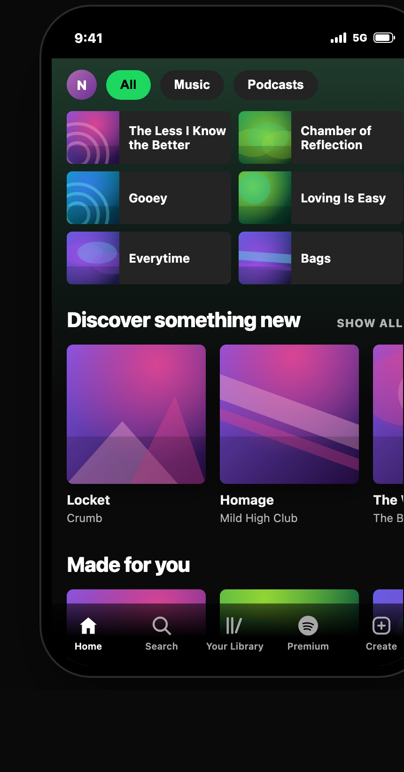
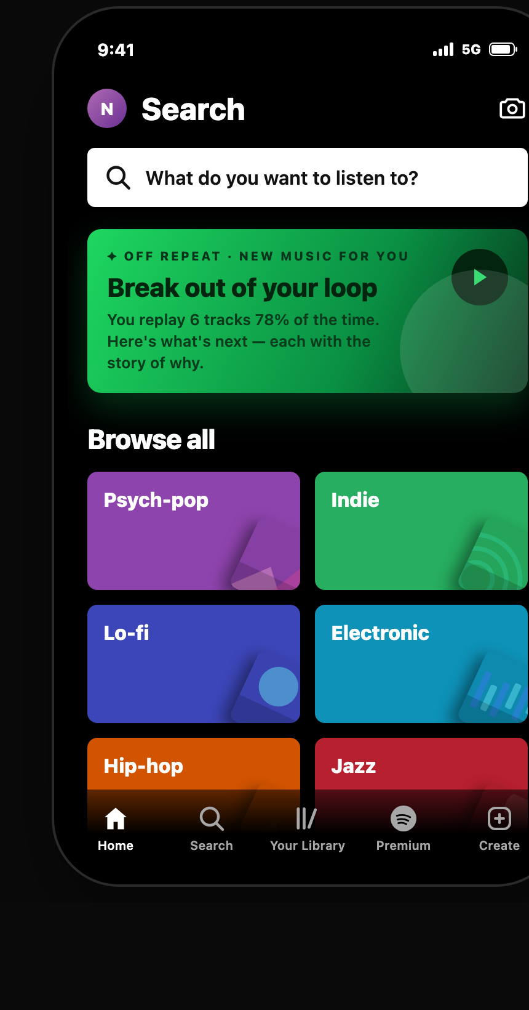
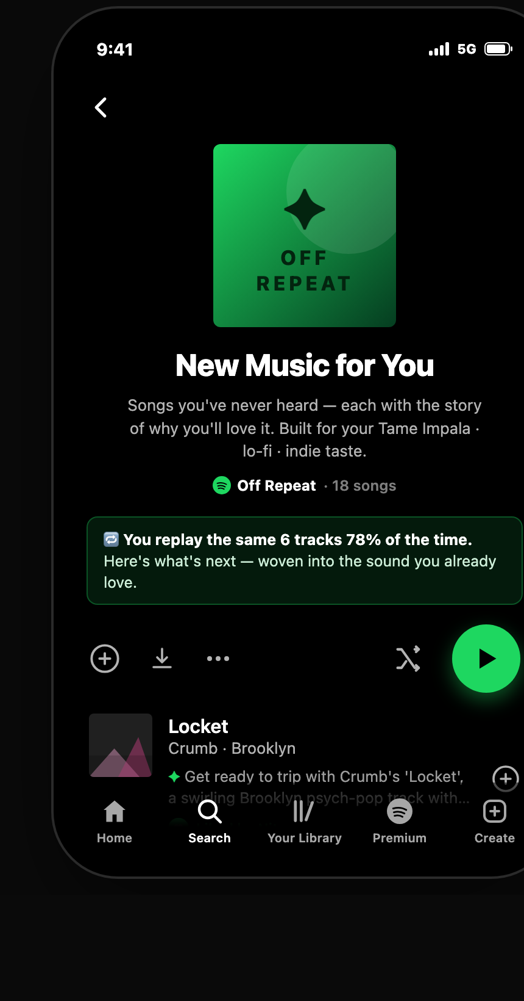
It's not theoretical — here's the live Off Repeat app, running in Spotify's UI
✦
Self-contained web app; AI writes each story live from your taste. Three screens, every button works.
① Home
② Search
③ Off Repeat
One clear entry: 'You're on repeat — break out.' Recently-played loop + a single tap into Off Repeat.
Discovery lives in Search (not a bolt-on tab): a featured Off Repeat card + 'Browse all' taste tiles.
A Spotify playlist page: cover, controls, and flat track rows — each with its AI story + trust cue.
Every button works: play · save · Save-all · 'Weirder' (deeper cuts) · Different-genre · Your Library. Trust cue is dynamic — 'Liked by Nitya', 'Popular with your taste', or 'Picked for you'.
▶ Live app + workflow: github.com/arjuncooliitr/spotify-discovery-engine · How to use: pick your taste → stories generate live → play & save.
▶▶ Now the system under the hood — data flow, nudges, edge cases →

Slide 8
Two engines, one grounded backbone — find the acceptance gap, then close it
✦
How it works under the hood: data flow, research grounding, behavioral nudges, and edge cases.
DATA FLOW — RESEARCH ENGINE → PRODUCT ENGINE
WHY EACH COMPONENT EXISTS — TRACED TO REVIEWS
① Review engine
Grounded story: top discovery gripe = 'stale/looping'; users want a reason, not a score
Collect (4 sources) → LLM label → embed + retrieve (MiniLM 384-d) → grounded synthesis → 💡 insight: acceptance gap
Trust layer: reviewers trust friends & 'people like me', not black-box recs
② Off Repeat MVP
Signals → taste vector → retrieve novel → novelty filter → grounded story + trust (LLM/RAG) → serve + learn ↻
Novelty filter: 'same 30 songs' (#4896) → must be genuinely new to you
No-fabrication guardrail: a trust feature can't lie → RAG over real artist facts
How it works: user opens Off Repeat → retrieval picks novel, taste-matched tracks → one LLM call writes a grounded story per track (RAG over real artist facts) → trust assigned by rule → rendered in the Spotify UI; adoption feeds back. Added latency ~1–2s; cached per taste.
EDGE CASES HANDLED
E1 Background listening: Off Repeat is opt-in / lean-in only — never interrupts passive play.
BEHAVIORAL NUDGES BUILT IN
E2 Cold start: AI story works alone; taste-twin fills in; friend is a bonus.
• Break-the-loop card — the first pick bridges from the familiar loop
E3 Thin long-tail data: confidence-gate; fall back to safe cues; never invent facts.
• One-line story default — glanceable; full story on tap — no fatigue
E4 Latency/cost at scale: cache per taste; batch; live gen for high-intent surfaces only.
• Save-all + 'Weirder' — low-friction commitment + deeper exploration
▶▶ System designed. Now success metrics, leading indicators & guardrails →

Slide 9
One North Star for the behavior shift, four indicators to prove it, guardrails to protect it
✦
Every threshold derived from our analysis of 7,296 real reviews, with secondary research woven in.
★ North Star
Definition: % of weekly listening on newly-adopted artists. Un-gameable — counts only when SURFACED (new to you) + TRIED (≥30s) + KEPT (saved & returned in 7d). Why: opening the feature and walking away is worth zero — we measure a behavior change, not a click. If it stalls: Off Repeat is informational, not persuasive → strengthen the story & the break-the-loop bridge.
Meaningful Discovery Rate
35% (M3) → 60% (M12)
😀 LEADING INDICATORS
> 25% Story-attach try-rate
> 30% New-artist save-rate uplift
A/B: story vs no story. 45% of reviewers ask for a 'reason'.
vs control. Proves adoption, not curiosity.
Below 15% → the story isn't persuading; rewrite & vary voice.
Below target → refresh the candidate pool; tune retrieval.
> 40% 7-day return on adopted artists
+30% Taste breadth by M6
they came back — real taste change, not a one-off.
distinct new artists / month — the bubble widening.
Below 30% → novelty decay; rotate stories, deepen catalog.
Flat → retrieval too safe; push further from the loop.
▶▶ We know what success looks like. Now what could go wrong →

Slide 10
Seven ways this could fail — and the guardrails to catch them
✦
Honest risk assessment with research-backed thresholds and specific mitigations.
FAILURE MODES & MITIGATIONS
GUARDRAILS
What could go wrong | How it's handled | Sev
Acceptance ≠ the real driver — 'won't play' is often mood/effort, not missing trust. | Validate the driver with a targeted user test before building; ship to lean-in surfaces only. | CRIT
Trust is fragile — one salesy or wrong story and users tune the layer out for good. | RAG grounding + no-fabrication guardrail; style variety; QA on samples. | CRIT
Payola & gaming — pressure to inject promoted tracks; stream-farming the metric. | Firewall from promotion; reward saved+returned, never raw plays. | CRIT
AI becomes a crutch — users stop exploring unaided; a new trust proxy. | Measure unaided exploration; ease off narration as adoption grows. | HIGH
Novelty decay — the first-try lift fades once the story feels normal. | Track 30/90-day adoption retention; refresh story styles. | HIGH
Cold-start / long tail — thin metadata where obscure tracks matter most. | Confidence-gate; safe fallback cues; enrich long-tail data. | HIGH
CRITICAL
< 3% false 'why' (hallucination)
the highest-risk failure — strictest threshold; drop invented claims.
Skip-rate flat / down
protect core listening — Off Repeat must not raise skips.
Unaided-exploration not falling
proof we're not creating a crutch.
Reward saved + returned, not plays
kills stream-farming incentives at the metric level.
Off Repeat doesn't eliminate the loop — it earns the play. The riskiest failures are the ones users don't notice, so we de-risk the acceptance driver with a small user test before we build.

