Slide 1
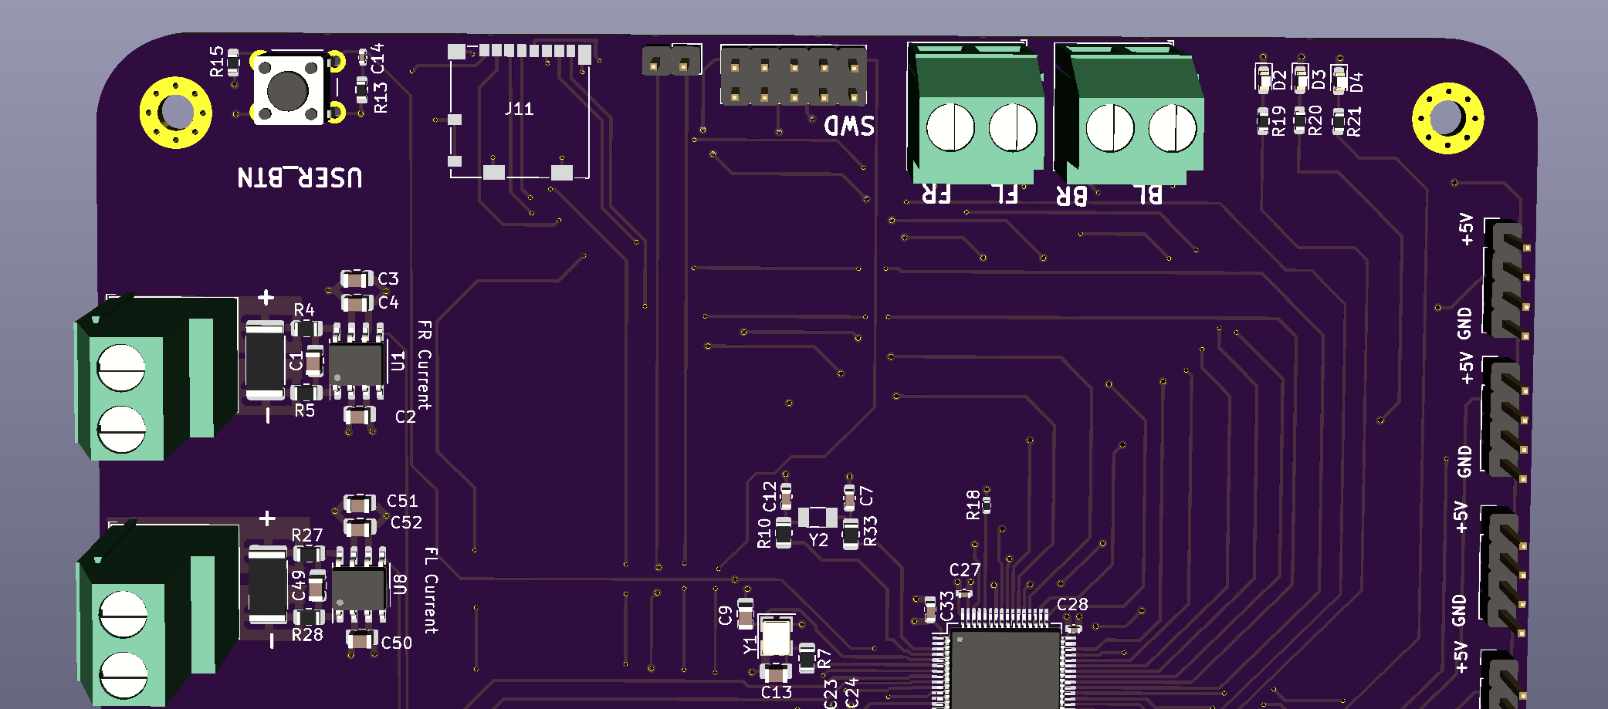
Skid Steer Board
ST-Link Connection
(SWD/JTAG)
SWDIO/TMS
SWDCLK/TCLK
STLK_RX
SW0/TDO
STLK_TX
(DNU)
NRST
GND
(DNU)
GND
VDD
Note: STLK RX and TX are defined in perspective of the ST-LINK. (Connect STLK_RX to RX pin of the ST_LINK and STLK_TX to the TX pin). Similarly, SBC_RX and SBC_TX are defined in perspective of the SBC. Either STLK and SBC pins can be used for UART, the purpose of STLK was to have a dedicated UART pin to connect to a debugger. STLK is using USART2 and SBC is using USART3.

Slide 2
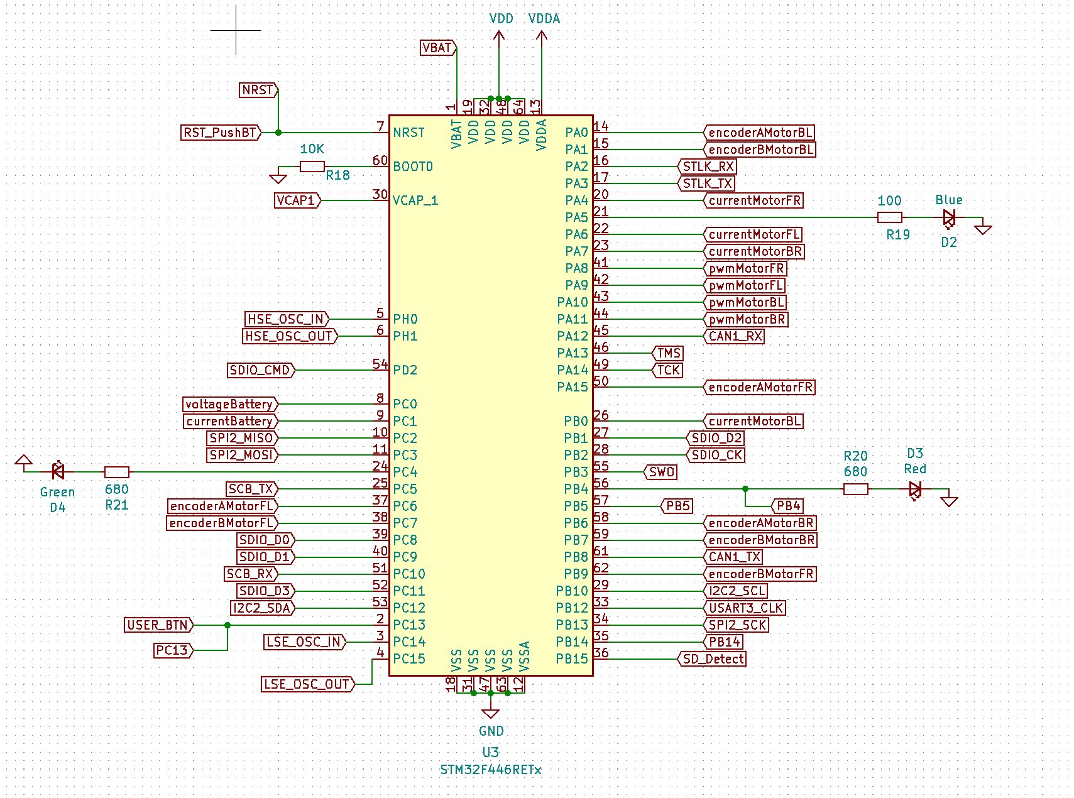
Microcontroller Pinout

