Slide 1
SenseSmart Region
Augmented reality

Slide 2
Unity
What is Unity?
3D/2D game engine.
Tons of plugins, scripts.
Even has an online store for models, textures, shaders…
Free to use for our purposes.
Why use Unity?
Simple.
Quick.
Works on every platform.
Well, almost works.

Slide 3
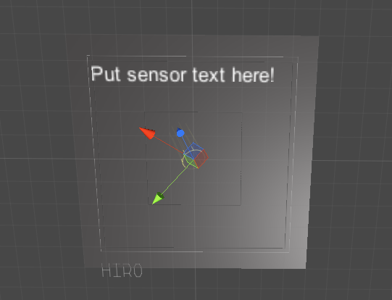
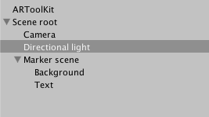
Augmented Reality
ARToolkit
Plugin available for Unity!
Which explains both choices… ☺
Lets us setup a scene.

Slide 4

Marker tracking
Most AR apps use markers.
Because the camera must recognize something.
Simple shapes are possible.
However markers are simplest!

Slide 5
DEMO!

Slide 6
Getting started
https://github.com/raiuli/arcticchallenge2016
An example project is included
Put it in your <Project_Name>/Assets/ARToolKit5-Unity folder.
The script used to communicate with SSR is under Scripts/
Reading the documentation for ARToolkit is a good start.
Documentation
Train your own marker

