Slide 1

Fluorescent Labeling of Cytolysin A Pore Forming Toxin and Assessing Lipid Phase Dependent Activity
Vivek Rai, Pradeep S. and Sandhya S. Visweswariah
18.05.2015 – 10.05.2015
Bio-Engineering Summer Training Program Indian Institute of Science, Bangalore

Slide 2
Pore Forming Toxins (PFTs)
represent the largest class of bacterial toxins
also produced by higher organisms like cnidaria, sea anemones (actinoporins), earthworm (lysenin), plants (enterolobin) and mammals (perforin)
exist in bistable states
cause unregulated efflux of ions, biomolecules, or allow influx of external toxins
look stunning!

Slide 3
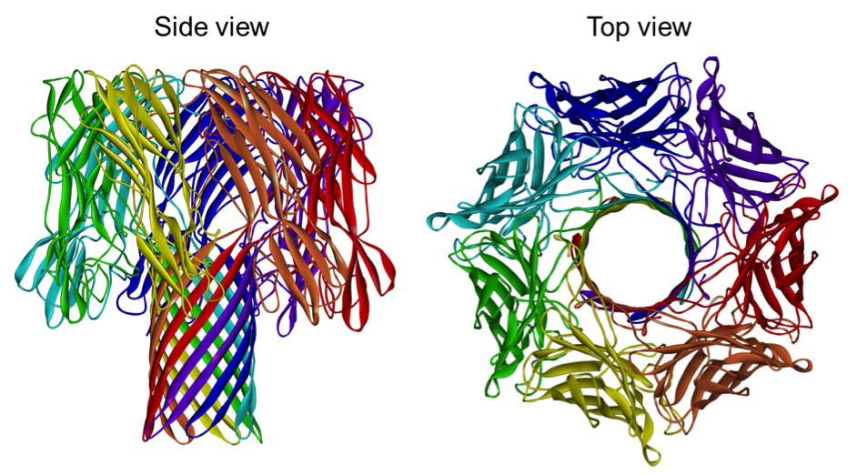
α-Haemolysin of S. aureus
Each segment coloured a different colour of the rainbow.
(L. Song et al. Science 274: 1859 -1866)

Slide 4
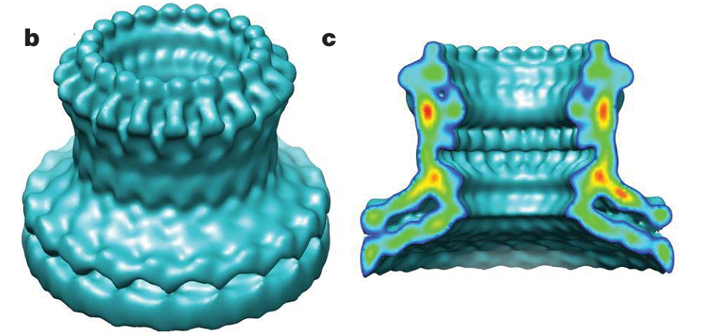
Perforin of Mammals
Cryo-electron microscopy of lymphocyte perforin.
(Law et al. Nature 468, 447–45)

Slide 5
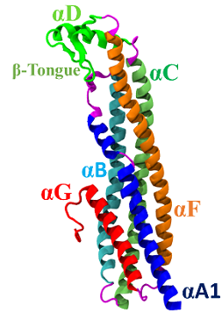
Cytolysin A of E. coli
a member of α-PFT family, present in E. Coli, Salmonella enterica, Shigella flexneri
assembles as a dodecameric* pore with a 2.8 nm cation selective lumen
not expressed at detectable levels in most strains of E. coli
presence in several strains of E. coli suggest a possible role in pathogenicity
Mueller, M et al., Nature 459, 726–30 (2009).

Slide 6
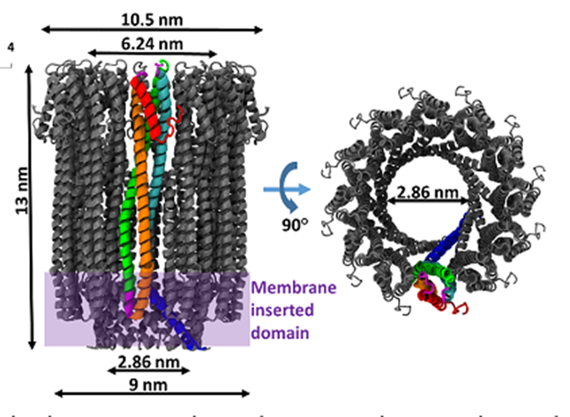
Cytolysin A of E. coli
Transition from monomer to protomer involves structural rearrangement of ~60% of residues
Source?

Slide 7
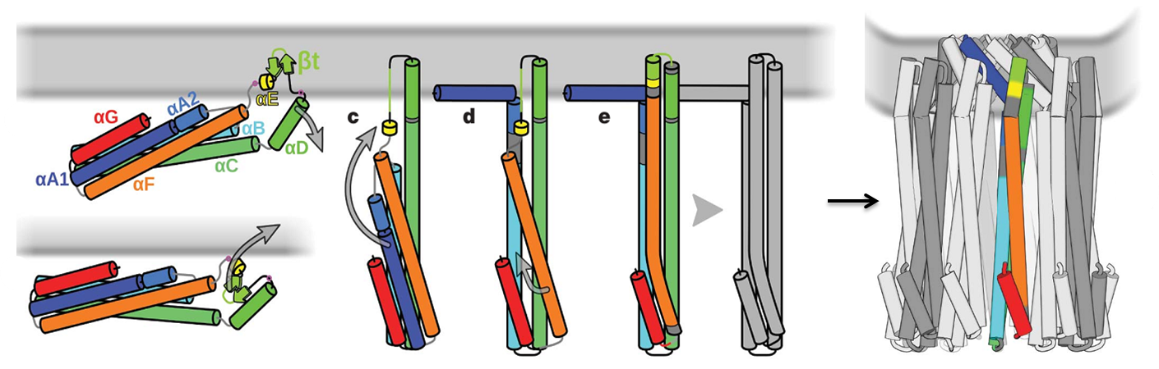
Assembly mechanism
Known
Known

Slide 8
Assembly mechanism
Known
Known
How does this occur?

Slide 9
What we did?
Extraction and purification of ClyA, ClyA Q56C
Obtained a fluorophore tagged potent toxin ClyA Q56C – Cy3
Verified the activity of proteins using hemolytic assay and calcein leakage assay
Studied the lipid phase dependent kinetics of protein

Slide 10
How we did?
Recovery, amplification and verification of His-ClyA Q56C plasmid
Expression, purification and characterization of His-ClyA Q56C and His-ClyA
Hemolysis assay of ClyA Q56C by spectrophotometric detection of released hemoglobin
Calcein leakage assay of small unilamellar vesicles (SUVs) containing calcein at a self-quenching concentration
Labelling the cysteine at 56th position with Cy3 using maleimide conjugation reaction

Slide 11
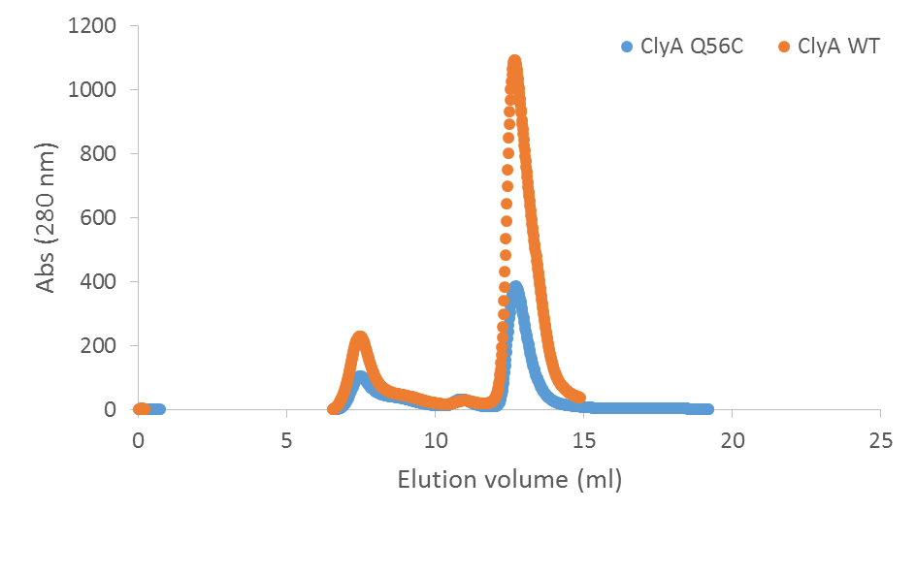
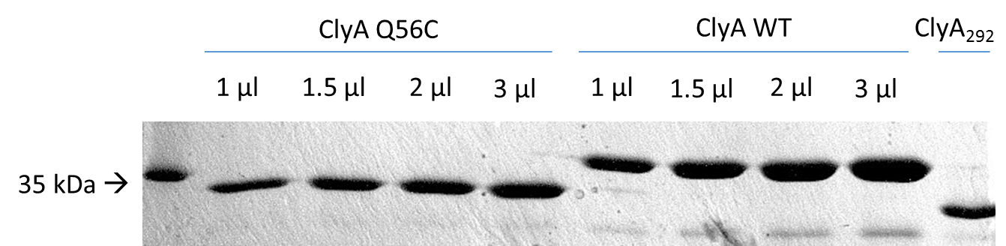
What we got?
Purified ClyA Q56C and ClyA WT with concentration .42 mg/ml and 1.01 mg/ml
Predominant monomeric fraction of protein during gel filtration

Slide 12
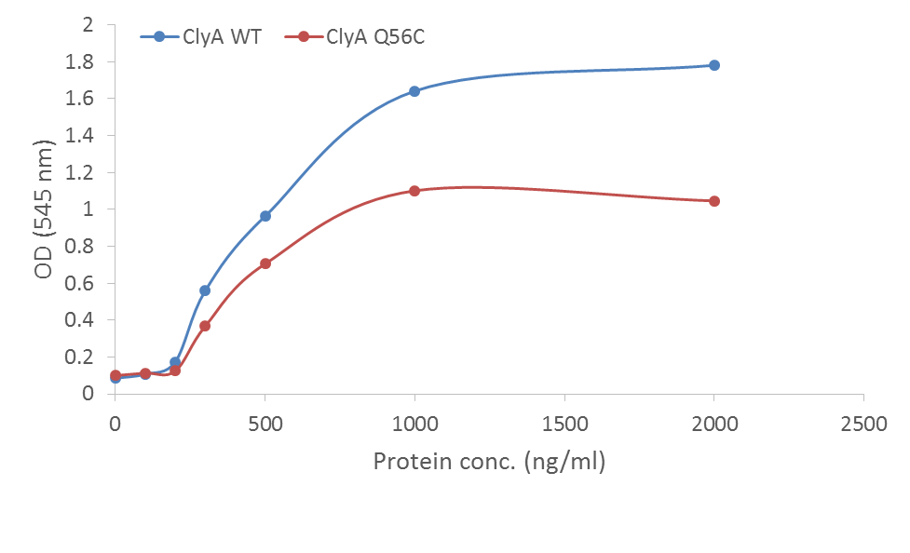
Hemolytic activity of ClyA Q56C

Slide 13
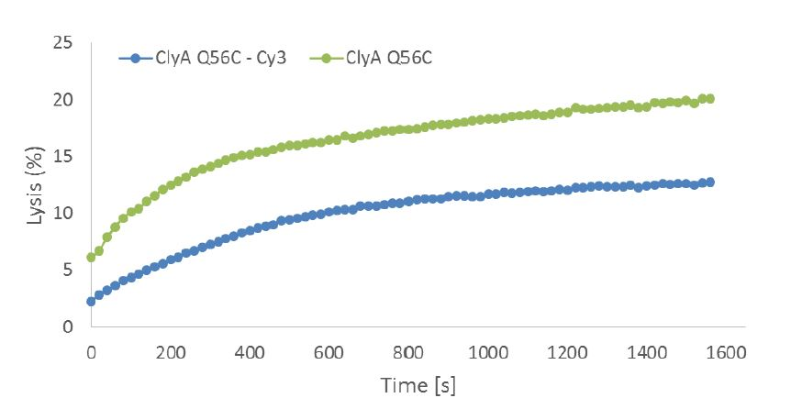
A labelled and potent toxin ClyA Q56C – Cy3

Slide 14
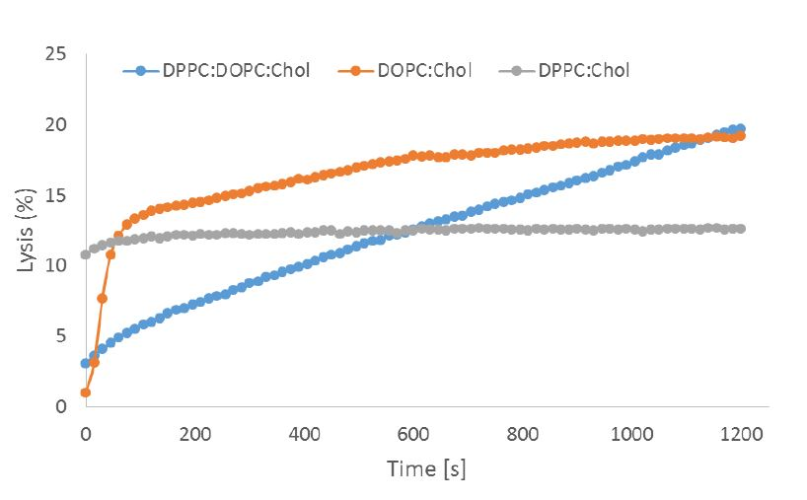
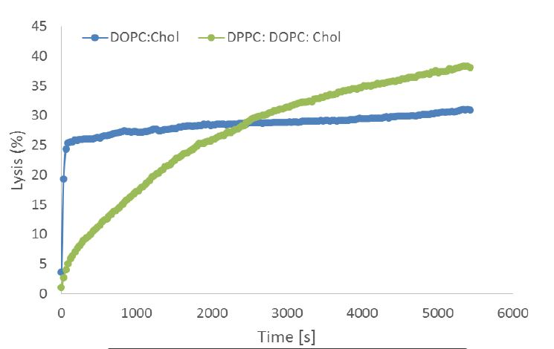
Lipid phase dependent kinetics of ClyA

Slide 15
How does it end?
A little, direct evidence is present elucidating the oligomer assembly mechanism
A fluorophore tagged protein could help us investigate the assembly mechanism on single molecule level, on both cellular and supported bilayer surfaces
A purified, potent fluorophore tagged single mutant protein ClyA Q56C – Cy3
A qualitative study of Cytolysin A showing lipid phase dependent kinetic behaviour

Slide 16
Where to, now?
Super resolution microscopy (TIRF/Confocal) with labelled protein on cell and supported lipid bilayer surface
Achieve better fluorescence labelling
Label the double mutant and perform FRET experiments to analyse conformational changes more closely
Quantify the lipid phase behaviour

Slide 17
Acknowledgements
Dr Ben Schuler for providing us the plasmid samples for mutant ClyA proteins.
Mr Pradeep Sathyanarayana for helping me with the theoretical and experimental knowledge base
Prof. Sandhya S. Visweswariah for her sustained support and monitoring of my efforts
All the lab members for providing a nourishing, learning oriented laboratory environment
Prof. Rahul Roy for his continuous inputs throughout the program

Slide 18
Thank you!

