Slide 1
Protein Knots a tangled story
Vivek Rai
Journal Club
August 20, 2015

Slide 2
Knots
Be it shoelaces or ropes, we find knots in our everyday life.
“a loop in a string which tightens when pulled”
Characterized by knot invariants.
Mathematically,
A knot requires its ends to be joined so that it cannot be undone. It is also referred to as the closure property.

Slide 3
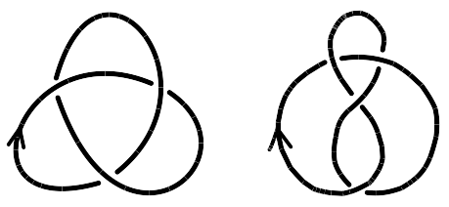
Examples
Trefoil Knot
Figure of eight knot

Slide 4
Knots and biology
DNA is often circular (closed curve!) and highly intertwined, knotted and coiled.
topoisomerase and recombinase can change the topology of the DNA molecule in various ways.
Knot theory has been successfully applied to DNA knotting and recombination process.
Provides a quantitative, powerful, and invariant way to measure properties of DNA.

Slide 5
Knots in proteins?
But proteins aren't closed! The ambiguity in a protein knot definition arises due to several reasons.
How do we detect non-trivial knots?
How do we detect the knot type?
What about the cross links?

Slide 6
Detecting knots: Two ways
Hold the ends fixed and deform the backbone. And then interpret the final configuration.
Start with an open knot and complete it to a topological knot and then identify the knot type.
Both approaches involve simplifying structures using Knot diagrams.

Slide 7
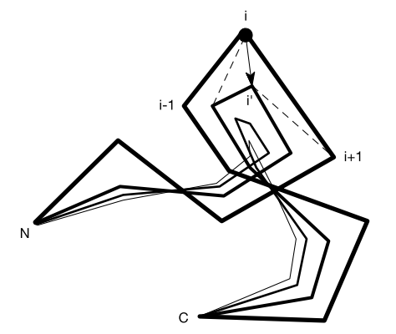
Detecting knots: First method
Hold the ends fixed and deform the backbone. And interpret the final configuration
KMT algorithm
Knotfind algorithm

Slide 8
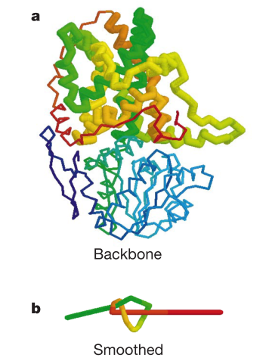
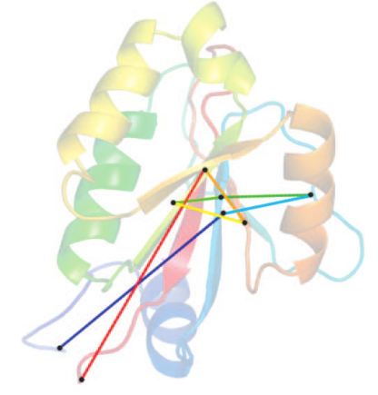
Examples
KMT algorithm
Knotfind algorithm

Slide 9
Detecting knots: Second method
Start with an open knot and complete it to a topological knot.
Calculating knot invariants like Alexander polynomial or Jones polynomial
Trefoil knot
Δ_{k}(x) = (1/x) – 1 + x
Figure eight knot
Δ_{k}(x) = -(1/x) + 3 – x
Unknot*
Δ_{k}(x) = 1

Slide 10
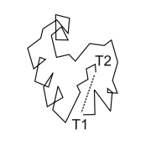
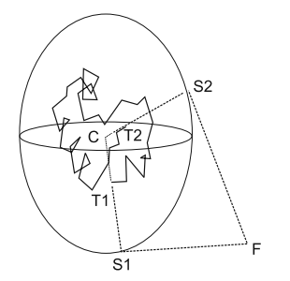
Creating a closure
Several approaches:
Direct N-C join
Center closure
Random closure

Slide 11
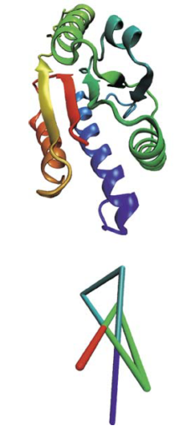
Identifying knots
Reduce the number of crossings and inspect visually.
Use calculators which determine knot invariants.

Slide 12
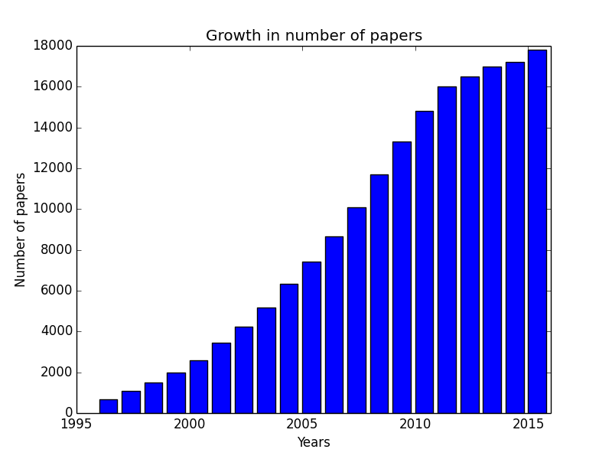
Interest in topic
Knots (1994): 1
Knots (2015): 900+
Source: Google Scholar,
KnotProt database (http://knotprot.cent.uw.edu.pl/)

Slide 13
Types
Shallow and Deep knots
Trefoil knot (3₁)
RNA methyltransferases, SAM synthetase
Figure-of-eight knot (4₁)
acetohydroxy acid isomeroreductase
Five-crossing knot (5₂)
ubiquitin hydrolase

Slide 14
Open questions
Do knots provide extra physiological stability to protein structure?
Why are knots so under-represented in protein population (~1% of total population)?
How does a knotted protein fold?
Why and how do they occur?

Slide 15
Potential answers
Knotted proteins might exist as knotted molecules in their unfolded state
Knots provide stability, resistance to cellular translocation and degradation pathway.

Slide 16
Future
Figuring out a sequence pattern and map it to related function.
Improve our understanding of folding pathway
Investigate benefits of knots.
If possible, given a knot K, to build a protein backbone with that knot

Slide 17
References
Mansfield (1994, 1997)
Khatib et. al. (2006)
Taylor et. al. (2000, 2002)
Mishra et. al. (2012)

Slide 18
Thank you!
Questions!

