Slide 1
SequenceServer, BLAST search made easy!
http://www.sequenceserver.com
http://dx.doi.org/10.1101/033142
Vivek Rai 5th year

Slide 2
SequenceServer is not a new alignment tool

Slide 3
How do we use BLAST?

Slide 4
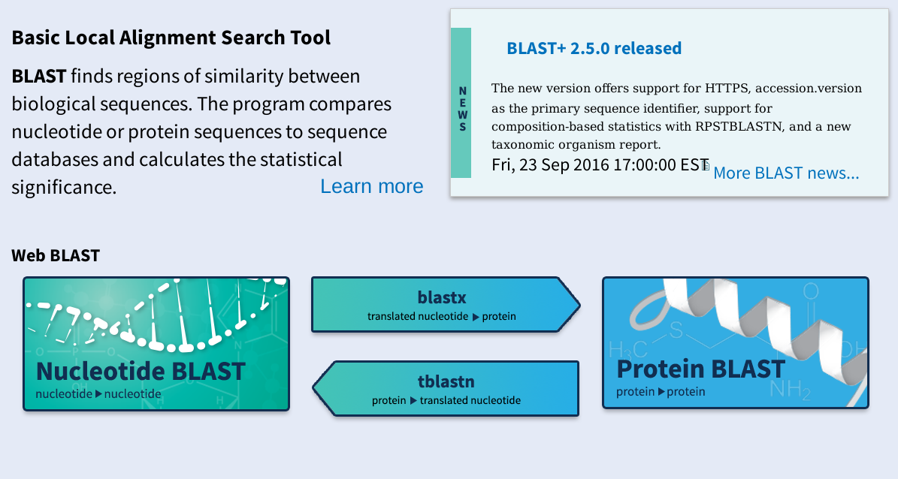

Slide 5
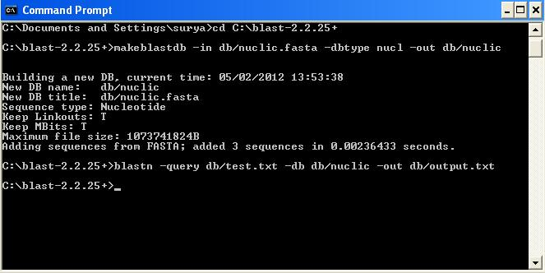

Slide 6


Slide 7
.. goals
Demonstrate SequenceServer
Encourage adoption
Collect suggestions and reviews for future improvment

Slide 8
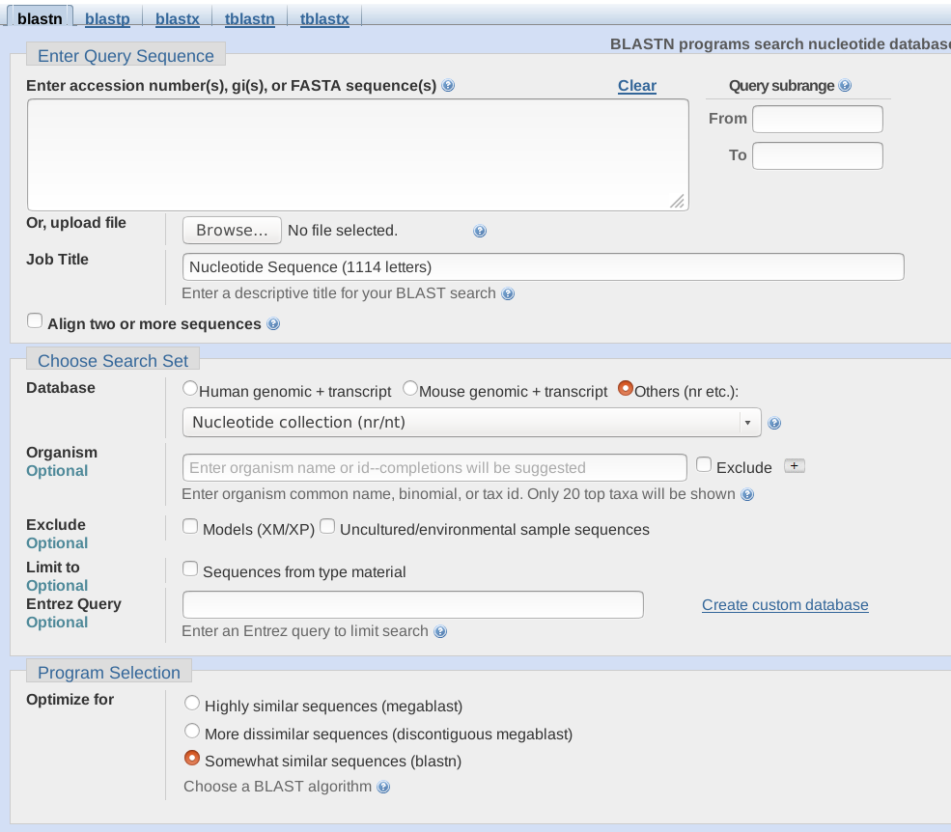
.. existing issues
User Interface
Notes:
NCBI Portal presents a program specific approach. You first decide which program you want to use and then perform your analysis. SequenceServer undoes this counterintuitive pattern and allows you think from the side of problem. You have a 'sequence', what all you can do to analyze it. It's a good, healthy shift in approach, in my opinion, especially during the literature review process.

Slide 9
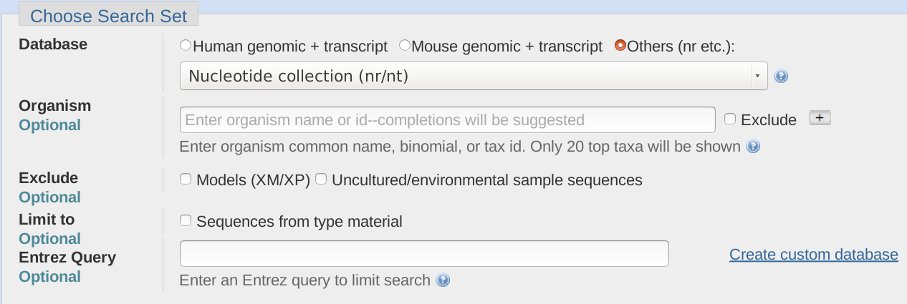
.. existing issues
Cannot use private databases

Slide 10
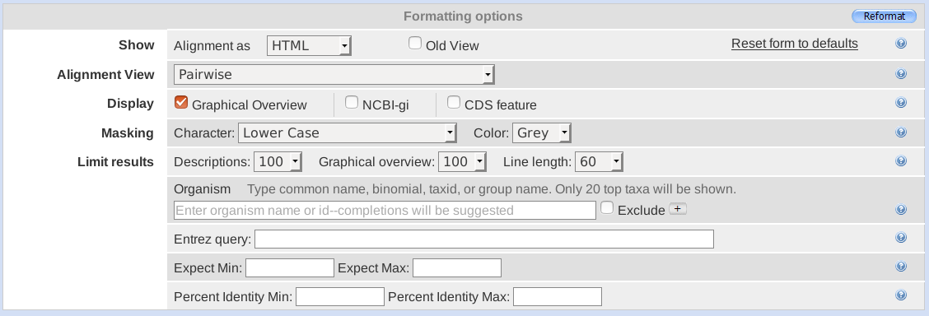
.. existing issues
Difficult to customize report

Slide 11
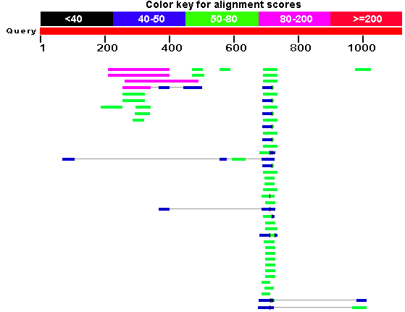
.. existing issues
Unintuitive visualizations

Slide 12
SequenceServer
40,000+ downloads, 30+ citations

Slide 13
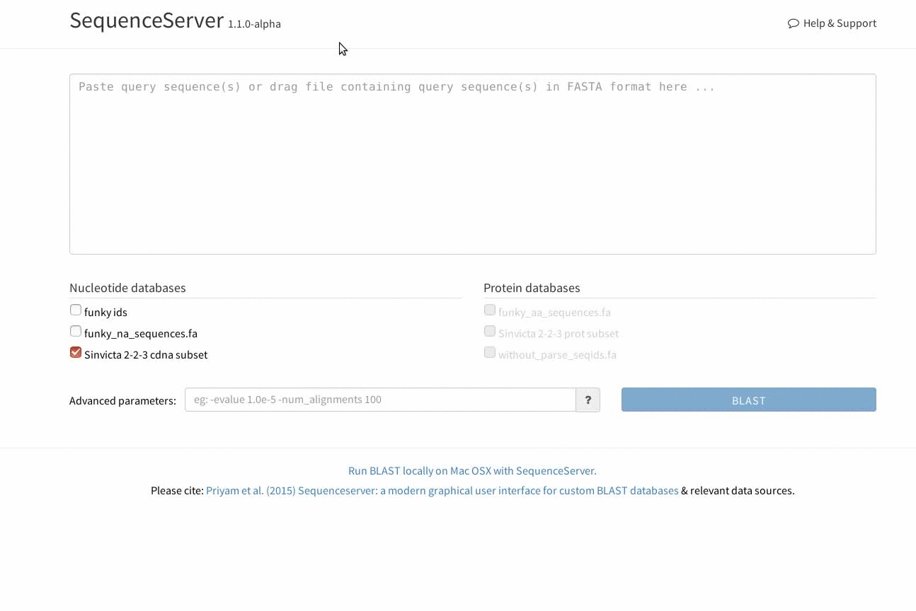
.. bespoke interface
Clutter free, streamlined, intelligent interface

Slide 14
.. host anyway you like
Can be setup for personal or public use;
share with collaborators
http://localhost:4567
http://www.antgenomes.org/sequenceserver/
http://reefgenomics.org/blast/

Slide 15
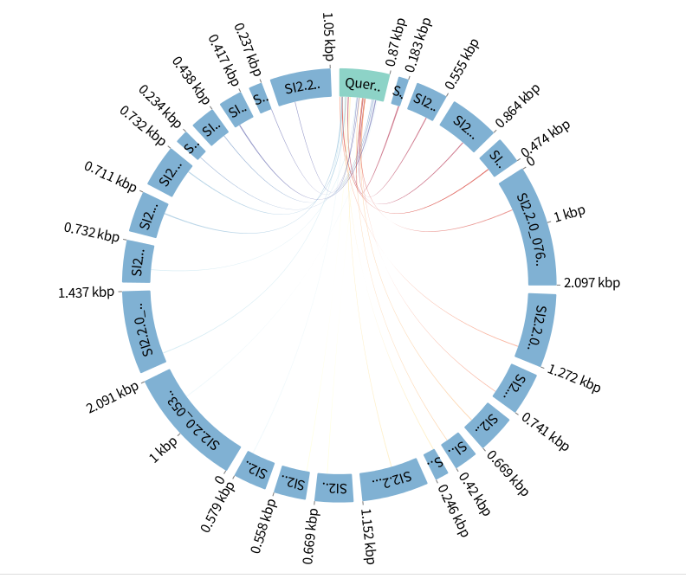
.. visualizations
Export graphics

Slide 16
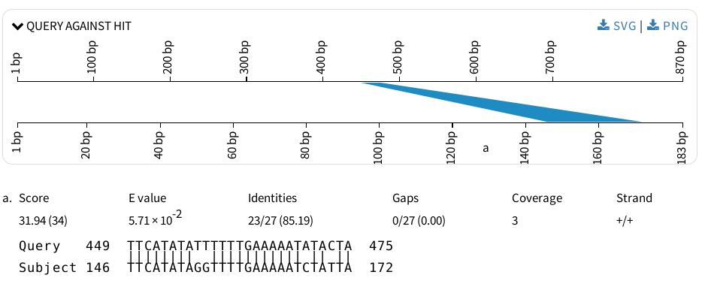
.. visualizations
Export graphics

Slide 17
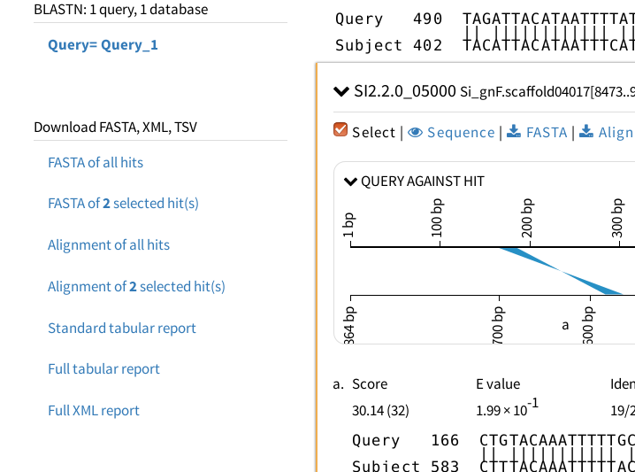
.. customized reports
Download FASTA files, reports

Slide 18
.. and many more
Link with other databases
Support other search programs
All features of BLAST+ supported
Guided setup (takes less than 15 minutes)
Free for research

Slide 19
Demonstration

Slide 20

.. summary
Feature | NCBI wwwBlast | SequenceServer
Private databases
Publishable Graphics
Personal/Public setup
Clutter free UI
BLAST
Support other programs

Slide 21
Thank you!
Questions?

